Slide 1


Slide 2
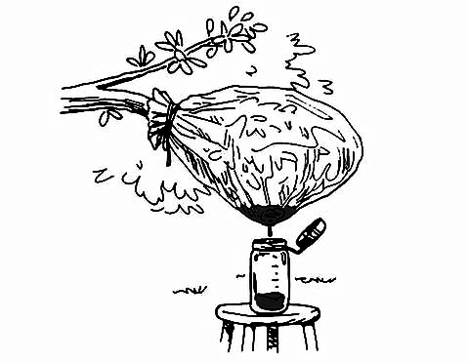
Data Selection

Slide 3


Slide 4

Versioning

Slide 5

Intellectual Property

Slide 6


Slide 7

Discovery

