Slide 1

Image processing

Slide 2

Reading
Jain, Kasturi, Schunck, Machine Vision. McGraw-Hill, 1995. Sections 4.2-4.4, 4.5(intro), 4.5.5, 4.5.6, 5.1-5.4.

Slide 3
Image processing
An image processing operation typically defines a new image g in terms of an existing image f.
The simplest operations are those that transform each pixel in isolation. These pixel-to-pixel operations can be written:
Examples: threshold, RGB → grayscale
Note: a typical choice for mapping to grayscale is to apply the YIQ television matrix and keep the Y.
Notes:
Use photoshop to make something grayscale

Slide 4

Pixel movement
Some operations preserve intensities, but move pixels around in the image
Examples: many amusing warps of images
[Show image sequence.]
Notes:
x~ = 2x
y~ = y
Then, how about y~ = y/3?

Slide 5
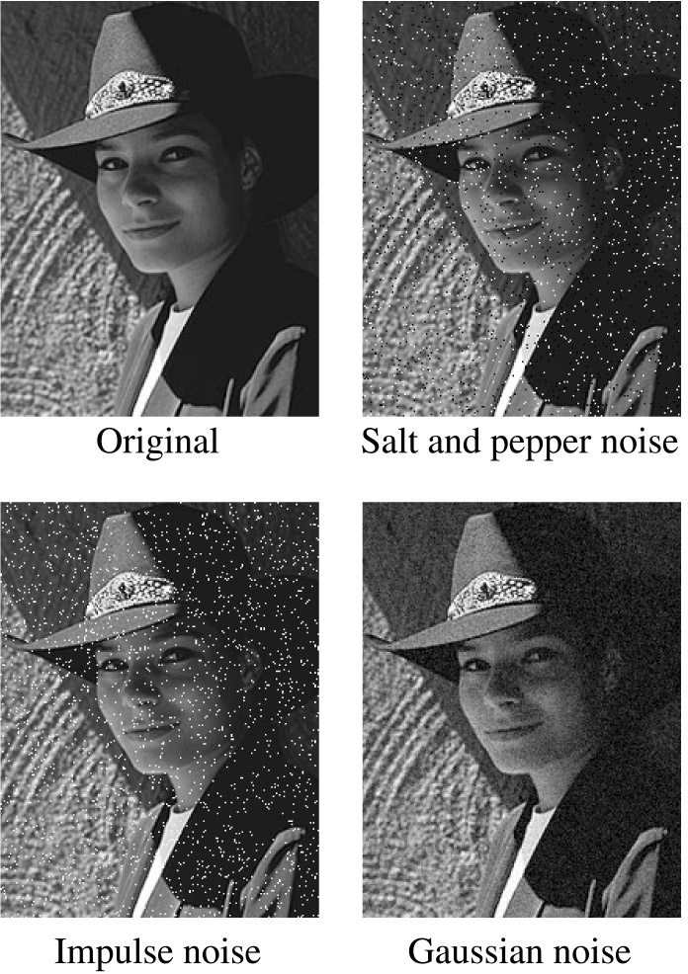
Noise
Image processing is also useful for noise reduction and edge enhancement. We will focus on these applications for the remainder of the lecture…
Common types of noise:
  Salt and pepper noise: contains random occurrences of black and white pixels
  Impulse noise: contains random occurrences of white pixels
  Gaussian noise: variations in intensity drawn from a Gaussian normal distribution
Notes:
Salt and pepper and impulse noise can be due to transmission errors (e.g., from deep space probe), dead CCD pixels, specks on lens
We’re going to focus on Gaussian noise first.
If you had a sensor that was a little noisy and measuring the same thing over and over, how would you reduce the noise?

Slide 6
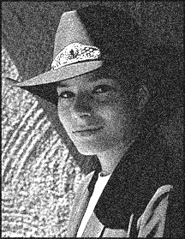


Ideal noise reduction
Notes:
Use snoop

Slide 7



Ideal noise reduction
Notes:
Use snoop

Slide 8
Practical noise reduction
How can we “smooth” away noise in a single image?
Is there a more abstract way to represent this sort of operation? Of course there is!
Notes:
Sketch a fairly constant digital signal with a bit of noise on top

Slide 9
Discrete convolution
For a digital signal, we define discrete convolution as:
where
Notes:
Slide digital box across

Slide 10
Discrete convolution in 2D
Similarly, discrete convolution in 2D becomes:
where

Slide 11
Convolution representation
Since f and h are defined over finite regions, we can write them out in two-dimensional arrays:
Note: This is not matrix multiplication!
Q: What happens at the edges?
Notes:
Print this twice and slide it around
What do we do at edges of image?? Pad to zero? Wrap? Reflect? Crop? (Reflect or crop)

Slide 12
Mean filters
How can we represent our noise-reducing averaging filter as a convolution diagram (know as a mean filter)?
Notes:
Bunch of 1’s over m^2

Slide 13
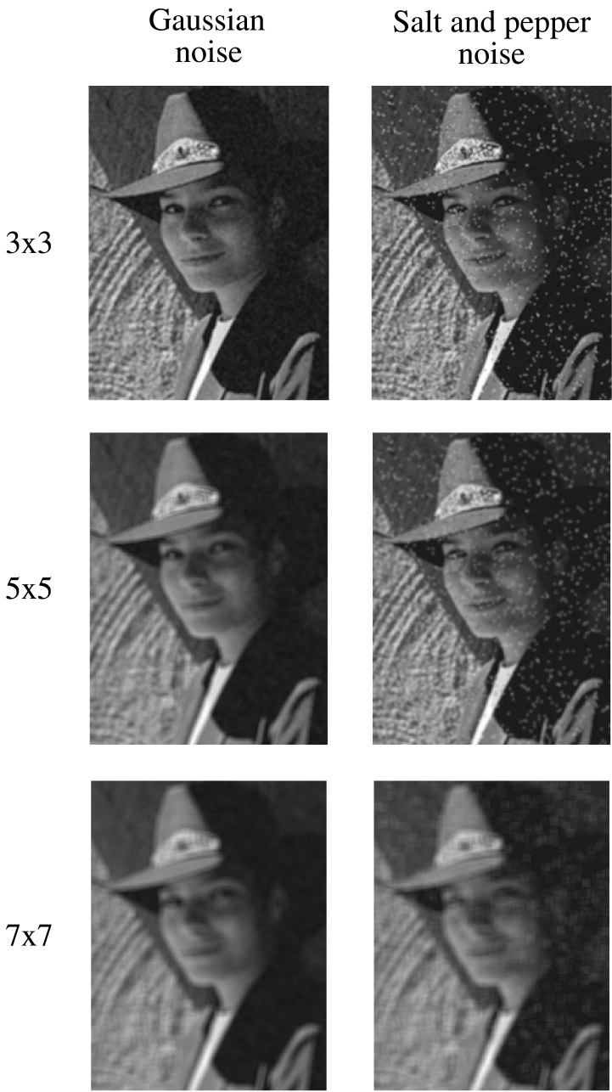
Effect of mean filters
Notes:
Demo with photoshop

Slide 14
Gaussian filters
Gaussian filters weigh pixels based on their distance from the center of the convolution filter. In particular:
This does a decent job of blurring noise while preserving features of the image.
What parameter controls the width of the Gaussian?
What happens to the image as the Gaussian filter kernel gets wider?
What is the constant C? What should we set it to?
Notes:
C = sum of filter values

Slide 15
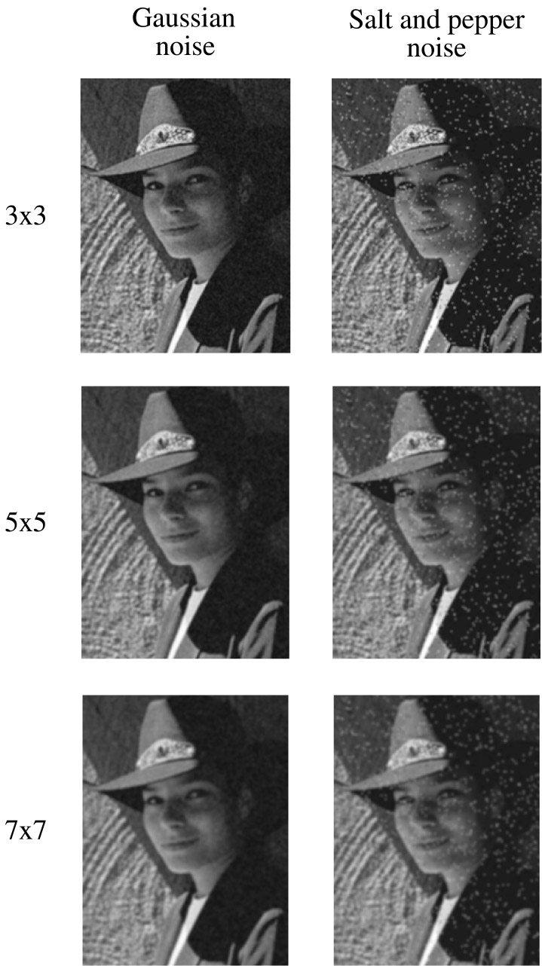
Effect of Gaussian filters
Notes:
Demo with Photoshop

Slide 16
Median filters
A median filter operates over an mxm region by selecting the median intensity in the region.
What advantage does a median filter have over a mean filter?
Is a median filter a kind of convolution?
Notes:
Better at salt’n’pepper noise
Not convolution: try a region with 1’s and a 2, and then 1’s and a 3

Slide 17

Effect of median filters
Notes:
Demo with photoshop

Slide 18
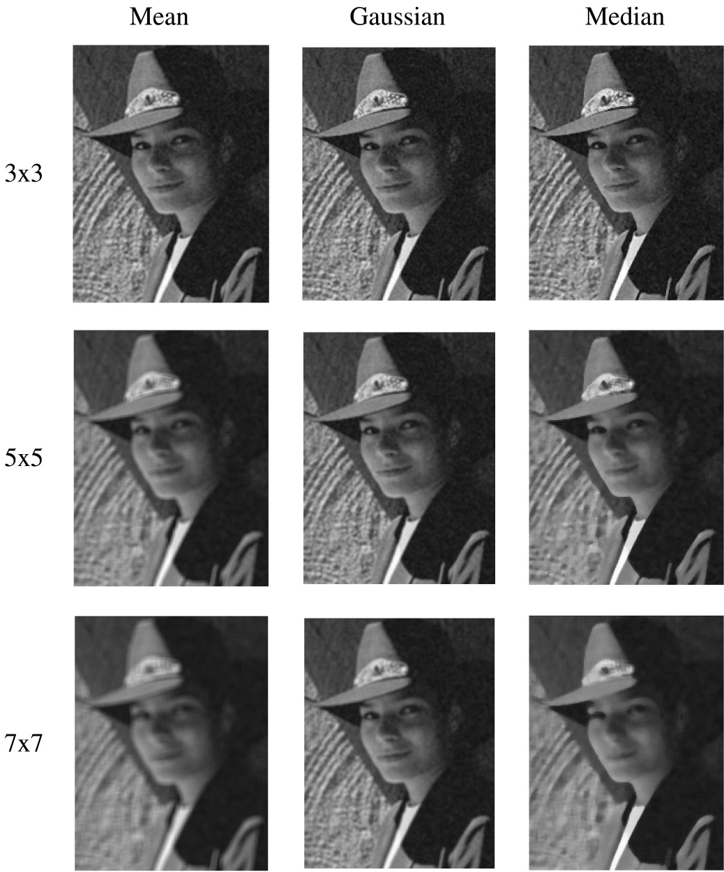
Comparison: Gaussian noise

Slide 19
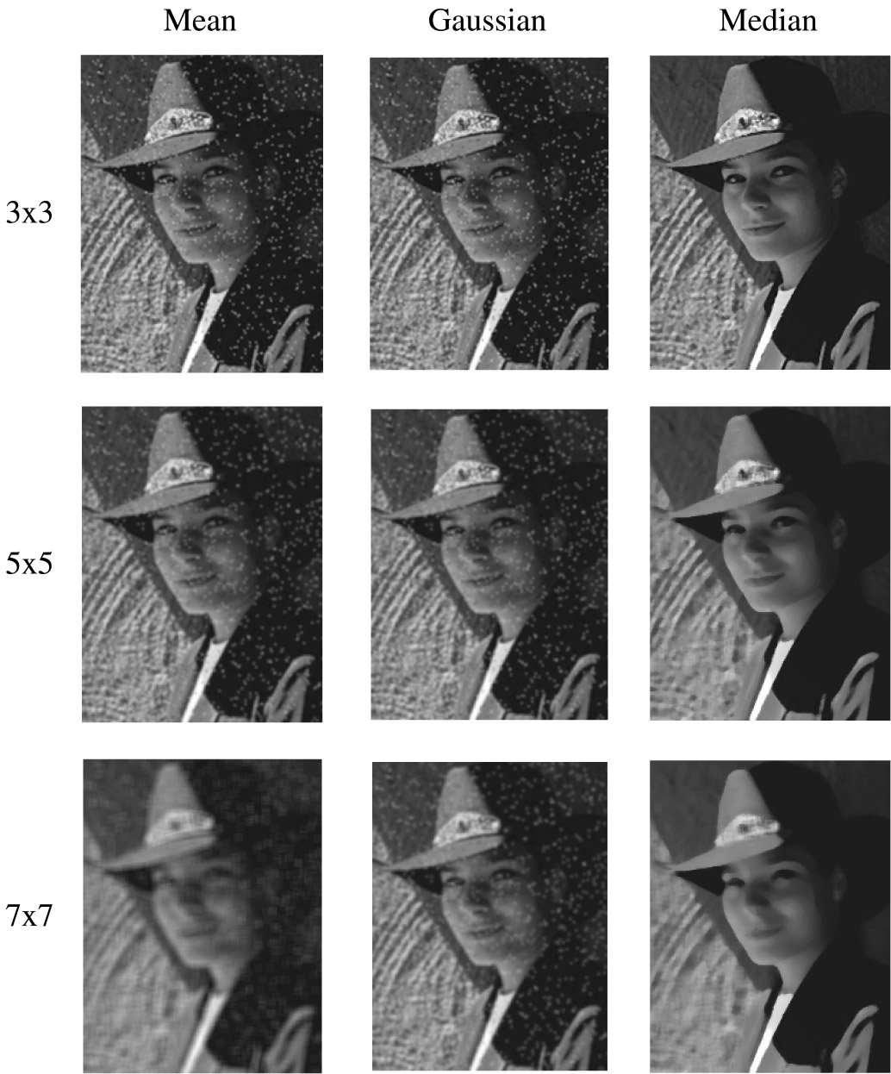
Comparison: salt and pepper noise

Slide 20

Edge detection
One of the most important uses of image processing is edge detection:
  Really easy for humans
  Really difficult for computers
  Fundamental in computer vision
  Important in many graphics applications

Slide 21
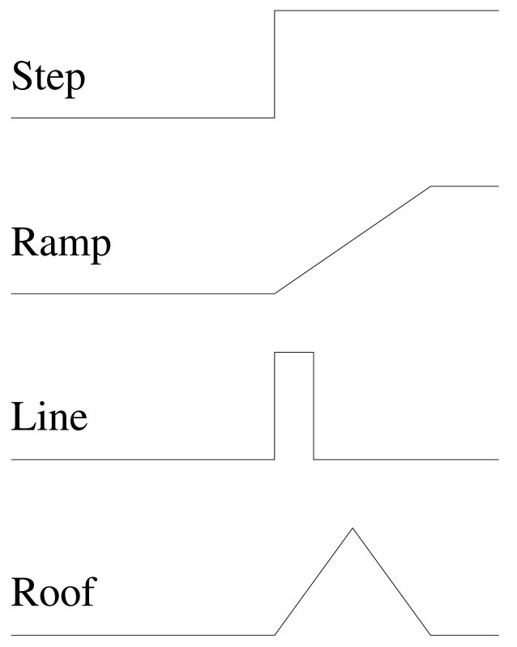
What is an edge?
Q: How might you detect an edge in 1D?
Notes:
Rapid change in intensity
Take derivative and look at magnitude

Slide 22
Gradients
The gradient is the 2D equivalent of the derivative:
Properties of the gradient
  It’s a vector
  Points in the direction of maximum increase of f
  Magnitude is rate of increase
How can we approximate the gradient in a discrete image?
Notes:
Write out angle and magnitude formula
Note that direction of minimum (zero) change is perpendicular: dot product with grad is zero, which direction is that?
Grad is gx[i,j] = f[I+1,j] – f[I,j] and gy[I,j]=f[I,j+1]-f[I,j]
Can write as mask [-1 1] and [1 –1]’
Refer to T2 figure

Slide 23
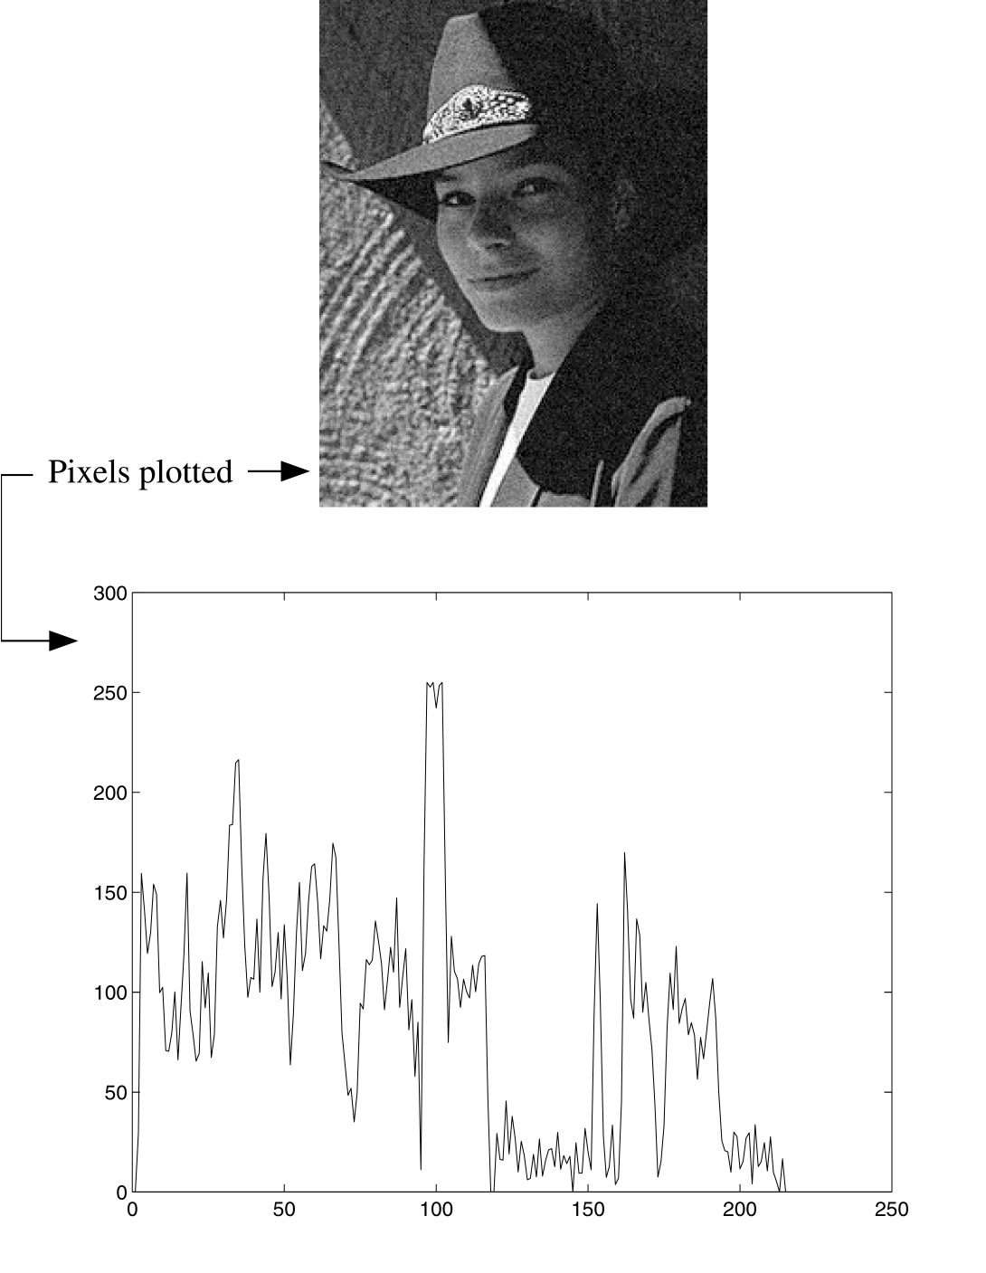
Less than ideal edges
Notes:
Where are the edges????

Slide 24
Steps in edge detection
Edge detection algorithms typically proceed in three or four steps:
  Filtering: cut down on noise
  Enhancement: amplify the difference between edges and non-edges
  Detection: use a threshold operation
  Localization (optional): estimate geometry of edges beyond pixels

Slide 25
Edge enhancement
A popular gradient magnitude computation is the Sobel operator:
We can then compute the magnitude of the vector (s_{x}, s_{y}).
Notes:
Does a little filtering over the region, has nice property of being odd X odd which means that there is no center pixel shift.
Also, gives more wait toward the center.

Slide 26
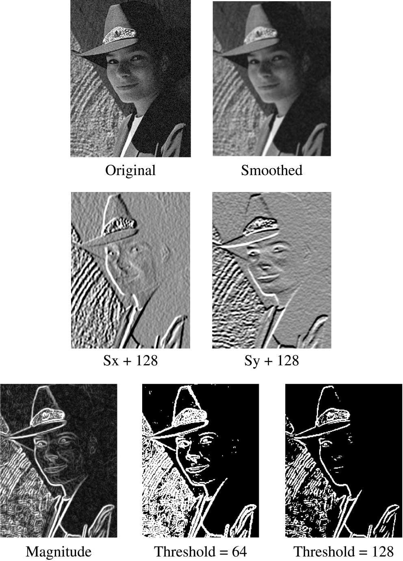
Results of Sobel edge detection
Notes:
Left side of hat is good x-grad.
Chin is good y-grad.
Notice how threshold changes both quantity and *thickness* of lines

Slide 27
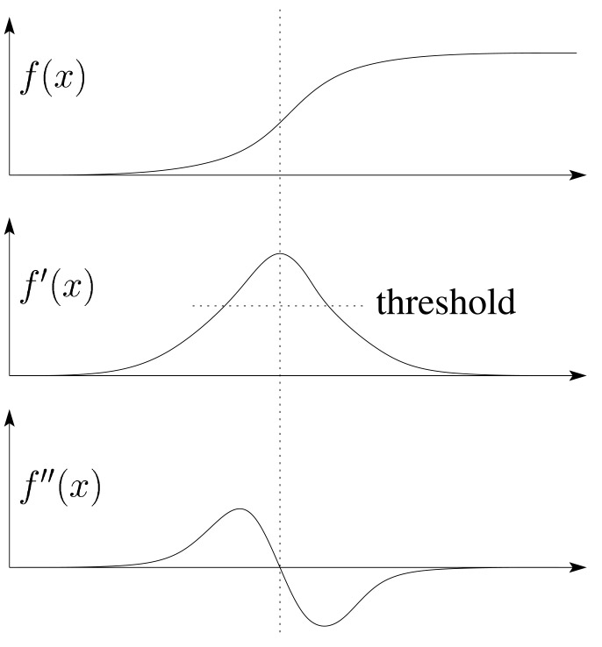
Second derivative operators
The Sobel operator can produce thick edges. Ideally, we’re looking for infinitely thin boundaries.
An alternative approach is to look for local extrema in the first derivative: places where the change in the gradient is highest.
Q: A peak in the first derivative corresponds to what in the second derivative?
Q: How might we write this as a convolution filter?
Notes:
A zero in the second derivative
Filter is [1 -2 1]

Slide 28
Localization with the Laplacian
An equivalent measure of the second derivative in 2D is the Laplacian:
Using the same arguments we used to compute the gradient filters, we can derive a Laplacian filter to be:
Zero crossings of this filter correspond to positions of maximum gradient. These zero crossings can be used to localize edges.

Slide 29
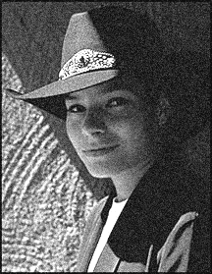
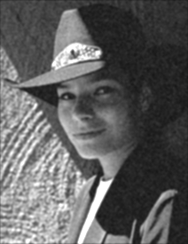
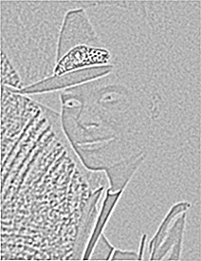
Localization with the Laplacian
Original
Smoothed
Laplacian (+128)

Slide 30
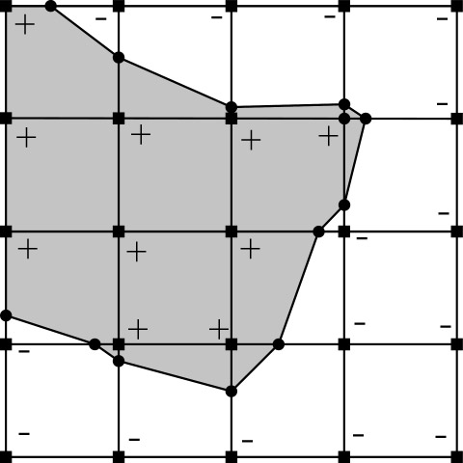
Marching squares
We can convert these signed values into edge contours using a “marching squares” technique:

Slide 31

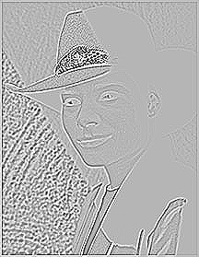
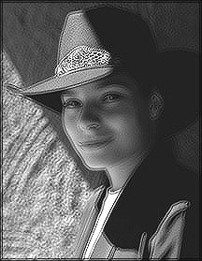
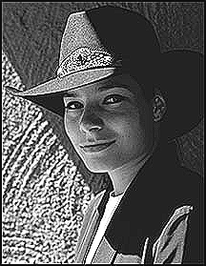
Sharpening with the Laplacian
Original
Laplacian (+128)
Original + Laplacian
Original - Laplacian
Why does the sign make a difference?
How can you write each filter that makes each bottom image?
Notes:
Regarding sign -- refer back the 2D Laplacian slide
Demo with photoshop

Slide 32

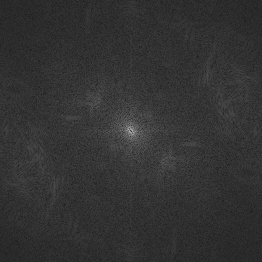

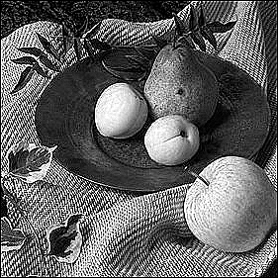
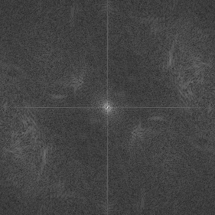
Spectral impact of sharpening
We can look at the impact of sharpening on the Fourier spectrum:
Spatial domain
Frequency domain

Slide 33
Summary
What you should take away from this lecture:
  The meanings of all the boldfaced terms.
  How noise reduction is done
  How discrete convolution filtering works
  The effect of mean, Gaussian, and median filters
  What an image gradient is and how it can be computed
  How edge detection is done
  What the Laplacian image is and how it is used in either edge detection or image sharpening

Slide 34
Next time: Affine Transformations
Topic:
How do we represent the rotations, translations, etc. needed to build a complex scene from simpler objects?
Read:
• Watt, Section 1.1.
Optional:
• Foley, et al, Chapter 5.1-5.5.
• David F. Rogers and J. Alan Adams, Mathematical Elements for Computer Graphics, 2nd Ed., McGraw-Hill, New York, 1990, Chapter 2.

