Slide 1

COVID CARE Software Requirements Specifications
Presented by:
Bibek Pokharel
Bibek Sitaula
Pranaya Sharma
Niraj Devkota
Suraj Kumar Bhetuwal

Slide 2

Contents
Intended User
Interview
Requirements
Design Constraints
Existing and New Function

Slide 3

INTENDED USER
Tech Experience: None
Culture: Any
Age: No limit
Smartphone Users

Slide 4

Interview Questions
Do you have any IT related experiences?
What are your thoughts on the ongoing COVID-19 pandemic?
Have you ever tested positive for COVID-19?
If yes, how was your experience with it?
Have you ever used any sort of application or website to retrieve COVID-19 related information?
If yes, what were the good and bad aspects of that application?
Were there any features you felt were important but missing?
If not used app or website, what are the features that you want to see if any application related to COVID-19 were to be developed?
With our application, do you believe it would help take the virus under control?
What do you think would make our application more user-friendly?

Slide 5

Interview
Interviewee Jon Tufte is a 47 years old IT technician for Risk Management Solutions
Interviewee Rick Fine is a 35 years old person with no knowledge of IT sector.
Interviewee Sami Sigdel is a 28-year-old nurse with little knowledge of computer

Slide 6
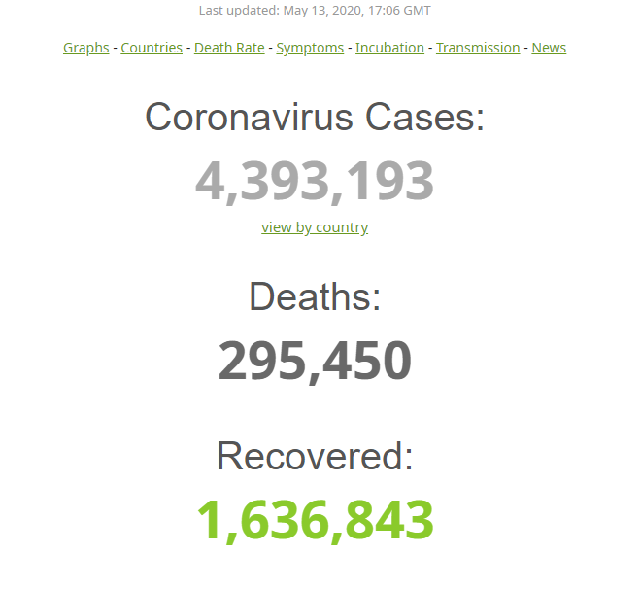
Interview Response
Out of three candidates, two of them had brief IT experience and one of them did not have any IT experience at all.
One of the candidate we interviewed was tested positive for COVID-19, he mention that it was terrible experience since he had some health condition.
Two of the candidates had used some COVID related application like Worldometer and one of them have not used yet.
One of the candidate wish if there was some sort of application which sent notification if they were exposed to COVID-19.

Slide 7

Interview Response Contd...
All of the candidate were concerns about the data accuracy in different website
Candidates shows good initiative to take control of the virus through the app.
One of the Candidate suggested us to make the application cost free.
Candidates suggested us to make the application user friendly to disabled people and also, add the fact-checks functionality to every input made on the application

Slide 8

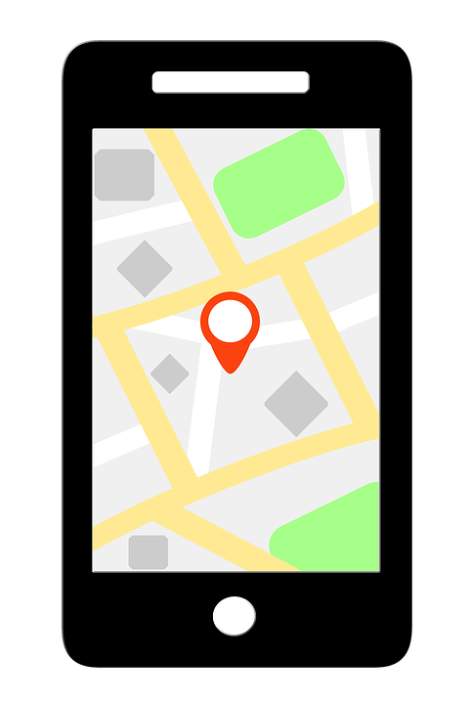
Requirements
The system must be able to create or sign in into account of different profile(Personal User,Business User and Admin)
The system must be able to track location precisely of different users
The system must be able to transmit a signal to the user’s phone informing the application via Bluetooth about the exposed area within certain range.
The user must be able to enter at least one emergency contact number into their profile

Slide 9

Requirements contd...
User will be notified if there are any changes or update on vaccination appointment.
The system must verify the account email address and phone number.
The system will allow the business owner to create and modify the business profile

Slide 10



Design Constraints
Limited time frame
Not a pro version
Limited user base
Portable on android only
Need Internet connectivity
Bluetooth connection

Slide 11

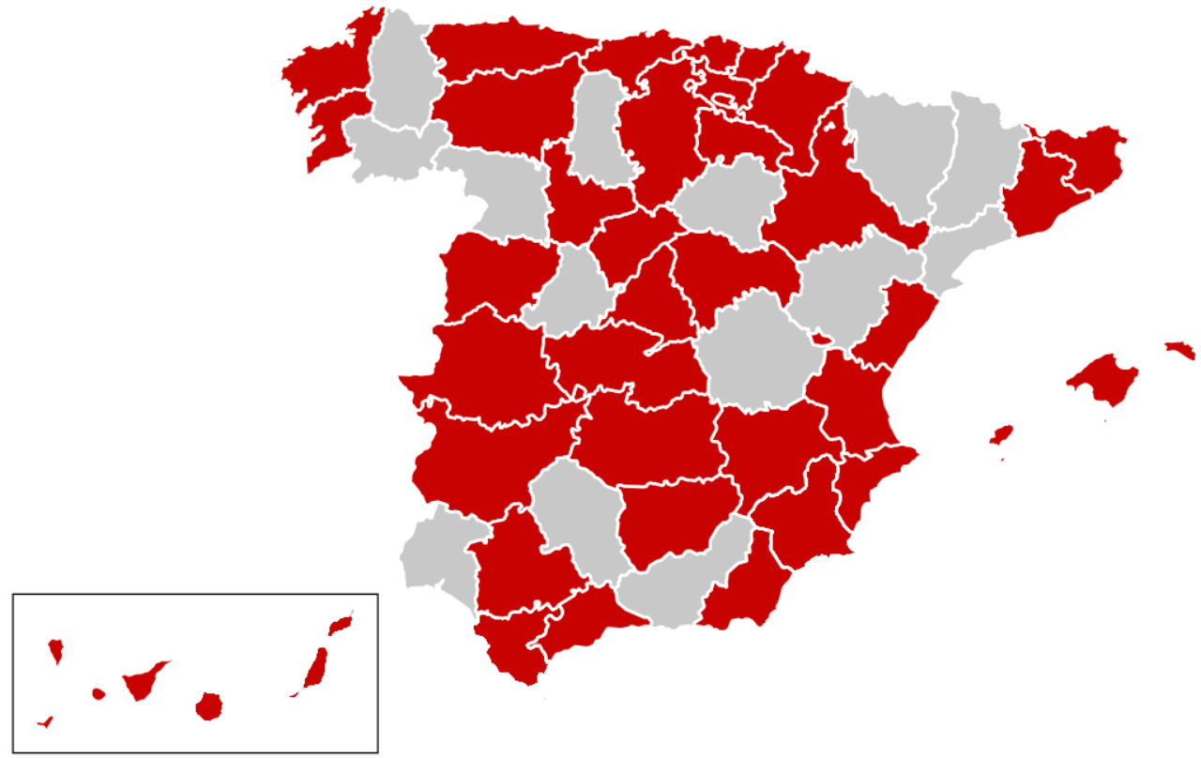
Existing and new functions
Sends alert notification to notify people who are nearby positive patient
Allow business owner to update their service hour
Allow user to write feedback after vaccination
Show real time map data indicating high and low risk areas
Provide vaccine review system
Allow users to make appointment, change appointment & cancel appointment

Slide 12

Notes:
If you have any questions or concerns feel free to ask???????????????????????????

