Slide 1

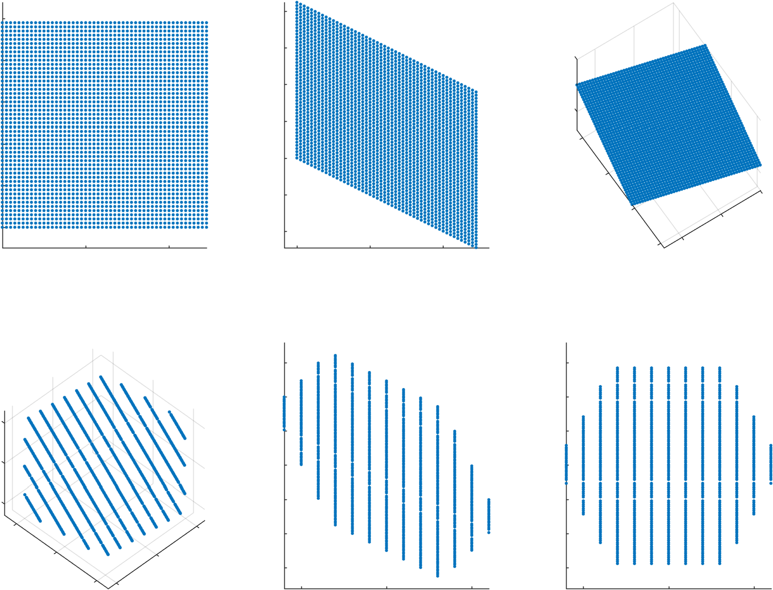
XY
Hex Coords
Cubic Coords
Wrap in Cubic Coords
Back to Hex
Back to XY

Slide 2
