Slide 1



Dublin Selenium Meetup
Visual Web Testing
6-Dec-2016

Slide 2
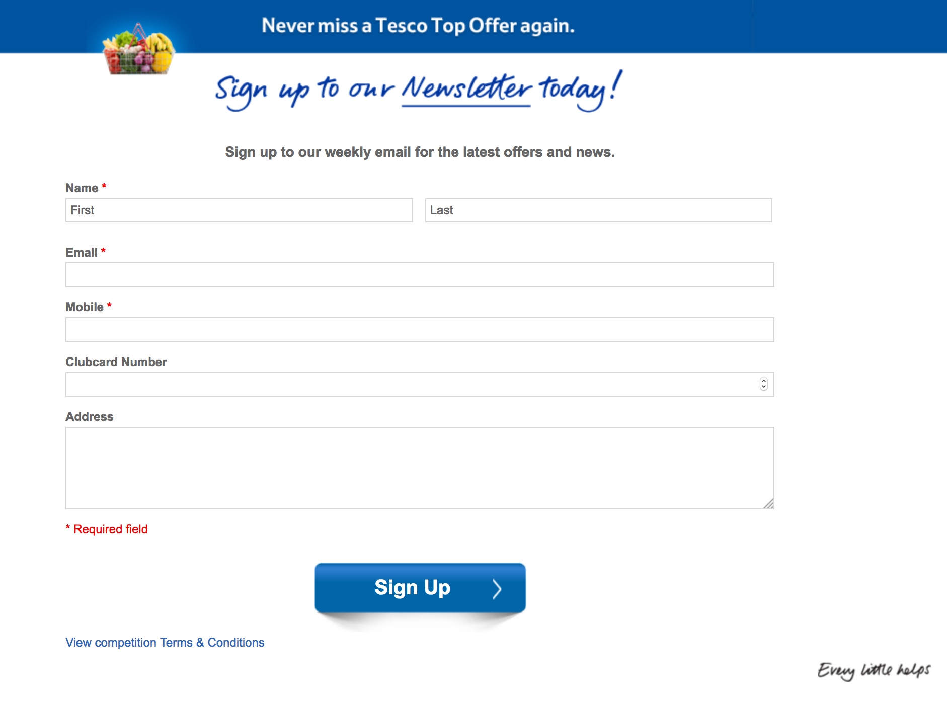
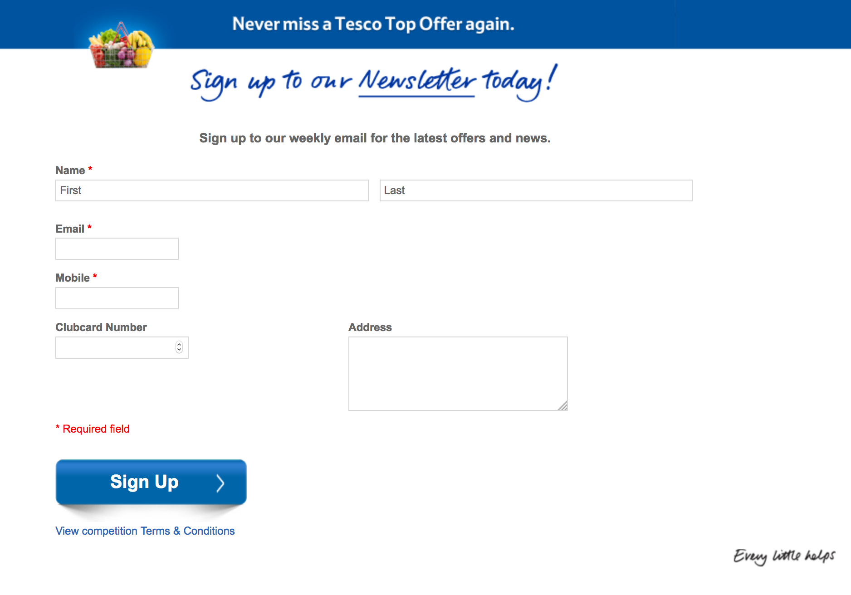
Dublin Selenium Meetup – Visual Web Testing
Would your Selenium tests notice the different between:
and
I'm guessing they wouldn't!

Slide 3

Dublin Selenium Meetup – Visual Web Testing
Ever had a developer say:
The page displays OK in Chrome, must be some quirk with Internet Explorer…
Selenium is a functional testing framework, we use it to prove that the website functionality behaves as expected.
If you do:
Selenium doesn’t care where the input element is visually located on the page. If Selenium can find the element in the DOM, it will return it.
var textBox = Driver.findElement(By.cssSelector(”input#name”));

Slide 4
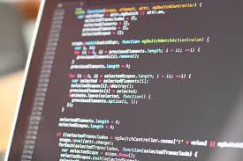
Dublin Selenium Meetup – Visual Web Testing
So What is Visual Testing?
Visual testing is making sure that the web page is displayed correctly (as per design) to the end user.
This is making sure that the various elements on the page are displayed in the correct positions.
Even if you had 100% functional selenium test coverage, would you be confident to release your website without anyone opening it and taking a peek?
Visual testing is therefore replacing/replicating the human eye, the human check that everything looks the way it should and nothing is out of place!
Visual Automation is then turning..
into

Slide 5
Dublin Selenium Meetup – Visual Web Testing
Why is Visual Testing Beneficial
Release Quicker : Less human interaction needed to verify pages are displayed correctly
Confidence : Be sure that great web design you have is being adhered to by all browsers
Customer Satisfaction : Ever been to a website and the layout is destroyed, did you buy from the website? Customers won’t tolerate poorly displayed websites
So how do we replicate the checks a human eye does?
How can we check that the visual design of our website is being adhered to?

Slide 6

Dublin Selenium Meetup – Visual Web Testing
Possible Approaches:
Get the X,Y coordinates of all elements of interest from Selenium, and assert the element is displayed in the correct location
Problem: But what about colors, fonts, different coordinate systems, browser width and height?
Resize the browser to a known width and height and capture a screenshot and compare it to a baseline
Problem: Full page screenshots aren't available from all browsers via Selenium, also how do I compare images and get a diff?

Slide 7

Dublin Selenium Meetup – Visual Web Testing
The Coding Approach:
Get the X,Y coordinates of all elements of interest from Selenium, and assert the element is displayed in the correct location
This approach is possible, but …
Would require A LOT of coding, each element, image, text, div etc. on the page will have to be checked for its X,Y coordinate.
Position fine, but what about colors, fonts, etc. This means more and more coding!
All this extra code to maintain, each time an element moves!

Slide 8

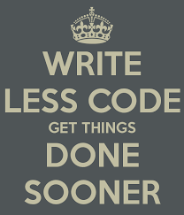
Dublin Selenium Meetup – Visual Web Testing
The Coding Approach:
Galen framework (as we will see later) adds a layer on top of selenium to verify the location of elements using a simple and easy to maintain syntax.

Slide 9
Dublin Selenium Meetup – Visual Web Testing
The Screenshot Approach:
Resize the browser to a know size (so that images are always the same size!)
Navigate to the page of interest
Take a screenshot from the browser
Compare the screenshot to a baseline screenshot (already verified to be OK)
Generate a diff image
Generate some metric (e.g. % diff) that you’re test can assert on
If the test fails, then the new screenshot needs to be verified. If the new screenshot is as expected, the new screenshot becomes the new baseline.

Slide 10
Dublin Selenium Meetup – Visual Web Testing
Screenshot Approach Challenges:
The main challenges from the screenshot approach are:
How to get a “full page” screenshot from all browsers (Seems only supported in Firefox)
How to compare the new screenshot with the baseline image
What about dynamic regions of the page, for example:
Dates, times
Usernames
Dynamic banners or product images
Screenshot Approach Benefits:
10’s even 100’s of elements can be compared in a single image
Colors, fonts as well as positions are compared
Less coding, as we only need a few tests per page (as apposed to many in the coding approach)

Slide 11

Dublin Selenium Meetup – Visual Web Testing
Screenshot Approach Simple Example:
I’m going to show you a simple Python script that uses Selenium and ImageMagik

Slide 12
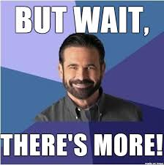
Dublin Selenium Meetup – Visual Web Testing
What about all those challenges!

Slide 13

Dublin Selenium Meetup – Visual Web Testing
Luckily we have some tooling!
The main tools for the screenshot approach are:
WebDriverCSS : https://github.com/webdriverio/webdrivercss
Screener : https://screener.io
AppliTools Eyes : https://applitools.com/

Slide 14
Dublin Selenium Meetup – Visual Web Testing
WebDriverCSS:
WebDriverCSS is built on top of WebDriverIO (Javascript implementation of WebDriver)
It uses GraphicsMagick to compare screenshots and generate a diff image
Can resizer the browser so that screenshots are the same size
Allows to set a Tolerance on how different the images have to be before tests fail
Can also define regions to ignore from the comparison
Baseline images are stored locally
However WebDriverCSS can also be integrated with AppliTools
The disadvantage is that its JavaScript, and hasn’t an equivalent in C# etc.

Slide 15
Dublin Selenium Meetup – Visual Web Testing
Screener:
An online Paid For service (starts at $199/month)
Images can be taken from several browsers (Firefox, Chrome etc.)
Can use the proprietary scripting language to navigate to page of interest
Can also be integrated with existing WebDriver tests by using Screener as a selenium grid
AppliTools:
Very active in the Visual Testing space (lots of webinar’s, attending conferences)
Online service starting at $129/month
Uses a local SDK to take screenshots so can be used in own selenium grid, or in SauceLabs
The SDK has multiple language bindings (Java, Ruby, Python, .Net, JavaScript)
Baseline images are managed online, together with their comparison options and ignore regions
Can be used for other types of apps too (Appium, Windows apps etc.)

Slide 16
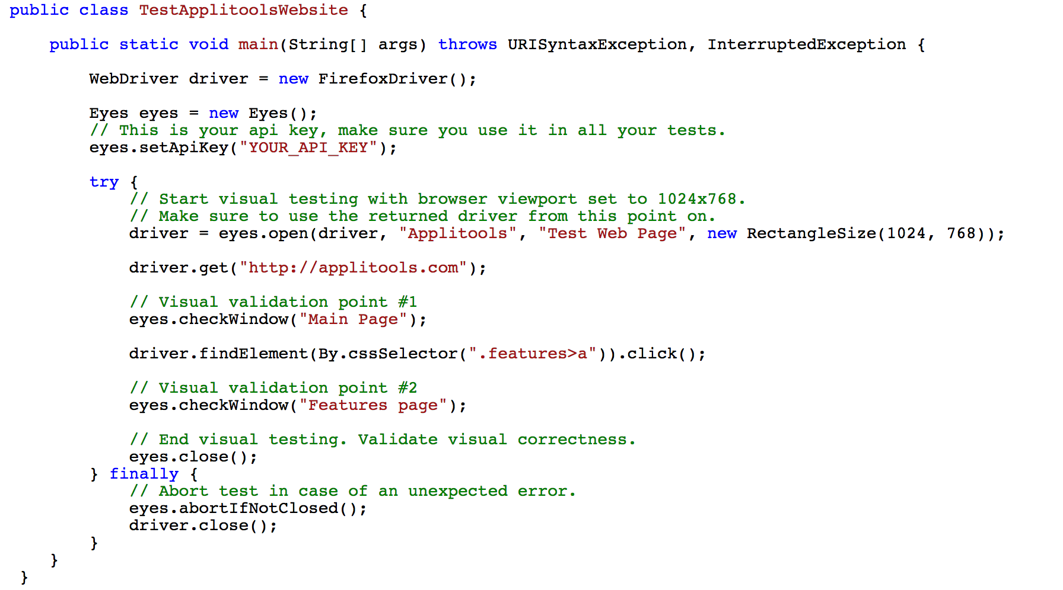
Dublin Selenium Meetup – Visual Web Testing

Slide 17

Dublin Selenium Meetup – Visual Web Testing
Hopefully your appetite for Visual Testing has been ignited…
Aim Small, Miss Small … and never miss a visual change in your website!

Slide 18
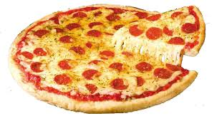
Dublin Selenium Meetup – Visual Web Testing
Hmm appetite … PIZZA!!
Next up
Ivan Shubin – Creator of Galen Framework

