Slide 1
PIC18F Serial Interfaces
RS232
I²C
SPI

Slide 2

Serial Port (RS232) basics
Serial vs Parallel – pros and cons
Serial port data transfer types
Simplex, half-duplex, full-duplex
Synchronous and asynchronous transmission
Asynchronous
Start (low) and Stop (high) bits, Parity bits
Data transfer rate vs Baud rate
Most common: 9600/8-N-1
9600 baud, 8-data-bits, No-parity-bits, 1 stop-bit

Slide 3
Serial Port (RS232) physical layer
RS232 is a “Point-to-Point” communication bus
Handshaking pins (h/w flow control)
DTR (data transmit ready), DSR (data set ready)
RTS (request to send), CTS (clear to send)
Data transfer pins
Tx for transmission
Rx for reception
Gnd
Voltage levels
RS232
Logic 1 => -3v to -25V
Logic 0 => +3V to +25V
-3V to +3V is undefined
TTL
Logic 1 => 2V to VCC
Logic 0 => 0V to 0.8V
RS232 and TTL are not compatible!

Slide 4
PIC18 Serial Port Registers
Tx and Rx pins are shared with PORTC (Tx/RC6, Rx/RC7)
TTL compatible, not compatible with RS232
So a line driver MAX232/233 is used for RS232 interface
Interrupts to indicate data transfer is complete
TXIF, RXIF flags (part of PIR1) – interrupt indicators
TXIE, RCIE flags (part of PIE1) – interrupt enablers
Register | Purpose | Remarks
SPBRG | Baud rate decider | Baud = Fosc / [64(X+1)]
TXREG | Transmit register
RCREG | Receive register
TXSTA | Transmit status/control
RCSTA | Receive status/control

Slide 5
PIC18 Serial Port: TXSTA
TXSTA
CSRC: clock select (not used in async mode)
TX9: Enable 9-bit data transmit
TXEN: Transmit enable
SYNC: Async / sync mode
BRGH: High baud rate select
TRMT: Transmit shift register status
TXD9: 9th bit of transmit data
TXSTA value for normal data transfer
B’0010 0000’ or 0x20
CSRC
TX9
TXEN
SYNC
0
BRGH
TRMT
TX9D

Slide 6
PIC18 Serial Port: RCSTA
RCSTA
SPEN: Serial port enable
RX9: Enable 9-bit data receive
SREN: Single receive enable (not used in async)
CREN: Continuous receive enable
ADDEN: Address detect enable
FERR: Framing error bit
OERR: Overrun error bit
RX9D: 9th bit of receive data
RCSTA value for normal data transfer
Enable SPEN (serial port enable)
SPEN
RX9
SREN
CREN
ADDEN
FERR
OERR
RX9D

Slide 7
PIC18: Serial data transmit
Load TXSTA (0x20)
Load SPBRG
Make RC6/TX output
Enable SPEN of RCSTA
Check if previous transfer is complete by polling TXIF of PIR1
Move data to TXREG
MOVLW 0x20
MOVWF TXSTA
MOVLW 0x81
MOVWF SPBRG
BCF TRISC, TX
BSF RCSTA, SPEN
DONE MOVLW a’B’
L1 BTFSS PIR1, TXIF
BRA L1
MOVWF TXREG
BRA DONE

Slide 8
PIC18: Serial data receive
Load RCSTA (0x90)
SPEN, Continuous receive
Load SPBRG
Make RC7/RX input
Check if entire byte has come in by polling RCIF of PIR1
Move data from RCREG to W
MOVLW 0x90
MOVWF RCSTA
MOVLW 0x0F
MOVWF SPBRG
BSF TRISC, RX
L1 BTFSS PIR1, RCIF
BRA L1
MOVF RCREG, W
BRA L1

Slide 9
PIC18: Higher baud rates
By taking BRGH bit of TXSTA to 1, we can quadruple the baud rate
Examples:
BRGH=0, SPBRG=15 gives us a baud rate of 9600
BRGH=1, SPBRG=15 gives us a baud rate of 38,400
BRGH=0, SPBRG=4 gives us a baud rate of 28,800
BRGH=1, SPBRG=4 gives us a baud rate of 115200

Slide 10
I²C: Introduction
I²C is a multi-master, serial, single-ended communication bus
Invented by Philips / NXP
Very popular bus for connecting/interfacing peripheral devices to micro-controllers / micro-processors
Reading config data from DDR1 SDRAM, DDR2 SDRAM (DIMM)
Controlling low speed ADC’s and DAC’s
Controlling OLED’s in smartphones
Accessing NVRAM chips/modules on SoC’s
Controlling monitor color, contrast, hue (Data Display Channel DDC)
Controlling RTC’s
Reading hardware monitors, temperature sensors
Royalty-free since Oct 2006
Though valid I²C address from NXP has costs
Bus speeds
Standard I²C: 100kHz
Fast: 400kHz
Hi-speed: 3.4MHz
Fast mode plus: 1MHz
Ultra fast mode: 5MHz

Slide 11
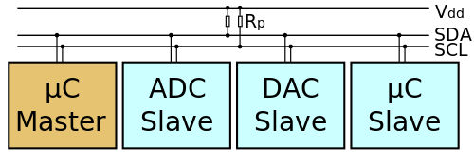
I²C: Physical layer
2 lines / pins
SCL (clock)
SDA (data)
Standard TTL voltages
3.3V / 5V
An open-drain / open-collector bus
Needs pull-up resistors to hold SDA/SCL at Logic 1
Wired OR logic – any device can pull the line LOW
Multi-master bus with 8 (actually 7)/10-bit addresses
Multiple masters (usually microcontroller / microprocessor)
Multiple slaves
Roles:
Master initiates communication, drives the clock (SCL), performs bus arbitration
Slave responds to master, gives/takes data on SDA

Slide 12
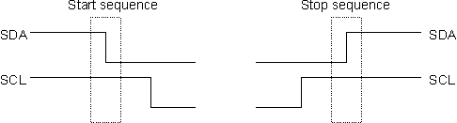
I²C: Signalling
I²C device modes of operation
Master send – slave receive <data/address>
Master receive – slave send <data>
Communication start: Master sends “START”
Communication end: Master sends “STOP”
START
SCL stays HIGH, SDA goes from HIGH to LOW
STOP
SCL stays HIGH, SDA goes from LOW to HIGH

Slide 13
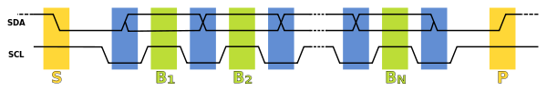

I²C: SCL, SDA relationship
Pin-wise:
SCL pin is clock; driven by master
SDA pin is data; driven by master / slave
SDA stable when SCL is HIGH
This is when the data is “sampled” on the line by master/slave
SDA line is written MSB-first:
8-bits, could be:
7-bit address + R/W
8-bit data
9th bit is driven LOW by slave as an ACK

Slide 14
I²C: WRITE (Steps)
Data transfer steps for WRITE:
Slave identification by device address (W)
Master sends START code
Master sends 7-bit slave address (MSB first)
Master sends R/W-bit (0 means write)
Slave sends 1-bit (with value 0) as ACK
Slave register address send-out
Master sends 8-bit address in the slave, that it wishes to write into
Slave sends 1-bit (with value 0) as ACK
Slave data send-out
Master sends 8-bit data to Slave
Slave sends 1-bit (with value 0) as ACK
End of transfer
Master sends STOP code

Slide 15
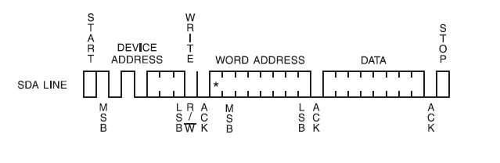
I²C: WRITE (Bus timing)

Slide 16
I²C: READ (steps)
Data transfer steps for READ:
Slave identification by device address (W)
Master sends START code
Master sends 7-bit slave address (MSB first)
Master sends 1-bit (0 means write)
Slave sends 1-bit (with value 0) as ACK
Slave register address send-out
Master sends 8-bit address in the Slave it wishes to write into
Slave sends 1-bit (with value 0) as ACK
Slave identification by device address (R)
Master sends START code
Master sends 7-bit slave address (MSB first)
Master sends R/W-bit (1 means read)
Slave sends 1-bit (with value 0) as ACK
Slave data send-out
Slave sends out 8-bit data
Master sends 1-bit (with value 1) as NACK
End of transfer
Master sends a STOP code

Slide 17
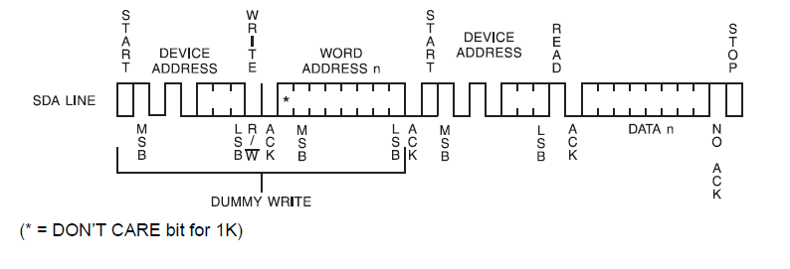
I²C: READ (Bus timing)

Slide 18
I²C: Clock stretching
If a slave device cannot cope up with the speed of data transfers / demand from the master, it can pull the SCL line low and “ask the master to hold”
This is called clock stretching
The master should keep a tab on the SCL line
Initiate the next data transfer only when SCL is high

Slide 19
I²C: Bus arbitration
All masters should monitor the SDA line for START and STOP codes
Transmit only when the bus is free
But sometimes, 2 masters may start transmitting at the same time
Here, I²C uses the SDA line for bus arbitration
SDA is open-drain
A master pulling SDA LOW will win over a master keeping SDA HIGH
A master keeps a tab on SDA and compares it with the level it expects
If a master sent a ‘0’ and got SDA LOW
Everything is alright
If a master sent a ‘1’ and got SDA HIGH
Everything is alright
If a master sent a ‘1’ and got SDA LOW
Some other master is driving the bus
This master then “loses” bus arbitration
It will retransmit after the current transaction finishes

Slide 20
I²C on PIC18F
PIC18F uses its MSSP for I²C and SPI
Master synchronous serial port
MSSP registers
SSPSTAT
SSPCON1
SSPCON2
SSPADD
SSPBUF

Slide 21
SSPSTAT – Status Register
SMP
CKE
D/A
P
S
R/W
UA
BF
BF: Buffer Full
In transmit mode, it gets set when data is written to SSPBUF and cleared when transmit is complete
In receive mode, it gets set when data/address is received in the SSPBUF
UA: Update Address (10-bit address mode)
R/W: In master mode, 1 means TXMIT in progress
S: 1 means START sequence detected last, cleared during reset
P: 1 means STOP sequence detected last, cleared during reset
D/A: Data/Address indicator (in Slave mode)
CKE: Clock Edge Select bit (1=> Transmit on Active->Idle Clock)
SMP: 1 means disable slew rate control (slew rate disabled for low speeds like 100 Khz)

Slide 22
SSPCON1 – Control Register 1
WCOL
SSPOV
SSPEN
CKP
SSPM3
SSPM2
SSPM1
SSPM0
SSPM0-SSPM3: Mode select bits
1111: I²C slave; 10-bit address, S-P interrupts enabled
1110: I²C slave, 7-bit address, S-P interrupts enabled
1011: I²C firmware controlled master, slave idle (bit bang)
1000: I²C master, clock = F_{osc} / (4*SSPADD+1)
0111: I²C slave, 10-bit address
0110: I²C slave, 7-bit address
CKP: SCL clock release bit (1 => release), used in Slave mode
SSPEN: SSP enable bit (1 => enable)
SSPOV: Receive overflow indicator, SSPBUF overflow
WCOL: Write collision detection bit (1 => collision)

Slide 23
SSPCON2 – Control Register 2
GCEN
ACKSTAT
ACKDT
ACKEN
RCEN
PEN
RSEN
SEN
SEN:
Master: Start condition enable
Slave: Stretch enable
RSEN: Repeated Start condition enable (master only)*
PEN: Stop condition enable (master only)*
RCEN: Receive enable bit (master only)
ACKEN: Ack sequence enable (master only)*
ACKDT: Ack data bit (master receive only)
ACKSTAT: Ack status bit [1 => NACK](master transmit only)
GCEN: General call enable
* Automatically cleared by hardware

Slide 24
SSPADD, SSPBUF, SSPIF
SSPADD determines the speed
Bus speed = F_{osc} / (4*SSPADD+1)
SSPBUF is an 8-bit register used for address/ data transfer
Similar to TXREG and RCREG for serial port
SSPIF is the interrupt flag
Set on getting an SSP interrupt
Part of PIR1

Slide 25
I²C on PIC board: Init Sequence
BSF SSPSTAT, 7 ;sampling done at the end of data output time
BCF SSPSTAT, 6 ;slew rate control disabled for standard speed
MOVLW D'49'
MOVWF SSPADD ;baud rate value for 100kHz
BSF SSPCON1,SSPEN ;enables serial port
BSF SSPCON1,SSPM3 ;
BCF SSPCON1,SSPM2 ;
BCF SSPCON1,SSPM1 ;
BCF SSPCON1,SSPM0 ;i2c Master mode, clock=Fosc/(4*(SSPADD+1))
;clock = 100kHz, Fosc = 20Mhz

Slide 26
I²C on PIC: Start, Stop, Verify
I2CSTART
BSF SSPCON2,SEN ;START Condition Enable Bit
BTFSS PIR1,SSPIF ;wait for START enable(check SSP interrupt flag)
GOTO $-1 ;skip if set
BCF PIR1,SSPIF ;clear flag bit
RETURN ;return from subroutine
I2CSTOP
BSF SSPCON2,PEN ;STOP Condition Enable Bit
BTFSS PIR1,SSPIF ;wait for STOP condition(check SSP interrupt flag)
GOTO $-1 ;skip if set
BCF PIR1,SSPIF ;clear flag bit
RETURN ;return from subroutine
VERIFY
MOVWF SSPBUF ;loading data to SSPBUF for i2c write
BTFSS PIR1,SSPIF ;wait for data write(check SSP interrupt flag)
GOTO $-1 ;skip if set
BCF PIR1,SSPIF ;clear flag bit
MOVF SSPBUF,W ;loading working register with SSPBUF data
RETURN ;return from subroutine

Slide 27
I²C on PIC: Write
Assumes data to be written is loaded into W register
I2C_WRITE
MOVWF tmp
CALL I2CSTART ;call for i2c START
MOVLW <address> ;writing Device Address with write enable
CALL VERIFY ;call for write verification
MOVLW <register address> ;writing Location Address
CALL VERIFY ;call for write verification
MOVF tmp, W ;Data to be written(ASCII)to device CALL VERIFY ;call for write verification
CALL I2CSTOP ;call for i2c STOP
CALL DELAY
CALL DELAY
RETURN

Slide 28
I²C on PIC: Read
I2C_READ CALL I2CSTART ;call for i2c START
MOVLW <Address> ;writing Device Address with write enable
CALL VERIFY ;call for write verification
MOVLW <Register > ;writing Location Address
CALL VERIFY ;call for write verification
CALL I2CSTOP ;call for i2c STOP
CALL I2CSTART ;call for i2c START
MOVLW <Address with read> ;writing Device Address with read enable
CALL VERIFY ;call for write verification
BSF SSPCON2,RCEN ;synchronous reception enabled
BTFSS PIR1,SSPIF ;wait for data to be read(check SSP interrupt flag)
GOTO $-1 ;skip if set
BCF PIR1,SSPIF ;clear flag bit
BSF SSPCON2,ACKEN ;Master acknowledge enable
BSF SSPCON2,ACKDT ;send active low as acknowledgement from PIC to EEPROM
MOVF SSPBUF, W ;move the received data to working register
CALL I2CSTOP ;call for i2c STOP
RETURN

Slide 29
I²C on PIC board: Projects
Write to I²C EEPROM and then read it back
User input (involves serial port):
Accept input from serial port, write the string to I²C EEPROM
Read it back in a separate program, display it on serial port

Slide 30
SPI: Introduction
Serial Peripheral Interface (SPI)
A 4-wire serial communication synchronous bus
Operates in full-duplex mode
Popular bus for connecting/interfacing peripheral devices to microcontrollers / microprocessors
Sensors (temperature, pressure), touchscreens, game controllers
ADC’s, DAC’s
Digital potentiometers, audio codecs
Memory: Flash, EEPROM
RTC’s, LCD’s, MMC/SD card variants
Devices communicate in Master/Slave mode
No addressing concept on the bus
Single master, multiple slaves
Master initiates data frame
Slave is selected (activated) for a transaction by an active LOW Slave Select (SS) line

Slide 31
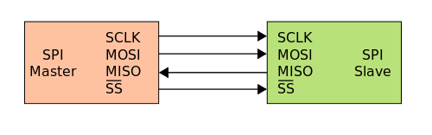
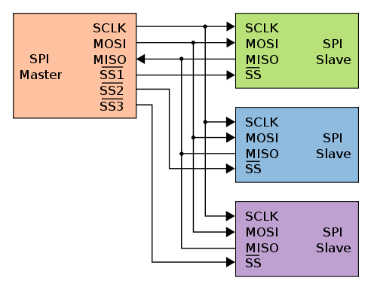
SPI: Bus topology
4-wire / 4-line bus
SCLK (clock) [driven by Master]
MOSI [Master Out Slave In]
MISO [Master In Slave Out]
SS (Active LOW) [Slave Select]
Number of SS lines increase with number of slave devices on the system

Slide 32
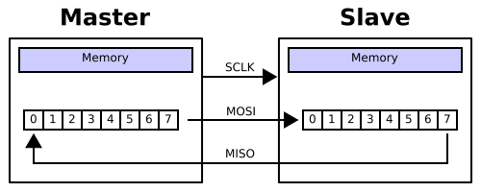
SPI: Data transfer
Master selects the slave device by asserting the SS line in LOW mode
If the slave device is slow, master waits for x cycles
Master then activates the clock on SCLK line
Typically, clock frequency is few MHz
During each SPI clock cycle, a full-duplex data transmission occurs
Master sends out a bit on MOSI, slaves reads it
Slave sends out a bit on MISO line, master reads it
Transmission usually occurs with 8-bit registers on Master and Slave, connected in a “ring” format
Not all the bit transfers may be meaningful, they happen nevertheless

Slide 33
SPI: Pros and Cons
Pros
Full-duplex communication, higher throughput
Protocol flexibility (arbitrary choice of word length)
Simple hardware interfacing
Low power consumption, no pull-up resistors
No arbitration messiness
No addressing schemes
Slave uses master’s clock, no precision oscillators needed
Clock speed can be arbitrary allowing high speeds
Cons
4-wire interface means high real estate demand on embedded boards
Supports only a single master
No support for flow control by the slave (master slows down if it knows slave is slow)
No support for ACK (receive acknowledgement) from either master / slave
No error checking supported by default
Difficult to add more slave devices (needs addition of an SS line on master and rewiring)
Handles only short distances (compared to UART / RS232)

