Slide 1
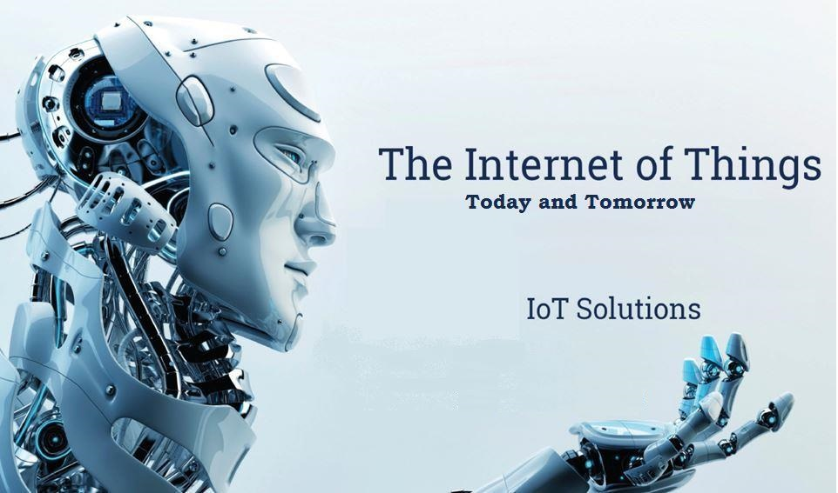

Slide 2
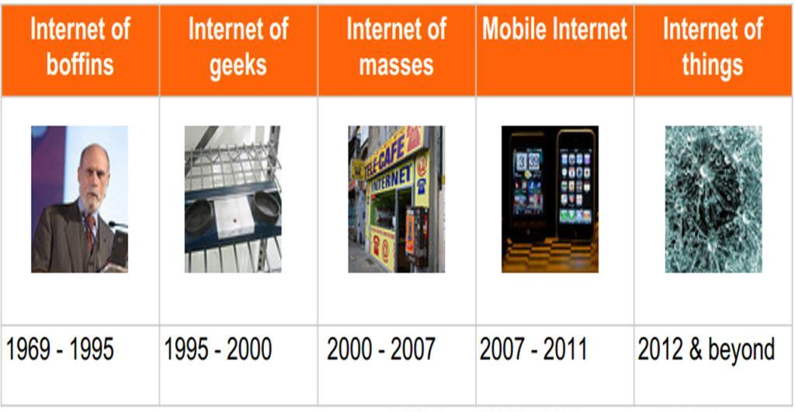
Internet Revolution

Slide 3
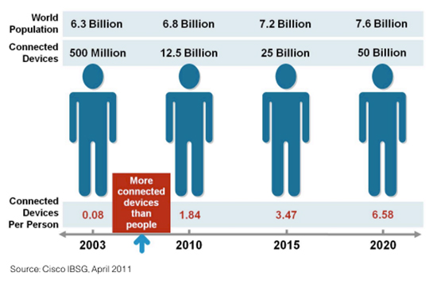
Internet Usage and Population Statistics

Slide 4
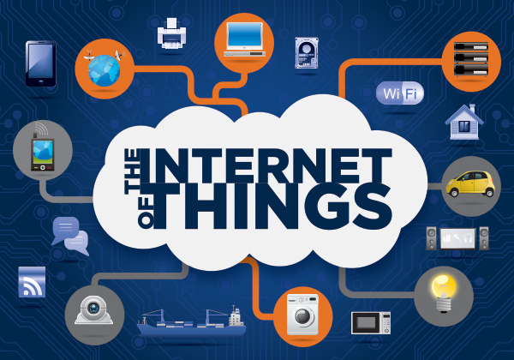
The Internet of Things
The term Internet of Things was first used by Kevin Ashton in 1999.
Refers to uniquely identifiable objects (things) and their virtual representations in an Internet-like structure

Slide 5
Characteristics
Ambient
Intelligence
Flexible
Structure
Event
Driven
Internet of Things
Semantic
Sharing
Complex Access Technologies

Slide 6
Enabling Technologies
RFID
Sensor
Smart Tech
Nano Tech
To identify and track the data of things
To collect and process the data to detect the changes in the physical status of things
To enhance the power of the network by devolving processing capabilities to different part of the network.
To make the smaller and smaller things have the ability to connect and interact.

Slide 7
Technical Perspective
Sensing Layer
Communication Layer
Management Layer

Slide 8
Application Areas
Media
Medical
Environment
IoT Applications
Infrastructure
Logistics
Manufacturing

Slide 9
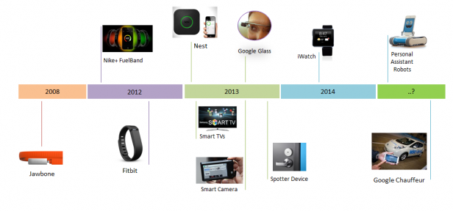
Smart Things Timeline

Slide 10
System Characteristics
Intelligence
Ambient Intelligence
Architecture
Event-driven
Manifests
Constrained – Power, Space, Size
Automatic Proactive Control
Distributed Framework
Embedded (device-side)
Self Awareness

Slide 11
Risks and Concerns
Safety
Privacy
Environment
Design
Autonomy
&
Control

