Slide 1
A Two-Stage Modeling Approach to Risk Prediction with High-Dimensional Two-Phase Data
Jill S. Hasler^{1,2,†}, Chenyu Bi^{1,†}, Changcheng Li³, Ravi B. Parikh⁴, Weidong Ma¹, Jinbo Chen¹
¹ University of Pennsylvania, USA ² Fox Chase Cancer Center, USA ³ Dalian University of Technology, China ⁴ Emory University, USA † Co-first authors

Slide 2



External Data: Improves Prediction but Often Incomplete
Patient | Age | Sex | SBP | …
A | 55 | M | 96
B | 43 | M | 114
C | 34 | F | 92
…
Pain score | Fatigue score | …
Missing
2 | 4
Missing
Complete EHR Data
Incomplete PRO Data
Advantages of combined data:
EHRs provide rich data but miss granular patient information
External data captures these missing details
However, external data is often only available for a subset of patients

Slide 3
Limitations of Common Approaches
Complete-case Analysis:
Reduced effective sample size
Distribution shift between the external-data subset and full cohort
Limited generalizability to the target population
Imputation-based Analysis:
Challenges with high-dimensional EHR predictors
Instability under substantial missingness
Limited accuracy under weak EHR–external data correlation
Need a method that uses all data without direct external-data imputation

Slide 4

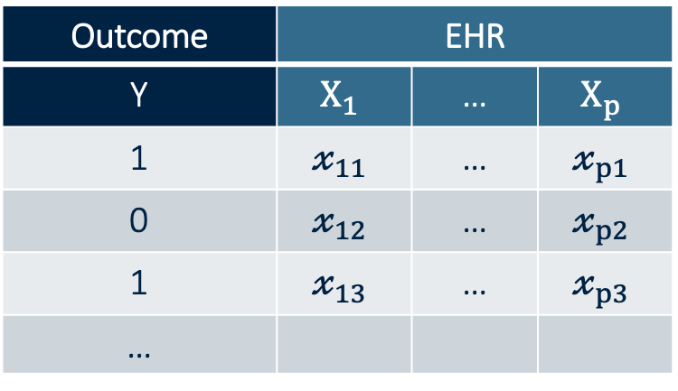
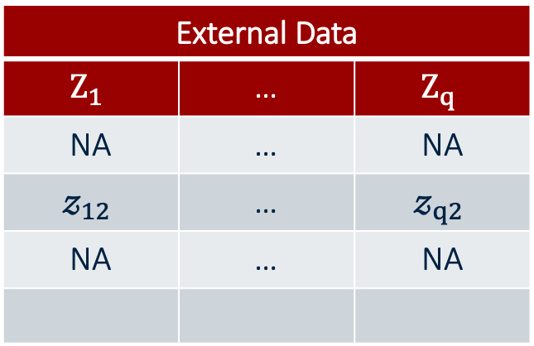
Reframing the Problem as Two-Phase Data
Phase I:
Phase II:
Outcome | EHR
Y | $$X_{1}$$ | … | $$X_{p}$$
1 | $$𝓍_{11}$$ | … | $$𝓍_{p1}$$
0 | $$𝓍_{12}$$ | … | $$𝓍_{p2}$$
1 | $$𝓍_{13}$$ | … | $$𝓍_{p3}$$
…
External Data
$$Z_{1}$$ | … | $$Z_{q}$$
NA | … | NA
$$𝓏_{12}$$ | … | $$𝓏_{q2}$$
NA | … | NA
Similar to classical two-phase studies, but with new challenges:
High-dimensional Phase I predictors (EHR data)
Phase II availability is observational, not designed sampling
Existing two-phase methods do not readily address this setting

Slide 5
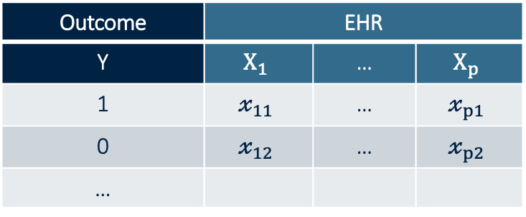
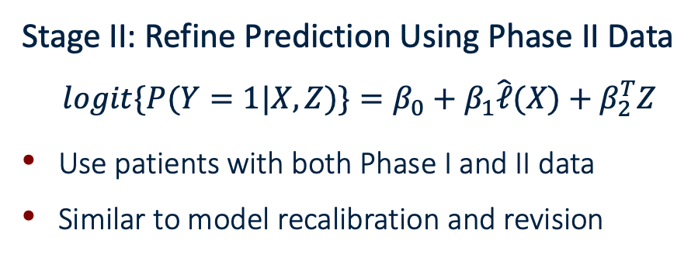
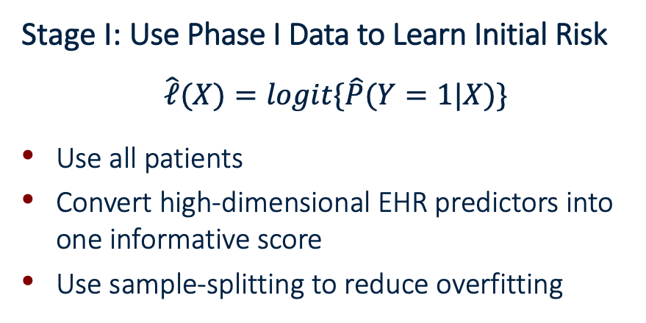
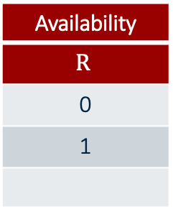
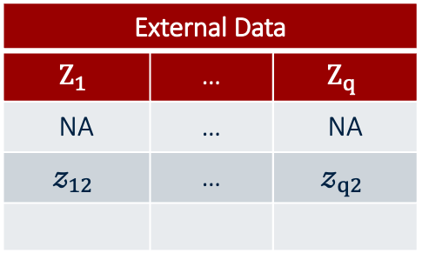
Our Two-Stage Modeling Framework
Outcome | EHR
Y | $$X_{1}$$ | … | $$X_{p}$$
1 | $$𝓍_{11}$$ | … | $$𝓍_{p1}$$
0 | $$𝓍_{12}$$ | … | $$𝓍_{p2}$$
…
External Data
$$Z_{1}$$ | … | $$Z_{q}$$
NA | … | NA
$$𝓏_{12}$$ | … | $$𝓏_{q2}$$
Availability
$$R$$
0
1
Stage I: Use Phase I Data to Learn Initial Risk
$$\hat{ℓ}(X)=logit\{\hat{P}(Y=1|X)\}$$
Use all patients
Convert high-dimensional EHR predictors into one informative score
Use sample-splitting to reduce overfitting
Stage II: Refine Prediction Using Phase II Data
$$logit\{P(Y=1|X,Z)\}=β_{0}+β_{1}\hat{ℓ}(X)+β_{2}^{T}Z$$
Use patients with both Phase I and II data
Similar to model recalibration and revision

Slide 6
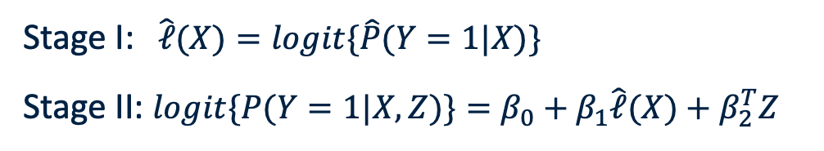
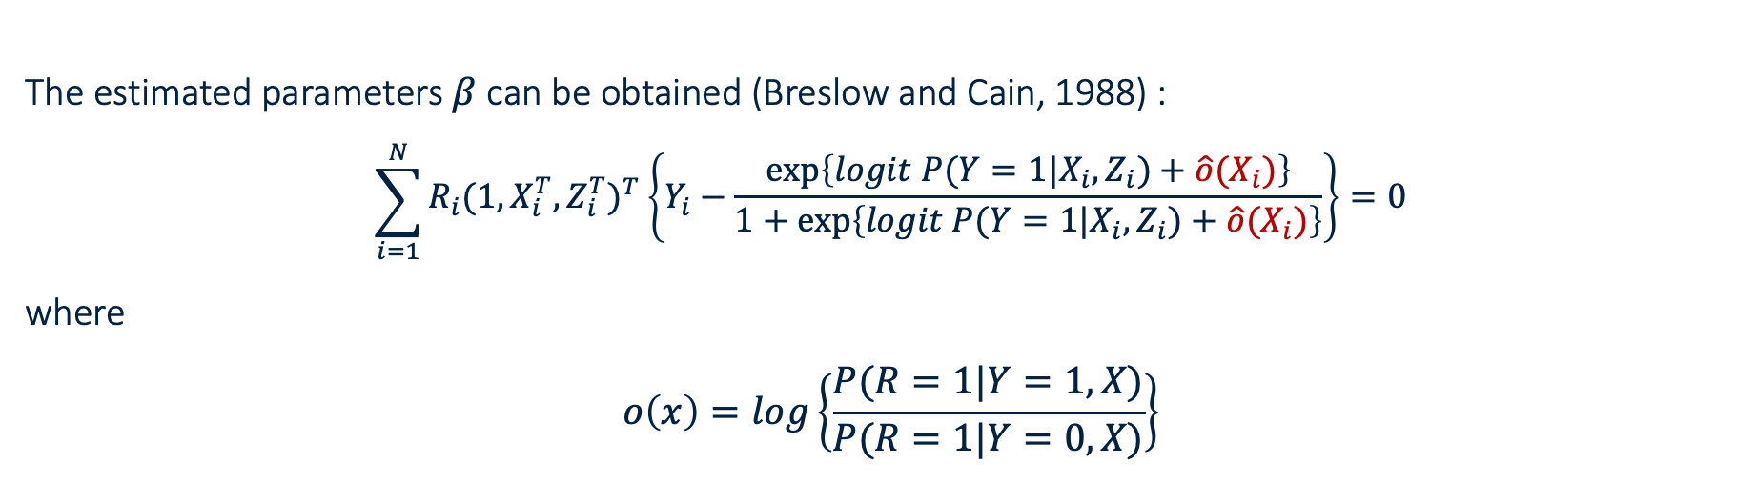
Model Fitting – Selection Bias Correction
Stage I: $\hat{ℓ}(X)=logit\{\hat{P}(Y=1|X)\}$
Stage II: $logit\{P(Y=1|X,Z)\}=β_{0}+β_{1}\hat{ℓ}(X)+β_{2}^{T}Z$
The estimated parameters $β$ can be obtained (Breslow and Cain, 1988) :
$$\sum_{i=1}^{N}{\begin{aligned}R_{i}(1,X_{i}^{T},Z_{i}^{T})^{T}\left\{Y_{i}−\frac{\exp\left\{logit P(Y=1|X_{i},Z_{i})+\hat{o}(X_{i})\right\}}{1+\exp\left\{logit P(Y=1|X_{i},Z_{i})+\hat{o}(X_{i})\right\}}\right\}=0 \\ \end{aligned}}$$
where
$$o\left(x\right)=log\left\{\frac{P(R=1|Y=1,X)}{P(R=1|Y=0,X)}\right\}$$

Slide 7
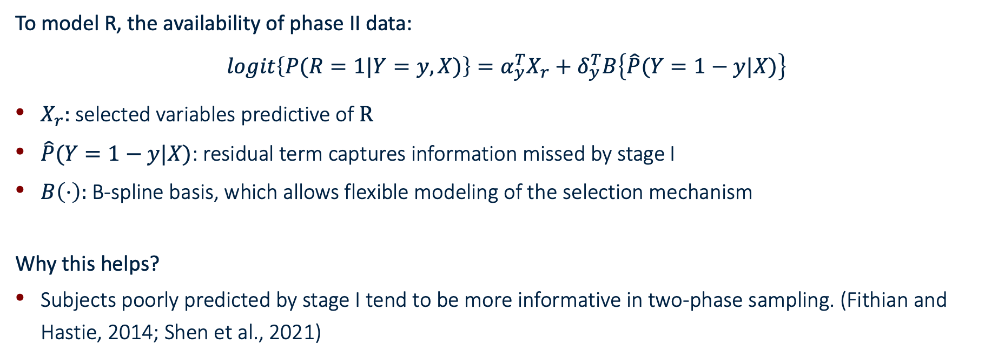
Model Fitting – Selection Bias Correction
To model R, the availability of phase II data:
$$logit\left\{P(R=1|Y=y,X)\right\}=α_{y}^{T}X_{r}+δ_{y}^{T}B\left\{\hat{P}(Y=1−y|X)\right\}$$
$X_{r}:$ selected variables predictive of $R$
$\hat{P}(Y=1−y|X)$: residual term captures information missed by stage I
$B\left(⋅\right):$B-spline basis, which allows flexible modeling of the selection mechanism
Why this helps?
Subjects poorly predicted by stage I tend to be more informative in two-phase sampling. (Fithian and Hastie, 2014; Shen et al., 2021)

Slide 8
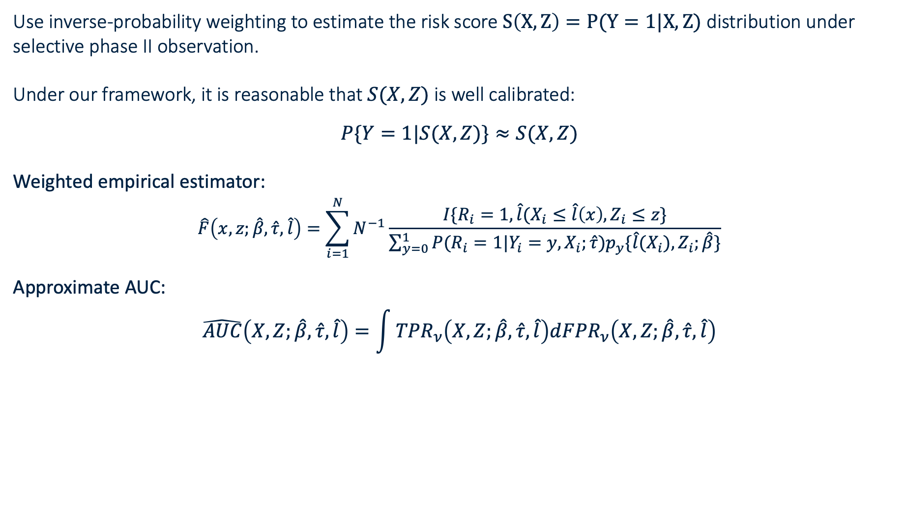
Approximation for Estimating AUC
Use inverse-probability weighting to estimate the risk score $S\left(X,Z\right)=P(Y=1|X,Z)$ distribution under selective phase II observation.
Under our framework, it is reasonable that $S(X,Z)$ is well calibrated:
$$P\{Y=1|S(X,Z)\}≈S(X,Z)$$
Weighted empirical estimator:
$$\hat{F}\left(x,z;\hat{β},\hat{τ},\hat{l}\right)=\sum_{i=1}^{N}{N^{−1}\frac{I\{R_{i}=1,\hat{l}(X_{i}≤\hat{l}\left(x\right),Z_{i}≤z\}}{\sum_{y=0}^{1}{P(R_{i}=1|Y_{i}=y,X_{i};\hat{τ})p_{y}\{\hat{l}(X_{i}),Z_{i};\hat{β}\}}}}$$
Approximate AUC:
$$\hat{AUC}\left(X,Z;\hat{β},\hat{τ},\hat{l}\right)=\int{{TPR}_{ν}\left(X,Z;\hat{β},\hat{τ},\hat{l}\right)d{FPR}_{ν}\left(X,Z;\hat{β},\hat{τ},\hat{l}\right)}$$

Slide 9
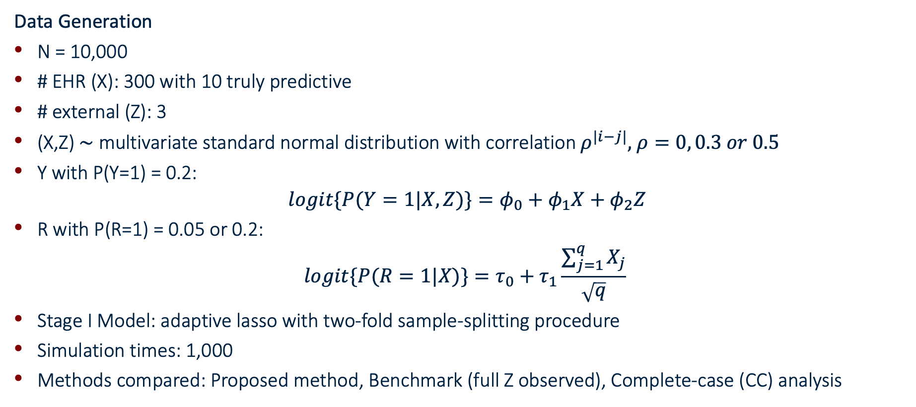
Simulation Setup
Data Generation
N = 10,000
# EHR (X): 300 with 10 truly predictive
# external (Z): 3
(X,Z) $\sim$ multivariate standard normal distribution with correlation $ρ^{|i−j|},$ $ρ=0, 0.3 or 0.5$
Y with P(Y=1) = 0.2:
$$logit\{P(Y=1|X,Z)\}=φ_{0}+φ_{1}X+φ_{2}Z$$
R with P(R=1) = 0.05 or 0.2:
$$logit\{P(R=1|X)\}=τ_{0}+τ_{1}\frac{\sum_{j=1}^{q}{X_{j}}}{\sqrt{q}}$$
Stage I Model: adaptive lasso with two-fold sample-splitting procedure
Simulation times: 1,000
Methods compared: Proposed method, Benchmark (full Z observed), Complete-case (CC) analysis

Slide 10
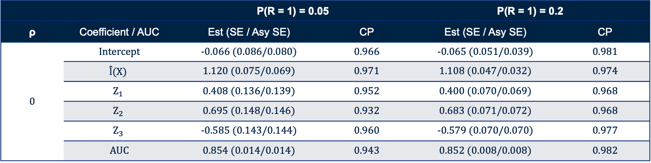
Simulation Results
Table 1. Results on the estimation of coefficients and AUC, where the stage I model is fitted using adaptive lasso. Est” refers to the mean coefficient/AUC estimates, “SE” to the empirical standard error, and “Asy SE” to the averaged asymptotic standard error. “CP” refers to the 95% coverage probabilities calculated compared to two-stage benchmark estimates.
 |  | P(R = 1) = 0.05 |  | P(R = 1) = 0.2
ρ | Coefficient / AUC | Est (SE / Asy SE) | CP | Est (SE / Asy SE) | CP
0 | Intercept | -0.066 (0.086/0.080) | 0.966 | -0.065 (0.051/0.039) | 0.981
 | $$\hat{l}(X)$$ | 1.120 (0.075/0.069) | 0.971 | 1.108 (0.047/0.032) | 0.974
 | $$Z_{1}$$ | 0.408 (0.136/0.139) | 0.952 | 0.400 (0.070/0.069) | 0.968
 | $$Z_{2}$$ | 0.695 (0.148/0.146) | 0.932 | 0.683 (0.071/0.072) | 0.968
 | $$Z_{3}$$ | -0.585 (0.143/0.144) | 0.960 | -0.579 (0.070/0.070) | 0.977
 | AUC | 0.854 (0.014/0.014) | 0.943 | 0.852 (0.008/0.008) | 0.982
Coefficient estimates from the proposed method were close to the benchmark
Asymptotic standard errors closely matched empirical standard errors
Coverage probabilities were close to nominal levels
Similar conclusions were obtained in other settings

Slide 11
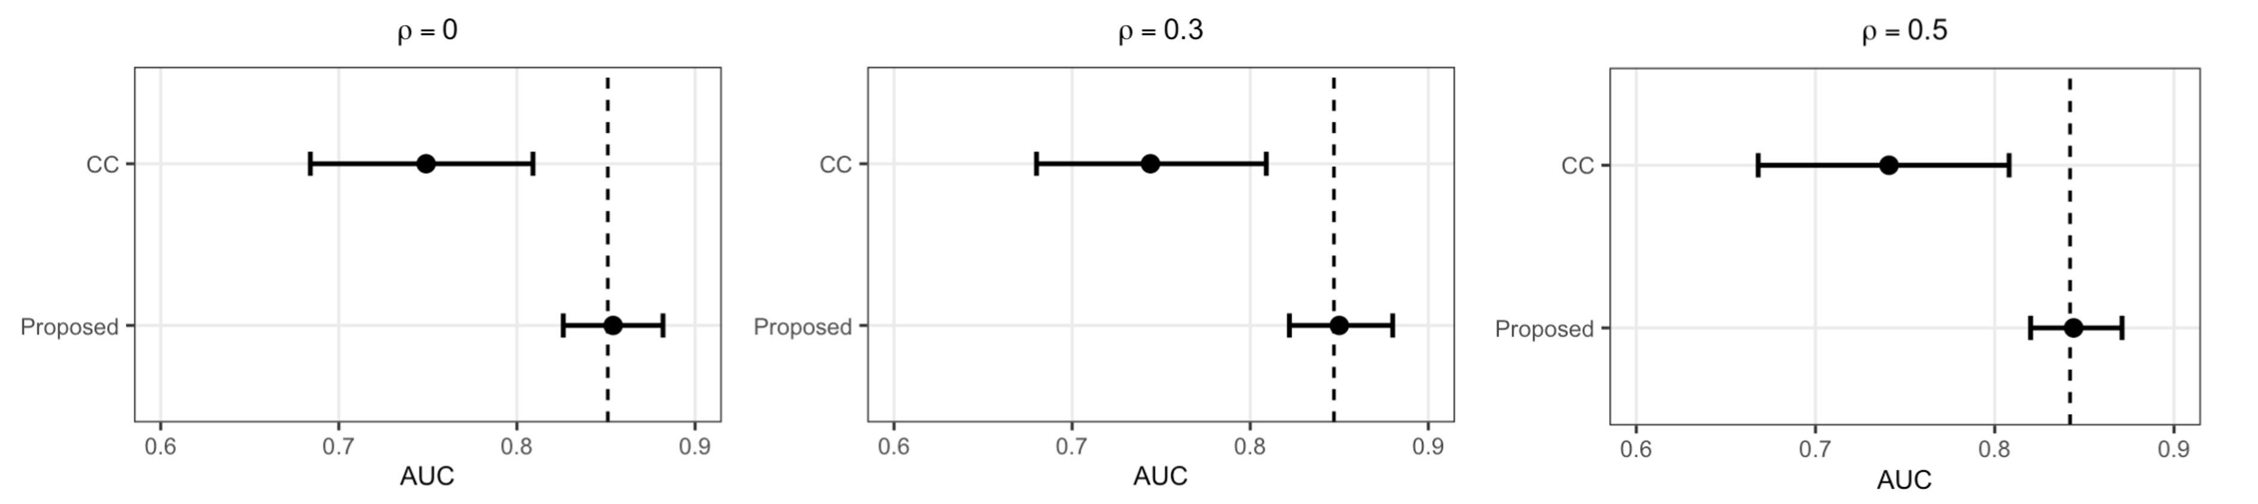
Simulation Results
Proposed vs CC
Figure 1. Comparison of AUC estimation between the proposed method and the CC approach when P(R = 1) = 0.05. “AUC” refers to the mean AUC estimates, and the dashed line represents the corresponding benchmark value.
Proposed estimates closely matched benchmark values
Much smaller variability than CC analysis

Slide 12
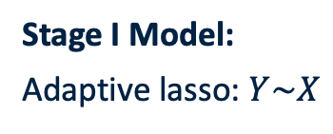
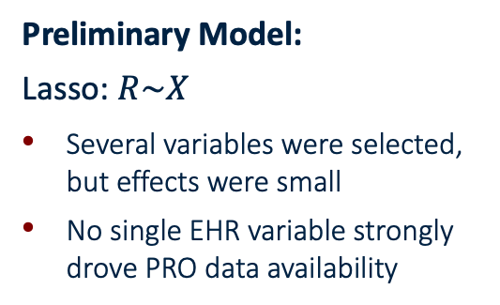
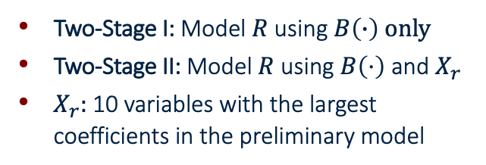
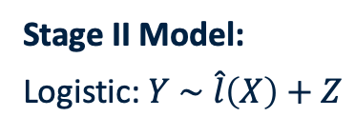
Real Data : Oncology Risk Prediction
Cohort​: 8,555 oncology patients from University of Pennsylvania Health System (UPHS)
Outcome: 180-day mortality (485 deaths; 5.7%)
EHR predictors: 204 variables
PRO predictors: 12 variables (55% available)
Preliminary Model:
Lasso: $R\sim X$
Several variables were selected, but effects were small
No single EHR variable strongly drove PRO data availability
Stage I Model:
Adaptive lasso: $Y\sim X$
Stage II Model:
Logistic: $Y \sim \hat{l}\left(X\right)+Z$
Two-Stage I: Model $R$using $B\left(∙\right) only$
Two-Stage II: Model $R$ using $B\left(⋅\right)$ and $X_{r}$
$X_{r}:$ 10 variables with the largest coefficients in the preliminary model

Slide 13
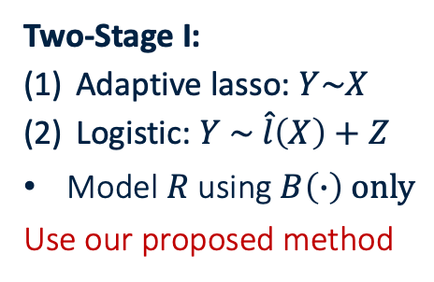
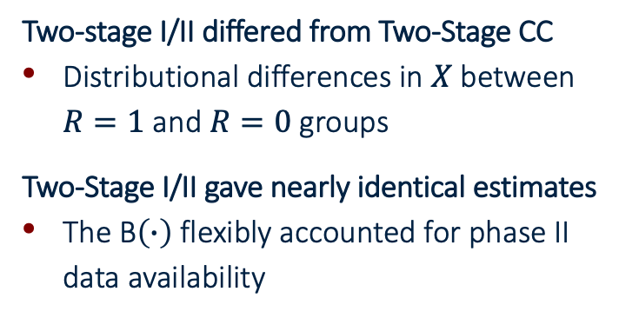

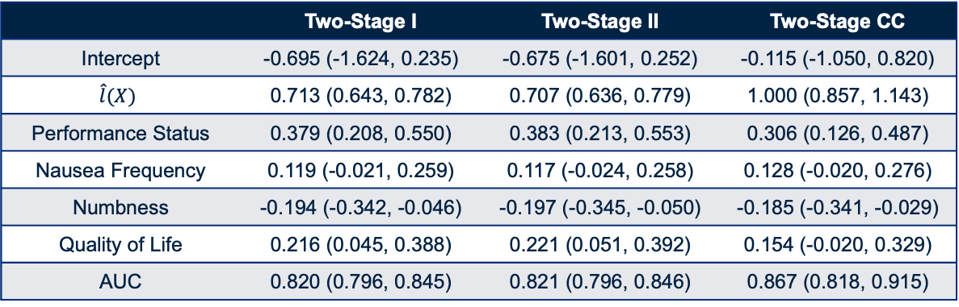
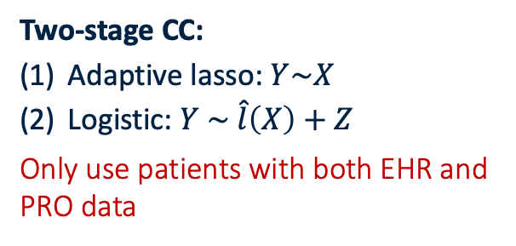
Real Data : Oncology Risk Prediction
Two-Stage I:
Adaptive lasso: $Y\sim X$
Logistic: $Y \sim \hat{l}\left(X\right)+Z$
Model $R$using $B\left(∙\right) only$
Use our proposed method
Two-Stage II:
Adaptive lasso: $Y\sim X$
Logistic: $Y \sim \hat{l}\left(X\right)+Z$
Model $R$using $B\left(∙\right) \text{and} X_{r}$
Use our proposed method
Two-stage CC:
Adaptive lasso: $Y\sim X$
Logistic: $Y \sim \hat{l}\left(X\right)+Z$
Only use patients with both EHR and PRO data
Table 2. Coefficient and AUC estimates for three models predicting short-term mortality
 | Two-Stage I | Two-Stage II | Two-Stage CC
Intercept | -0.695 (-1.624, 0.235) | -0.675 (-1.601, 0.252) | -0.115 (-1.050, 0.820)
$$\hat{l}(X)$$ | 0.713 (0.643, 0.782) | 0.707 (0.636, 0.779) | 1.000 (0.857, 1.143)
Performance Status | 0.379 (0.208, 0.550) | 0.383 (0.213, 0.553) | 0.306 (0.126, 0.487)
Nausea Frequency | 0.119 (-0.021, 0.259) | 0.117 (-0.024, 0.258) | 0.128 (-0.020, 0.276)
Numbness | -0.194 (-0.342, -0.046) | -0.197 (-0.345, -0.050) | -0.185 (-0.341, -0.029)
Quality of Life | 0.216 (0.045, 0.388) | 0.221 (0.051, 0.392) | 0.154 (-0.020, 0.329)
AUC | 0.820 (0.796, 0.845) | 0.821 (0.796, 0.846) | 0.867 (0.818, 0.915)
Two-stage I/II differed from Two-Stage CC
Distributional differences in $X$ between $R=1$ and $R=0$ groups
Two-Stage I/II gave nearly identical estimates
The B$\left(∙\right)$ flexibly accounted for phase II data availability

Slide 14
References Breslow, N. E. and Cain, K. C. (1988). Logistic regression for two-stage case-control data. Biometrika 75, 11–20. Fithian, W. and Hastie, T. (2014). Local case-control sampling: Efficient subsampling in imbalanced data sets. The Annals of Statistics 42, 1693–1724. Shen, X., Chen, K., and Yu, W. (2021). Surprise sampling: Improving and extending the local case-control sampling. Electronic Journal of Statistics 15, 2454 – 2482.

