Slide 1

HOUSING MARKET DATA SCIENCE
Estimating Paris
Property Prices
Prepared by: Yoser Bichiou Case study: Automated Valuation Model
Date: July 2026

Slide 2
Table of Contents
01
02
03
04
05
06
07
Data
Preprocessing
Exploratory
Analysis
Baseline
Models
Advanced
Models
Model
Interpretation
Deployment
Scenario
Risks &
Limitations
2

Slide 3
1 · DATA PREPROCESSING
Cleaning and preparing the data
01
Removing duplicates and empty columns
Removed 92 duplicate relistings and 17 non-residential rows
Dropped columns that were empty or carried zero information
02
Corrected invalid values
Repaired zipcodes, capped impossible counts and floors, and removed 8,211 outliers using price / area / €-per-sqm intervals
03
Imputation
Null imputation where missing meant not present (parking, cellar)
Median imputation where it meant entry error
04
Engineered 14 new features
Property age, area ratios, outdoor space, floor position, arrondissement geography, seasonality, and one-hot property type.
3

Slide 4
1 · DATA PREPROCESSING
Final dataset: 91.7% of original rows
100,000
91,680
raw listings
clean listings
8,211
32
outliers removed
final features
4

Slide 5
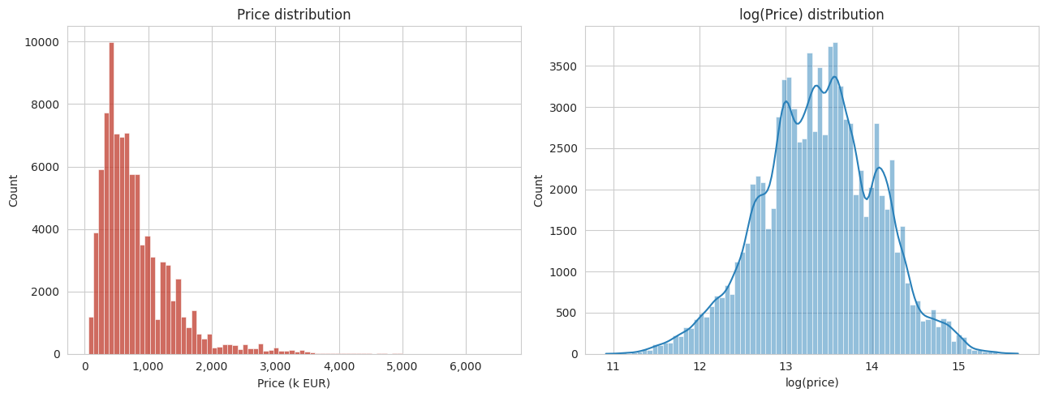
4 · EXPLORATORY ANALYSIS
Price distribution
Half of the values go for under €650,000 but the average is €812,306
The price distribution is so left skewed (a small number of very expensive properties pull the mean well above the median)
Log transforming the price makes the skew mostly disappears. it's the reason a we will test training the model later with log-transformed target
5

Slide 6
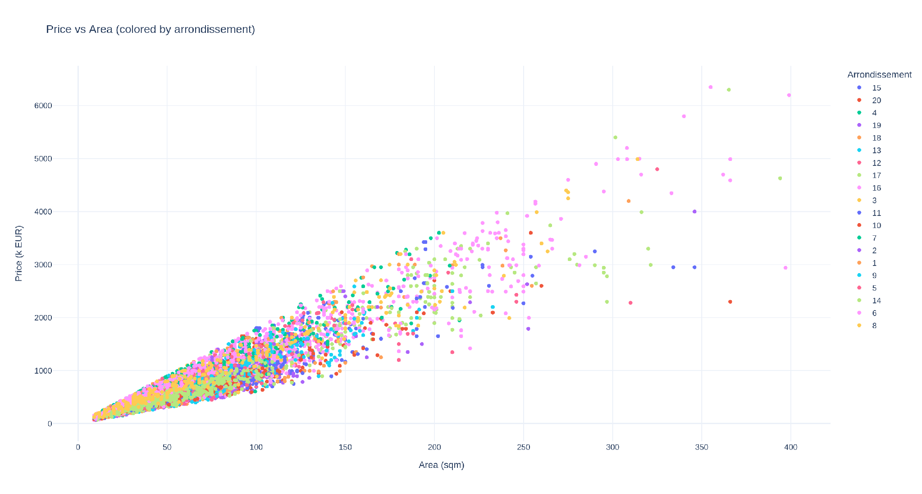
4 · EXPLORATORY ANALYSIS
Price Vs Area Plot
Area and price move together almost perfectly (0.94 correlation) which means that they are highly correlated
If we look at the colors (arrondissement) same size apartments, different arrondissements, and the price jumps around a lot. So the location is also so correlated to the price
6

Slide 7
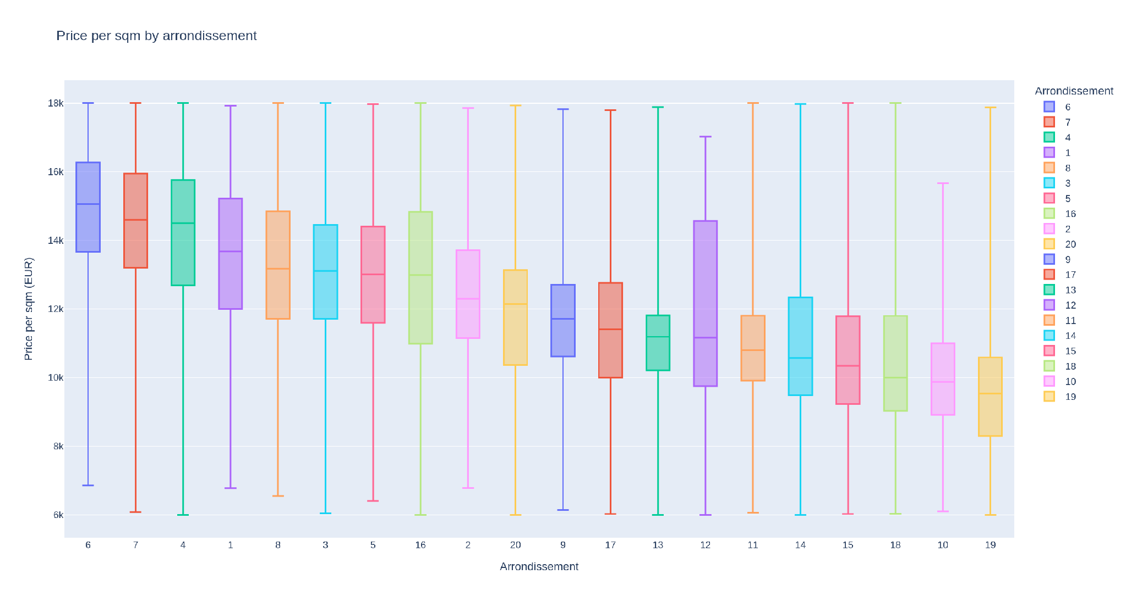
4 · EXPLORATORY ANALYSIS
Box plot of Price per square meter, by arrondissement
€15,065 /sqm in arrondissement 6 the highest price
€9,535 /sqm in arrondissement 19 the cheapest
The ranking lines up with what anyone who knows Paris would expect a good sign the data reflects a real market, not noise
7

Slide 8
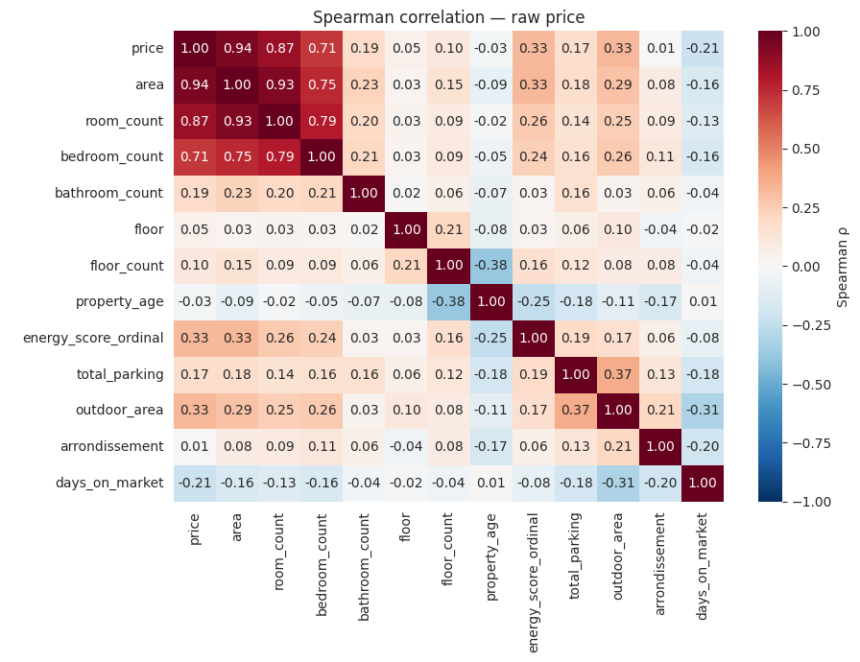
4 · EXPLORATORY ANALYSIS
Correlation matrix heatmap
The heatmap shows that:
Area is the strongest correlate with price at 0.94. Room count (0.87) and bedroom count (0.71) also correlate strongly, which makes sense since they're basically all measuring size in different ways.
Energy rating and outdoor area have a coefficient of about 0.33, so they matter, just a lot less than size does.
Days on market is negatively correlated at −0.21, so the longer a listing sits unsold, the more likely it was overpriced.
Floor, arrondissement, and building age barely correlate with price on their own.
8

Slide 9
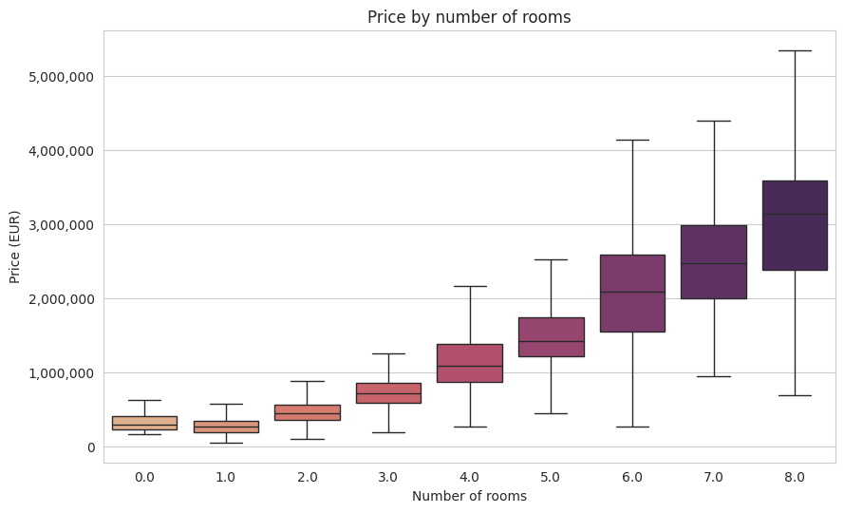
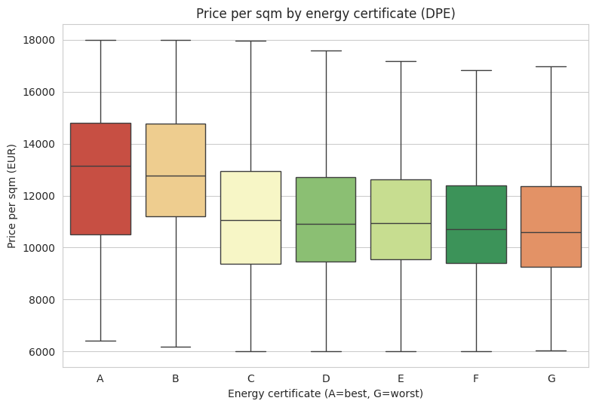
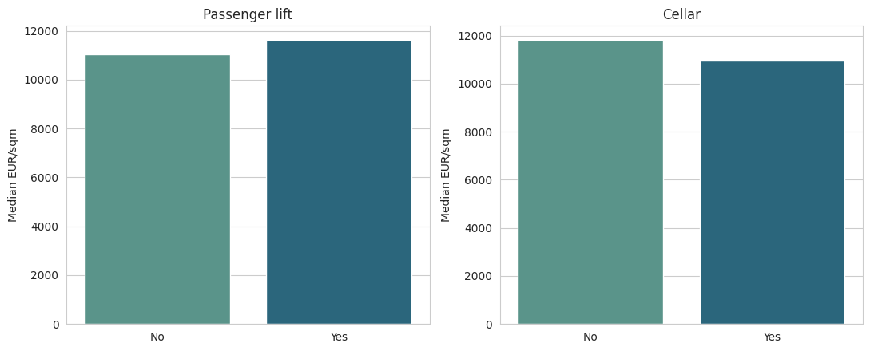
4 · EXPLORATORY ANALYSIS
Rooms, amenities and energy analysis
- Room count and price rise together, which is logical because area and price already have the same correlation.
- Having a lift goes with a higher price while having a cellar actually goes with a lower price likely because we did null imputation to the feature and it had initially a fill percentage of 47%
- Energy rating shows only a mild A-to-G decline likely because old, central buildings often carry poor DPE scores despite commanding high prices.
9

Slide 10
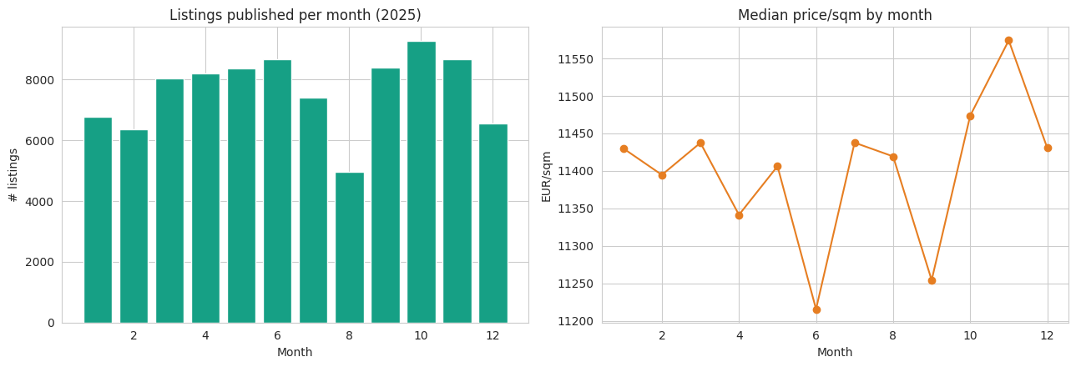
4 · EXPLORATORY ANALYSIS
Seasonality effect
In summary
Area and location explain most of it.
Rooms, amenities, energy rating add smaller, sensible effects.
Real anomalies exist (bad zipcodes, impossible values) and were handled.
Real limits remain : only one year of data, missing values in some columns
Listings decrease every August ( French summer holidays ) then rebound in September. Median €/sqm stays roughly flat across the year but one calendar year alone can't tell trend from noise.
10

Slide 11
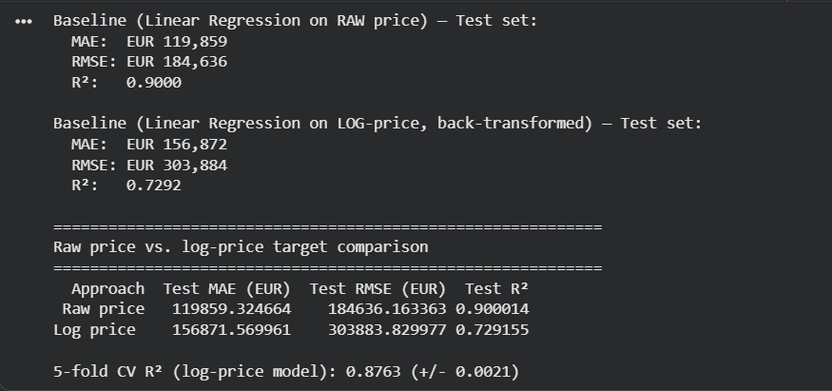
5 · BASELINE MODELS
Baseline Model: Linear regression with two options
We tested two versions of the same model:
one trained directly on price, one trained on log of price and then converted back. Raw price wins clearly. It's off by about €120,000 on average, vs €157,000 for the log version, and explains 90% of the variation in price versus 73%.
The log model actually scores well in its own world, 0.876 R² across five different data splits, so it's not a bad model. The problem shows up when we convert log predictions back into euros. A small miss in log space can turn into a huge miss in euros once we reverse the transformation, especially for expensive properties. That's exactly why the log version's errors balloon on the real scale even though it looked fine before converting back.
Decision: raw price, for every model that follows because it's the more accurate choice on the number that actually matters
Tested, log-transform lost on every model in this project
11

Slide 12
6 · ADVANCED MODELS
How the models were trained
Feature selection
→
80 / 20 split
→
Imputation
→
Standardize*
→
Fit & Evaluation
73,344 / 18,336
rows in train and test, split after selecting the training features
Median imputation
Median imputation for tree based models
Standardization
Standard scaling for linear models
Training models and evaluation metrics
Evaluating the test dataset based on metrics after training them
12

Slide 13
6 · ADVANCED MODELS
Evaluation Metrics
MAE
RMSE
R²
How wrong is a typical guess, in euros?
How bad are the worst mistakes?
How much of the story do we actually explain?
Mean Absolute Error : On average how far off our price prediction is in euros.
Root Mean Squared Error : Same idea as MAE, but it penalises big mistakes harder, so it tells us how bad our worst predictions are.
Out of everything that affects price, how much of it our model actually manages to explain, from 0 to 1.
The one that matters most here: MAE. It's the number we can deliver to the user 'expect the real price to be within €45,000 of our estimate '
13

Slide 14
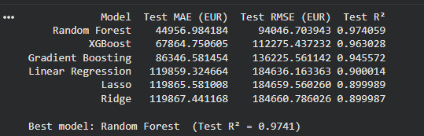
6 · ADVANCED MODELS
Random Forest wins on every metric
Random Forest comes out ahead by a wide margin
The three tree based models, Random Forest, XGBoost, and Gradient Boosting, all outperform the three linear ones, Linear Regression, Lasso, and Ridge.
That makes sense because Linear Regression, Lasso, and Ridge are all still just drawing a straight line through the data. They differ a bit in how they handle overfitting, but it's still a straight line trying to predict price and price doesn't really work that way
Location, size, and amenities interact with each other in ways a straight line can't capture, and tree based models are built to pick up exactly that kind of pattern.
Random Forest edges out XGBoost and Gradient Boosting too, because it averages many independent trees rather than building them one after another, which makes it a bit more stable on this dataset.
That's why we picked it as the final model
14

Slide 15
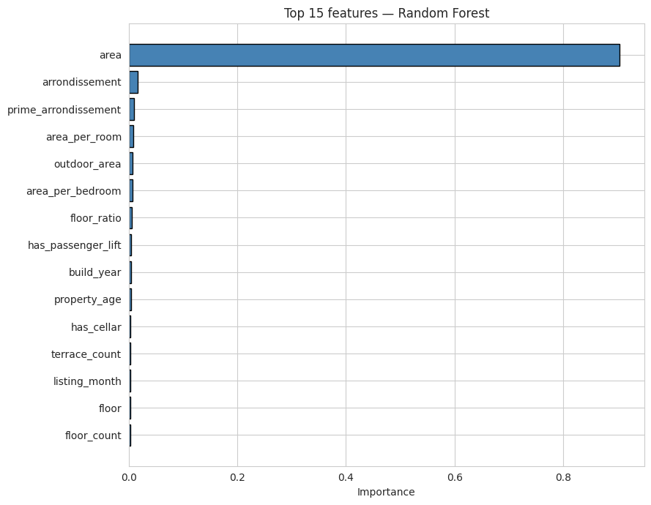
7 · MODEL INTERPRETATION
Feature Importance
Area is the most important feature in our prediction : about 90% of what the model relies on how big the listing is
After that, location impacts too, arrondissement and being in one of the prime districts both show up, which makes sense, we already saw that in the correlation and geography slides.
Then we find features like outdoor space and having a lift they also have a smaller impact
What's kind of surprising is that energy rating and the type of property : whether it's a duplex or a loft barely matter to the model
Logically energy rating should count for more given the energy consumption but once the model already knows the size and the location, it just doesn't add much extra information
15

Slide 16
8 · DEPLOYMENT SCENARIO
Potential User Experience
1
2
3
4
Listing created
Data enriched
automatically
Model runs
automatically
Estimate
appears
1 The seller enters a new listing : area, year built, arrondissement, rooms, amenities…
2 Before they've typed an asking price, the platform already has an estimate ready.
3 It's shown as a range (€630k to €670k ) not a single number
4 The seller prices with real market context, drawn from roughly comparable transactions.
16

Slide 17
8 · DEPLOYMENT SCENARIO
Potential Product
01
Flag it if it's overpriced.
A listing well above the model's estimate is a candidate for a seller nudge before it stalls on the market.
02
Flag it if it's underpriced.
The inverse : useful signal for buyers and investors scanning for value.
03
Rank listings by the gap.
Sort search results by predicted-versus-asking difference, surfacing the most interesting listings first and potentially catch what looks like a scam, promote the fair deals
17

Slide 18
9 · RISKS & LIMITATIONS
Potential Risks & Limitations
01
02
Flag low-confidence listings
The final output should be an interval not a single value
Properties missing a lot of information should come with a visibly weaker estimate.
A bare number implies false precision the model doesn't have.
03
Less accuracy on the unusual listings
Rare or exceptional properties have fewer comparables to learn from.
18

Slide 19
9 · RISKS & LIMITATIONS
Potential features to add to the model
Available means of transport nearby, schools, neighborhood quality
All known drivers of what a buyer is willing to pay in Paris (none of them present in this dataset today)
Multiple years of listings
All the listing are from 2025 year so the results may not hold beyond that year
19

Slide 20
Thank you
20

