Slide 1
ML-PBL
AMC Engineering College
Department of Computer Science and Engineering(Data Science)
Amortized Inverse PDE Inference with Analytical Data
Generation
Presented By :
Khushi Joshi (1AM23CD045) Matharishwa S (1AM23CD053) Bichitra Behera (1AM23CD020) Bharath S (1AM23CD017)

Slide 2
INTRODUCTION
The inverse PDE problem involves finding unknown system properties from observed data.
These hidden coefficient fields cannot be directly measured in practice.
The estimation is done using available observations of the system output.
This problem is widely used in fields like geophysics, materials science, and thermal engineering.
The input data is usually sparse, meaning only a few measurement points are available.
The observed data also contains noise, which makes the problem more difficult.
The main goal is to accurately reconstruct the unknown spatial parameters from limited and noisy data.

Slide 3
EXISTING SOLUTION
Traditional methods solve a new optimization problem for every instance.
This makes them very slow and computationally expensive.
Their performance depends heavily on initialization and parameter tuning.
They often struggle to provide reliable uncertainty estimates.
Poor uncertainty calibration reduces trust in the results.
Overall, these methods are inefficient for repeated or real-time use.

Slide 4
Proposed Approach
The proposed method uses amortized learning to solve inverse problems efficiently.
A single trained model can handle multiple problem instances.
It directly predicts the coefficient field from observed data.
This removes the need for repeated optimization.
The approach significantly reduces computation time.
It also improves scalability for large datasets.

Slide 5
Data Generation
The method generates training data using an analytical approach instead of repeated optimization.
It samples random coefficient fields from a smooth prior distribution.
A forward PDE is solved once to obtain the corresponding output.
Synthetic observation data is then created by sampling from this output.
This process produces large amounts of labeled data efficiently.
It ensures diversity and reduces computational cost.

Slide 6
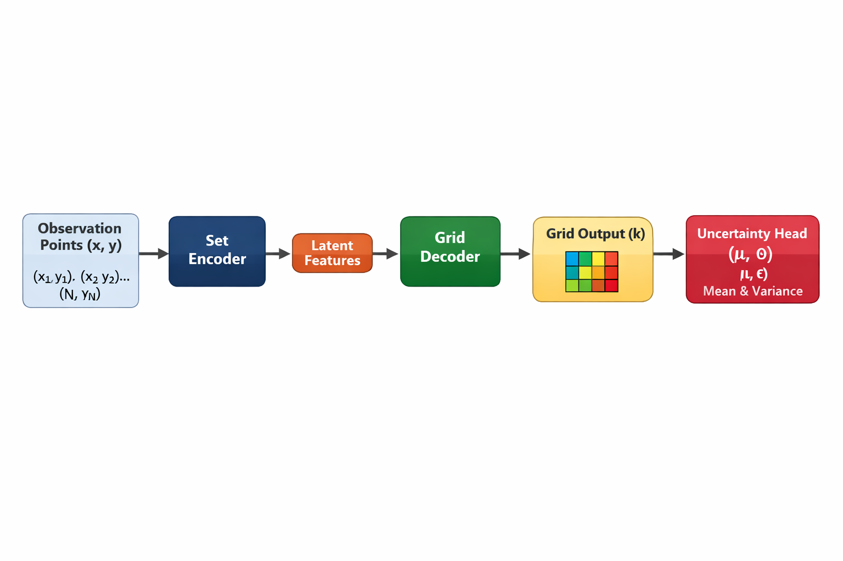
Model Architecture
The model uses a set encoder to process input observations.
It can handle variable numbers of observation points.
A grid decoder maps the encoded information to spatial outputs.
The model predicts values for each point in the grid.
An uncertainty head estimates both mean and variance.
The output is a probabilistic prediction using a Gaussian distribution.

Slide 7
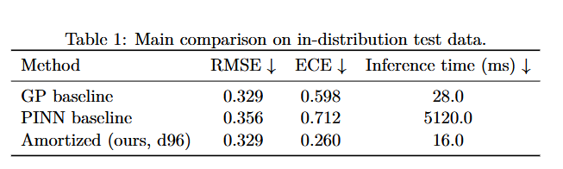
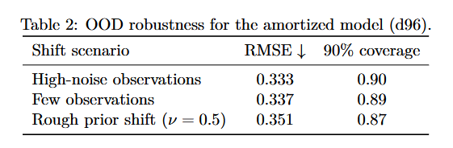
RESULTS
The proposed method achieves the same accuracy as the Gaussian Process baseline.
It improves uncertainty calibration by about 2.3 times.
The model is significantly faster, around 320 times faster than PINN.
It performs well even with noisy data.
It remains effective when the number of observations is low.

Slide 8
LIMITATIONS
The model is tested only on smooth coefficient fields.
Its performance on complex or discontinuous fields is not evaluated.
It is applied to only one type of PDE.
Results on real-world data are not included.
There is no theoretical guarantee for accuracy or uncertainty calibration.

Slide 9
LIMITATIONS
The method introduces a fast and efficient approach for inverse PDE problems.
It achieves accuracy comparable to traditional methods.
It provides better uncertainty estimation.
It significantly reduces computation time.
It is suitable for repeated and real-time applications.
Future work includes testing on more PDE types and real-world datasets

