Slide 1

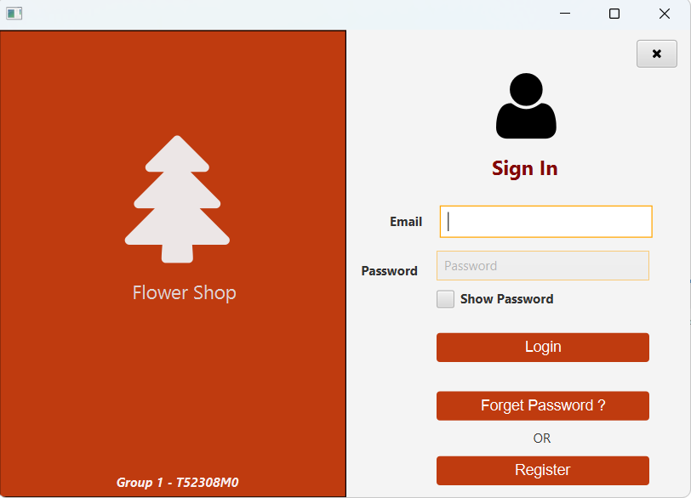
Flower Shop

Slide 2
Flower Shop
1
Hồ Thị Bích Liên
Student1506037
2
Võ Hoàng Khải
Student1501207
3
Nguyễn Lâm Chí Nguyễn
Student1501858
4
Trần Thị Thảo
Student1501216

Slide 3
Register-Login System
Nguyễn Lâm Chí Nguyễn

Slide 4
Login and Register
Admin and User
Permission
Database:
Employee,Customer.

Slide 5
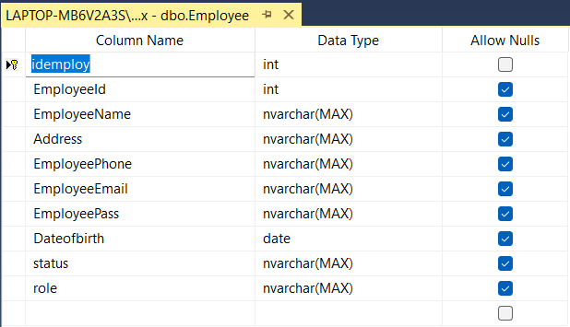
Database

Slide 6
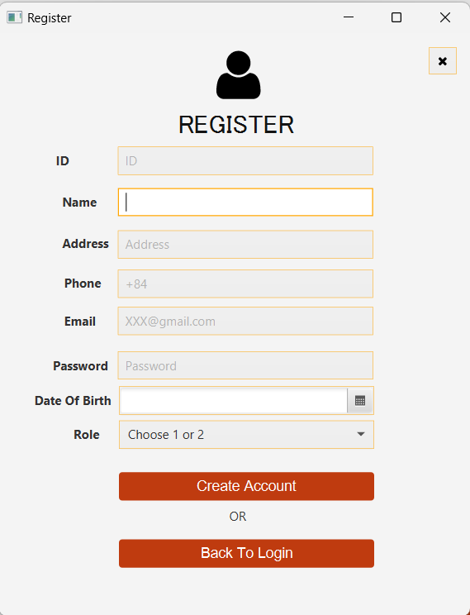
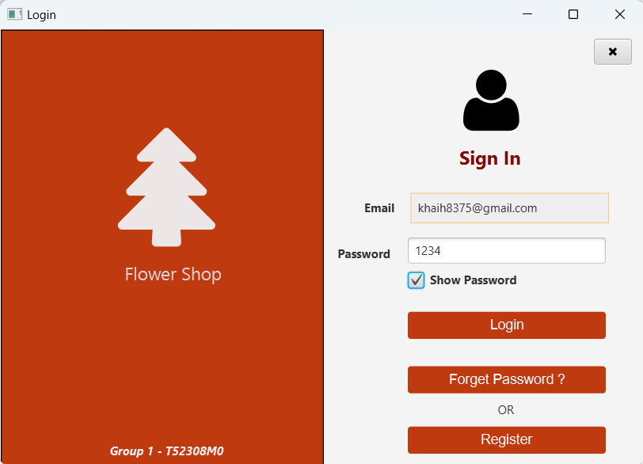
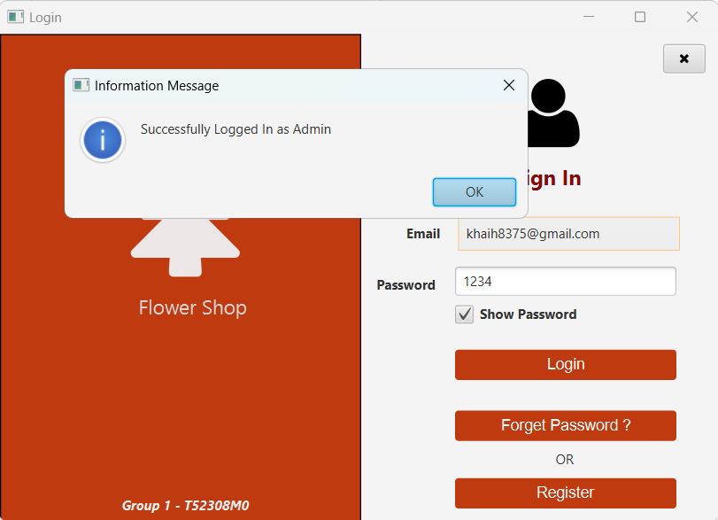
Register Form
Login Admin
Logged in successfully

Slide 7
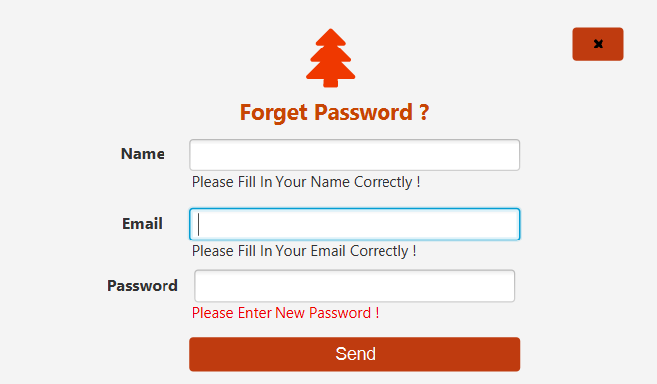
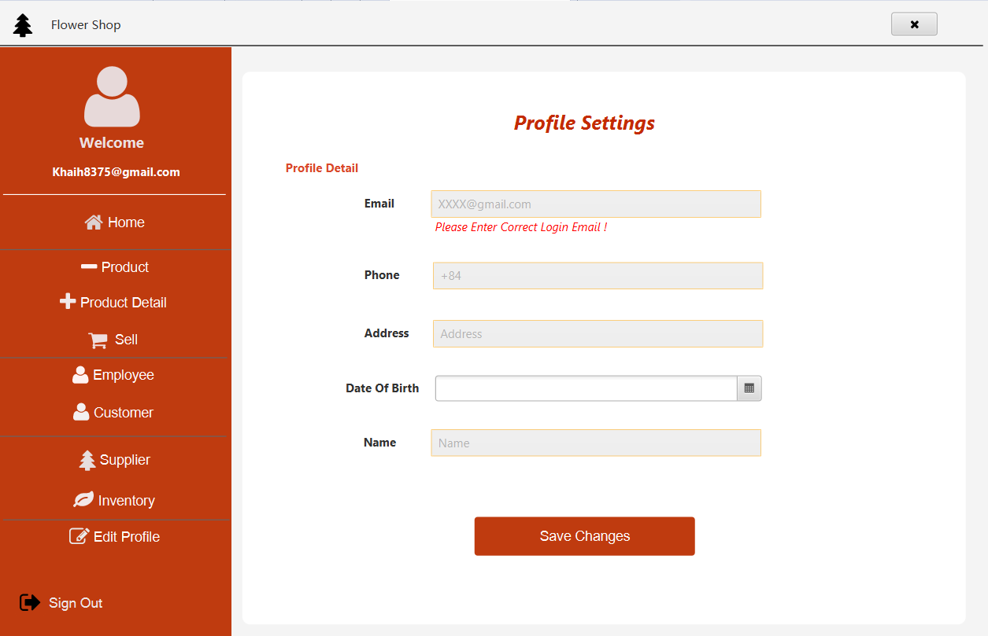
Forget Password
Edit Proflie

Slide 8
Product
Võ Hoàng Khải

Slide 9
Product
Product-Detail
Admin
Add
Update
Delete
Reset
Search
Database:
Product
Product-Detail.

Slide 10
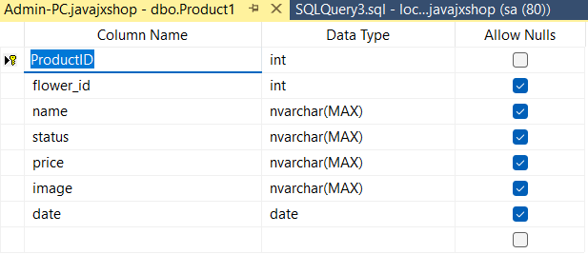
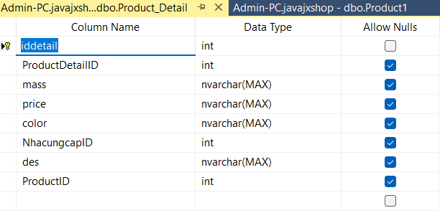
Database

Slide 11
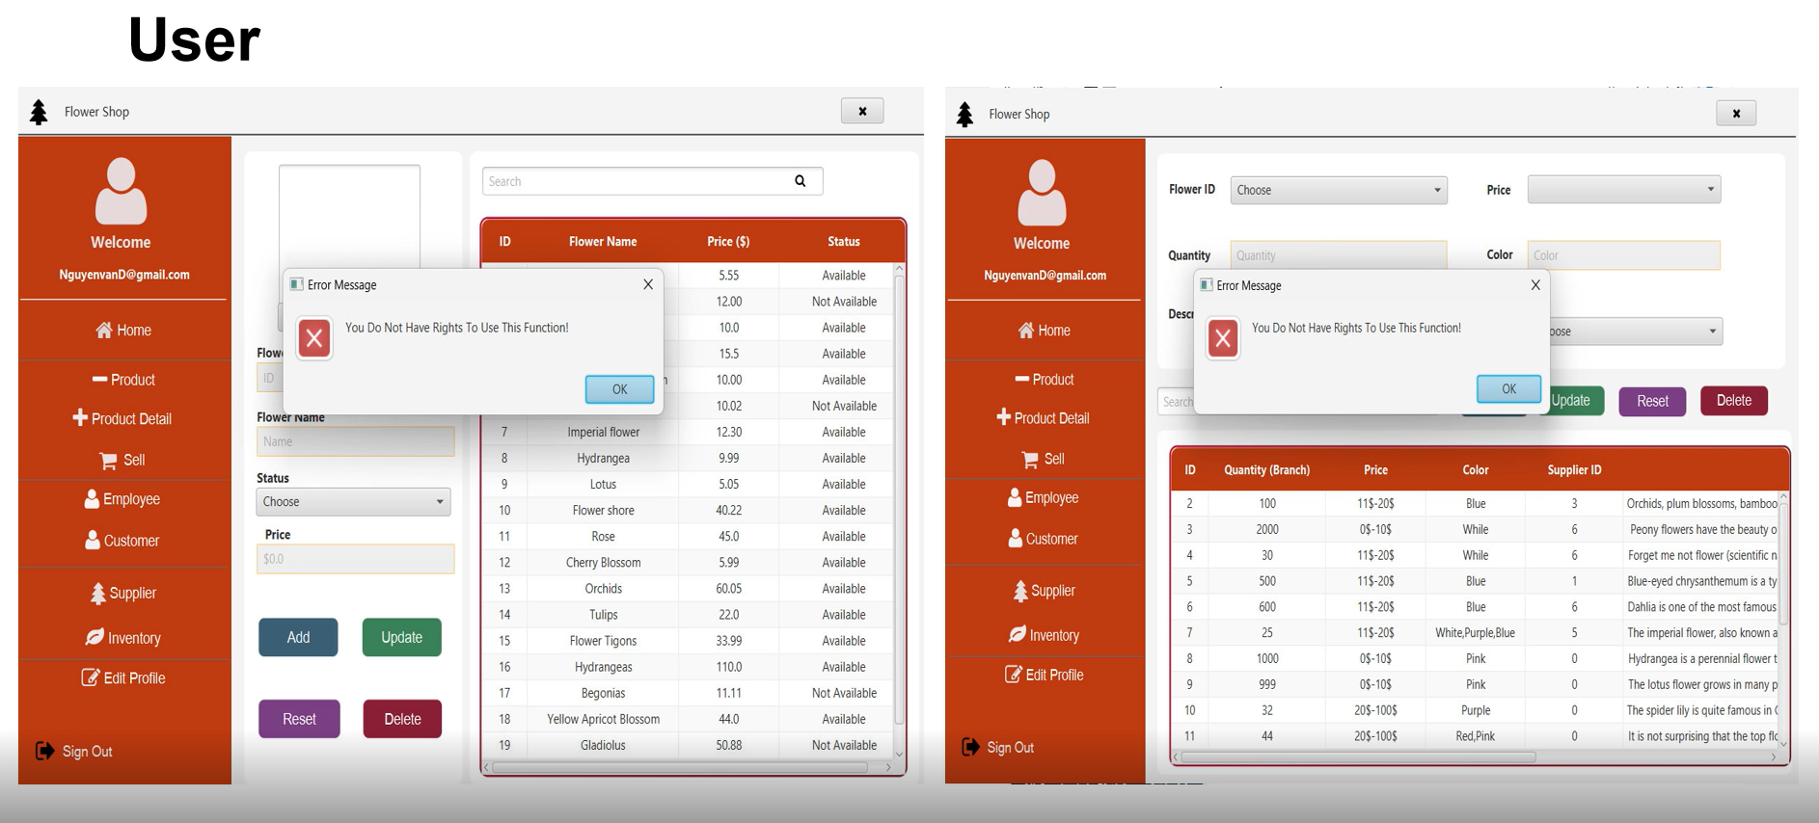

Slide 12
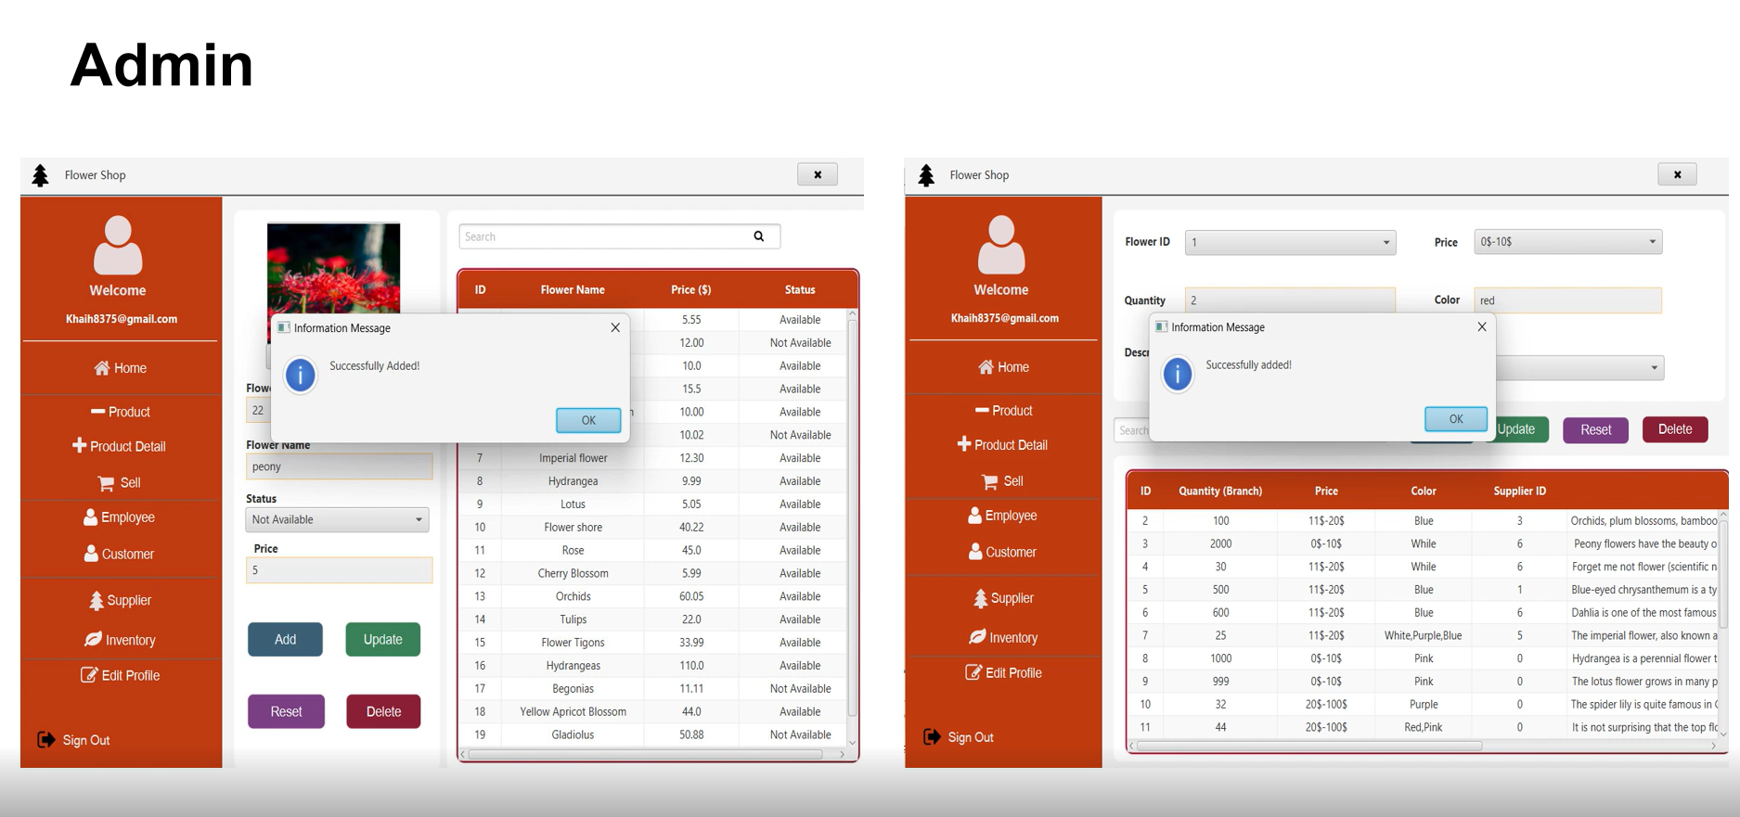

Slide 13
Sell
Trần Thị Thảo

Slide 14
Sell
Employee
Admin and User
Add to cart , Reset ,Pay
Delete cart
Add,Update,
Delete,Search
Database:
Invoice
Invoice-info.

Slide 15
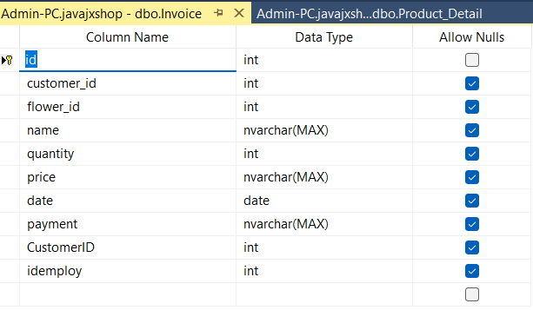
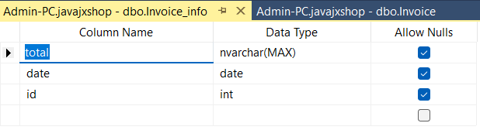
Database

Slide 16
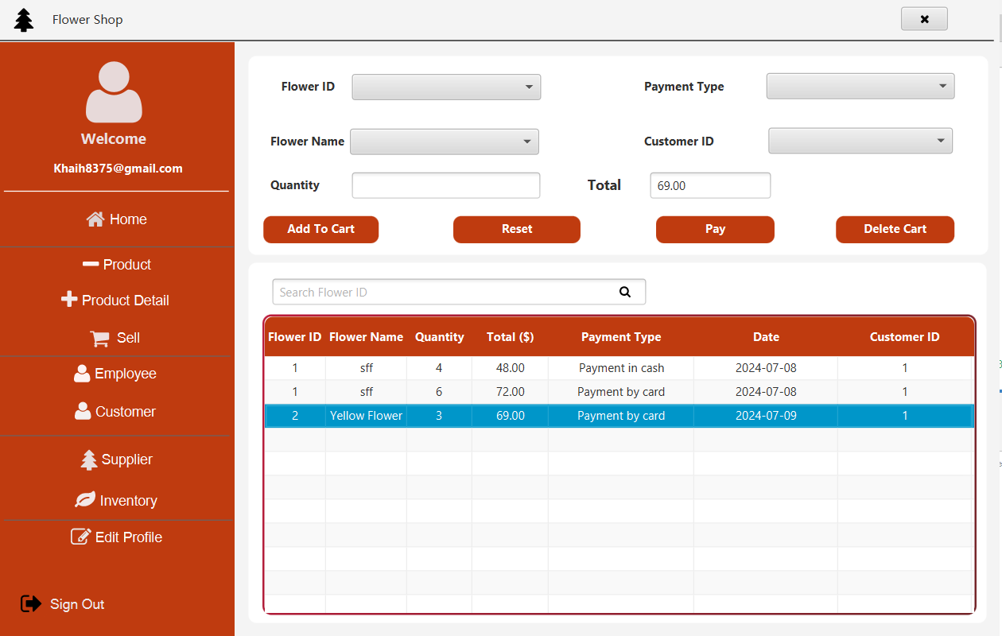

Slide 17
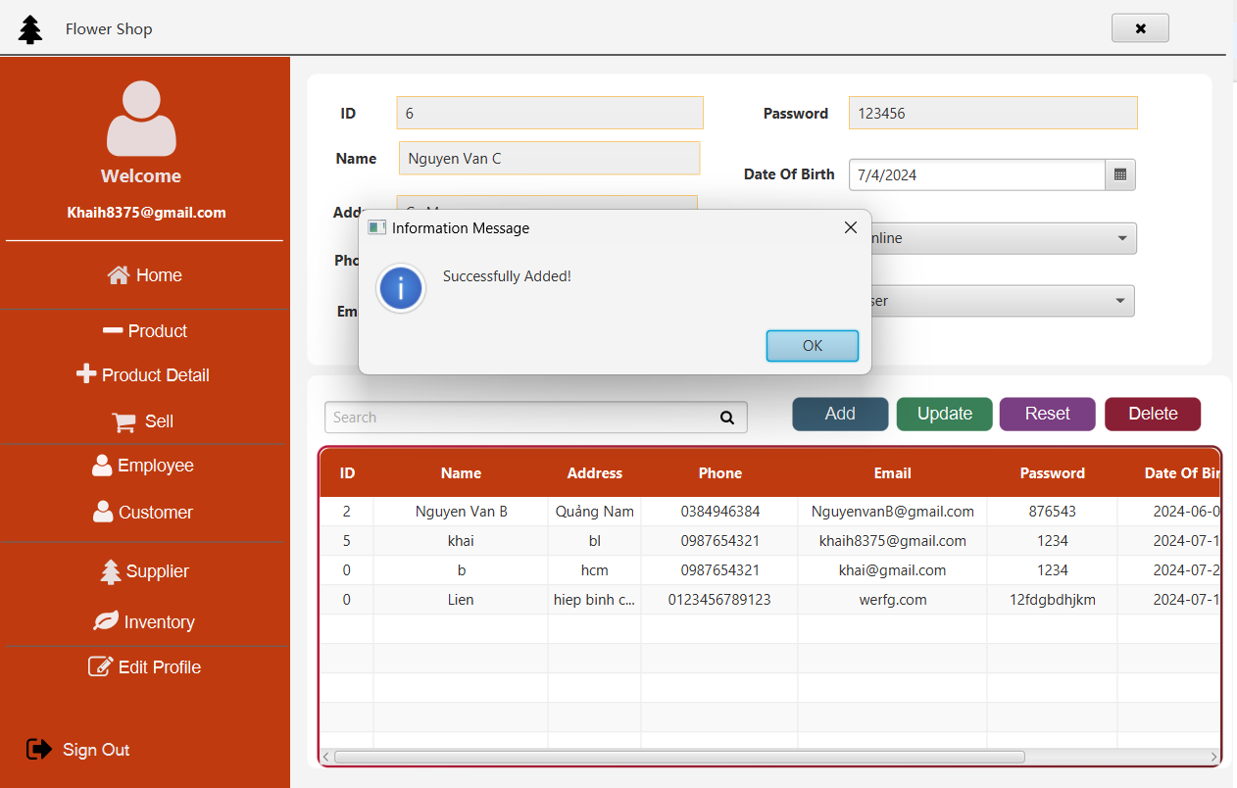

Slide 18
Supplier and Invenoty
Hồ Thị Bích Liên

Slide 19
Supplier
Inventory
Customer
Admin and User
Add
Update
Delete
Reset
Search
Database:
Nhacungcap
Hangtonkho

Slide 20
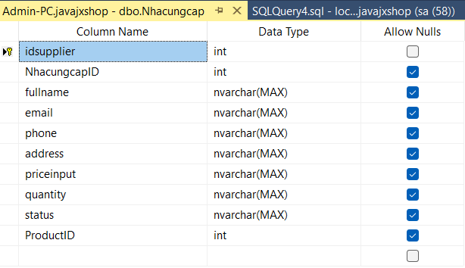
Database

Slide 21
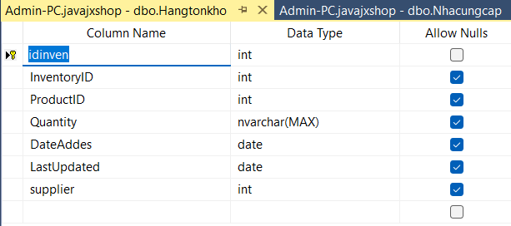
Database

Slide 22
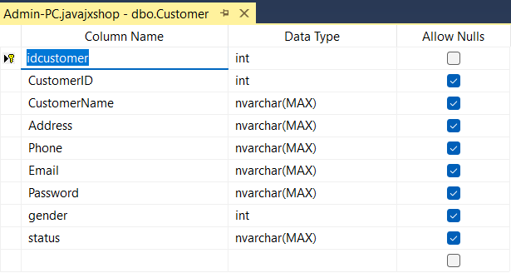
Database

Slide 23
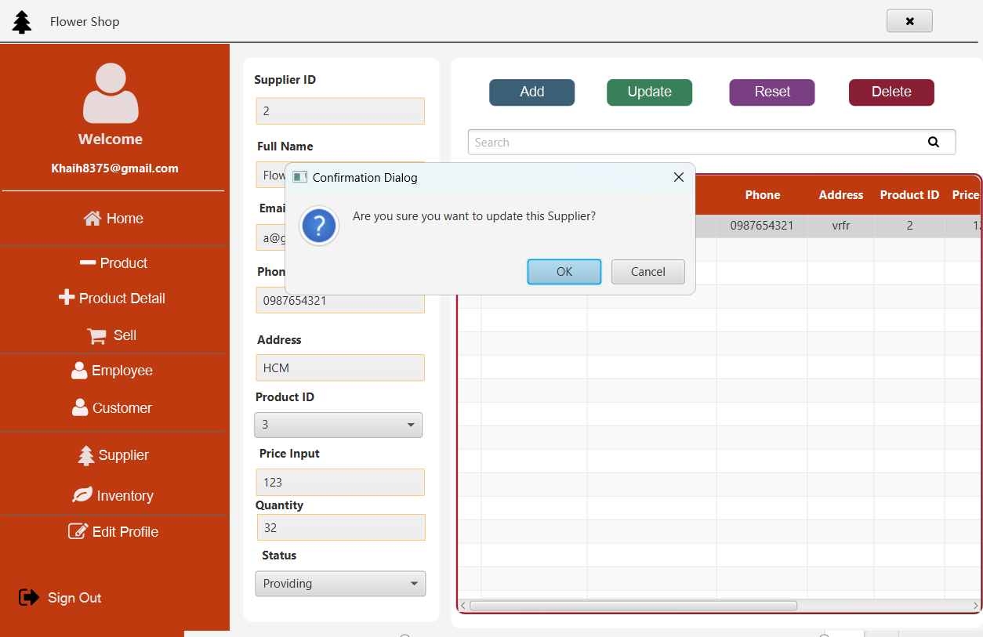

Slide 24
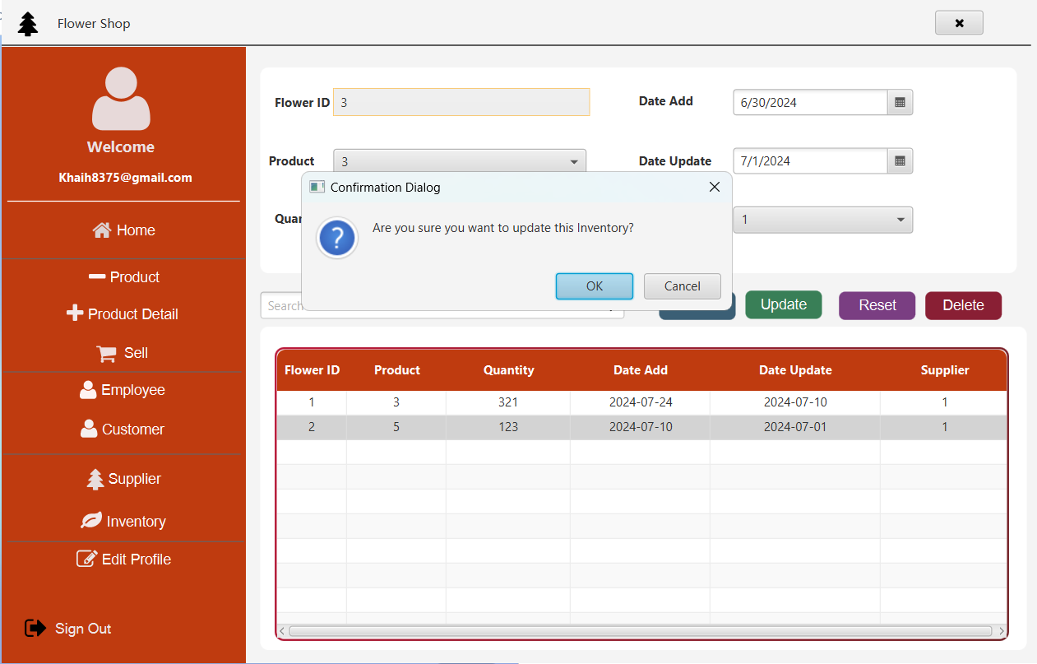

Slide 25
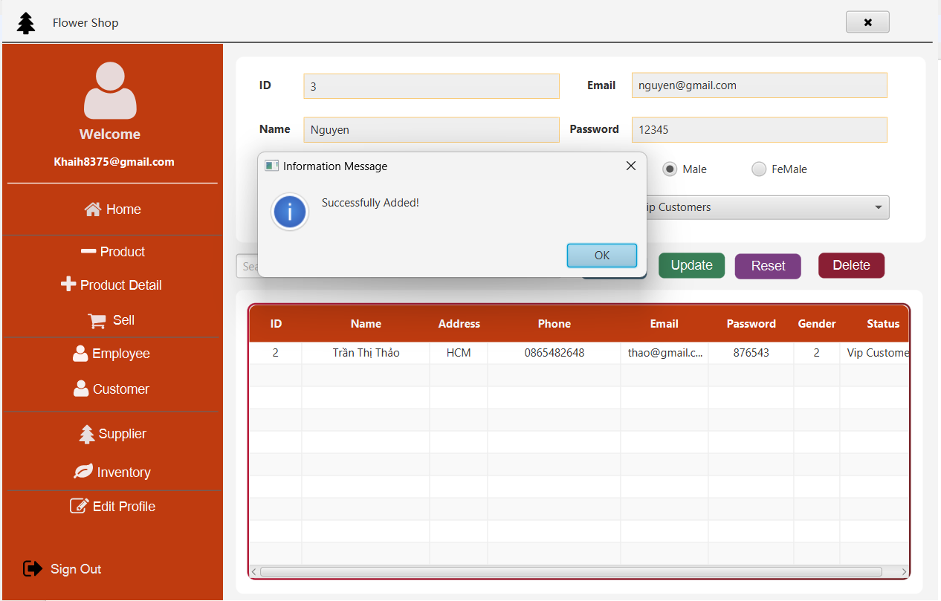

Slide 26
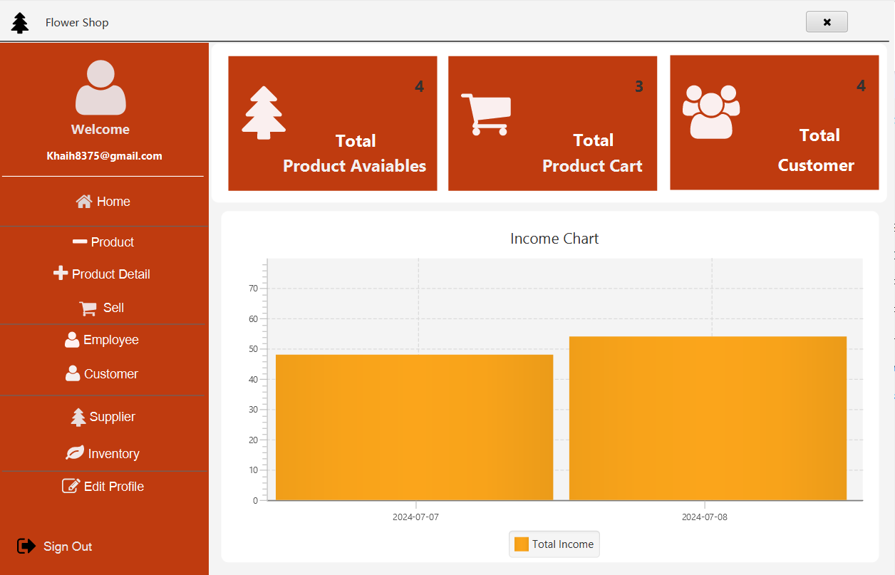

Slide 27
Group1
Thank you everyone for listening.

