Slide 1
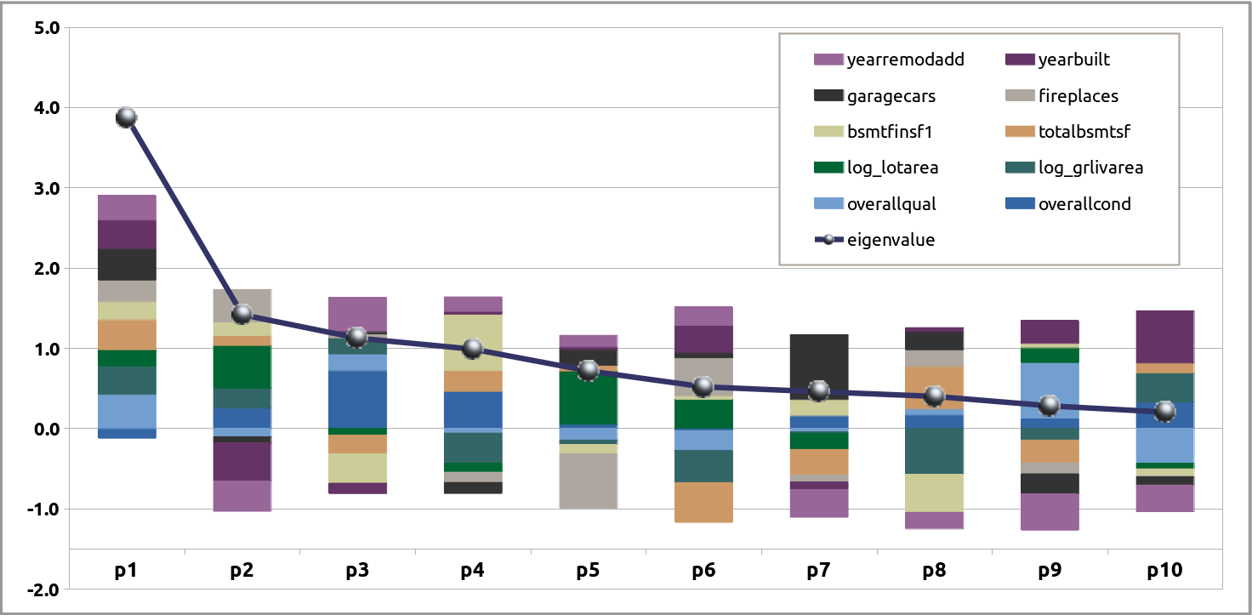
Eigenvalues
age related
{
amenities
{
basement features
{
{
size, area (sq-ft)
{
condition, quality

