Slide 1
Top 100 Topic Modeling
MSDS 7337 – NLP
Patrick McDevitt
04-Dec-2018

Slide 2

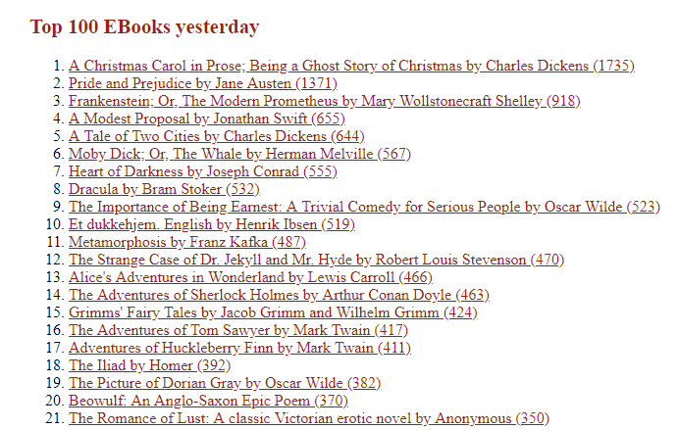
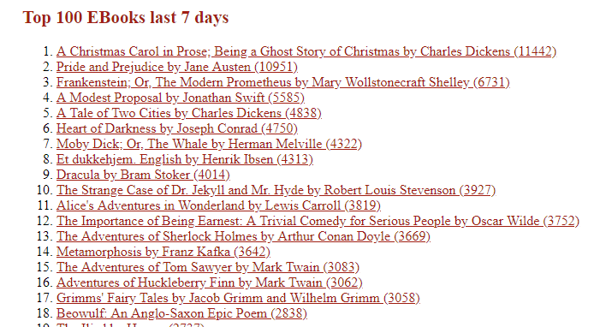
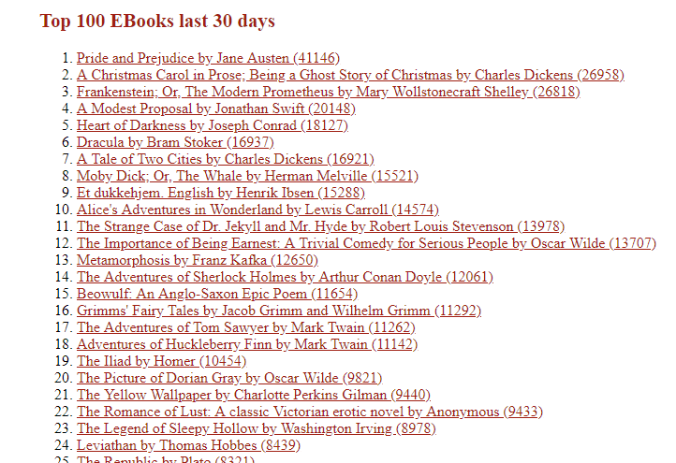
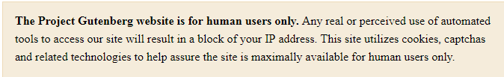
Summer reading challenge
discover a book from each topic category
Passport to 19th and early 20th century (mostly) English literature !

Slide 3
NLP – Topic Model - Pipeline
download .txt books to local hard drive
118 unique for the 3 Top 100 lists - 105 have .txt format
read into memory
nltk CorpusReader
initial normalizations
chunk each book into 2000 token segments
placeholder retains count for non-noun eliminated tokens
remove special characters, words < 3 letters
remove stopwords
each segment is independent text
Feature Matrix + LDA
counts + tfidf
num topics = 9
max_iter = 100
pyLDAvis & mglearn
discover topic identities
word cloud – all nouns
educational / visual engagement
expand contractions
POS tag (Penn)
down select to retain only NOUNs
lemmatize all the nouns (WordNet)
5,827 stop words - includes common personal names + dickens characters
7,597 segments from 105 books
passport participation
gain customer input
1st MVP ... plan to re-tune with customer input & SME review
min_df = 0.1; max_df = 0.5
ngram_range = (1,1)
develop passport with list of books that support each topic
9 topics well-suited to desired product
regex for >50x increased speed !
next : each topic & specific books
remove guttenberg license info

Slide 4
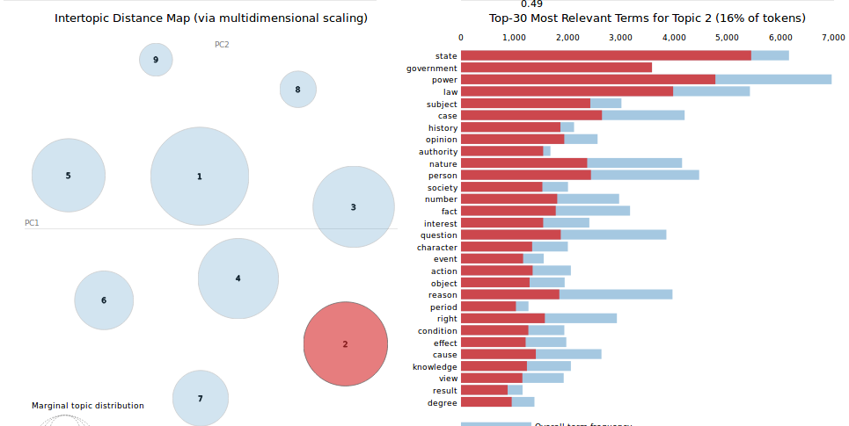
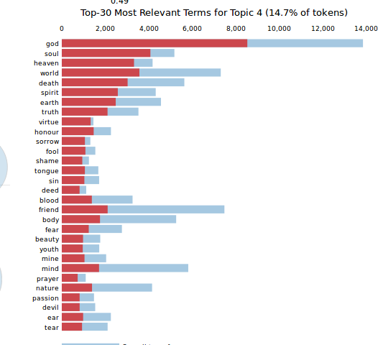
Passport to 19th c. English literature !
Landed Military
horse
Royal Battles
war
army
soldier
officer
arm
field
force
order
road
sir
horse
sword
name
London
brother
battle
lord
arm
death
Seafaring
sea
water
ship
captain
foot
tree
year
land
air
wind
Civics
lord
god
land
city
child
nation
servant
battle
court
peace
Romance
room
face
girl
door
woman
friend
mother
gentleman
table
voice
Man & State
state
power
law
government
case
person
subject
nature
opinion
question
Family
father
woman
wife
child
brother
mother
year
daughter
master
family
19th c. Landed Living
night
boy
door
arm
side
round
foot
light
bed
street
God & the All-After
god
soul
world
heaven
death
spirit
earth
friend
truth
body

Slide 5

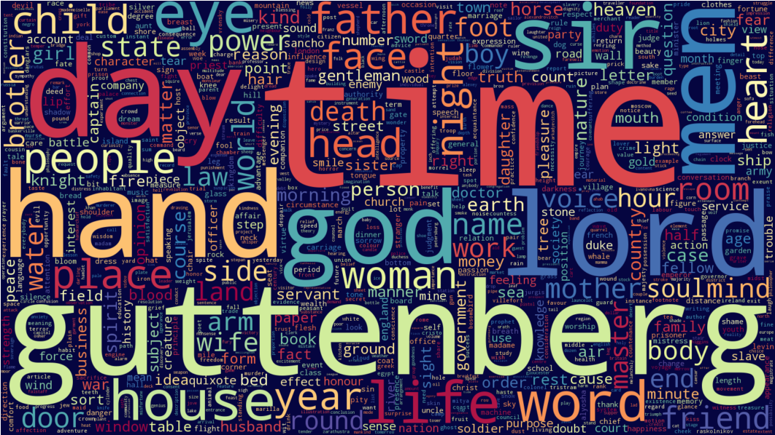
Lexicon (nouns) of Guttenberg
17,206,479 characters

Slide 6
Topic Modeling – by the numbers
105
books
5,827 stopwords
02:03:28
normalization process time
linux ubuntu 16.04 LTS
Intel Core i5 CPU @ 1.70Ghz x 4
72,408,393 characters
9 topics
7,597
text segments

