Slide 1
Error mitigation for reliable quantum computation
Heumtum
김정원(SKKU) ,김경훈(SNU),
정종흠(SNU),이정수(SNU)
정승원(SNU)

Slide 2
Contents
Three qubit Randomized Benchmarking(RB) with Dynamical Decoupling
Randomized Compiling on QFT circuit on IBM backend

Slide 3
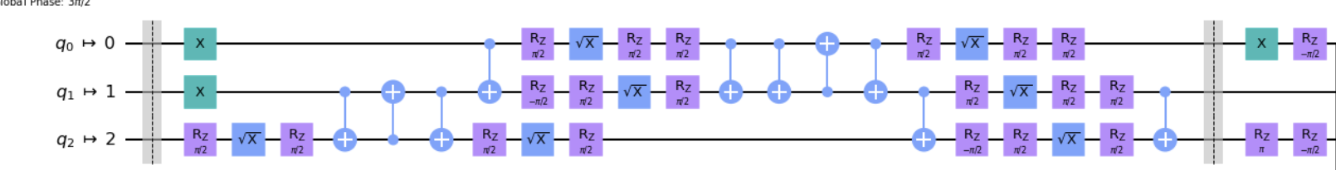
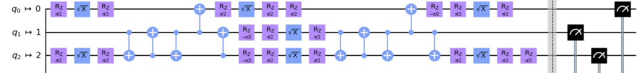
3 Qubit RB Circuit
Dynamical
Decoupling
Dynamical
Decoupling
Dynamical
Decoupling
Dynamical
Decoupling
Dynamical Decoupling Sequence
X+X
X+X+X+X
X+Y+X+Y (XY-4)
CT : X+X on target spectator qubit, X+Y+X+Y on control spectator qubit
IBM backend
Single qubit gate time | ~35ns
Two qubit gate time | 200ns~800ns

Slide 4
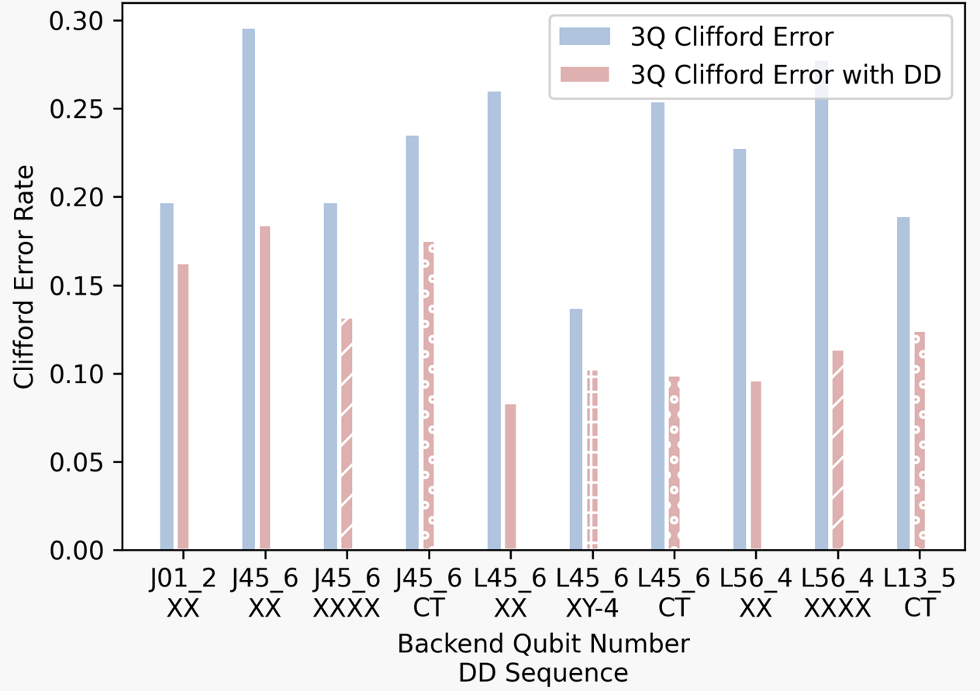
3 Qubit RB Error per Clifford
Dynamical Decoupling Sequence
X+X
X+X+X+X
X+Y+X+Y (XY-4)
CT : X+X on target spectator qubit, X+Y+X+Y on control spectator qubit

Slide 5
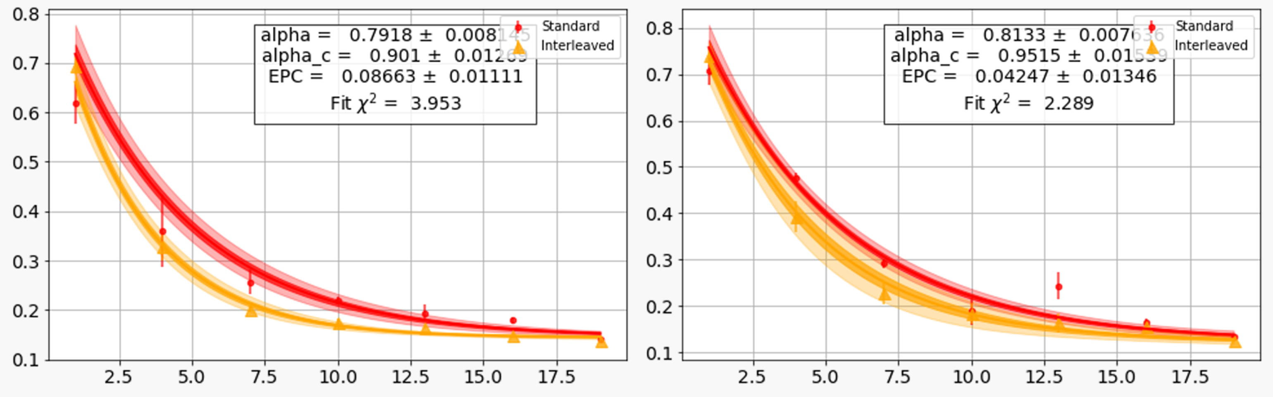
3Qubit Interleaved RB
Before Dynamical Decoupling
After Dynamical Decoupling

Slide 6
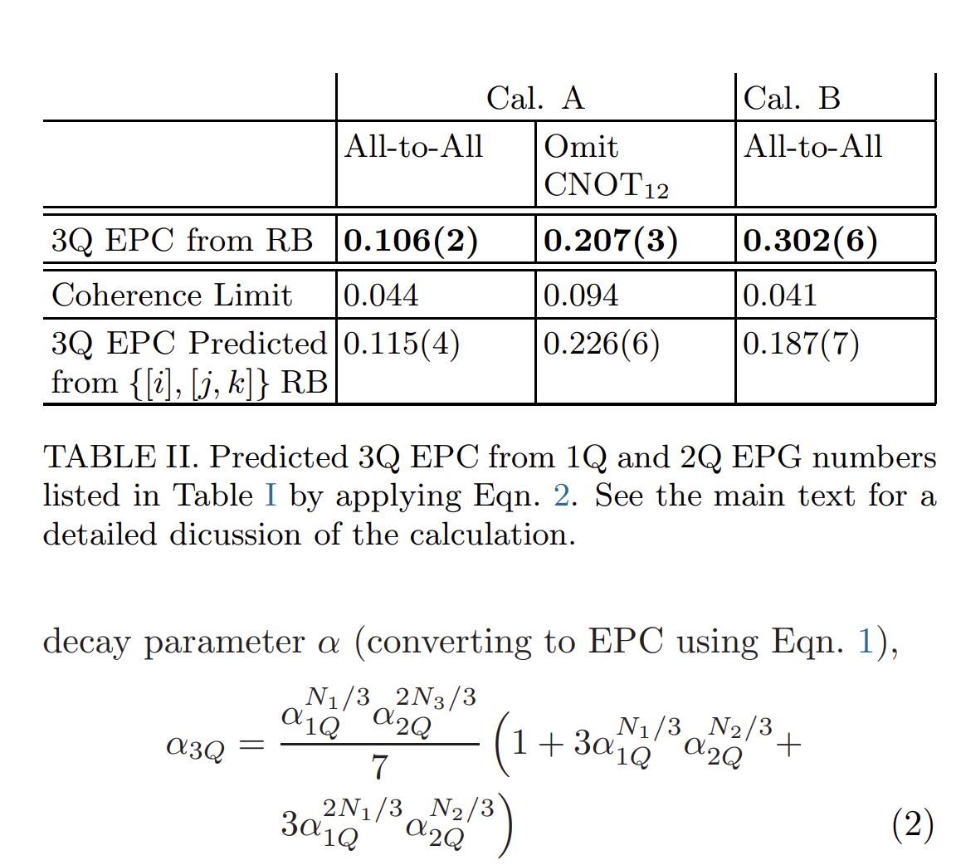
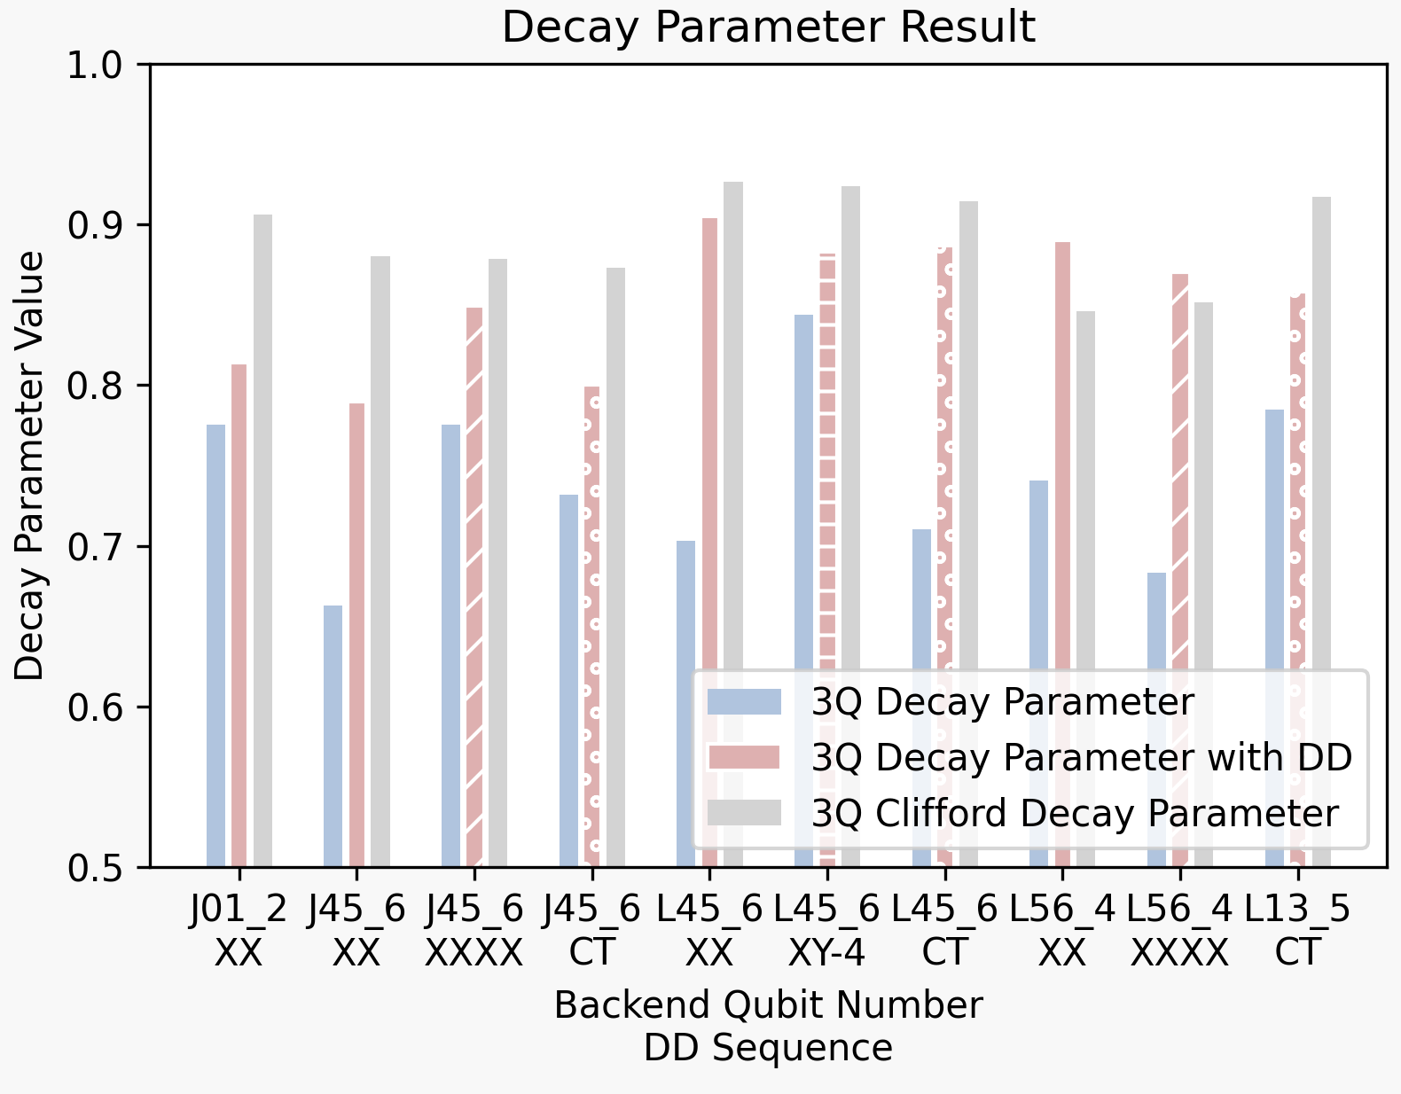
Expect 3Q RB with Simultaneous1,2Q RB
1,2Q Simultaneous RB ➔ 3Q RB
1,2Q Simultaneous RB ➔ 3Q RB
*McKay, D. C., Sheldon, S., Smolin, J. A., Chow, J. M., & Gambetta, J. M. (2019). Three-qubit randomized benchmarking. Physical review letters, 122(20), 200502.

Slide 7
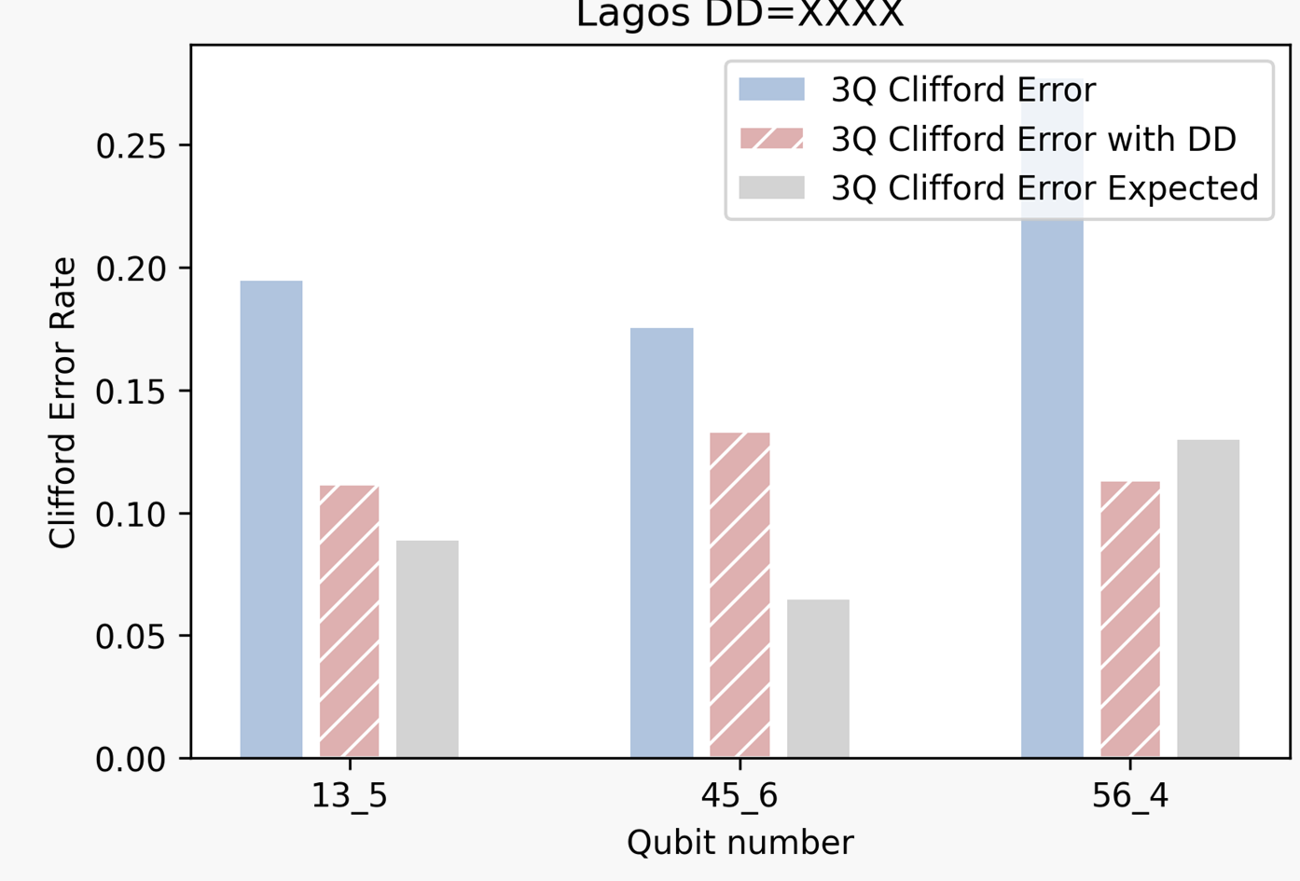
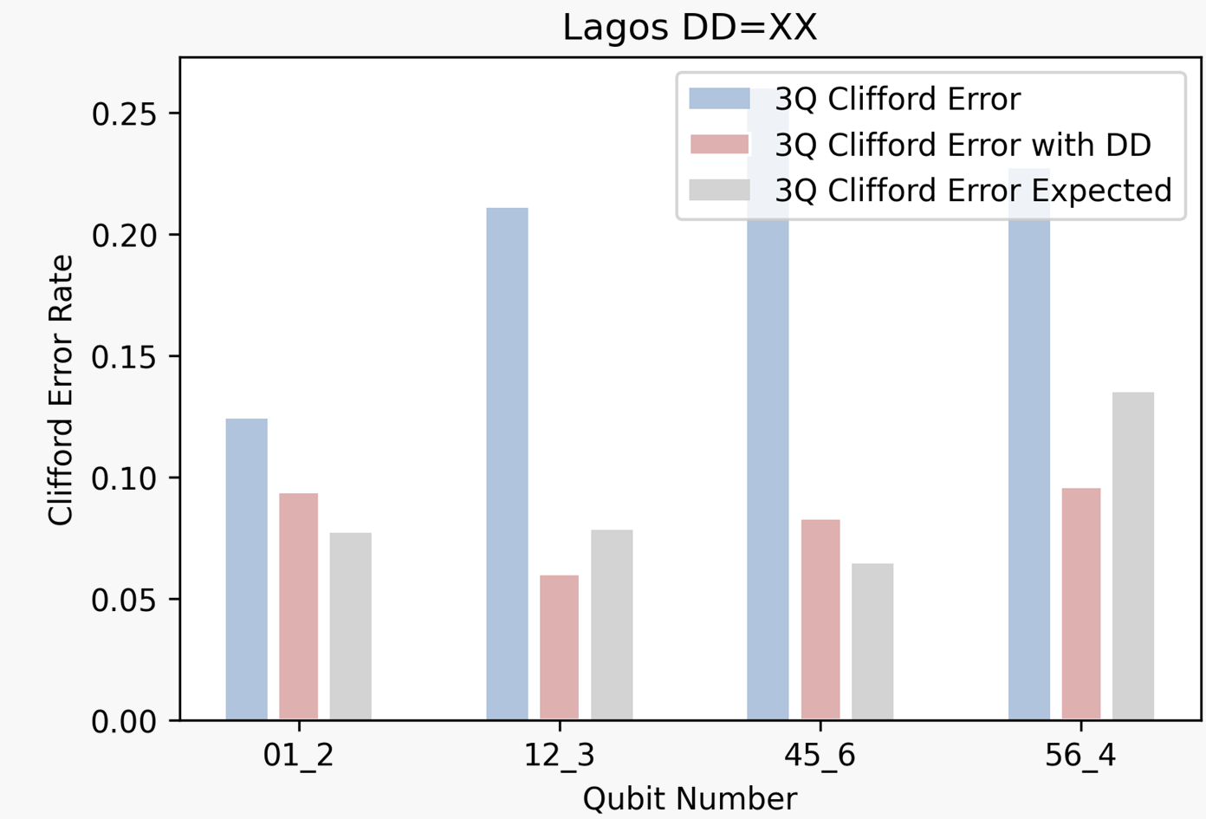
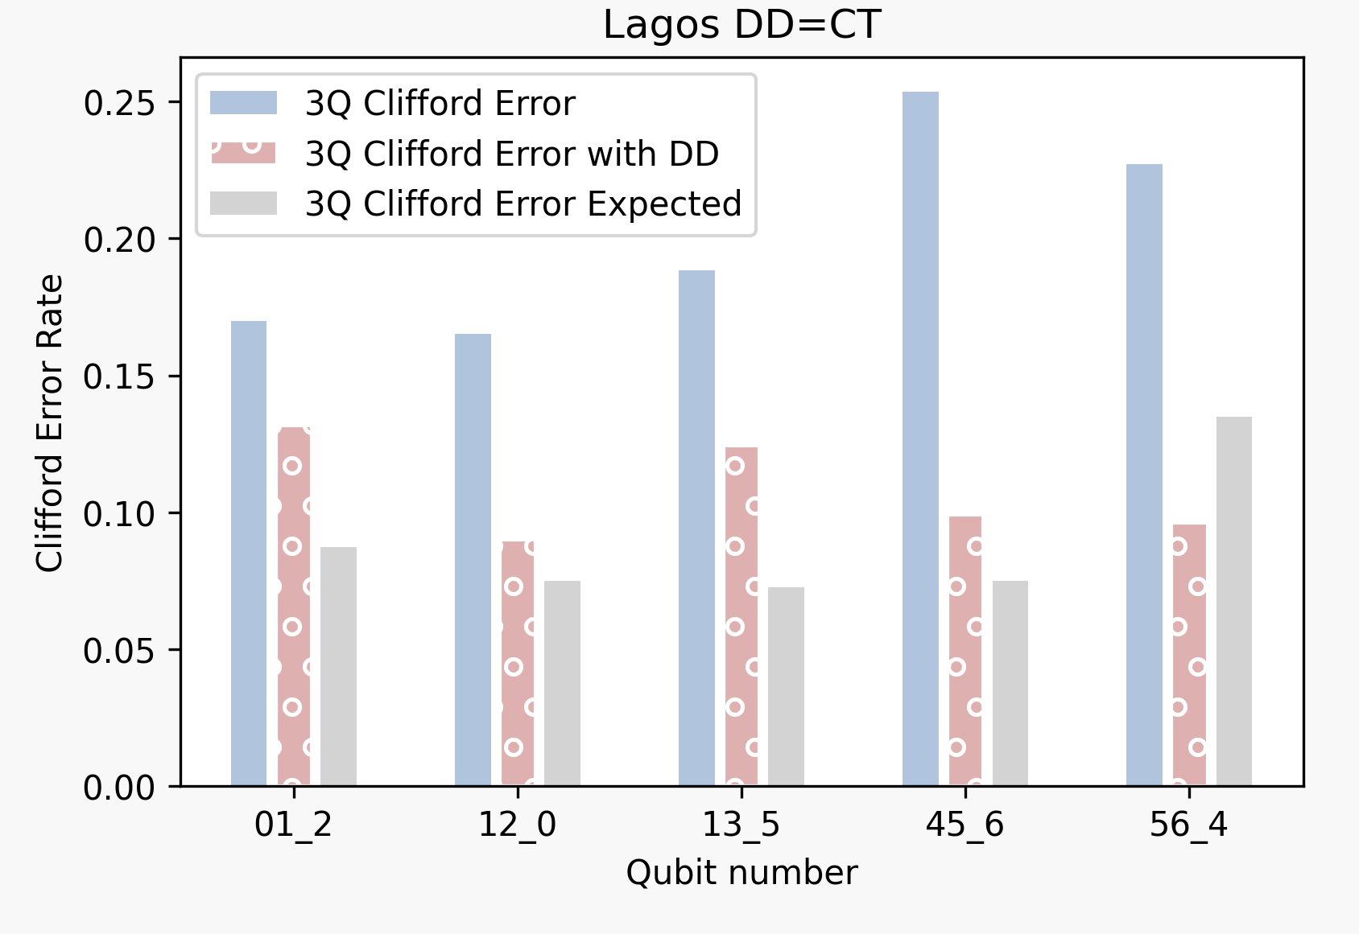
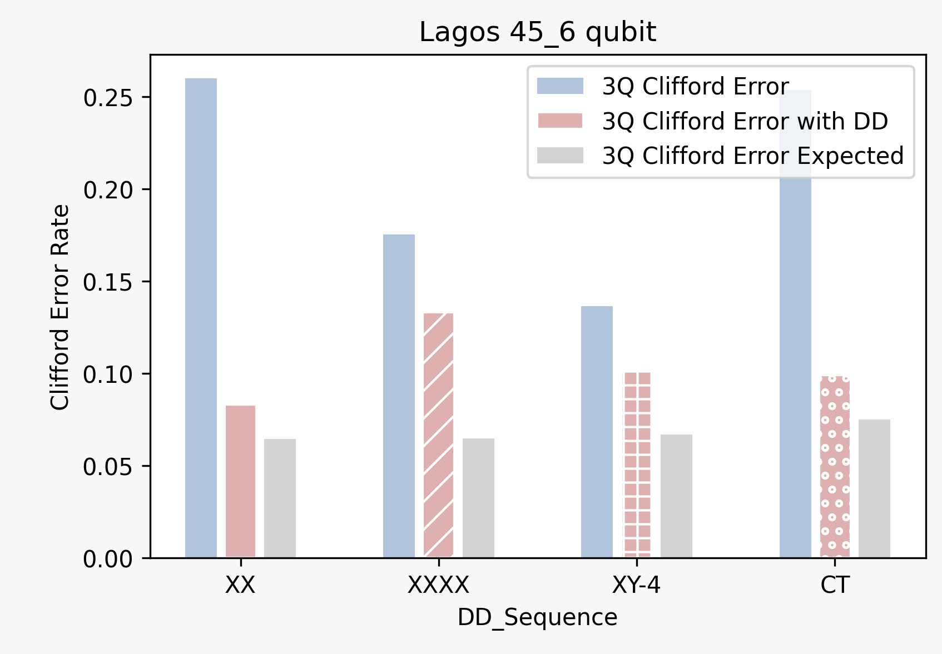
3 Qubit RB Error per Clifford with various DD

Slide 8
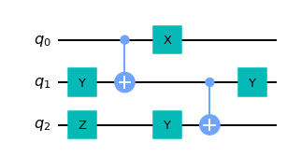
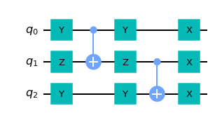
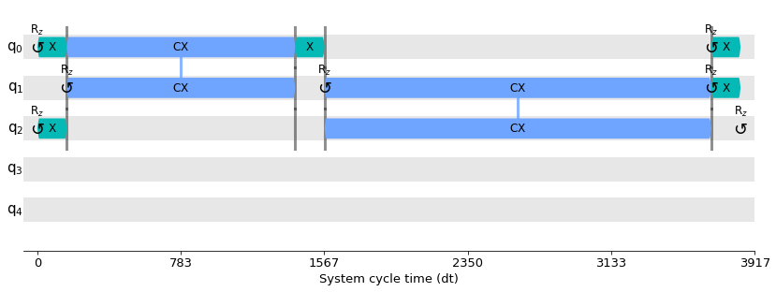
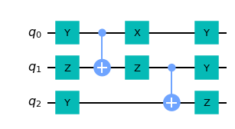
The randomized compilation: trade-off between coherent and stochastic errors
(a)
RC
Probability
<Zideal>
<Z>
(b)

Slide 9
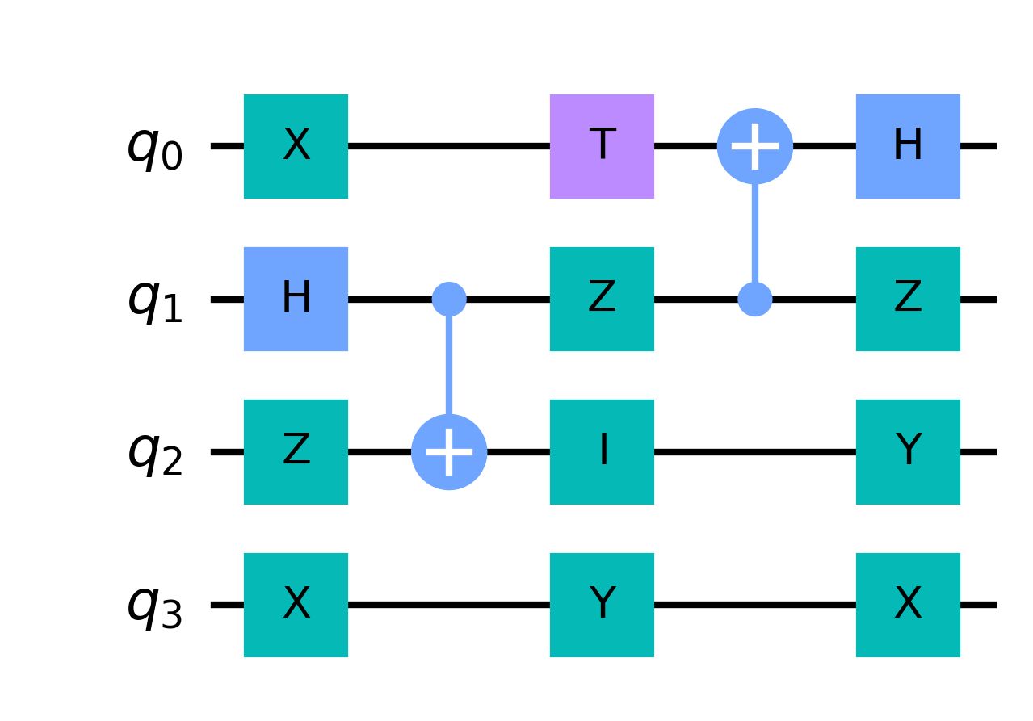
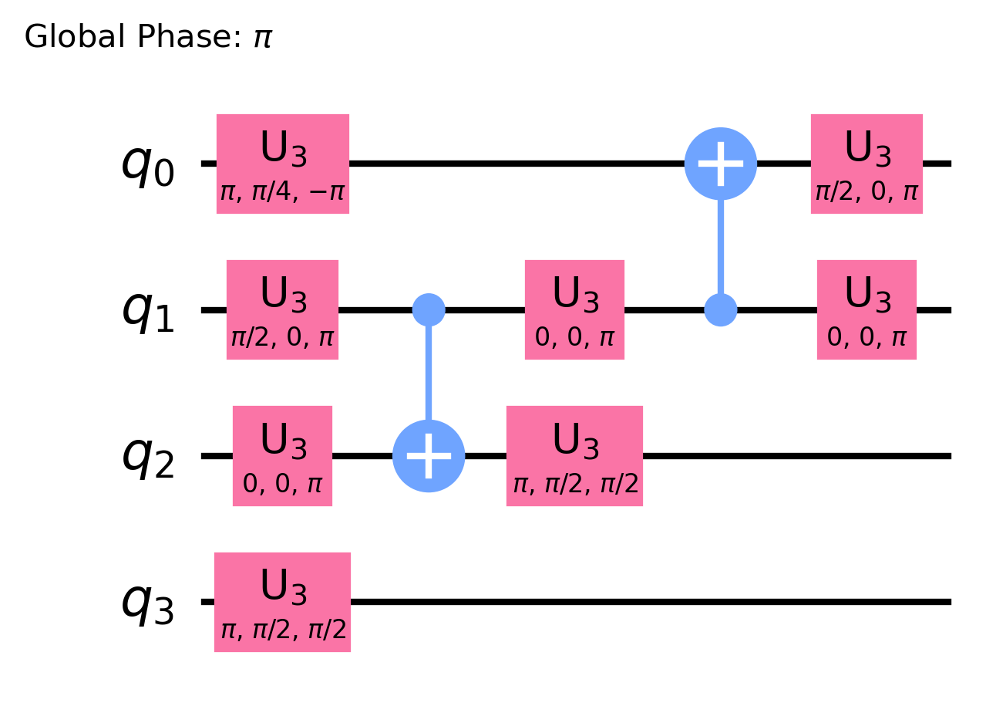
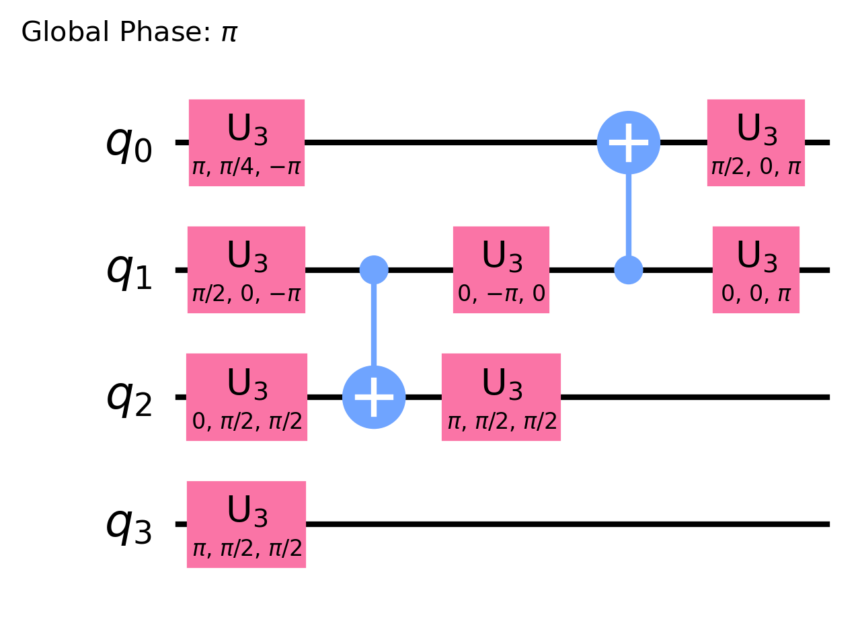
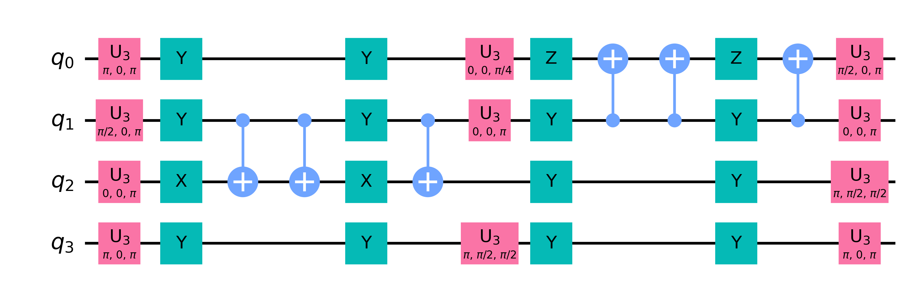
How can we implement randomized compiling on the IBM backend?
(a)
(b)
(d)
(c)

Slide 10
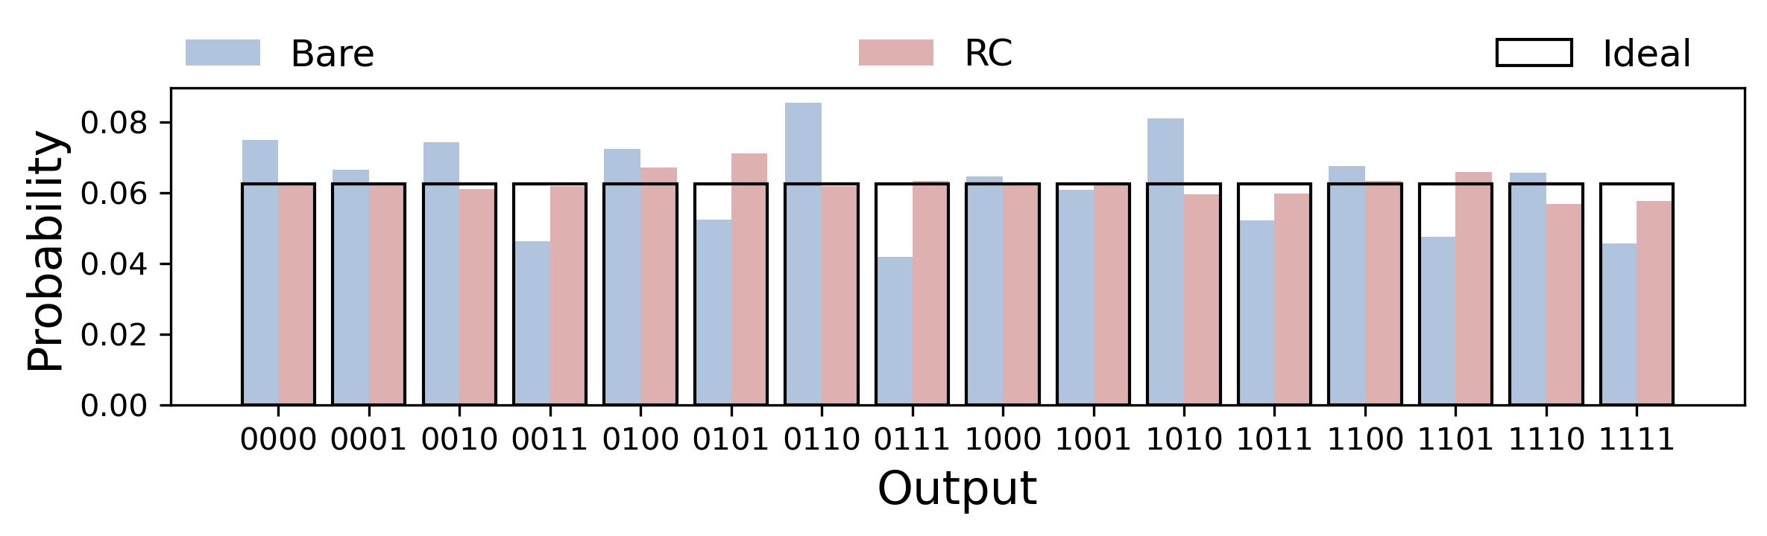
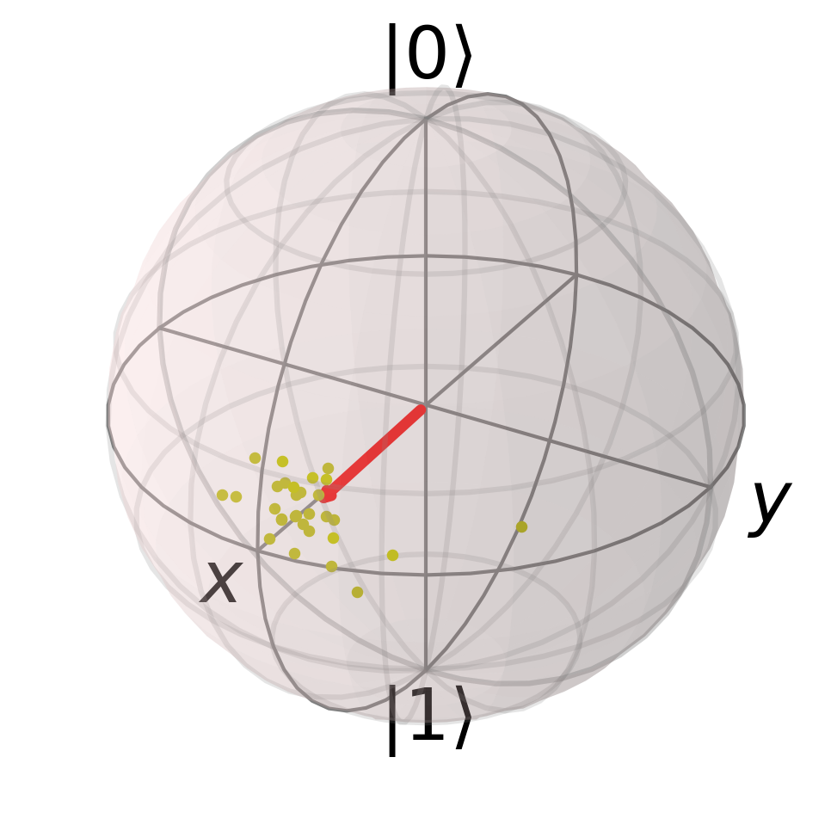
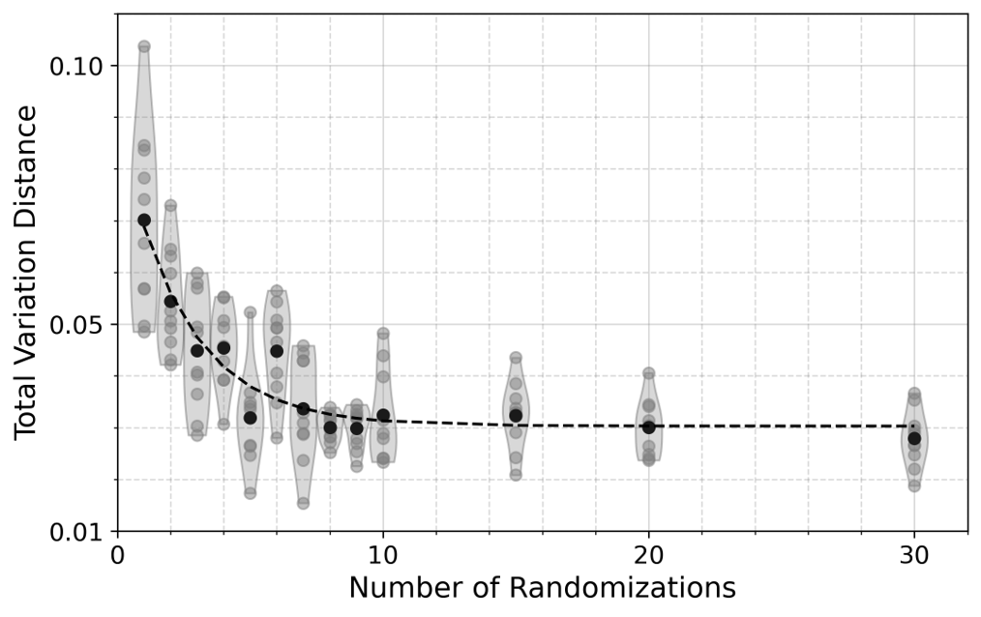

Experiment result: 4-qubit QFT with $|0000⟩$ initial state
(a)
(b)
(c)

Slide 11
Thank you!

