Slide 1
1. JPA Project

Slide 2
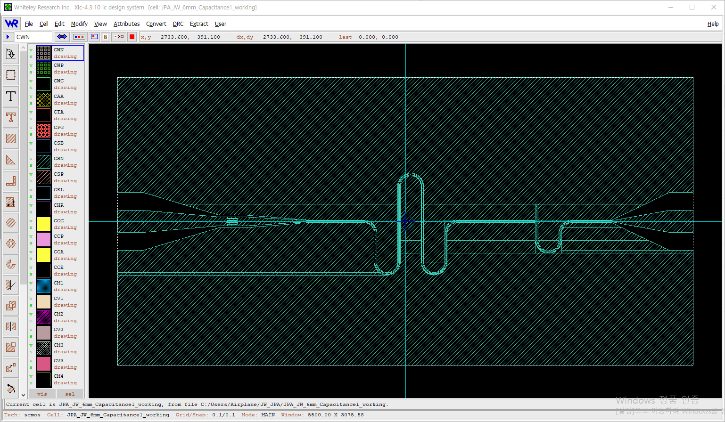
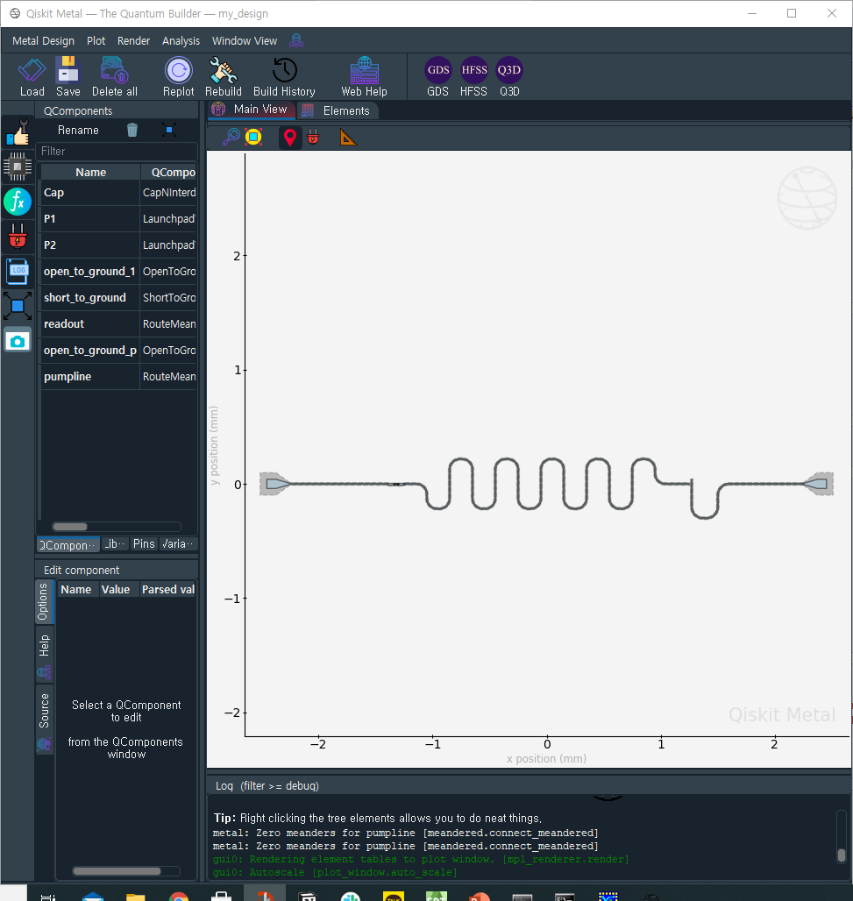
Flux Driven Josephson Parametric Amplifier : XIC, QiskitMetal design

Slide 3
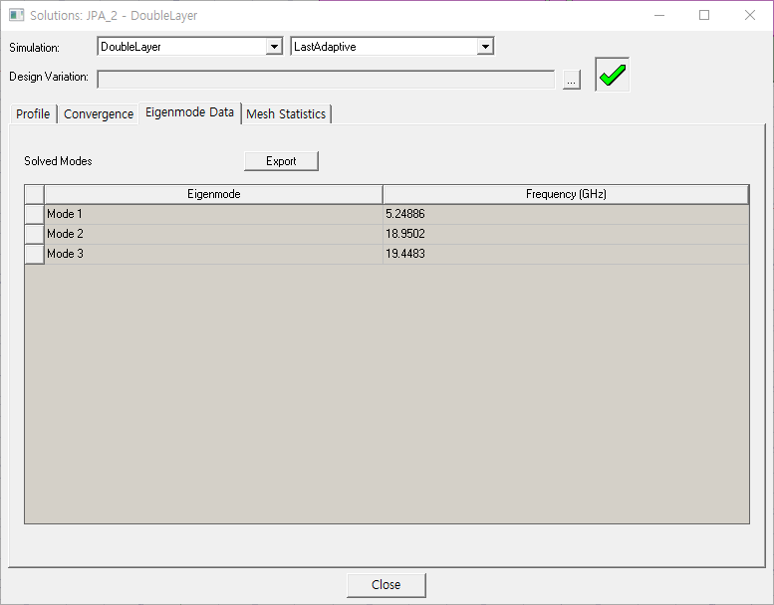

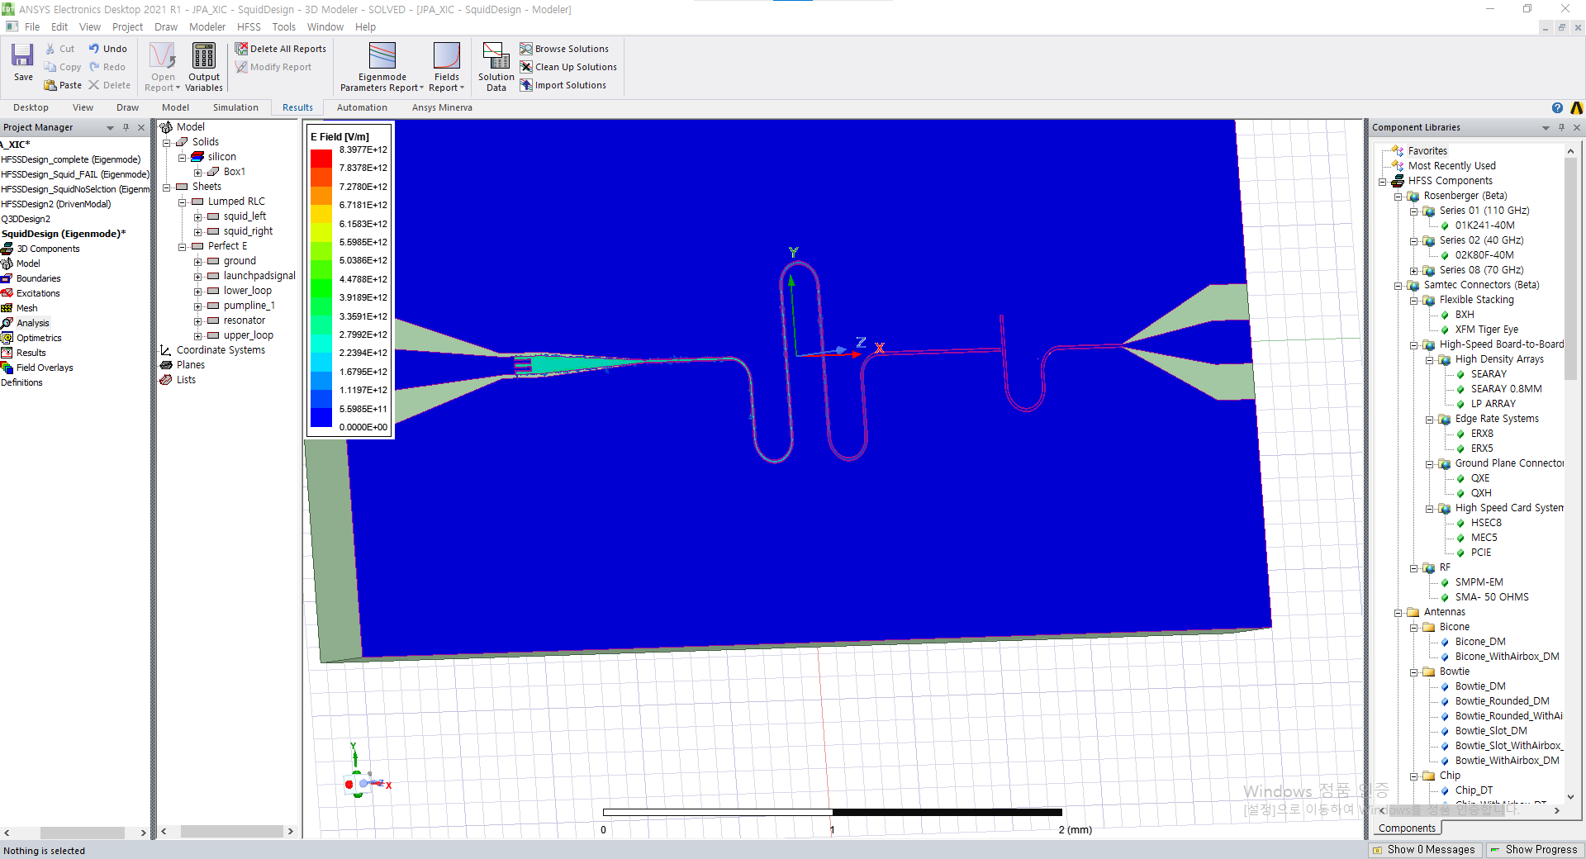
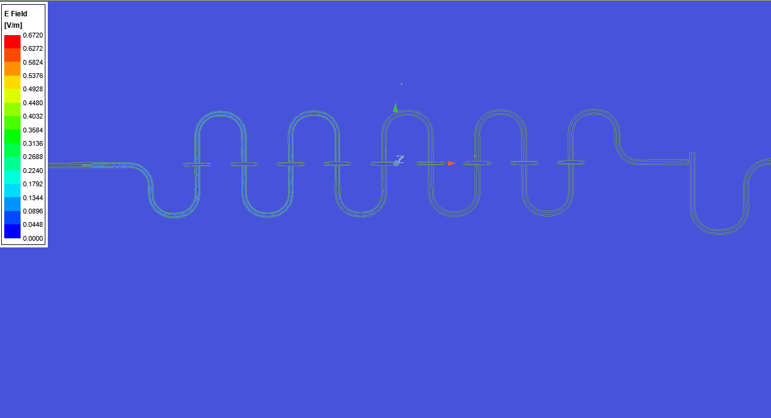
HFSS Rendering : Find Eigenmode of XIC, Metal design

Slide 4
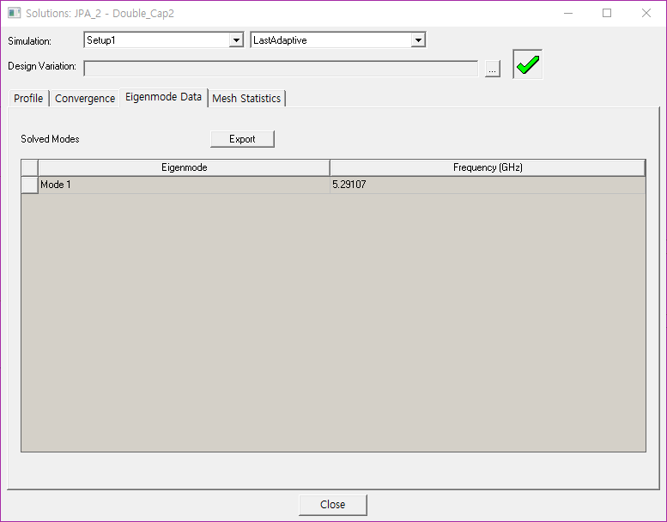

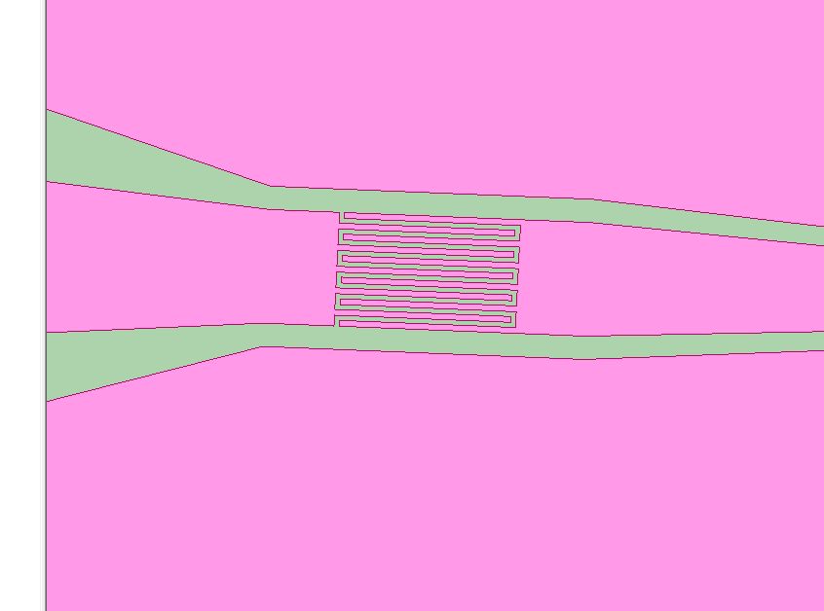
HFSS : Eigenmode for different Capacitor design
Eigenmode1=5.29894GHz
Setting : 10, 6, Si-300um, SiO2-300nm substrate, Capacitance_1
Eigenmode1=5.29107GHz
Setting : 10, 6, Si-300um, SiO2-300nm substrate, Capacitance_2

Slide 5
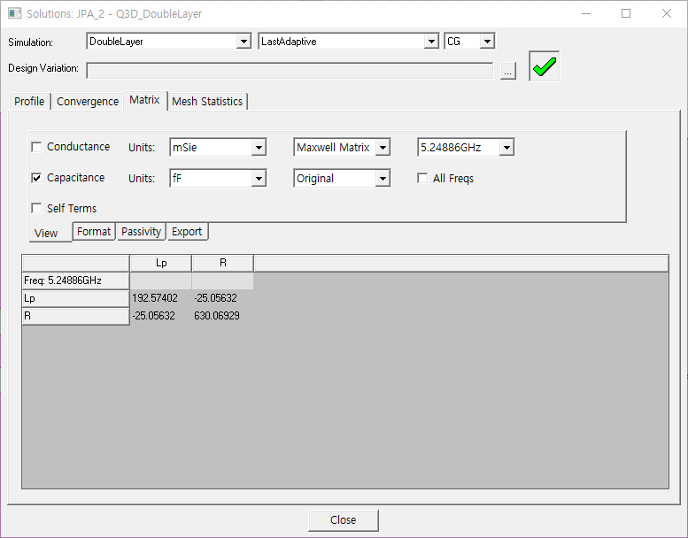

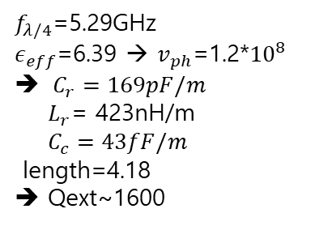
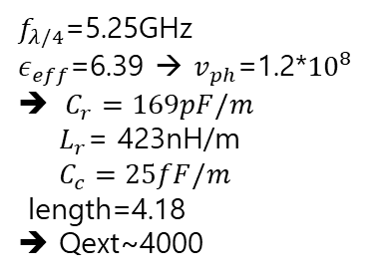
Q3D : Different Capacitance Design → Different $Q_{ext}$
$f_{λ/4}$=5.25GHz
$ε_{eff}$=6.39 → $v_{ph}$=1.2*${10}^{8}$
$C_{r}=169pF/m$
$L_{r}$= 423nH/m
$C_{c}=25fF/m$
length=4.18
➔ Qext~4000
$f_{λ/4}$=5.29GHz
$ε_{eff}$=6.39 → $v_{ph}$=1.2*${10}^{8}$
$C_{r}=169pF/m$
$L_{r}$= 423nH/m
$C_{c}=43fF/m$
length=4.18
➔ Qext~1600

Slide 6
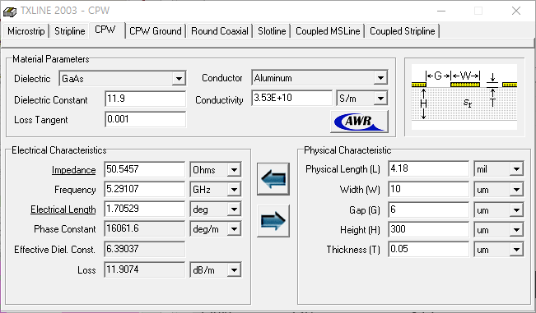
CPW Resonator Impedance Matching

Slide 7
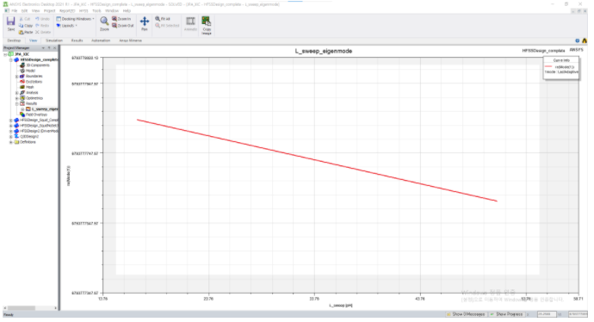
Tunability of JPA
HFSS Eigenmode inductance sweep ➔
Resonator’s frequency is tunable by changing inductance
In real device, by modulating magnetic flux in SQUID loop →
inductance(loop) change → resonator frequency can be modulated
➔ parametric Gain !!

Slide 8
2. Qiskit-Experiment Project

Slide 9
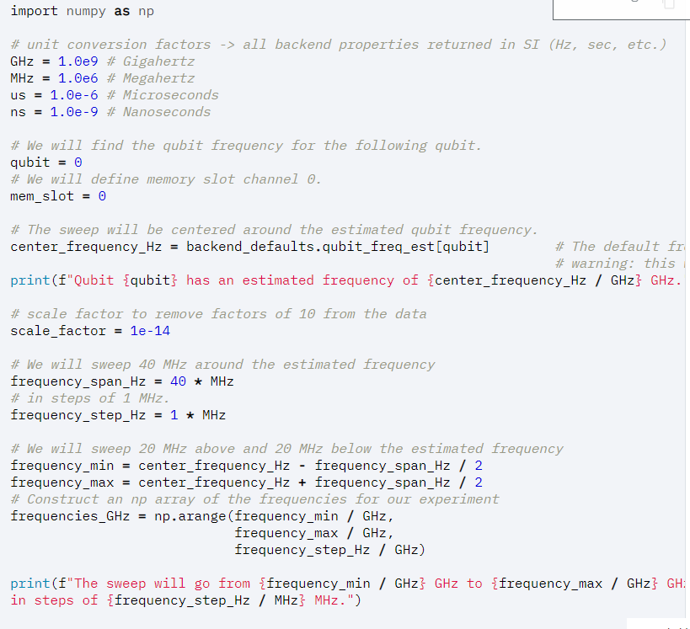
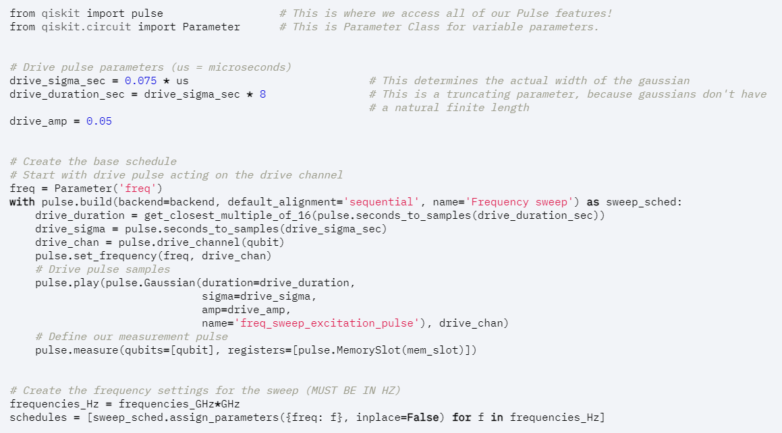









Qiskit-Terra → finding qubit frequency

Slide 10
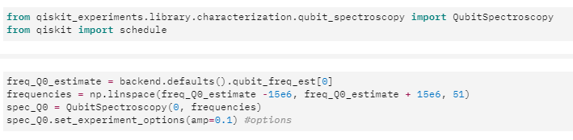
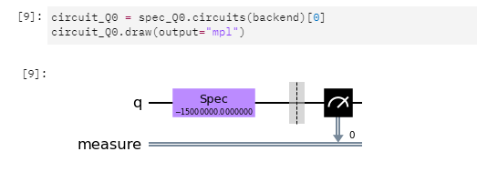
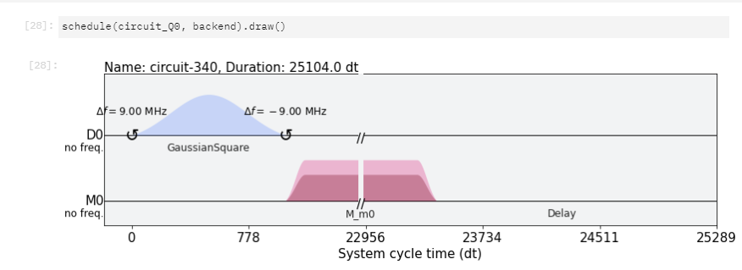


Qiskit-Experiment → finding qubit frequency : decent!
Pulses(schedules) are embedded in the spectroscopy gate
Still control the option parameters

