Slide 1
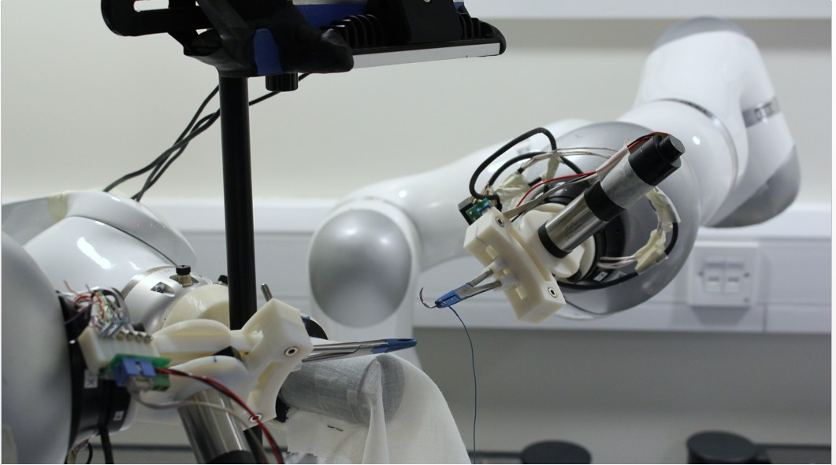
Vision Guided Sewing
Programmed by demonstration
Mandrel
Curved needle
Motorized needle driver

