Slide 1
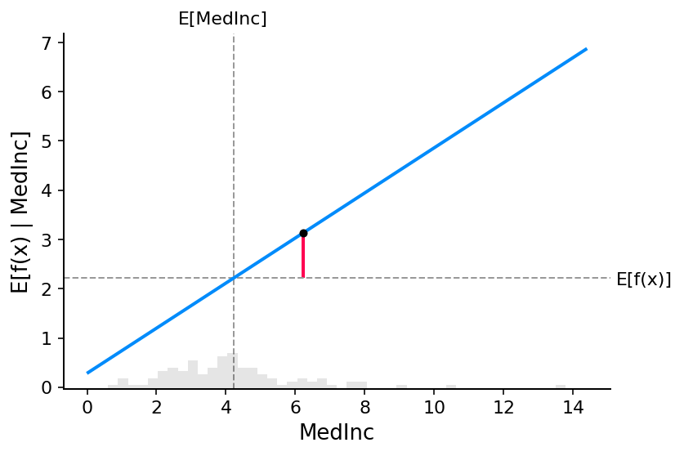
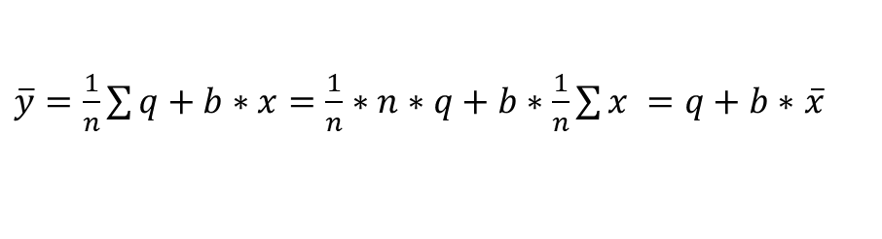



$$y= LogOR=q+b∗x$$
$$contr_{x}=b∗\left(x −\overline{x}\right)$$
$$modello2$$
$LogOR_{2}=q_{2}+b_{2}∗y=q_{2}+b_{2}∗\overline{y}+contr_{y}$
$$contr_{y}=b_{2}∗\left(y −\overline{y}\right)=b_{2}\left(q+b∗x−\left(q+b∗\overline{x}\right)\right)=b_{2}∗b∗(x−\overline{x})$$
$\overline{y}=\frac{1}{n}\sum{q+b∗x=\frac{1}{n}∗n∗q+b∗\frac{1}{n}\sum{x =q+b∗}}$ $\overline{x}$

