Slide 1


OrangeLabs RCS-e stack
Roadmap 2011
Edition 6.0
Date: 15/06/2011
Author: Orange Labs, ASC Devices

Slide 2
History…
2007 / First RCS stack for J2ME platform.
2008-2009 / RCS 1.0 stack:
  GSMA IOT: Helsinki (2008) / First participation.
  GSMA IOT: Paris (2009).
  GSMA IOT: Munich (2009).
Jan. 2010 / First RCS stack for Android platform.
2010 / RCS 2.0 stack:
  GSMA IOT: Paris (2010).
  GSMA IOT: Beijing (2010).
  GSMA IOT: Madrid (2010).
Jan. 2011 / RCS 2.0 stack:
  GSMA IOT: Helsinki (2011).
  OrangeLabs stack is taken as Reference Implementation by GSMA.
Feb. 2011 / Integrate the same SIP stack as Google Android 2.3.
March 2011 / RCS-e stack implementation based on 2.0 stack started.
April 2011 / First RCS-e 1.1 release available.
Mai 2011 : RCS-e stack published to open source community.

Slide 3
RCS-e features list
(not exhaustive)
Note:
See in green color, features which has been already implemented and tested.
See in orange color, features which has been already implemented but not yet tested.
See in default color, features which are not yet implemented.

Slide 4
Capability discovery
Capability discovery via SIP OPTIONS.
Capability discovery via Anonymous fetch.
Periodic polling.
First time discovery.
Address book monitoring.
Integration into native address book.
Supported capabilities: CS video, IM, FT, Image share, Video share, Presence discovery, Social presence, RCS extensions.
Update capabilities in case of error, end of session.
Adapt capabilities thanks to network coverage.

Slide 5
Chat 1/2
Chat 1-1.
Chat group.
File transfer.
Chat and file transfer history.
Multi-session management.
Is-composing.
List of participants in the session.
Add 1 participant.
Add N participants.
Conference event subscription.
Support of plain text UTF-8 format.
Support of message/CPIM format.
IMDN and message delivery report (“delivered”, “displayed”).

Slide 6
Chat 2/2
Block/unblock contacts (black list).
Spam folder for message received from blocked contacts.
Store & Forward procedure management.
Use an alias to initiate a chat session.
Close a chat session after an inactivity timeout.

Slide 7
Richcall
Image sharing.
Live video & pre-recorded video sharing.
Capability exchange during call.
Call monitoring.
H263 file parser.
H263+ software codec (from Android opencore package).
H264 file parser. -> Postponed because pre-recorded H.264 file not used with QCIF format in Android apps
H.264 packetizer.
H264 software codec (from Android opencore package).
RTCP event management.
Visio share from 2 individual video share sessions.
Stop sharing if call hold or if a multiparty call -> Should be done in native dialer

Slide 8
Social presence
This package is optional in RCS-e.
Same features as RCS 2.0.

Slide 9
Misc.1/2
Address book integration via ContactContract API.
Event log history (one content provider which aggregates Call/SMS/MMS/Chat & FT per contact).
RCS account based on SyncAdapter API.
Presence is now an optional package which may be activated by configuration.
RTP stack is now part of the media player to avoid AIDL exchange between UI and stack.
New SIP stack (NIST SIP stack deployed under Android 2.3).
Backup and restore last RCS info if user account has changed.
OTA provisioning via WAP PUSH SMS & HTTP/XML download.
Registration management in case of failure.
Session refresh management.

Slide 10
Misc. 2/2
Support of GIBA & HTTP Digest for IMS attachment.
Support several network access: mobile or Wi-fi.
RCS API for multi-applications context.
SIPS and secured media transport protocol (MSRP, RTP).
GRUU for multidevice management.
IPv6 support.
Roaming APN.

Slide 11
Roadmap

Slide 12
Roadmap for Dev
April 18: Sprint 0
  First RCS-e release.
May 02: Sprint 1
  Update capabilities in case of error, end of session.
  Adapt capabilities thanks to network coverage.
  Registration management in case of failure.
  H264 software codec (from Android opencore package).
  Visio share from 2 individual video share sessions.
May 15: Sprint 2
  IMDN and message delivery report (“delivered”, “displayed”).
  Add 1/N participants.
  Close a chat session after an inactivity timeout.
  OTA provisioning with WAP PUSH event and direct HTTP download of XML config.
May 30: Sprint 3
  RTCP event management.
  H264 packetizer.
  H264 file parser -> Postponed because pre-recorded H.264 file is not used with QCIF format in Android apps
  Store & Forward procedure management via WAP PUSH event.

Slide 13
Roadmap for Dev
June 15: Sprint 4
  Session refresh management (RFC 4028).
  Spam folder for message received from blocked contacts.
  Use an alias (i.e. display name) to initiate sessions.
  RCS API permission checking.
  Dynamic discovery of RCS extensions.
  SIP keep alive if a NAT is auto detected.
June 30: Sprint 5
  Capabilities discovery enhancement to support large address book.
  SIPS (SIP over TLS).
July 30: Sprint 6
  NAT traversal support.
  GRUU for multidevice support.
August 15: Sprint 7
  IPv6 tests.
  OTA authentication procedure (algorithm to be defined).
  Generic SIP API to open the stack for new IMS services implementation.

Slide 14
Roadmap for Support
July: First IOT tests.
From June to first commercial release: Several sprints to be planned to correct bugs and IOT results.

Slide 15
Features not yet planned
Some RCS-e features are not yet planned in the :
IMS authentication over Wi-fi.
LTE support.

Slide 16
Implementation

Slide 17
Software architecture
Applications
Address Book
Dialer
Widget
Chat view
…
RCS API (AIDL interface / Intents / Database providers)
RCS-e stack
Chat history
Contacts
Chat
Capabilitiy discovery
Social presence
Richcall
Event log
Richcall
history
RCS settings
Anonymous fetch
manager
Options
manager
IMS service
dispatcher
Conference event
manager
Content Sharing
Network access
manager
Registration
manager
User account
manager
Call monitoring
OTA provisioning
SIP stack (NIST)
SDP stack
MSRP stack
RTP stack
XCAP stack

Slide 18
RCS API evolutions
No API change between RCS 2.0 and RCS-e for Presence API and Richcall API.
New methods to monitor IMS events (connected, disconnected).
New Contacts API:
  Request and receive contact capabilities.
  Interface to manage contact info in the address book.
Chat group features are now implemented (e.g. new events).
RTP media samples are no more exchanged between UI and core stack via AIDL interface: now media samples are direclty exchanged from the UI to the network -> more efficient.
Default media players are now delivered in the RCS API. These players may be redefined in the UI part.

Slide 19
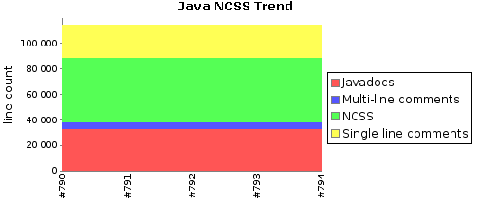
Metrics
RCS stack + NIST SIP stack

Slide 20
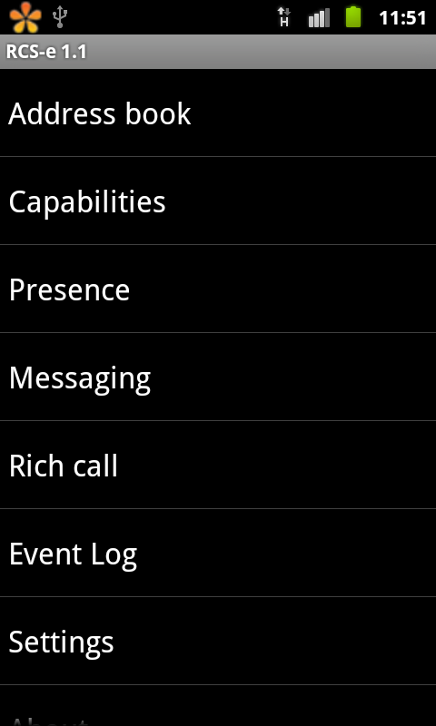
Tools
Bug tracking via Mantis.
Continueous Integration via Hudson.
RI application which offers a low level UI interface to test RCS stack and its protocols:
RI

Slide 21
RCS-e applications
Screenshots

Slide 22
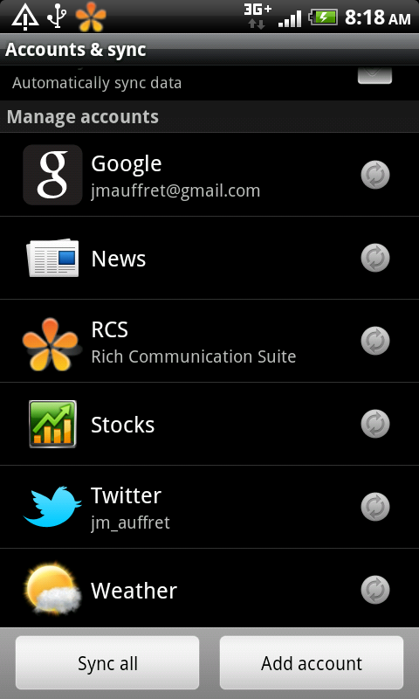
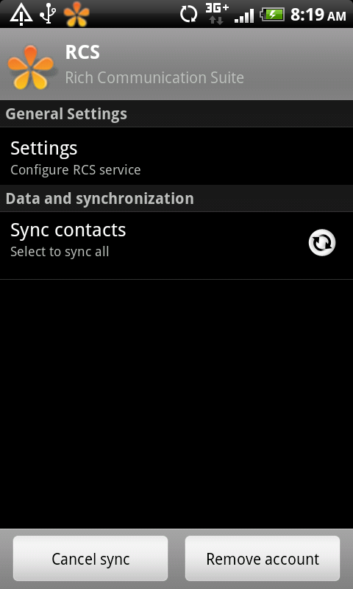
RCS account

Slide 23
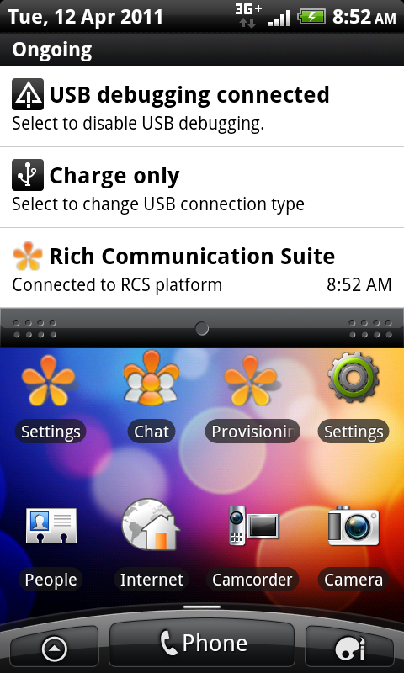
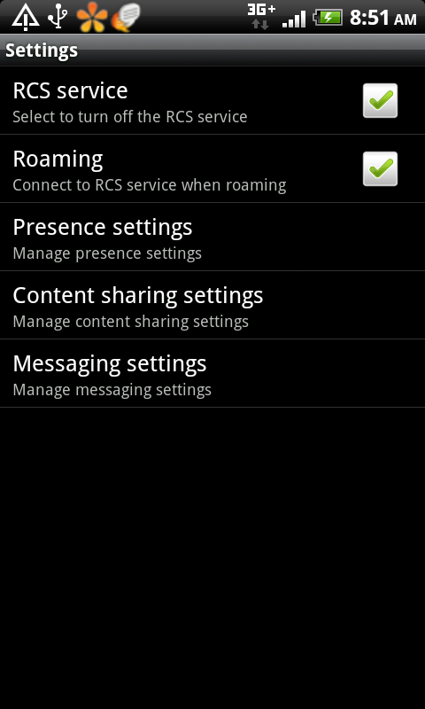
RCS settings

Slide 24
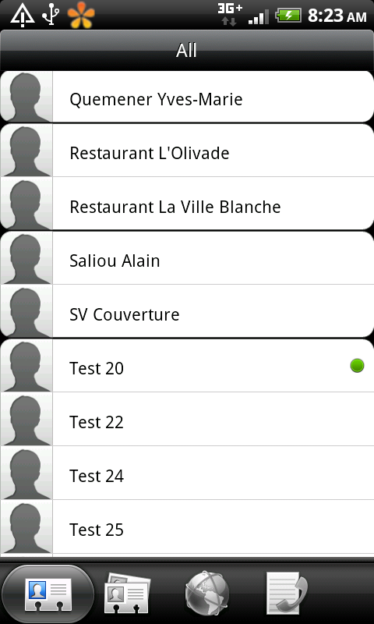
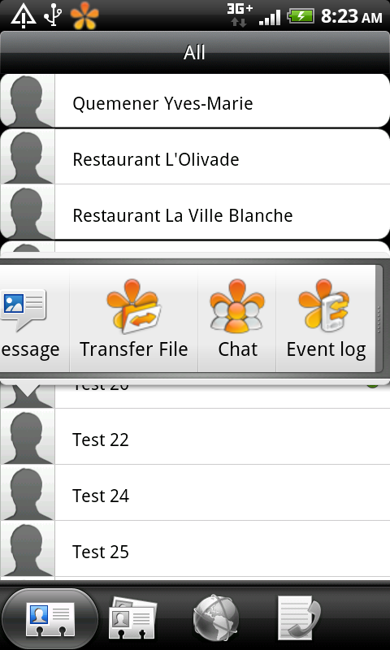
Native address book integration 1/2
Native
address
book
from HTC

Slide 25
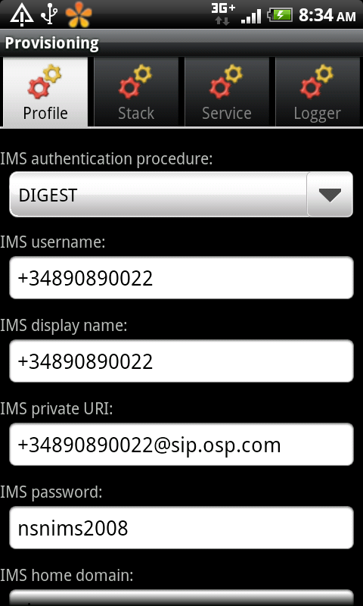
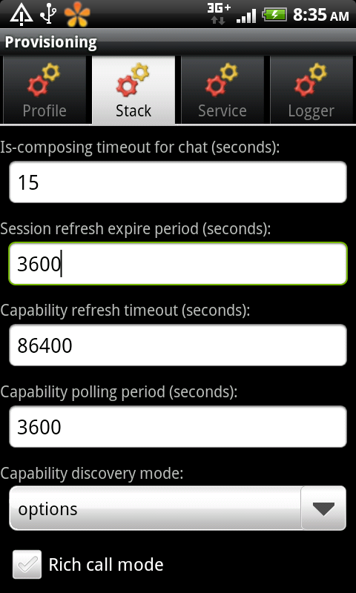
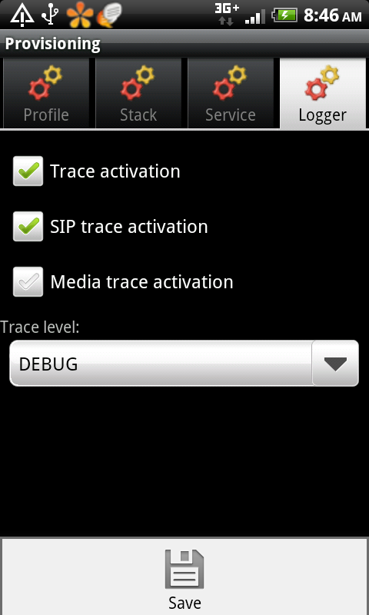
Local provisioning application
Only for debug

Slide 26
Supported standards
Note: Sometimes only a part of the referenced standard is implemented. Only the necessary features for RCS-e are implemented.

Slide 27
RCS
RCS Release 2 - Functional Description.
RCS Release 2 - Technical Realization.
RCS Release 2 - Endorsement of OMA SIP/SIMPLE IM 1.0.
RCS Release 2 - Management Objects.
RCS-e - Services and Client Specification.
IR74 - Video Share Interoper ability Specification.
IR79 - Image Share Interoperability Specification.
Instant Messaging using SIMPLE Architecture, v1.0.
Instant Messaging Requirements, v1.0.
Instant Messaging using SIMPLE, v1.0.
Presence SIMPLE Architecture, v2.0.
Resource List Server (RLS) XDM Specification, v2.0.

Slide 28
3GPP
TS 24.229 - IP multimedia call control protocol based on Session Initiation Protocol (SIP) and Session Description Protocol (SDP), Stage 3.
TS 24.279 - Combining Circuit Switched (CS) and IP Multimedia Subsystem (IMS) services, Stage 3.

Slide 29
RFC
RFC 1321 - The MD5 Message-Digest Algorithm.
RFC 2327 - SDP: Session Description Protocol.
RFC 2617 - HTTP Authentication: Basic and Digest Access Authentication.
RFC 3261 - SIP: Session Initiation Protocol.
RFC 3264 - An Offer/Answer Model with the Session Description Protocol (SDP).
RFC 3265 - Session Initiation Protocol (SIP) Specific Event Notification.
RFC 3325 - Private Extensions to the Session Initiation Protocol (SIP) for Asserted Identity within Trusted Networks.
RFC 3339 - Date and Time on the Internet.
RFC 3455 - Private Header (P-Header) Extensions to the Session Initiation Protocol (SIP) for the 3rd-Generation Partnership Project (3GPP).

Slide 30
RFC
RFC 3515 - The Session Initiation Protocol (SIP) Refer Method.
RFC 3550 - RTP: A Transport Protocol for Real-Time Applications.
RFC 3608 - Session Initiation Protocol (SIP) Extension Header Field for Service Route Discovery During Registration.
RFC 3840 - Indicating User Agent Capabilities in the Session Initiation Protocol (SIP).
RFC 3856 - A Presence Event Package for the Session Initiation Protocol (SIP).
RFC 3857 - A Watcher Information Event Template-Package for the Session Initiation Protocol (SIP).
RFC 3858 - An Extensible Markup Language (XML) Based Format for Watcher Information.
RFC 3862 - Common Presence and Instant Messaging (CPIM): Message Format.

Slide 31
RFC
RFC 3863 - Presence Information Data Format (PIDF).
RFC 3903 - Session Initiation Protocol (SIP) Extension for Event State Publication.
RFC 3966 - The tel URI for Telephone Numbers.
RFC 3994 - Indication of Message Composition for Instant Messaging.
RFC 4145 - TCP-Based Media Transport in the Session Description Protocol (SDP).
RFC 4566 - SDP: Session Description Protocol.
RFC 4662 - A Session Initiation Protocol (SIP) Event Notification Extension for Resource Lists.
RFC 4480 - RPID: Rich Presence Extensions to the Presence Information Data Format (PIDF).

Slide 32
RFC
RFC 4481 - Timed Presence Extensions to the Presence Information Data Format (PIDF) to Indicate Status Information for Past and Future Time Intervals.
RFC 4975 - The Message Session Relay Protocol (MSRP).
RFC 5262 - Presence Information Data Format (PIDF) Extension for Partial Presence.
RFC 5438 - Instant Message Disposition Notification.
RFC 5547 - A Session Description Protocol (SDP) Offer/Answer Mechanism to Enable File Transfer.
RFC 5839 - An Extension to Session Initiation Protocol (SIP) Events for Conditional Event Notification.

Slide 33
RFC
draft-ietf-sip-uri-list-conferencing-01 - Conference Establishment Using Request-Contained Lists in the Session Initiation Protocol (SIP).
draft-ietf-sip-multiple-refer-01 - Referring to Multiple Resources in the Session Initiation Protocol (SIP).
draft-ietf-simple-imdn-04 - Instant Message Disposition Notification.
draft-ietf-mmusic-file-transfer-mech-03 - A Session Description Protocol (SDP) Offer/Answer Mechanism to Enable File Transfer.

