Slide 1

Healthcare Appointment No-Show Analysis Program
Presentation and Demo to the Board of Directors
Bidemi Adeoye
05/08/2026

Slide 2


The Problem
Missed healthcare appointments, also known as no-shows, are a persistent and costly problem for clinics and hospitals
As a result, decision-makers often know that no-shows are happening, but not why, when, or where they are most likely to occur
Notes:
“Healthcare organizations struggle with missed appointments, which impact efficiency and patient access.”
- Missed appointments (no-shows) are a major issue in healthcare
- Lead to wasted provider time and reduced efficiency
- Clinics collect data, but often don’t analyze it effectively

Slide 3


The Solution
Menu-driven Python program that accepts CSV input and perform analysis on the dataset like “Day of week”, “Time of day”, and “age group”.
The goal is not to predict behavior, but to turn existing data into actionable insights using fundamental Python programming techniques
Notes:
“The program allows users to load their own dataset and explore patterns interactively.”

Slide 4
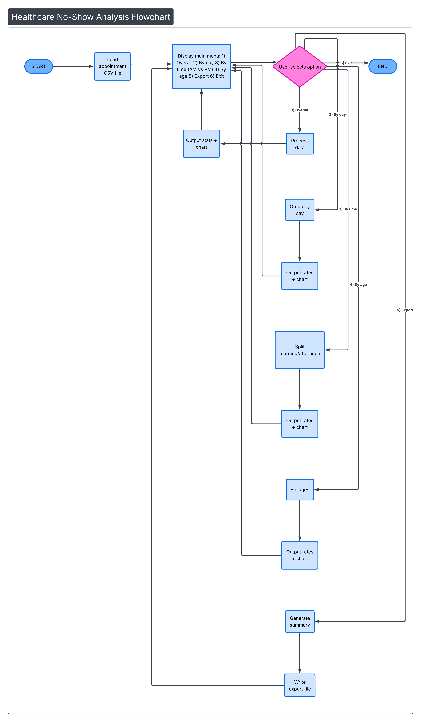
Program Flow
Notes:
“The system is straightforward — users load data, select an option, and the program generates insights.”

Slide 5
Dataset
Synthetic dataset (~500 records)
Fields:
Age
Appointment Time
Day of Week
Attendance (Yes/No)
Notes:
I used synthetic data to simulate real-world conditions while avoiding privacy concerns

Slide 6
Example Output Design Decisions
No-show rate summary
Text-based chart visualization
No external libraries used
Works on any system
Handles messy/missing data
Notes:
The program outputs both numerical results and visual summaries using text-based charts.
I intentionally avoided external libraries to ensure the program runs reliably on any machine.

Slide 7
Value
Identifies patterns in missed appointments
Helps improve scheduling decisions
Demonstrates real-world Python application
Notes:
This project shows how simple programming can support operational improvements in healthcare.

Slide 8
Live Program Demonstration
Notes:
I’ll now demonstrate how the program works.

Slide 9
Conclusion
Simple
Scalable
Practical
Notes:
In summary, this is a simple but effective tool for analyzing appointment behavior.

Slide 10
Thanks for listening
Bidemi Adeoye
oadeoye@students.kennesaw.edu
02/27/2026

