Slide 1

Healthcare Appointment No-Show Analysis Program
Pitch to the Board of Directors
Bidemi Adeoye
02/27/2026

Slide 2


The Problem
Missed healthcare appointments, also known as no-shows, are a persistent and costly problem for clinics and hospitals
As a result, decision-makers often know that no-shows are happening, but not why, when, or where they are most likely to occur
Notes:
Every missed appointment:
Wastes provider time
Reduces access for other patients
Creates inefficiencies in scheduling and staffing
Many clinics collect appointment data, but they:
- Do not analyze it effectively
- Lack simple tools to identify patterns
- Rely on manual review or intuition instead of data

Slide 3


The Solution
Python-based program that analyzes appointment data to uncover patterns in no-show behavior
The goal is not to predict behavior, but to turn existing data into actionable insights using fundamental Python programming techniques
Notes:
The program will:
- Read a CSV file containing simulated appointment records
- Provide a menu-driven interface so users can choose what to analyze
- Calculate no-show rates based on:
Day of the week
Time of day (morning vs afternoon)
Patient age group
Instead of just showing raw data, the program will:
- Summarize findings in clear statistics
- Display simple visualizations
- Allow users to export results for review

Slide 4


Why Fund This Project?
Business perspective
Reducing no-shows improves clinic efficiency
Even small improvements can save time and money
Scalability perspective
The program could be expanded to:
Include reminders
Flag high-risk appointment slots
Integrate real-world clinic data
Notes:
From a technical perspective:
The program demonstrates strong Python fundamentals:
File input/output
Functions and modular design
Conditional logic and loops
Basic data analysis and visualization
It is interactive and user-driven, not just a static report

Slide 5
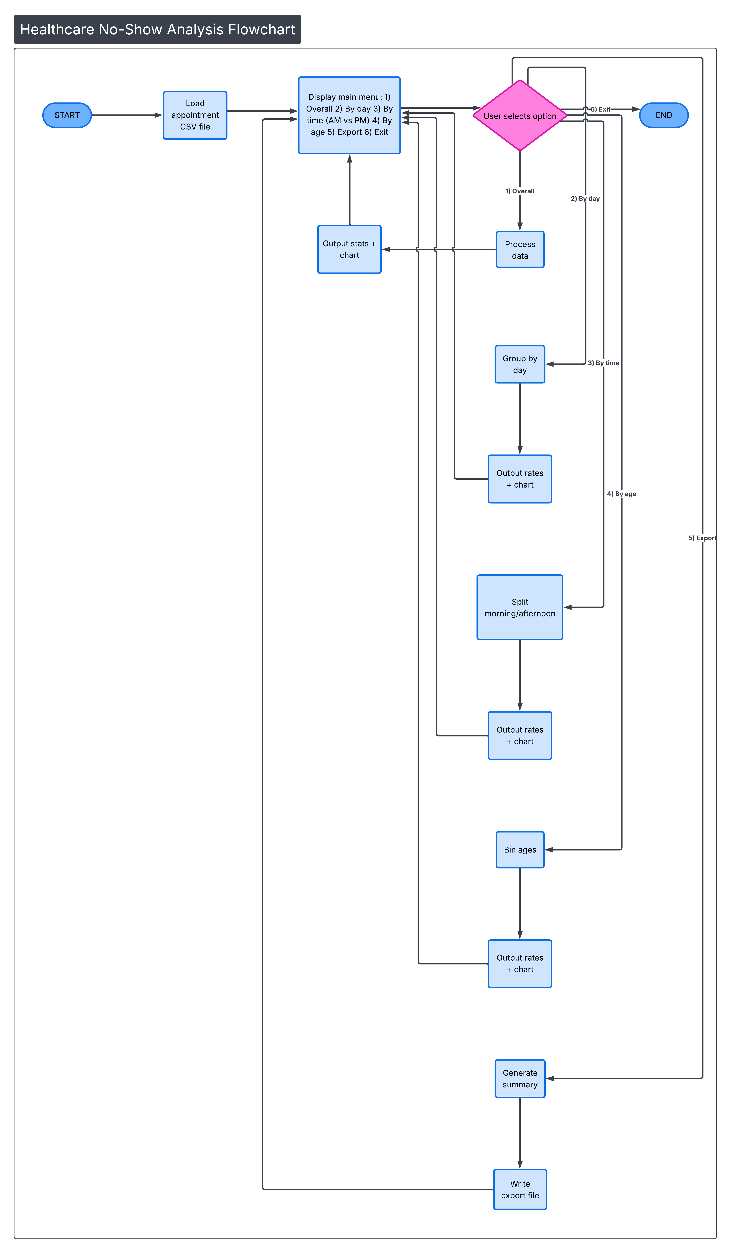
Program Blueprint
Notes:
This diagram shows the overall structure of the program.
It starts by loading appointment data from a CSV file, then presents a menu that allows the user to choose different types of analysis.
Each option is handled by a separate function, which keeps the program organized and easy to maintain.
After results are displayed or exported, the user can return to the menu or exit

Slide 6
Thanks for listening
Bidemi Adeoye
oadeoye@students.kennesaw.edu
02/27/2026

