Slide 1

Crossing Number
Bidgoli 2017-01-09

Slide 2

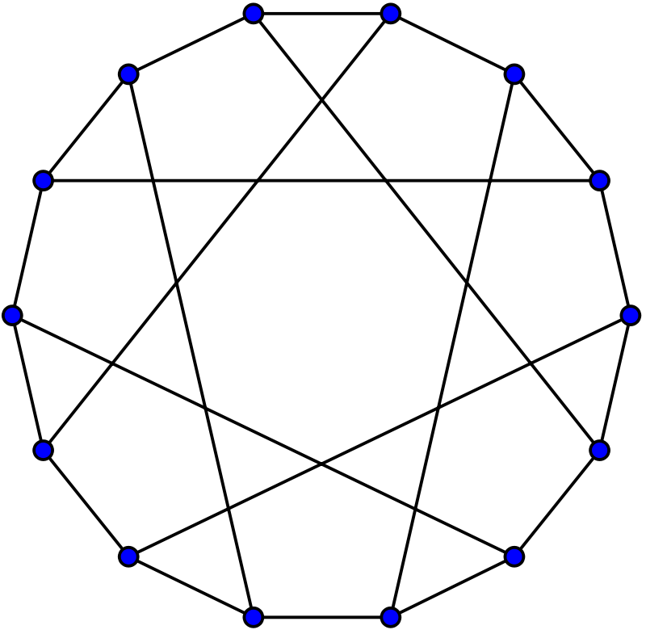
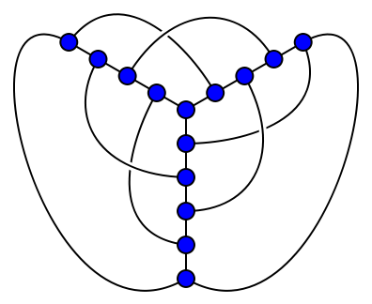
Cr(G)= Min # edge crossing G

Slide 3

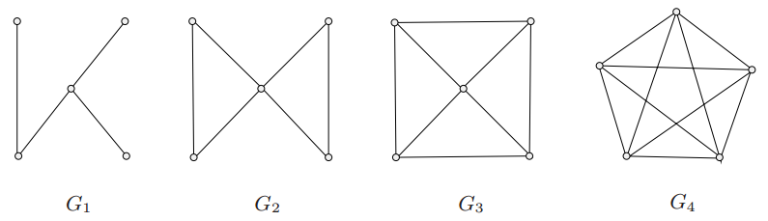

Connectivity!

Slide 4
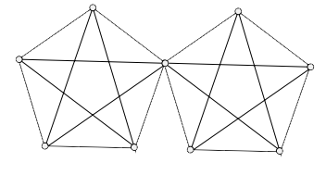
Connectivity!
Vertex Conncevtivy VS Edge Connectivity
𝜅 ≼ 𝜅’ ≼ 𝛿

Slide 5
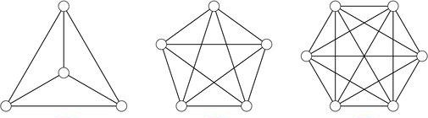
Non-Planarity…

Slide 6


Bridge!

Slide 7
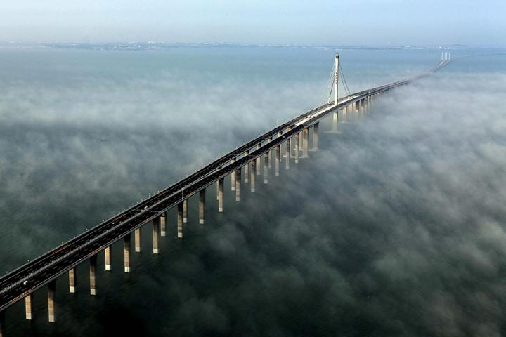
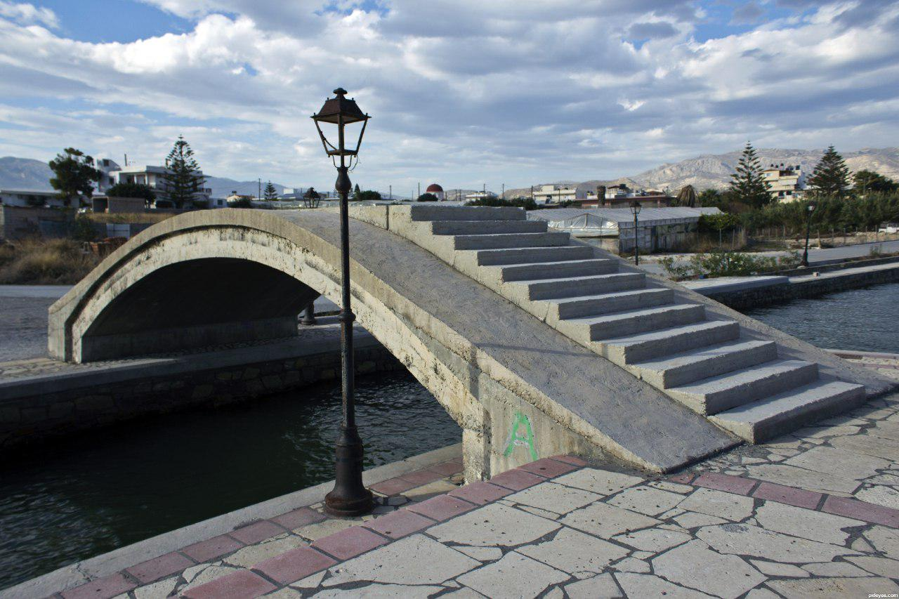
Bridge!
Big Bridge VS Small Bridge
g ≼ Cr

Slide 8

Cr Vs g (Complete Graphs)
K₅ g=1 Cr=1
K₇ g=1 Cr=9
K₁₅ g=11 Cr=447
K₁₉ g=20 Cr=1318
K₂₇ g=46 Cr=6180
…

Slide 9
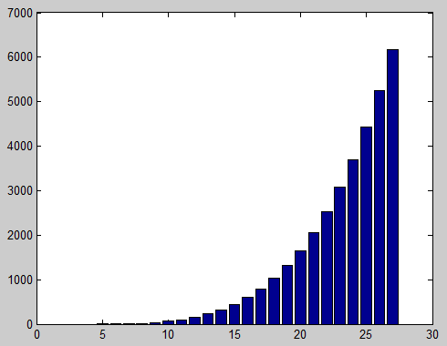
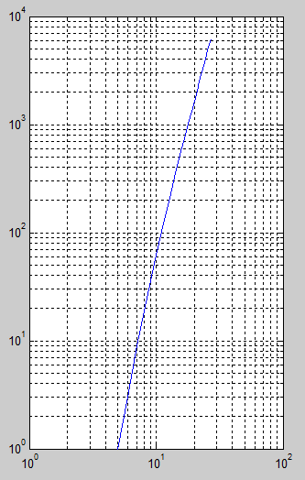
Cr (Complete Graphs)

Slide 10

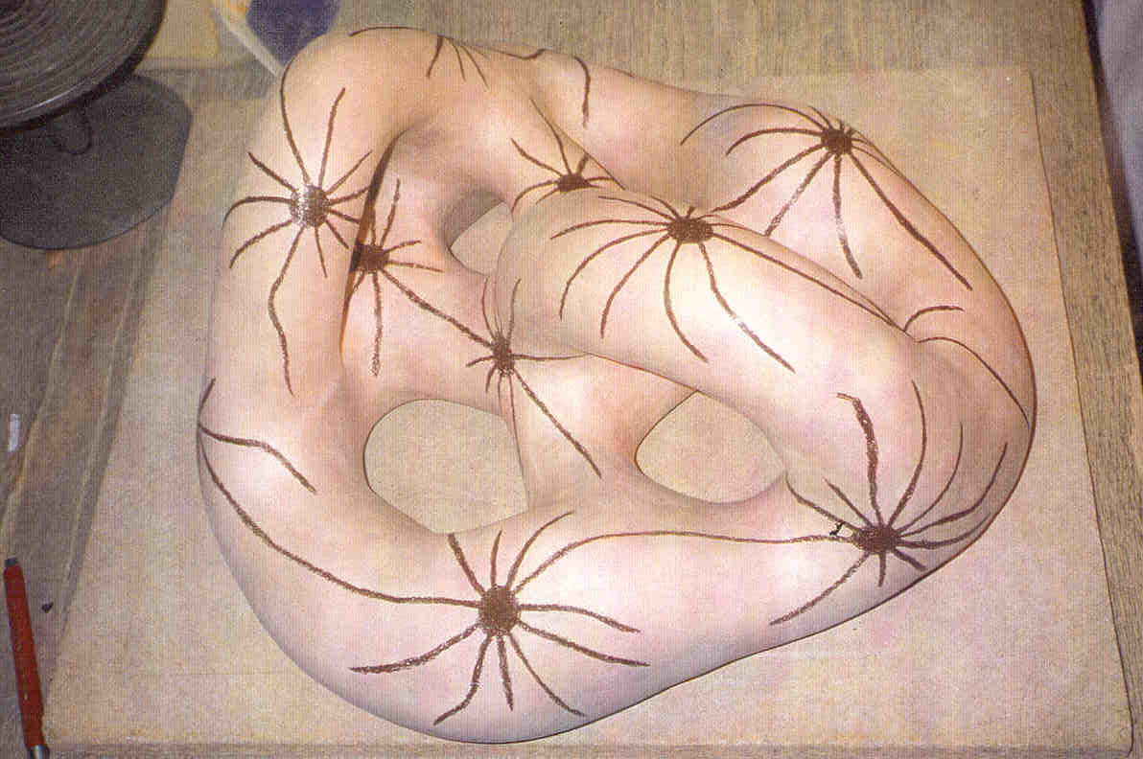
g (Complete Graphs)

Slide 11
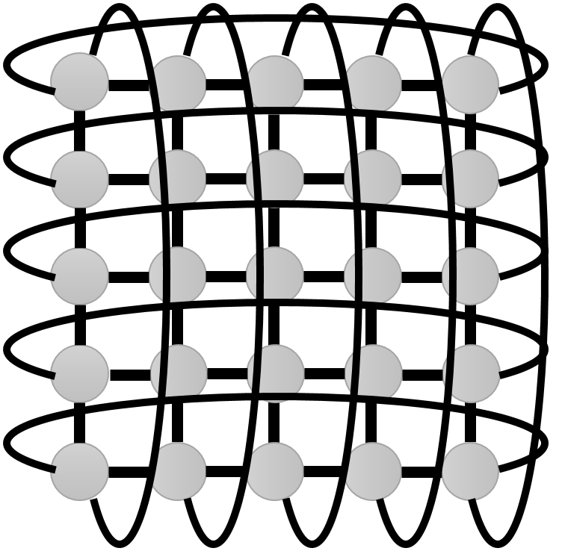
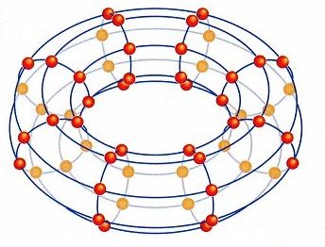
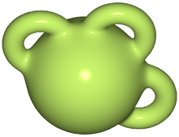
Cr Vs g
C_{m} □ C_{n}

Slide 12
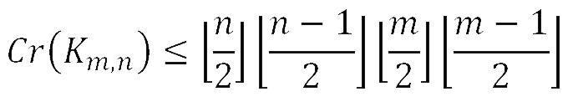
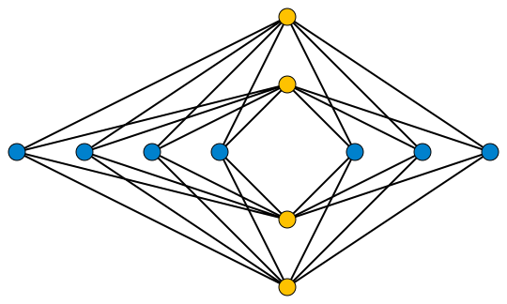
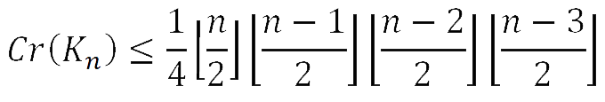
(Upper) Bounds for Cr
Turán ’s Brick Factory Problem

Slide 13

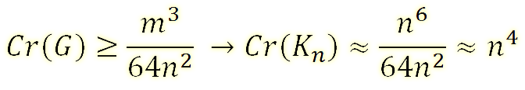
(Lower) Bounds for Cr
Crossing Number Inequality
Conjectured by Erdös-Gallai [1973]
Proved by Leighton [1982]
Probabilistic Proof by Székely [1997]

Slide 14
Proof
Planar graphs:
_{N-M+F = 2 ⟼ M ≼ 3N-6}
_{So}
_{Cr ≽ M-(3n-6)}

Slide 15
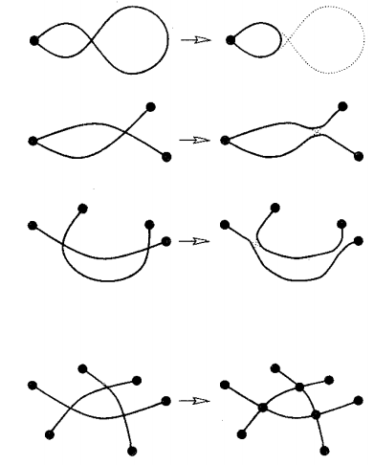
Proof…
_{Cr ≽ M-(3n-6)}
_{M’=M+2Cr}
_{N’=N+Cr}
_{M’ ≼ 3n’-6}
_{M ≼ 3N+Cr-6}

Slide 16
…Proof
Pick every vertex with probability p ⟼ G_{p}
N_{p} / M_{p} / X _{p} / Cr_{p}
X_{p} ≽ Cr_{p} ≽ M_{p}-3N_{p}+6 ≽ M_{p}-3N_{p}

Slide 17
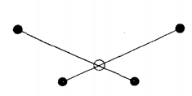
…Proof
Taking Expectation
X_{p} ≽ M_{p}-3 N_{p}
𝔼X_{p} ≽ 𝔼M_{p}-3 𝔼N_{p}
Cr × p⁴ ≽ M × p² -3N × p

Slide 18

…Proof
Setting p=4n/m (≼ l)
Cr × p⁴ ≽ M × p² -3N × p
Cr ≽ M ×(M/4n) ²-3N ×(M/4N) ³ ≽ M³/64N²

Slide 19
Generalizations
- For M≽7N
Cr ≽ M³/29N²
- For girth ≽ 2r
Cr ≽ k× M^{r+l}/N^{r}

Slide 20
Applications
Combinatorial Geometry
- Szemeredi-Trotter Theorem
- Beck (2extremities) Theorem
See Jukna 18.5

Slide 21

Q?
ThanQ.

