Slide 1

Chernoff Bounds
Bidgoli 2016-10-18

Slide 2
No Heads at all!
Flip a coin N times…
P( #Heads = 0 ) = ?
2^{-N} → Exponential!

Slide 3

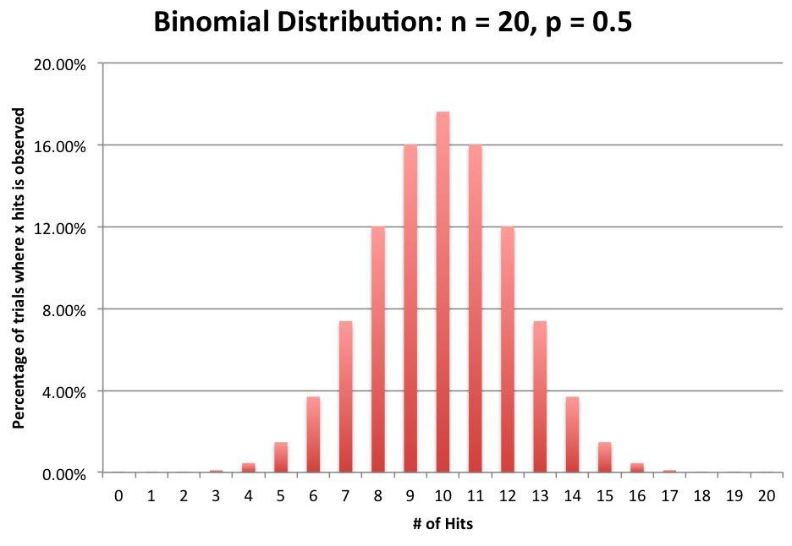
Binomial Distribution

Slide 4
Concentration Inequalities
(AKA Tail Bounds)
Markov
Chebyshev
Chernoff

Slide 5
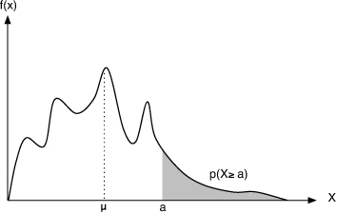
Markov
X ≥ 0 µ<∞
P(X ≥ a)≤ µ/a
P(X ≥ aµ)≤ 1/a
  Linear Decreasing
µ ≥ 0× P(X < a)+a× P(X ≥ a)

Slide 6
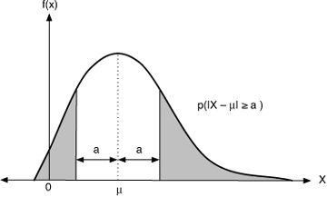

Chebyshev
µ<∞ σ < ∞
  Quadratic Decreasing
Proof: Similarly!

Slide 7

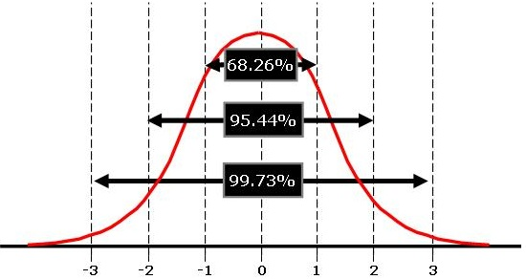
Special Case:
Normal Distribution

Slide 8
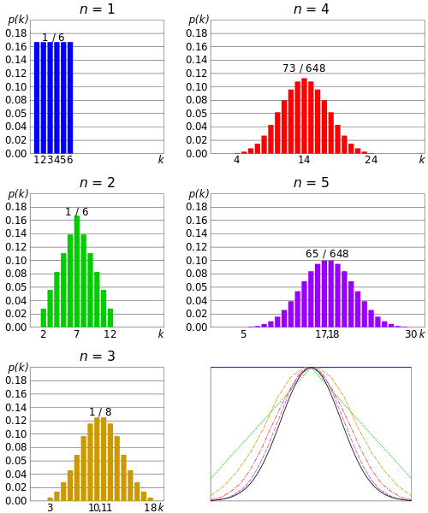
Central Limit Thm

Slide 9
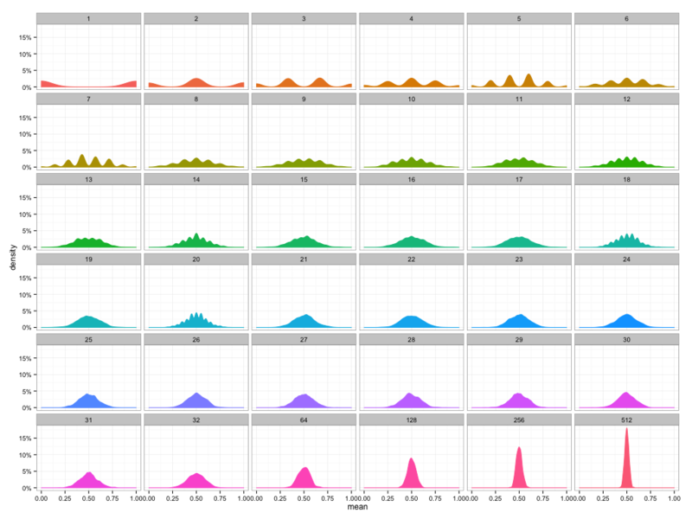
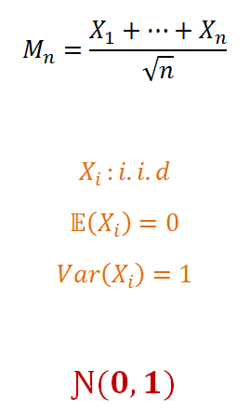
Central Limit Theorem

Slide 10
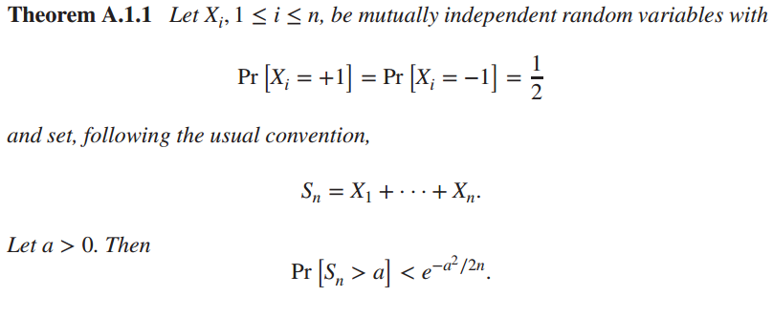

Chernoff

Slide 11
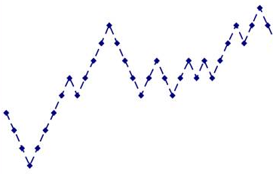
Random Walk

Slide 12
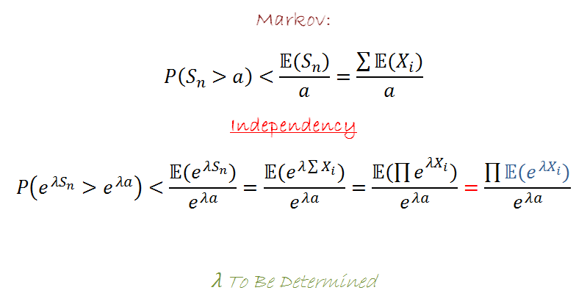
Chernoff : Proof

Slide 13
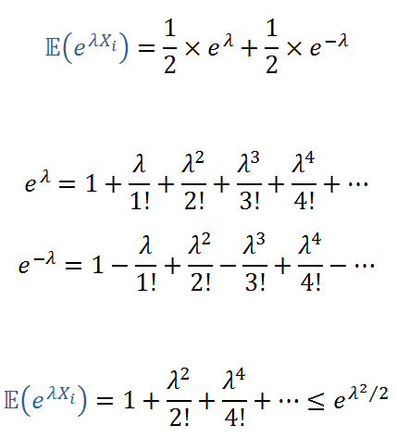
Upper Bound For E(e^{λx})

Slide 14
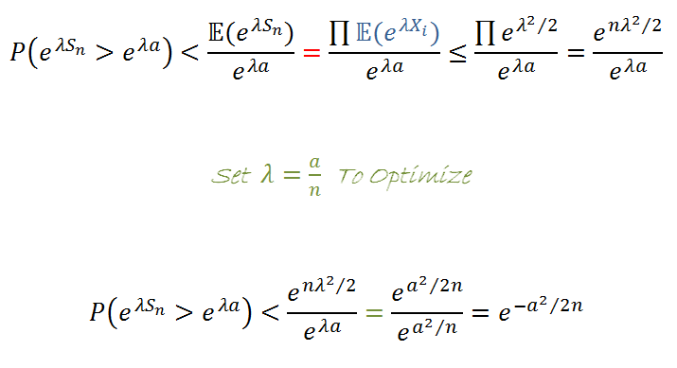

Chernoff : Proof

Slide 15
Chernoff:
(Semi!) General Case
Unbiased Random Walk
To Avoid(!) Complexity Consider:
Biased « Unbiased Random Walk»
! ! !

Slide 16
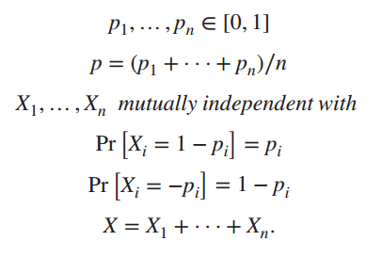
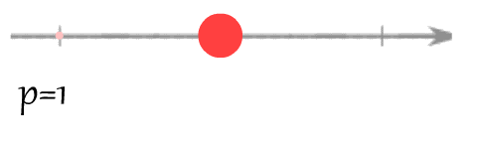

Biased Unbiased !

Slide 17

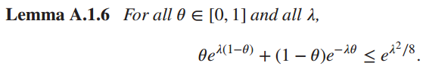
BUb Proof
Almost Similarly!
Remark:

Slide 18
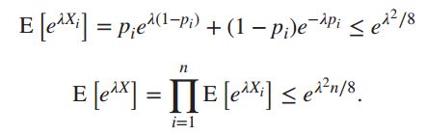
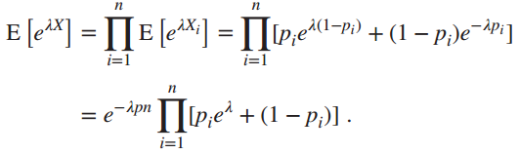
Better Bound

Slide 19
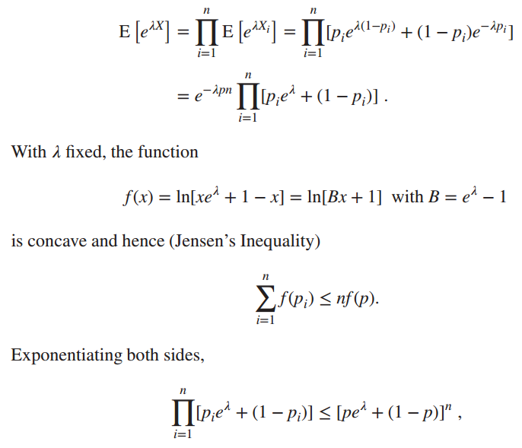
Jensen Inequality

Slide 20
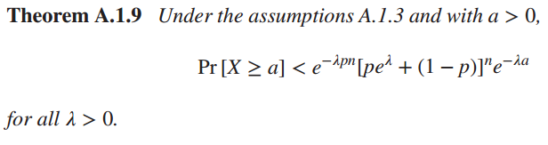


(Sub) Optimal λ

Slide 21
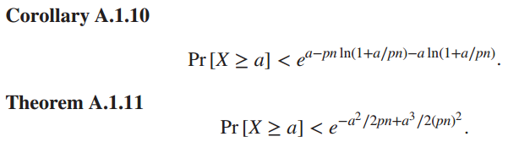
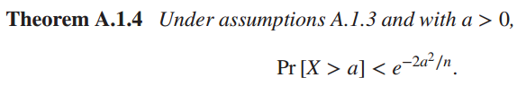
VS Previous

Slide 22


Asymmetry

Slide 23
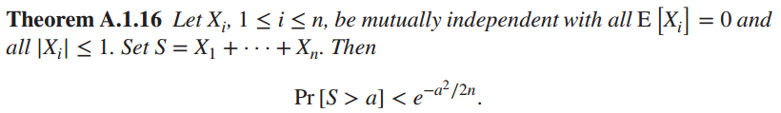
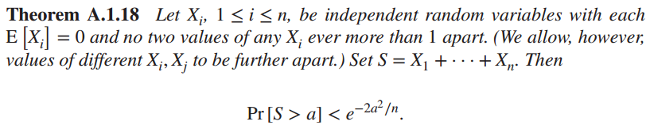
Various Versions

Slide 24

Lower Bounds
How Tight this bounds is?

Slide 25

Fin

Slide 26


