Slide 1
Extremal and Probabilistic Graph Bootstrap Percolation
MohammadReza Bidgoli
12 November 2018

Slide 2
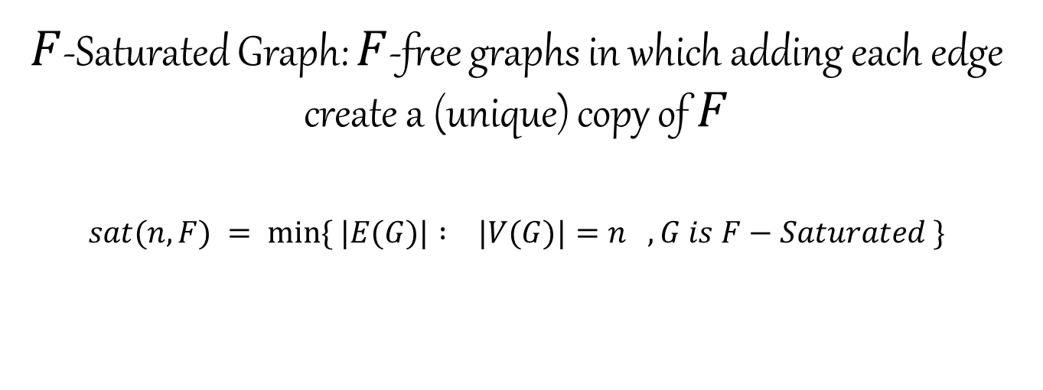
Saturation
$F$-Saturated Graph: $F$-free graphs in which adding each edge create a (unique) copy of $F$
$$sat(n,F) = min⁡\{ |E(G)| : |V(G)|=n , G is F−Saturated \}$$

Slide 3
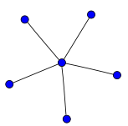
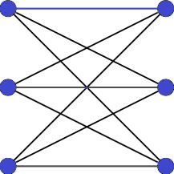
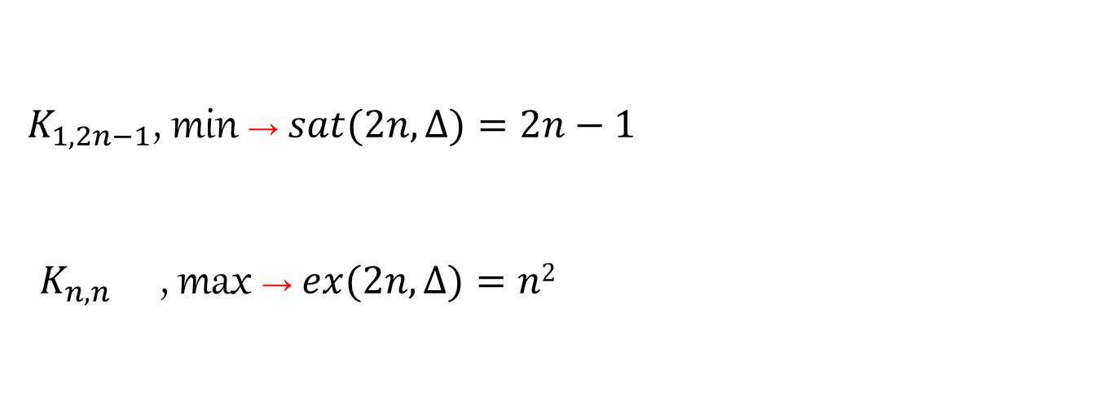
example
$K_{1,2n−1}$, min → $sat(2n, ∆)=2n−1$
${ K}_{n,n}$ , max → $ex(2n, ∆)=n2$

Slide 4
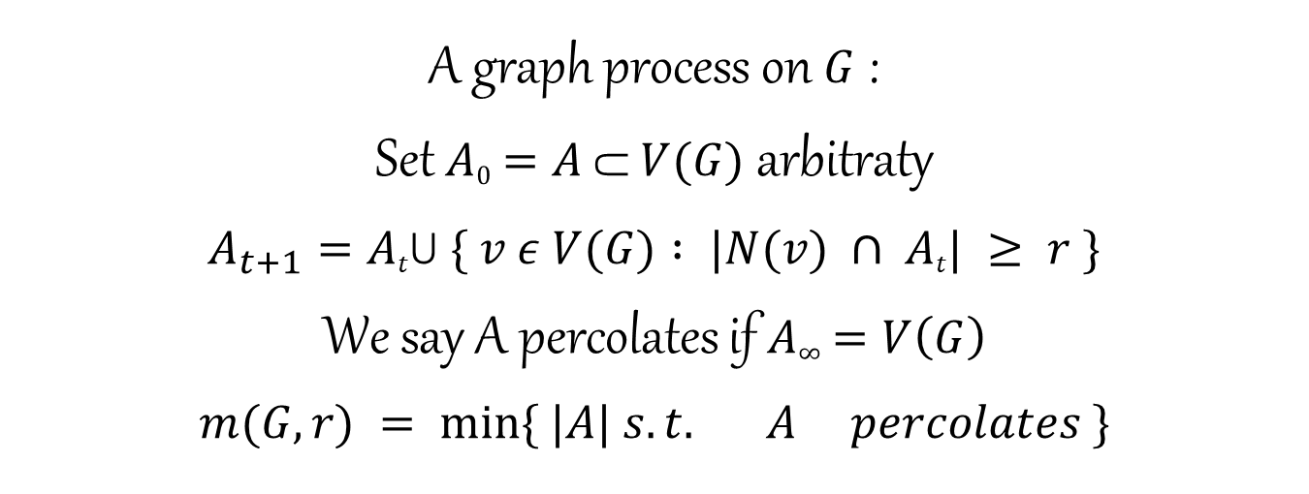
r-neighbor Bootstrap Percolation
A graph process on $G$ :
Set $A0=A ⸦ V(G)$ arbitraty
$$A_{t+1}=Atꓴ \{ v ε V(G) : |N(v) ∩ At| ≥ r \}$$
We say A percolates if $A∞=V\left(G\right)$
$$m(G,r) = min⁡\{ |A| s.t. A percolates \}$$

Slide 5
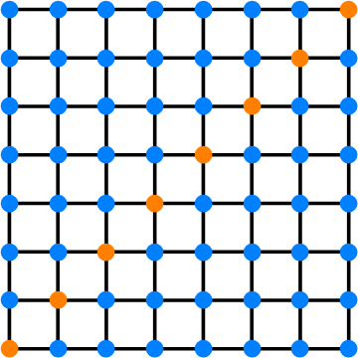
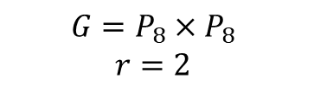
example
$$G=P_{8}×P_{8}$$
$$r=2$$

Slide 6
Saturation
Weak Saturation
Graph Bootstrap Percolation
r-neighbor Bootstrap Percolation

Slide 7
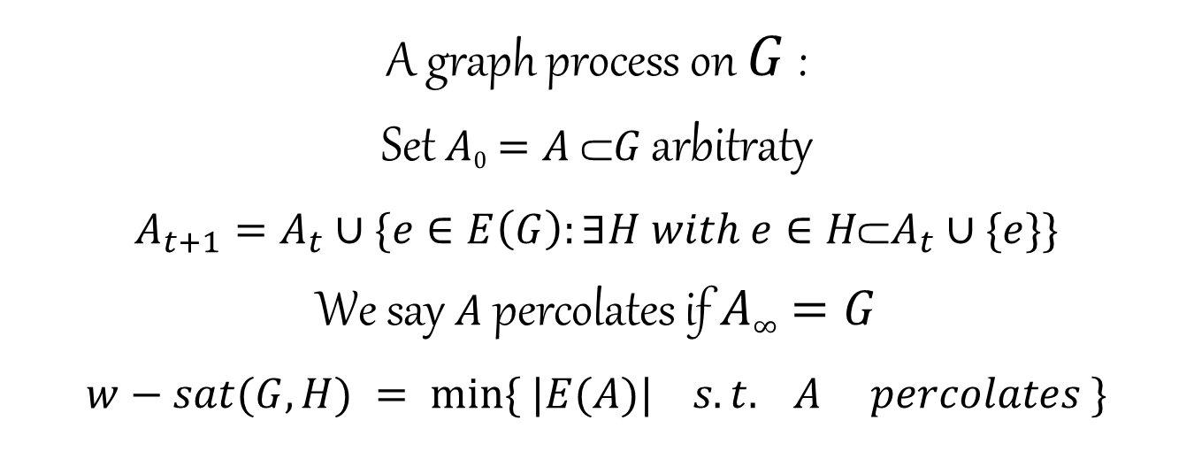
Graph Bootstrap Percolation/Weak Saturation
A graph process on $G$ :
Set $A0=A ⸦G$ arbitraty
$$A_{t+1}=A_{t}∪\{e∈E\left(G\right):∃H with e∈H\text{⸦}A_{t}∪\{e\}\}$$
We say $A$ percolates if $A∞=G$
$$w−sat(G,H) = min⁡\{ |E(A)| s.t. A percolates \}$$

Slide 8
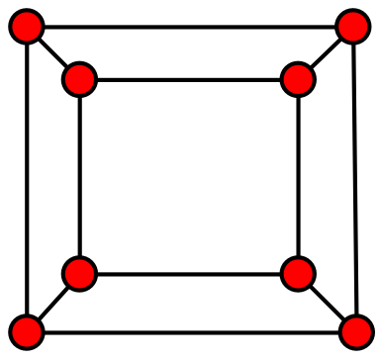

example
$$G=Q_{3}$$
$$H=Q_{2}$$

Slide 9
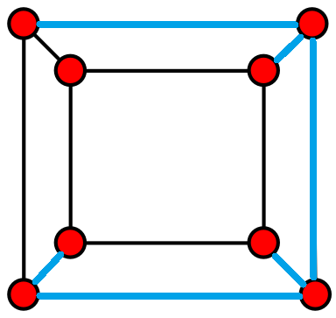
example
$$G=Q_{3}$$
$$H=Q_{2}$$

Slide 10
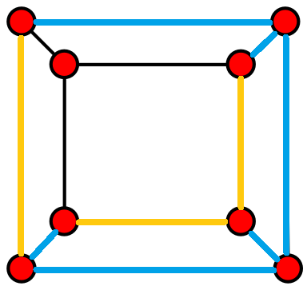
example
$$G=Q_{3}$$
$$H=Q_{2}$$

Slide 11
Parameters
G: Host Graph
  Deterministic { K_{n} , Q^{d} , Grid , ... }
  Random { G_{n,p} , Galton-Watson Tree , ... }
H: Rule(Guest)
A: Initiatially Infected → Objective
  Extremal → Minimum
  Probabilistic → Threshold

Slide 12
Problem Space!
G: Det
A: Min
G:Det
A:Random
G: Random
A: Min
G: Random
A: Random

Slide 13
Problem Space!
G: Det
A: Min
G:Det
A:Random
G: Random
A: Min
G: Random
A: Random

Slide 14
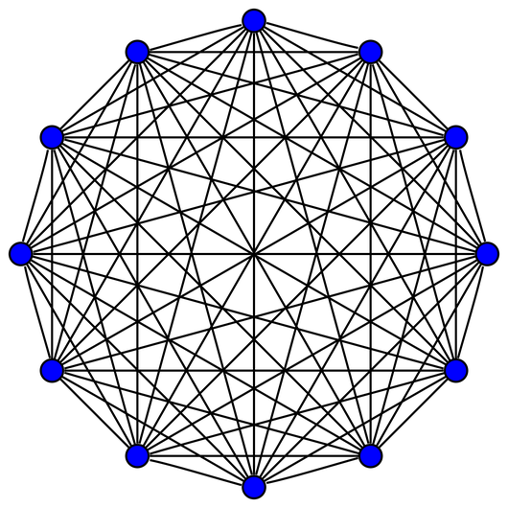
Known Results
m (K_{n} , r) simple!

Slide 15
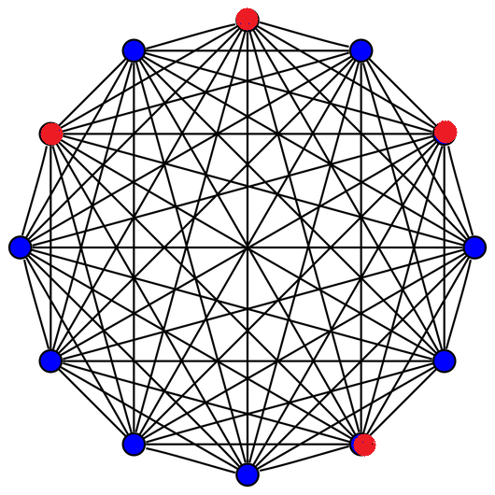
Known Results
m (K₁₂ , 4) = 4

Slide 16
Known Results
w-sat (K_{n} , S_{r+1}) easy!

Slide 17
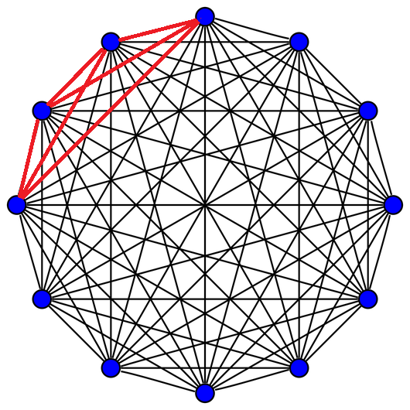
Known Results
w-sat (K₁₂ , S₄) = 6

Slide 18
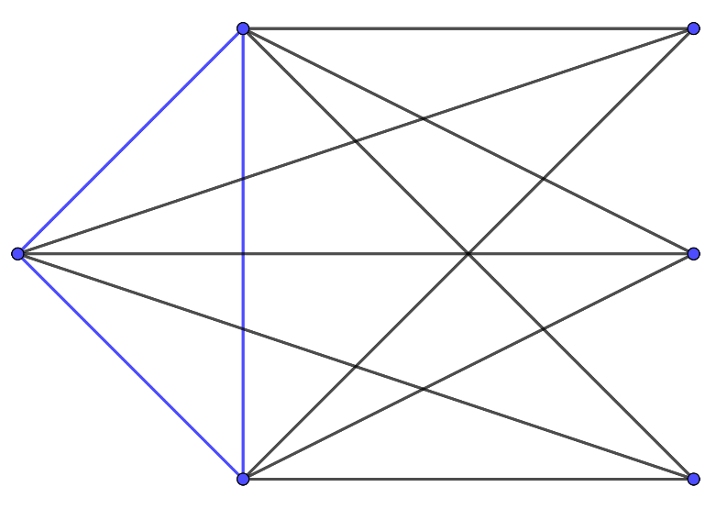
Known Results
sat (K_{n} , K_{r}) Erdos - Hajnal - Moon 1964
w-sat (K_{n} , K_{r})=sat (K_{n} , K_{r}) =(r-2)n-C(r-1,2)
Lovasz 1977
w-sat(K₆ , K₅)=12

Slide 19
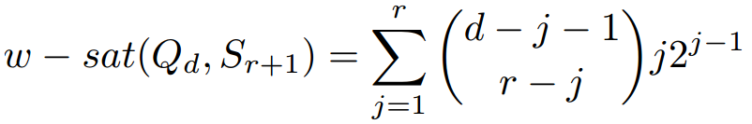
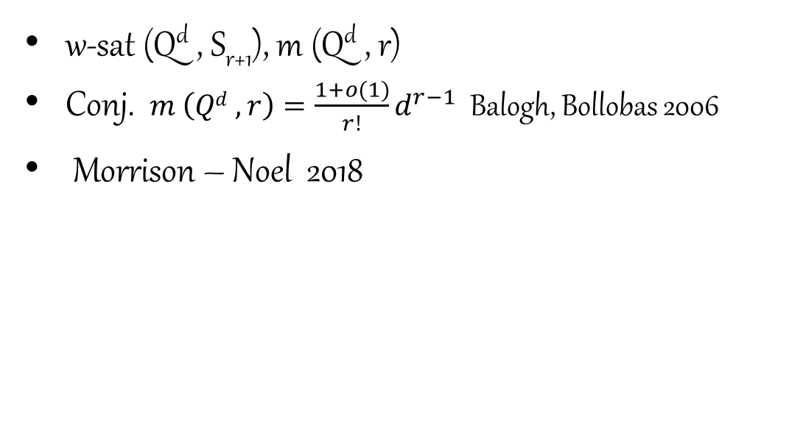
Known Results
w-sat (Q^{d} , S_{r+1}), m (Q^{d} , r)
Conj. $m \left(Qd , r\right)=\frac{1+o(1)}{r!}d^{r−1}$ Balogh, Bollobas 2006
Morrison – Noel 2018

Slide 20
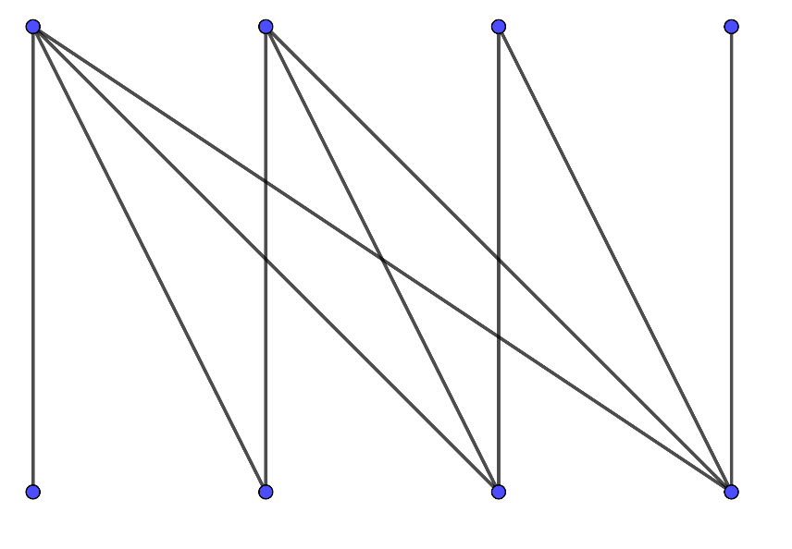
Proposed Problem #1
m (L(K_{n}) , r)
Special case m (L(K_{n}) , n-1)

Slide 21
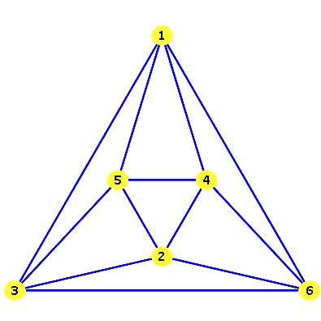
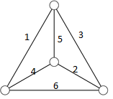
Proposed Problem #2
w-sat (L(K_{n}) , S_{r+1})

Slide 22
Problem Space!
G: Det
A: Min
G:Det
A:Random
G: Random
A: Min
G: Random
A: Random

Slide 23
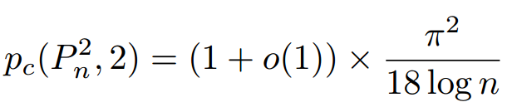
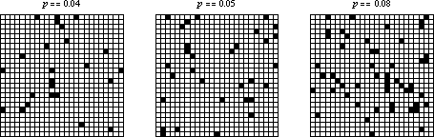
Known Results
Holroyd 2003

Slide 24
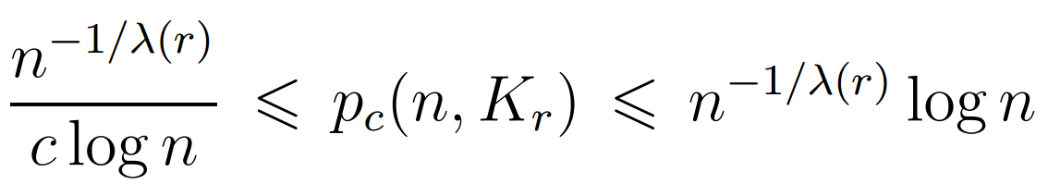
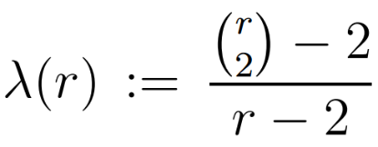
Known Results
p_{c}(n,K_{r}) Balogh – Bollabas – Morris 2012

Slide 25
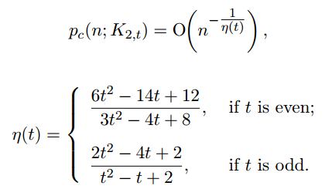
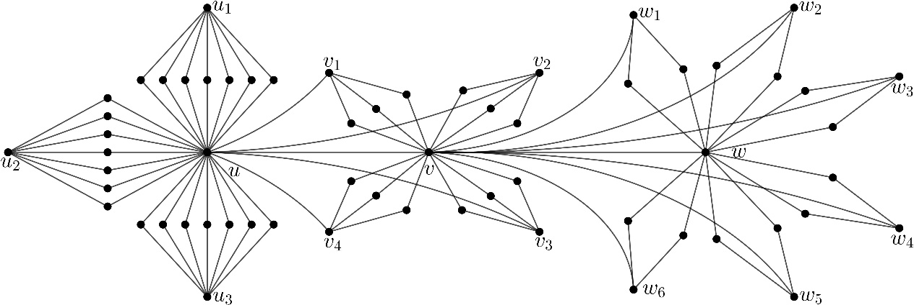
Proposed Problem #3
p_{c}(n,K_{2,t})

Slide 26
Problem Space!
G: Det
A: Min
G:Det
A:Random
G: Random
A: Min
G: Random
A: Random

Slide 27
Known Results
w-sat(G_{n,p},K_{r}) p: constant
Korandi – Sudakov 2016
w-sat (G_{n,p} , K_{r})=sat (K_{n} , K_{r}) =(r-2)n-C(r-1,2)

Slide 28
Problem Space!
G: Det
A: Min
G:Det
A:Random
G: Random
A: Min
G: Random
A: Random

Slide 29
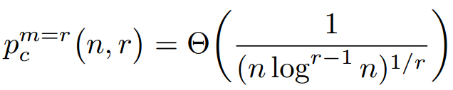
Known Results
Feige, Krivelevich , Reichman 2016

Slide 30
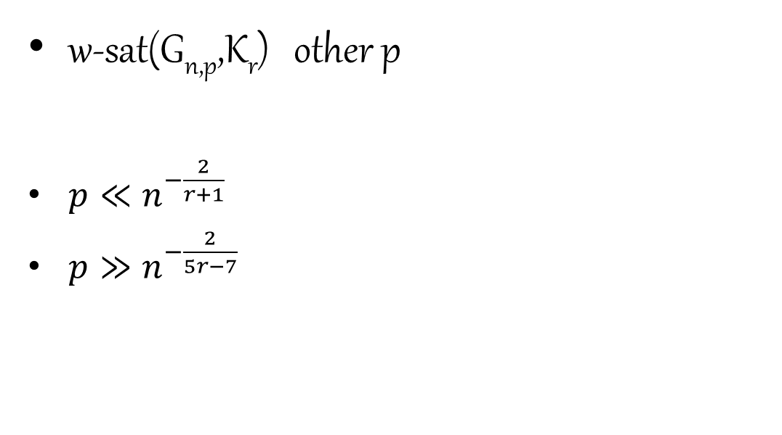
Proposed Problem #4
w-sat(G_{n,p},K_{r}) other p
$p≪n^{−\frac{2}{r+1}}$
$p≫n^{−\frac{2}{5r−7}}$

Slide 31

Proposed Problem #4
w-sat(G_{n,p},H) other H (p: constant)

Slide 32
Problem Space!
G: Det
A: Min
G:Det
A:Random
G: Random
A: Min
G: Random
A: Random

Slide 33
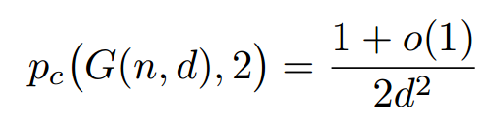
Known Results
Balogh , Pittel 2007

Slide 34
Problem Space!
G: Det
A: Min
G:Det
A:Random
G: Random
A: Min
G: Random
A: Random
Time of percolation!!

Slide 35
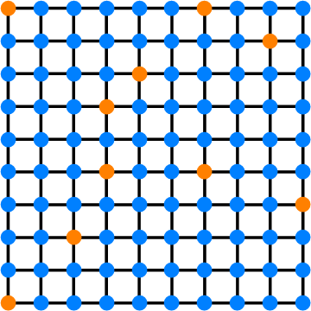
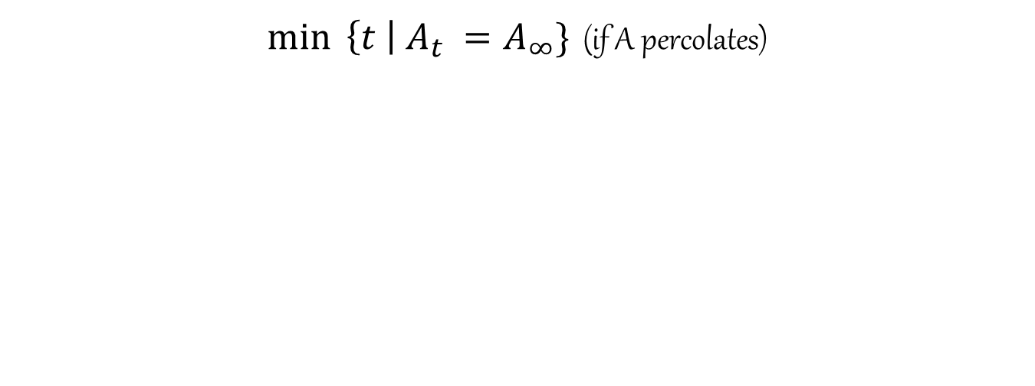
Time of percolation
$\min{ \left\{t \right| A_{t} =A_{∞}\}}$ (if A percolates)

Slide 36


