Slide 1
Using codebooks of fragmented connected-component contours in forensic and historic writer identiﬁcation
Lambert Schomaker, Katrin Franke, Marius Bulacu
Pattern Recognition Letters 28 (2007) 719–727
MohammadReza Bidgoli
‎January ‎12, ‎2014

Slide 2
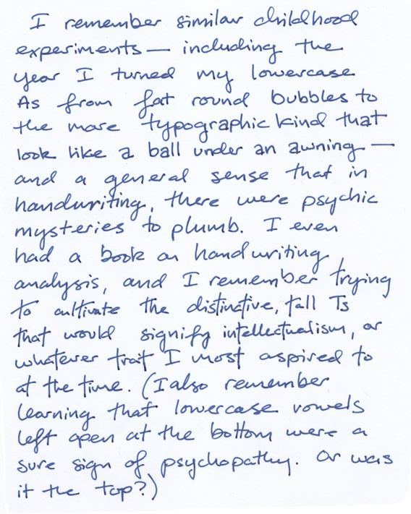

Writer Identification

Slide 3
Writing Analysis
Handwriting Recognition
Writer Veriﬁcation
  One To One
Writer Identification
  One To Many
  Offline VS Online
  Text-Independence VS Text-dependence

Slide 4
Writer identiﬁcation as a biometric
Biometrics
physiological
ﬁnger
print
Behavioral
voice
face
iris
DNA
gait
signature
Hand
Writing
invasive and require cooperating subjects
less impressive

Slide 5
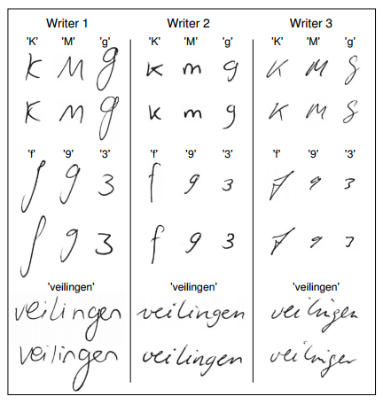
Within-writer variance VS Between-writer variation

Slide 6
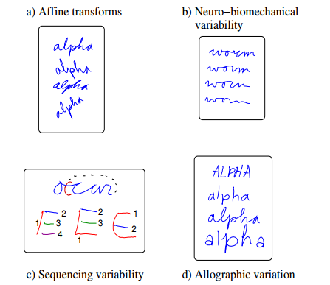
Factors causing variability in handwriting

Slide 7
Complexity Of Problem
the degree of variability and variation of script
The problem of fore/background segmentation in highly textured and smudged documents
the limited amount of text in unknown samples
the diﬀerences in scanning technologies and image preprocessing

Slide 8
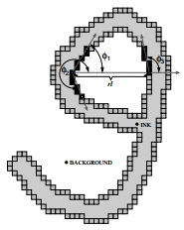
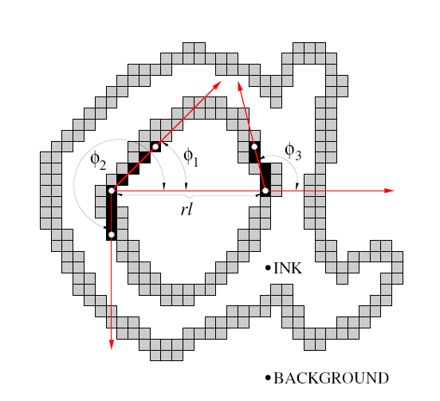
Writer Identiﬁcation Using
Edge-Based Directional Features

Slide 9
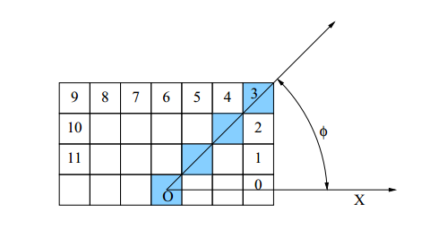
Extraction of edge-direction distribution

Slide 10
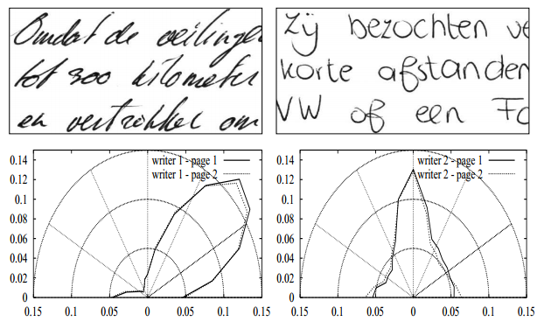
Polar PDF

Slide 11
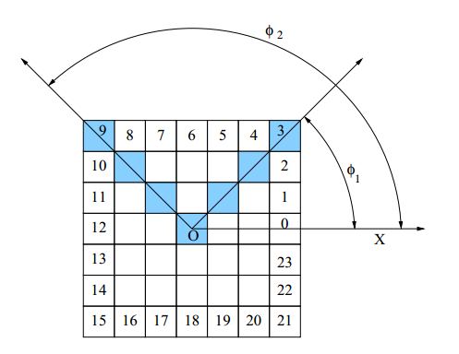
Extraction of edge-hinge distribution

Slide 12
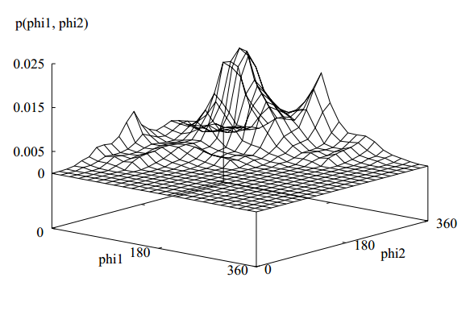
3D Plot

Slide 13
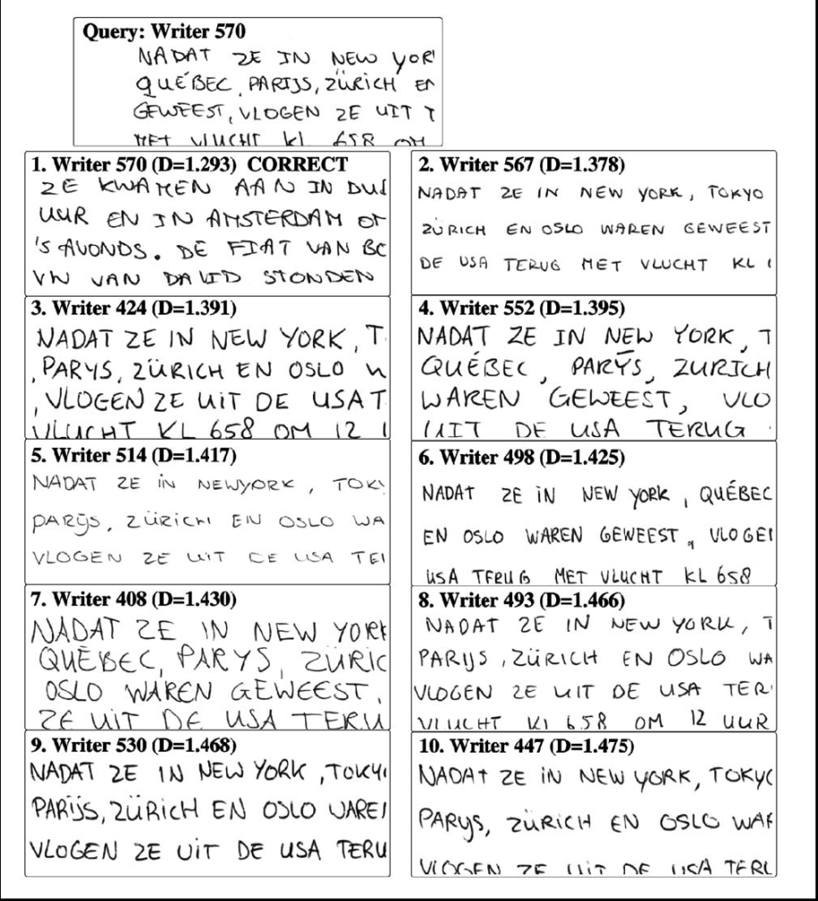
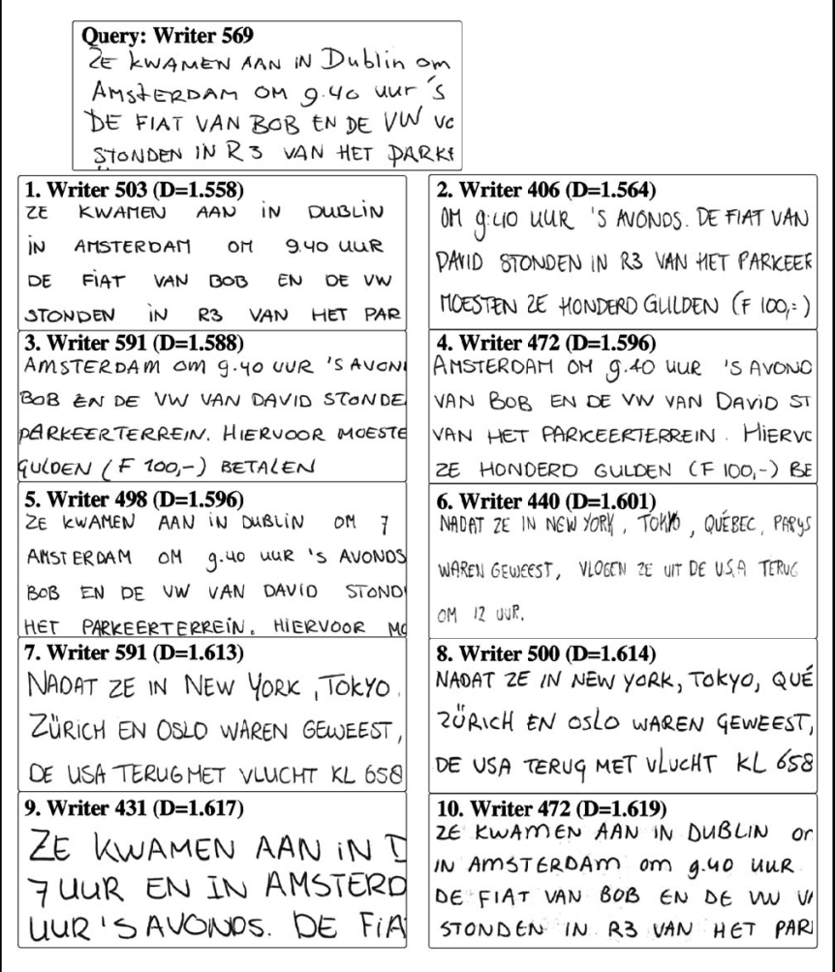
SuccessFul & UnSuccessFull Example

Slide 14
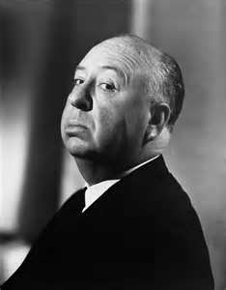
Alfred HitchCock!!!

Slide 15
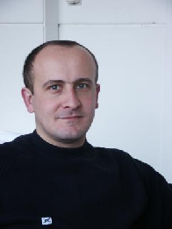


Marius Bulacu , Lambert Schomaker , Katrin Franke

Slide 16
Within-writer variance VS Between-writer variation

Slide 17
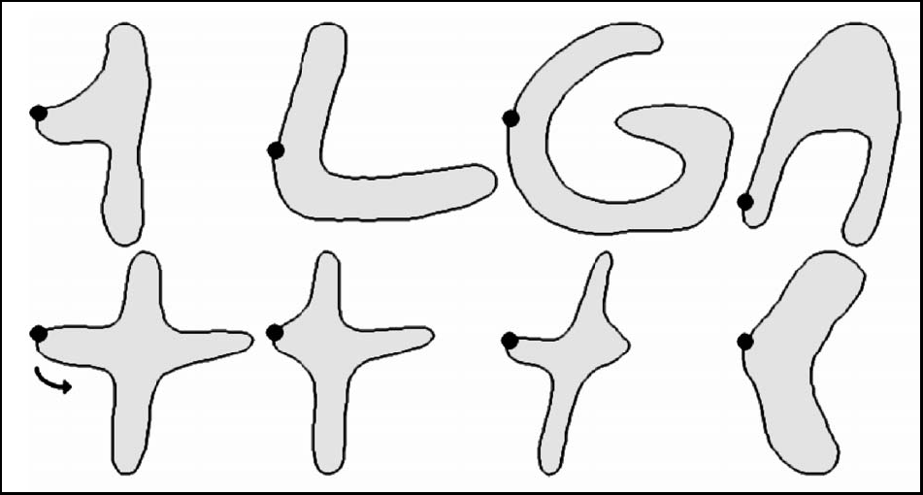

Connected-Component Contours (COCOCO=CO³)

Slide 18
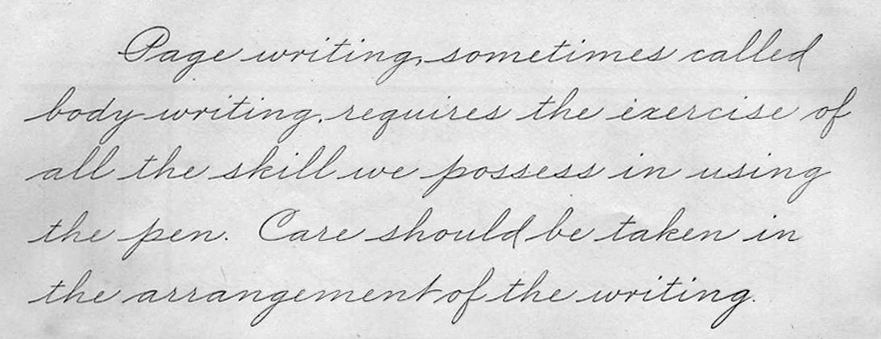
Complexity!

Slide 19
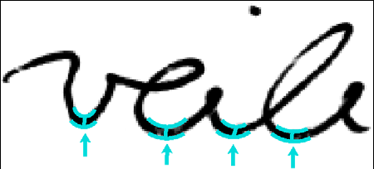
Fragmented CO³ = FCO³
Fragmentation on the basis of minima in the vertical contour

Slide 20
Method
Firemaker Database
250 writers
4 pages per writer
  Copied text
  Copied Upper-case text
  Copied Forged text
  Self-generated Description of a Cartoon Image
  Lineated paper
  Scanned at 300 dpi gray-scale

Slide 21
Method
Training Neural Network By 100 Writer
  Pages 1,3,4
Test By 150
Determine a Codebook (KSOM) Of FCO³
It will be useful for 15×15 Codebook Or Larger

Slide 22
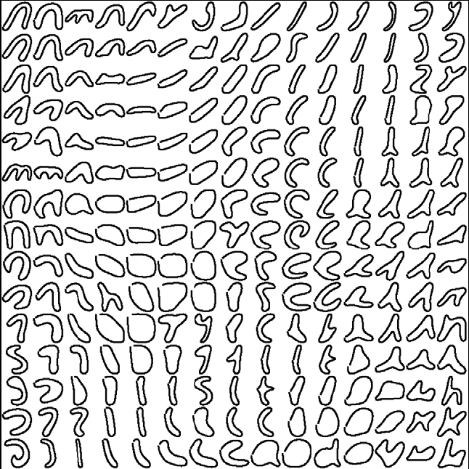
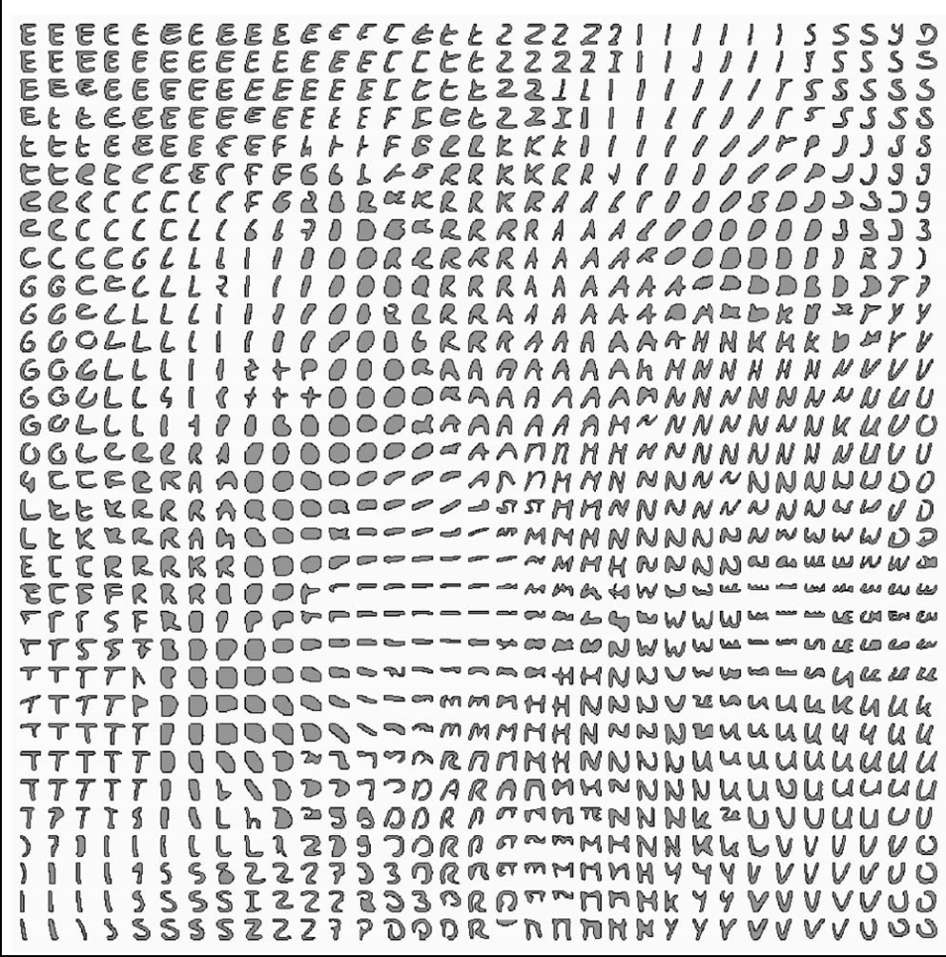
15×15 & 33*33 Codebook (26k samples)

Slide 23
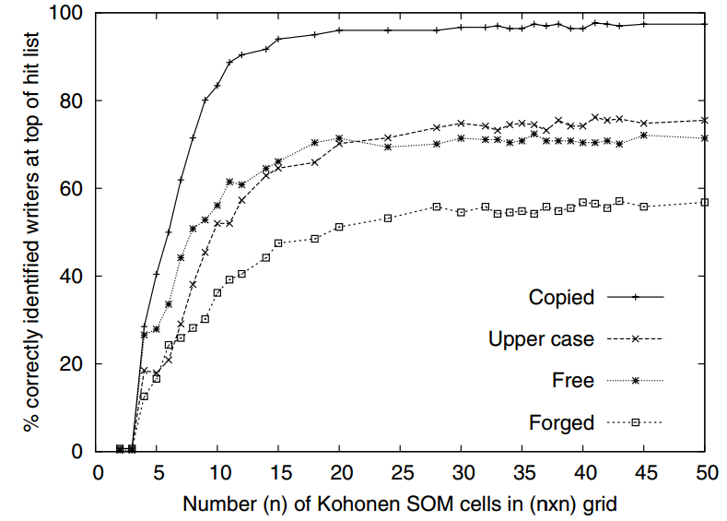
Top-1 writer-identiﬁcation performance as a function of SOM Dim

Slide 24
Discrete Occurrence Histogram

Slide 25
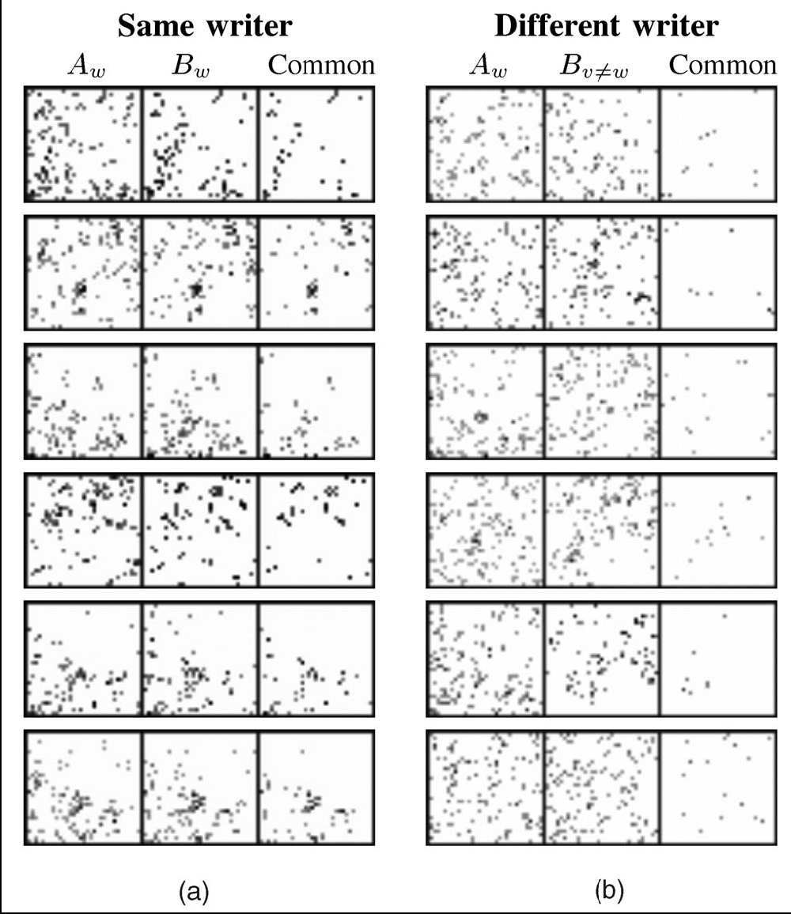
Discrete Occurrence Histogram

Slide 26
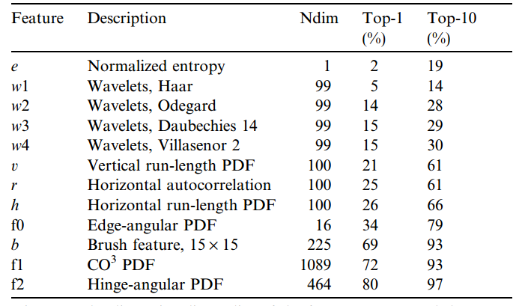
Combining Features

Slide 27
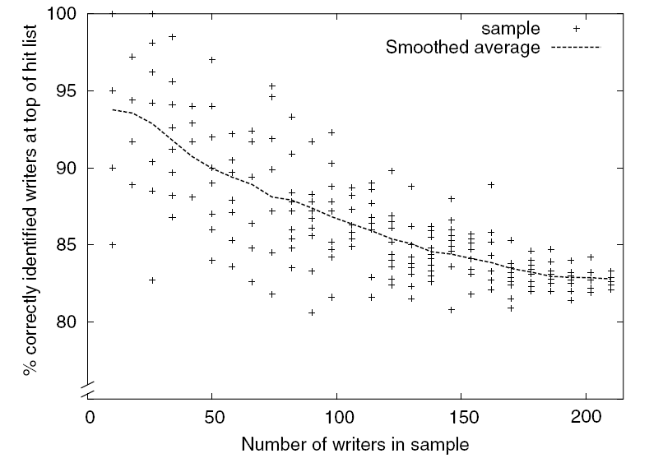
Top-1 writer-identification performance

Slide 28
Discussion & Conclusion
FCO³ works Because writing style is largely determined by allographic shape variations
the combination of character-shape elements and image properties such as the edge-hinge angular probability distribution function will yield further enhanced classiﬁcation rates.

Slide 29
References
Lambert Schomaker, Katrin Franke, Marius Bulacu (2007) "Using codebooks of fragmented connected-component contours in forensic and historic writer identification", Pattern Recognition Letters (PRL), Pattern Recognition in Cultural Heritage and Medical Applications, Elsevier Science, vol. 28, no. 6, pp. 719-727, 15 April.
Lambert Schomaker, Marius Bulacu (2004) "Automatic writer identification using connected-component contours and edge-based features of upper-case western script", IEEE Trans. on Pattern Analysis and Machine Intelligence (PAMI), IEEE Computer Society, vol. 26, no. 6, pp. 787-798, June.
Marius L. Bulacu (2007) "Statistical pattern recognition for automatic writer identification and verification", PhD thesis, Artificial Intelligence Institute, University of Groningen, The Netherlands, 140 pages, ISBN 90-367-2912-2, 15 March.

Slide 30
References
Marius Bulacu, Lambert Schomaker, Louis Vuurpijl (2003) "Writer identification using edge-based directional features", Proc. of 7th Int. Conf. on Document Analysis and Recognition (ICDAR 2003), IEEE Computer Society, pp. 937-941, vol. II, 3 - 6 August, Edinburgh, Scotland.
Marius Bulacu, Lambert Schomaker, Axel Brink (2007) "Text-independent writer identification and verification on offline Arabic handwriting", Proc. of 9th Int. Conf. on Document Analysis and Recognition (ICDAR 2007), IEEE Computer Society, pp. 769-773, vol. II, 23 - 26 September, Curitiba, Brazil.

Slide 31
Fin

