Slide 1


Slide 2
Covariance Matrix Adaptation for
Multi-objective Optimization
Christian Igel, Nikolaus Hansen, Stefan Roth
Mohammad Reza Bidgoli
‎December ‎30, ‎2012

Slide 3
ES
Uncorrelated Mutation with One Step Size
Uncorrelated Mutation with n Step Sizes
Correlated Mutations
ES
c_{ij} = ½ • ( σ_{i}² - σ_{j}² ) • tan(2 α_{ij})

Slide 4
CMA-ES
ES
COVARIANCE
ADAPTATION
CMAES

Slide 5

Covariancing!
Mr.
Covariance Matrix

Slide 6
(µ+λ) VS (µ,λ)
(µ,λ)CMAES
Standard Version
(µ+λ)CMAES
New Version
Non-elitist
cumulative step size adaptation
several offspring needed for each strategy parameters adaption
Find Best Solution
Elitist
success rule based on
step size adaptation
1.5 times faster
Rotation & Order-Preseving invariant

Slide 7
Nomenclature
a=[x , P_{succ} ,σ , P_{c} ,C]
x ∈ R^{n}
candidate solution vector
P_{succ} ∈ [0, 1]
averaged success rate
σ ∈ R⁺
global step size
P_{c} ∈ R^{n}
evolution path
covariance matrix
C ∈ R^{n*n}
number of successful new candidate
λ_{succ}^{(g+1)}

Slide 8
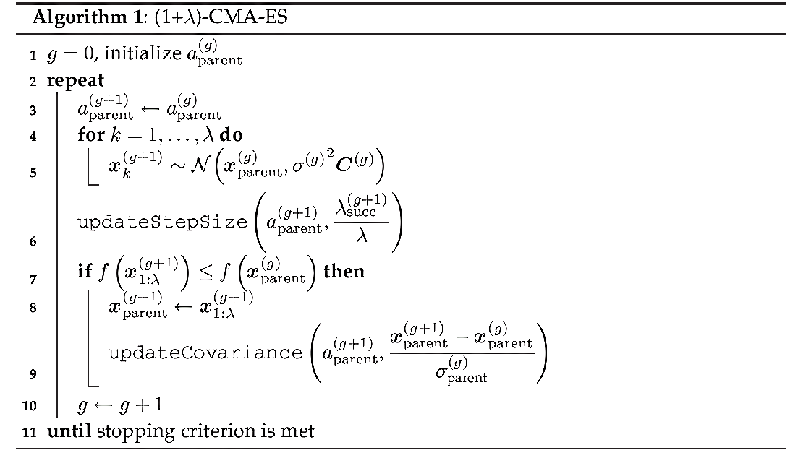
Algorithm1: (1+λ)-CMA-ES

Slide 9
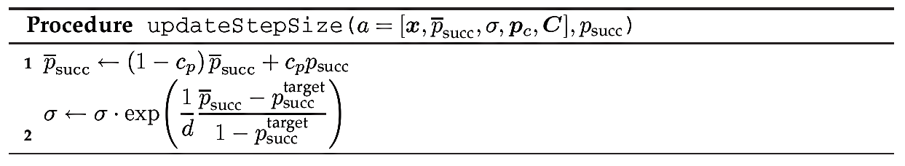
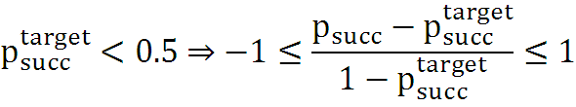
Update Step Size
c_{p} : Learning Rate (0 < c_{p} ≤ 1)
Based On 1/5-success-rule [Rechenberg (1973)]
d : Damping Parameter

Slide 10
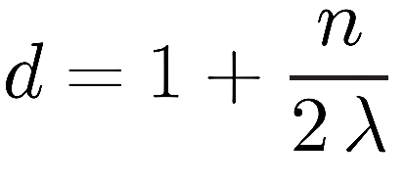
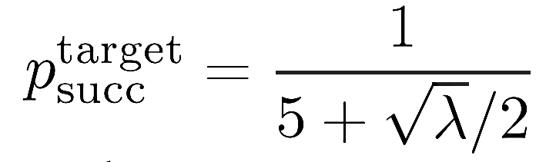
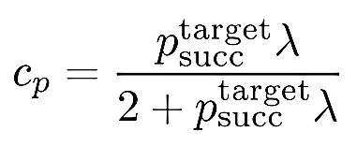
Default Values

Slide 11
Covariance Update
End Of Screen 1

Slide 13
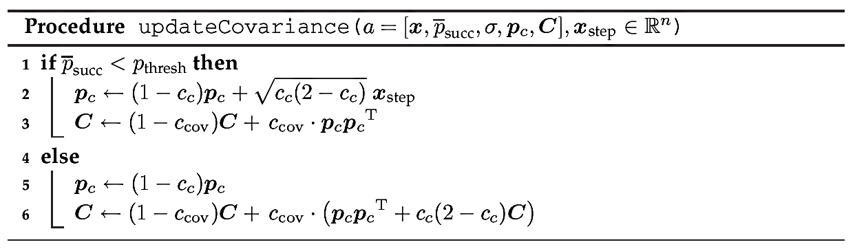
Covariance Update Again!
p_{thresh} =0.44
c_{c}=2/(n+2)
c_{cov}=2/(n²+6)

Slide 14

P_{c} Update
t= 1-c_{c}
√ c_{c}(2-c_{c})= √ 1-1+2c_{c}-c_{c}²
= √ 1-(1-c_{c})²
= √ 1-t²
y
1-x²√
1-x
x

Slide 15
Initialization
P_{succ}=P_{succ}^{target}
P_{c} =0
C=I
X and σ such that:
    Optimum ∈ x± σ(1,1,…,1)^{T}

Slide 16
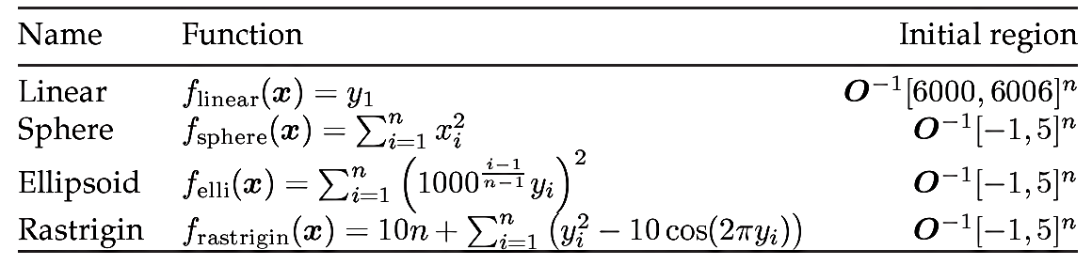
Test Functions
O is an Orthogonal Matrix
y=Ox
Invariant under rotation of the search space
Apart from f_{linear}, the optimum function value is zero
f_{linear} :test the ability and the speed to increase σ
f_{sphere} :basic convergence properties & speed of σ-decrease
f_{elli}: ability to adapt the distribution shape
f_{rastrigin}: ability to circumvent local optima

Slide 17
Method
51 runs for each function!!!
Initial candidate solution x is chosen uniformly randomly
Initial σ =3 is half of the width of the initial interval
Stopping Criterion: function value differences ≤ 10⁻¹²
OR the function value becomes <10⁻⁹
Ranking Runs for statistical testing
Mann-Whitney U-test (Wilcoxon rank sum test)

Slide 18
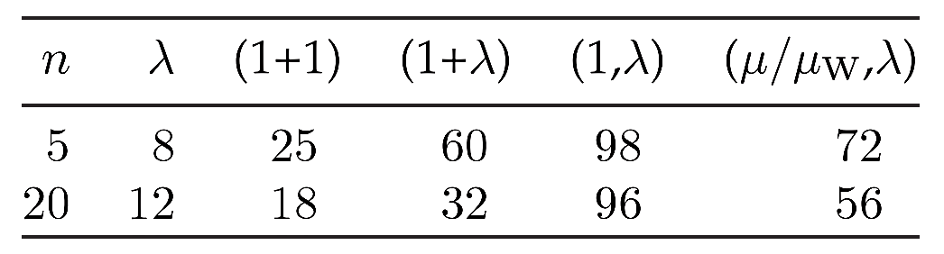
Results and Discussion I
f_{linear}:
Mean number of function evaluations needed to increase the step size by a factor of ten

Slide 19
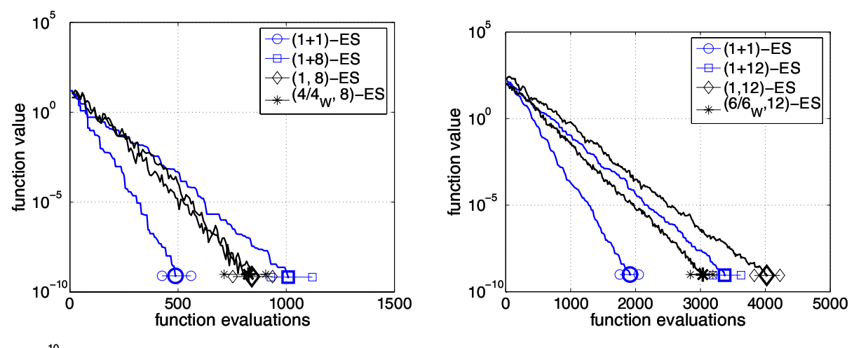
Results and Discussion II
f_{sphere}:
5D
20D

Slide 20
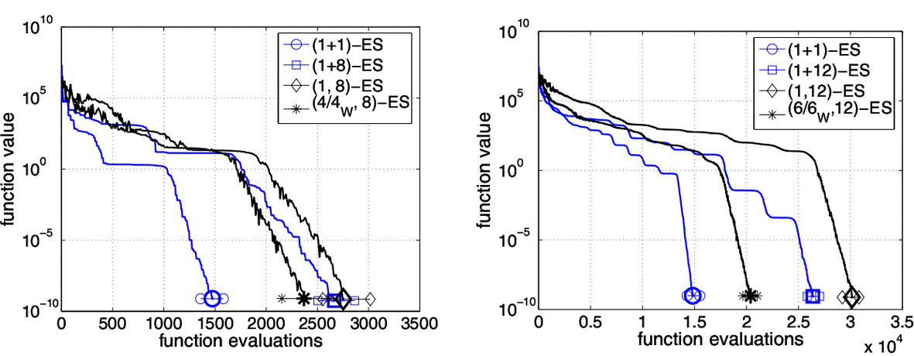
Results and Discussion III
f_{elli}:
5D
20D

Slide 21
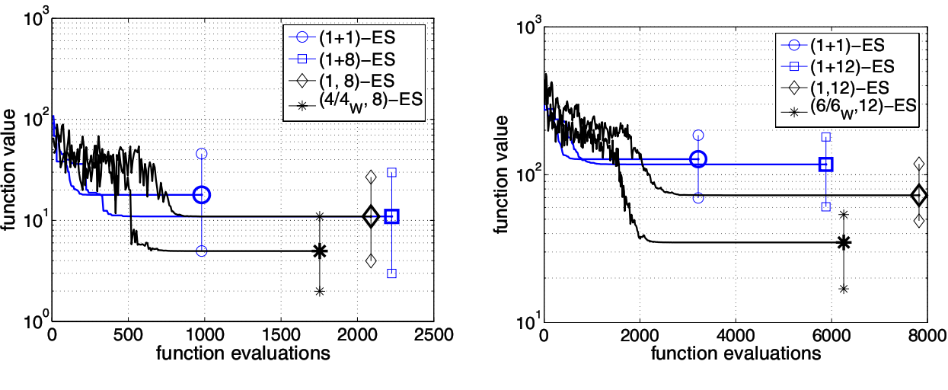
Results and Discussion IV
f_{rastrigin}:
5D
20D

Slide 22
MOO
Multi-objective Optimization:
f₁,...,f_{M} : X → R
f(x)=(f₁(x),...,f_{M}(x))
Elements of X can be strictly partially ordered
x ≺ x’ iff ∀m ∈{1,...,M} : f_{m}(x) ≤ f_{m}(x’)
and ∃m ∈{1,...,M} : f_{m}(x) <f_{m}(x’)
Pareto Front: {f(x) | x ∈ X ∧ x’∈ X : x’≺ x} ⊂ R^{M}
Linearly aggregating all objectives

Slide 23
Multi-objective Selection
Sorting individuals
First sorting criterion:
  Non-dominated Sorting
Second sorting criterion
  Crowding-distance
  Contributing Hypervolume

Slide 24
Non-dominated Sorting
ndom(A)= {a ∈ A| a’∈ A : a’≺ a}
The elements in ndom(A) get rank 1
dom₀(A)= A
dom_{L}(A)=dom_{L−1}(A) \ ndom_{L}(A)
ndom_{L}(A)=ndom(dom_{L−1}(A))
For a ∈ A : r(a,A)=i iff a ∈ ndom_{i} (A)
time complexity O(MN²)

Slide 25
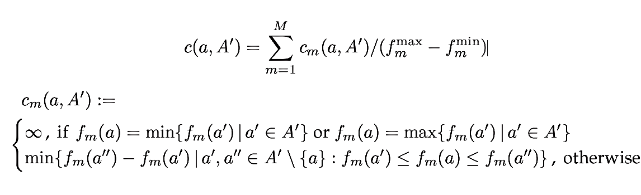
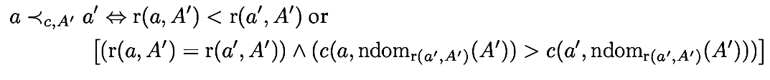
Crowding Distance
Crowding-distance of a ∈ A’ is given by:
The individuals are ranked according to how much they contribute to the diversity
Time complexity : O(MN logN)
Formal Definition:

Slide 26
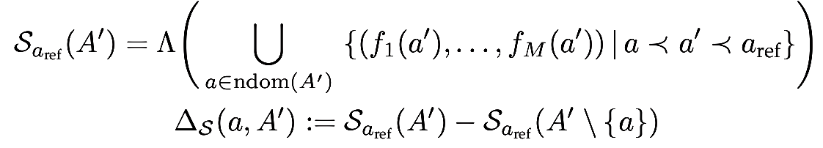
Contributing HyperVolume
S(a,A’)=n iff
The individual contributing least to the hypervolume of A’ gets the worst rank.
The individuals at the “boundaries” of the Pareto front of A’ are preferably selected
Time Complexity: O(NlogN)

Slide 27
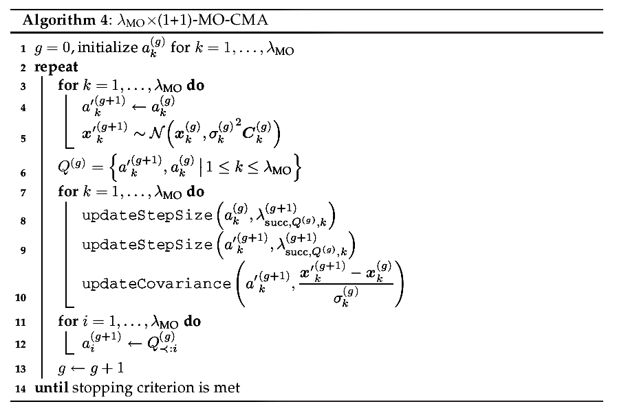
MO-CMA Algorithm

Slide 28
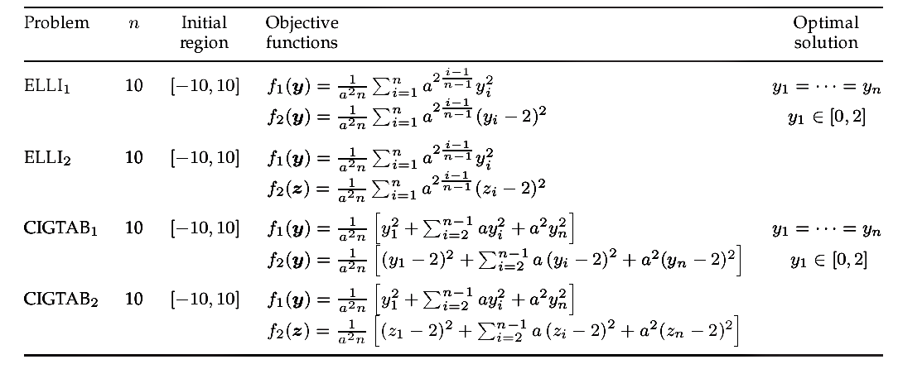
UnConstrained Test Functions

Slide 29
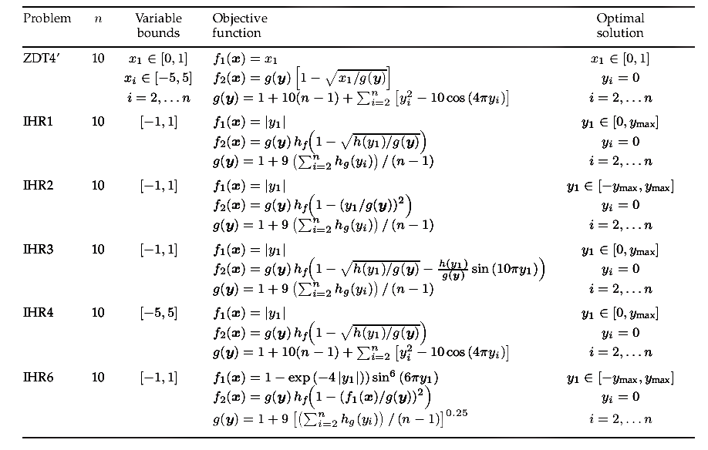
Constrained Test Functions

Slide 30
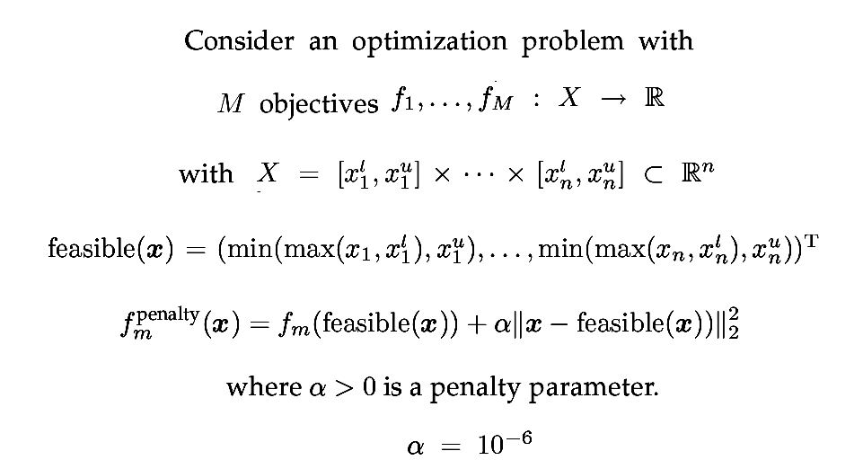
Handling Constraints

Slide 31
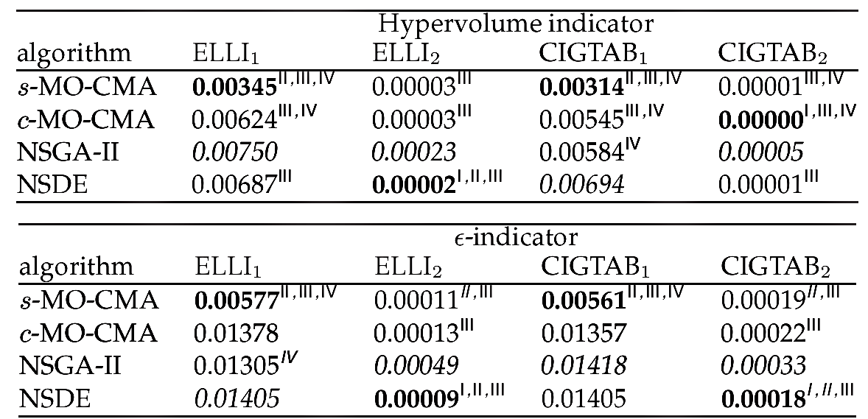
UC Test Function Result

Slide 32
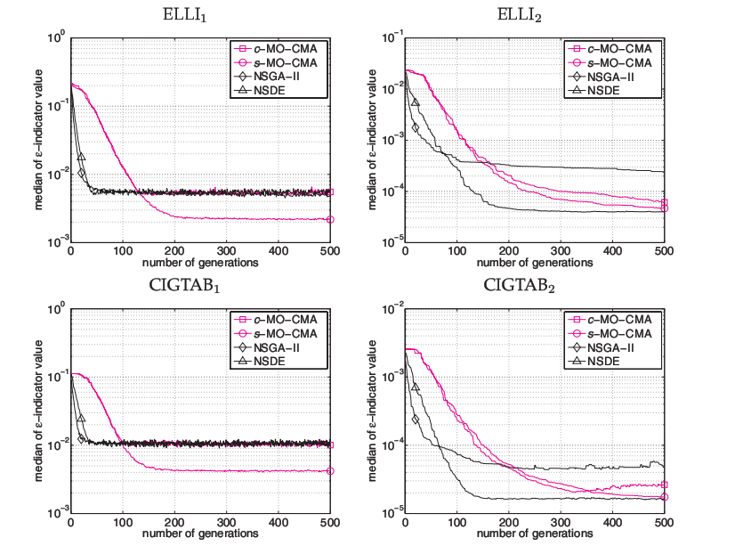
UC Test Function Result

Slide 33
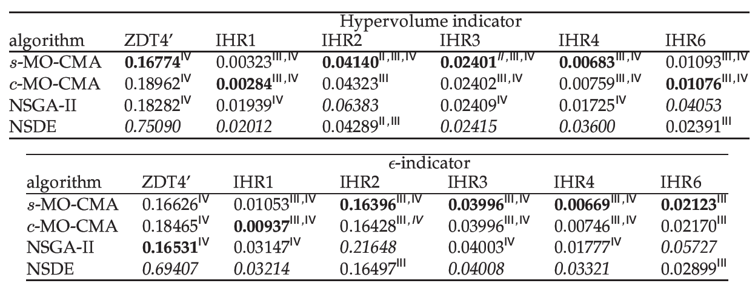
C Test Function Result

Slide 34
Summary and Conclusions
(1+1)-CMA-ES works reliably and that it is 1.5 times faster on unimodal functions VS standard CMA-ES with comma selection but (1+1)-CMA-ES is more susceptible to get trapped into sub-optimal local minima
MO-CMA strategies are independent of chosen coordinate system
s-MO-CMA algorithm appears to be the superior method

Slide 35
Refrences
Christian Igel(2007), CovarianceMatrix Adaptation for Multi-objective Optimization
Anne Auger (2011),CMA-ES — Evolution Strategies and Covariance Matrix Adaptation
Hansen, N. and A. Ostermeier (2001). Completely derandomized self-adaptation in evolution strategies

Slide 36
End Of Screen 2

Slide 37
Q?
Than Q

