Slide 1

Fast Mojette Transform for Discrete Tomography
MohammadReza Bidgoli
April ‎27, ‎2013

Slide 2
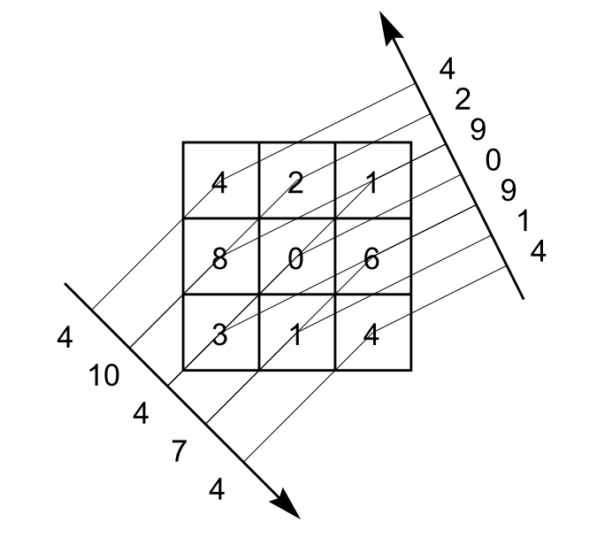
Discrete Mojette Transform

Slide 3
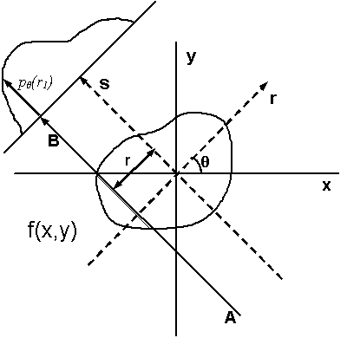
Continuous Mojette Transform

Slide 4
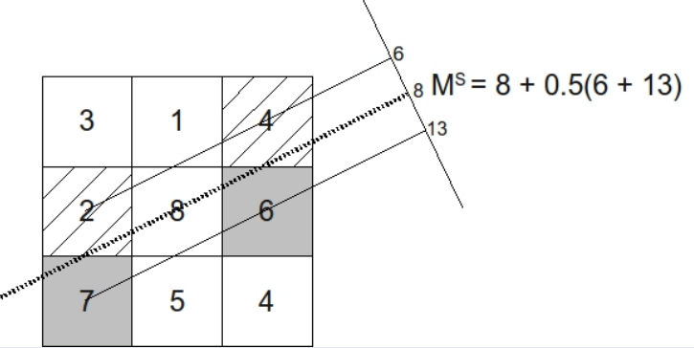
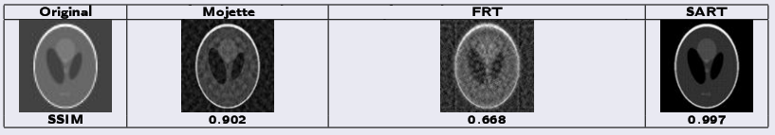
Spline Mojette (Optional)

Slide 5
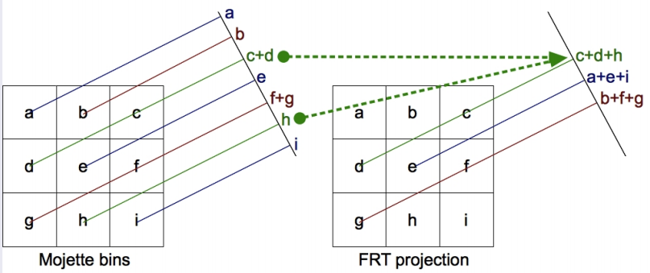
Mojette Vs Radon

Slide 6
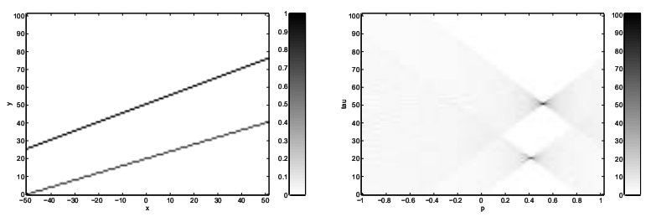
Mojette Vs Hough
Picture (x,y)
Mojette (m,b)

Slide 7
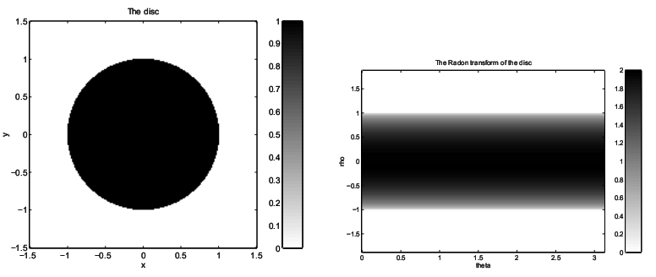
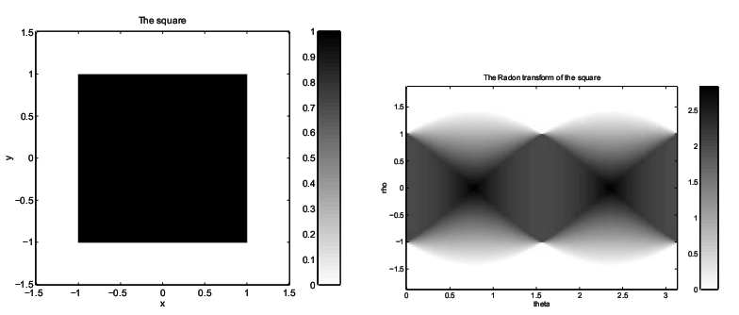
Mojette Of Square & Circle

Slide 8
Mojette Of Shepp Logan
Wait…

Slide 9
Reconstruction Methods
Algebraic Reconstruction Technique [Kaczmarz]
Corner Based Inversion [Normand]
Greedy
…
Monte Carlo !
…
Fast Mojette Transform

Slide 10
Fast Radon Transform
Fast Fourier Transform
  Cooley–Tukey (For 2^{n})
  Rader (For Primes)
  Bruun
  Bluestein

Slide 11




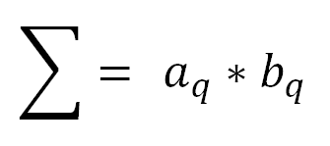
Rader
Base idea:
Convolution Theorem
N is Prime
g is a primitive root Module N

Slide 12
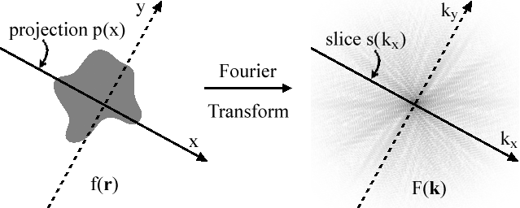
Connection With FFT
Projection-slice theorem

Slide 13
Viva France
Mojette Bin
Original Picture
Mojette Bin
1D FFT
2D
Fouried(!)
Picture
Mojette Bin
2D Inverse Fourier
1D FFT
Mojette Bin
Mojette Bin
1D FFT
Mojette Bin

Slide 14
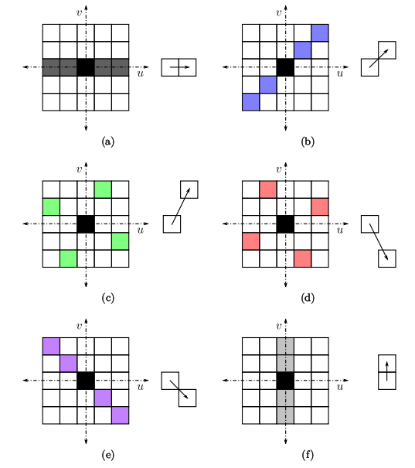
Tiling With Prime Slice
Can be tiled with
p+1 Slice
(1,0) (1,1)
(1,2) (1,3)
(1,4) (0,1)

Slide 15
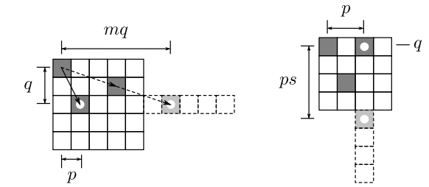
FMT!

Slide 16

Applications
CT Scan
Image Retrival
Security
Coding
WaterMarking
…
And…

Slide 17
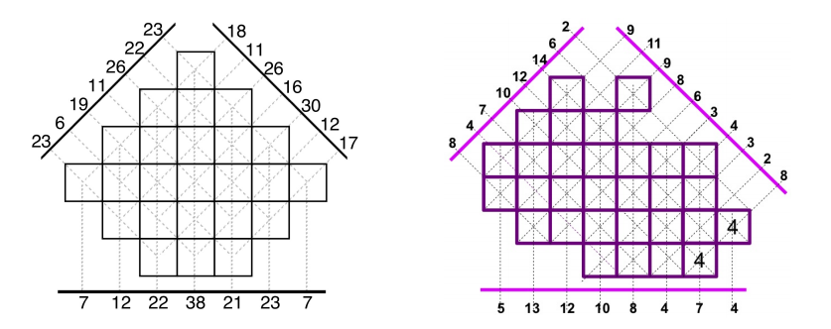
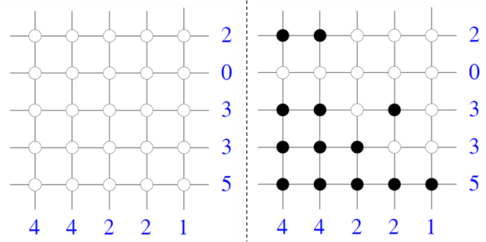
The Most important Application
Mojette Games
www.mojette.net
Try it!

Slide 18
Fin

