Slide 1
Hello,
PRESTENTED BY BIDHAN

Slide 2
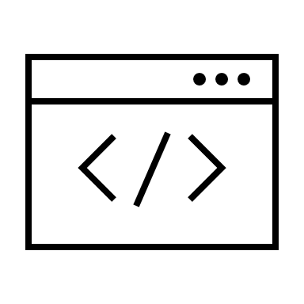
WEB APPLICATION

Slide 3
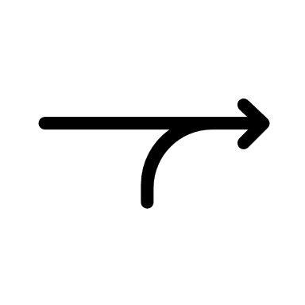
What is a Web Application?
A web-application is an application program that is usually stored on a remote server, and users can access it through the use of Software known as web-browser.

Slide 4
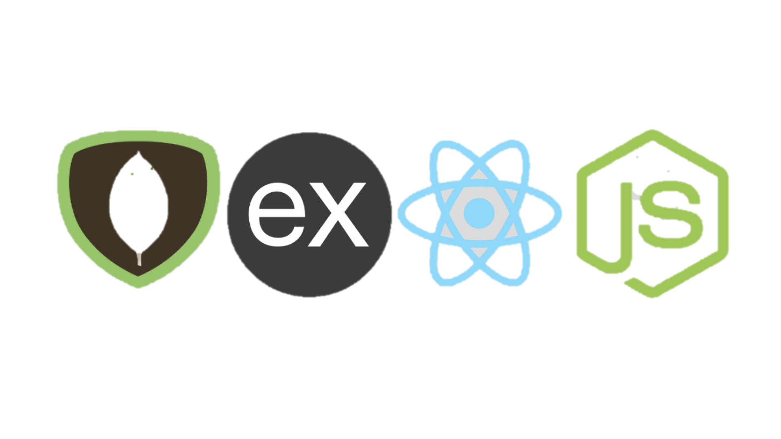
PLATFORMS USED TO DEVELOP WEB APPLICATIONS
MERN Stack: MERN stands for MongoDB, Express JS, React JS, and node.js. This platform is popular for building real-time web applications.

Slide 5


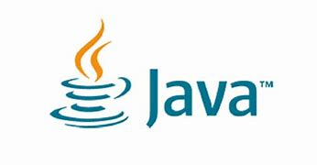
Ruby on Rails: This is a popular web application framework that uses the Ruby programming language.
Django: This is a web application framework that uses the Python programming language.
Java: Java is a popular programming language that can be used for building web applications.

Slide 6
COMPONENTS OF WEB APPLICATIONS
Front-end development: This involves the creation of the user interface and user experience (UI/UX) of the web application. This is typically done using HTML, CSS, and JavaScript.
Back-end development: This involves the creation of the server-side logic and database functionality that powers the web application. This is typically done using languages such as PHP, Ruby, Python, or Java.

Slide 7
Database management: This involves the creation and management of the database that stores the web application's data. This can be done using SQL or NoSQL databases.
Web servers: This involves the hosting of the web application on a web server that can handle incoming HTTP requests from users and serve the appropriate response.
APIs: APIs (Application Programming Interfaces) are used to allow the web application to communicate with other applications or services, such as social media platforms or payment gateways.
Security: This involves implementing measures to ensure the web application is secure, including data encryption, authentication, and authorization.

Slide 8
Testing and debugging: This involves the testing and debugging of the web application to ensure it is functioning properly and free of errors.
Deployment and maintenance: This involves the deployment of the web application to a production server, as well as ongoing maintenance and updates to ensure the application remains functional and up-to-date.

Slide 9

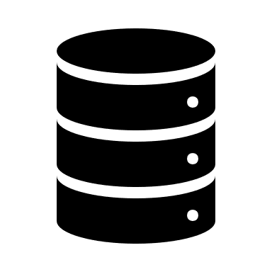
CONNECTION OF WEB APP’S WITH DATABASE
REACT JS
EXPRESS / NODE JS
MONGO DB
HTML / CSS / JS
MONGOOSE
FRONTEND DEVLOPMENT
BACKEND DEVLOPMENT
DATABASE

Slide 10

Thank You.

