Slide 1

Welcome to Everest Phones
Your Go-To Platform for Mobile Phones

Slide 2
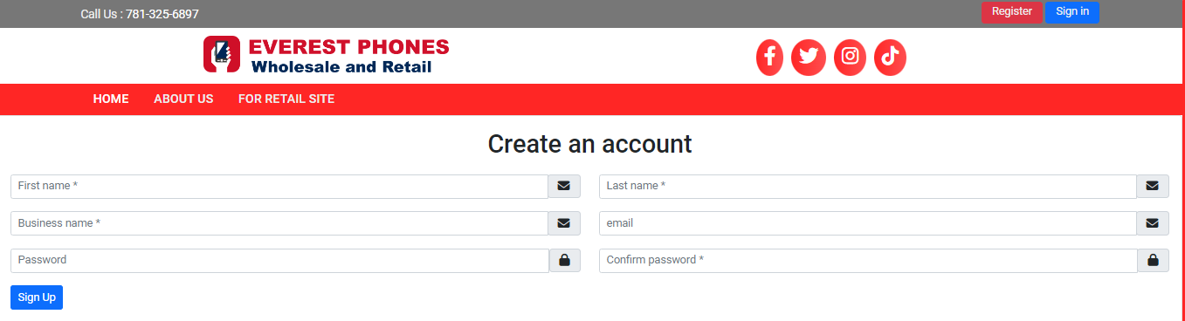
Step 1 - Account Creation
• Visit Everest Phones and register
• Provide personal/business details (first name, last name, email, password)
• System sends an email for verification
• Submit the form

Slide 3
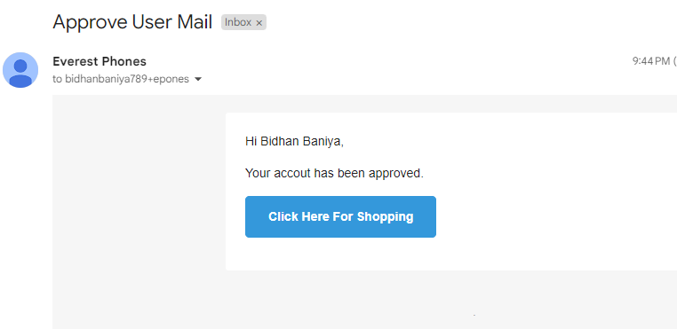
Step 2 - SysAdmin Approval
• Admin reviews your registration request
• Upon approval, you receive an email notification
• You can now log in with your credentials

Slide 4
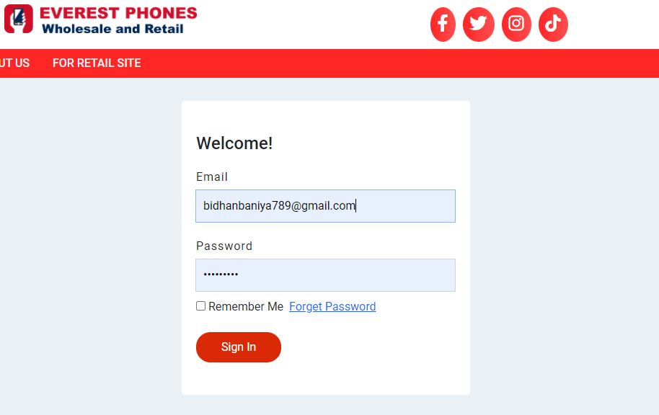
Step 3 - First-Time Login
• Log in for the first time after approval
• Provide additional business details (phone, address)

Slide 5
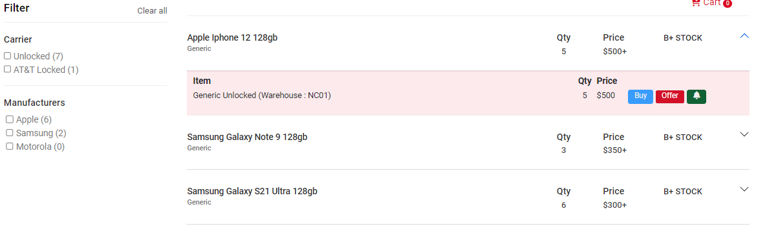
Step 4 - Browsing the Stock List
• Access a curated list of available phones with real-time updates
• See pricing and quality grades

Slide 6
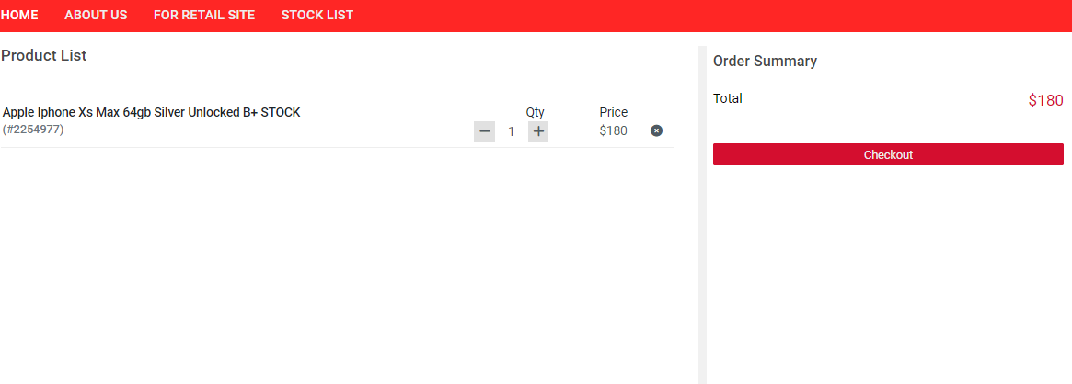
Step 5 - Adding Items to Cart
• Click 'Buy Now' to add phones to your cart
• Adjust quantities, review product details, and proceed to checkout

Slide 7
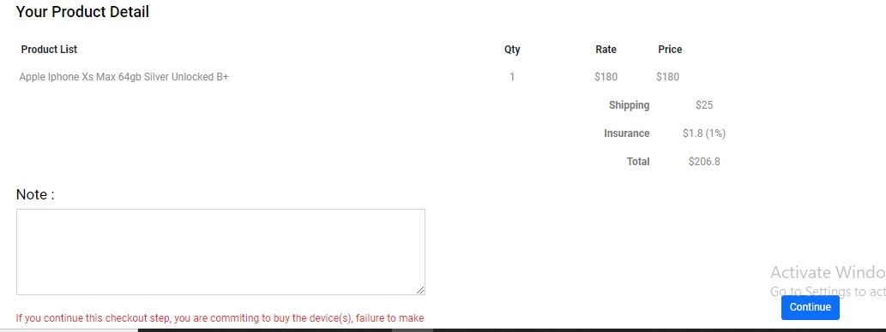
Step 6 - Finalizing Order and Checkout
• Fill in shipping details, select a shipping method, and review your order
• Complete the payment process

Slide 8
Step 7 - Payment Details (Bank Transfer & Zelle)
To complete your purchase, use the following payment methods:
**Bank Wire Transfer**:
• Bank Name: Bank of America
• Account Name: Everest Phone LLC
• ABA Routing Number (Wire): 026009593
• ABA Routing Number (Electronic): 053000196
• Account Number: 237036339301
**Zelle**: everestphones@gmail.com

Slide 9
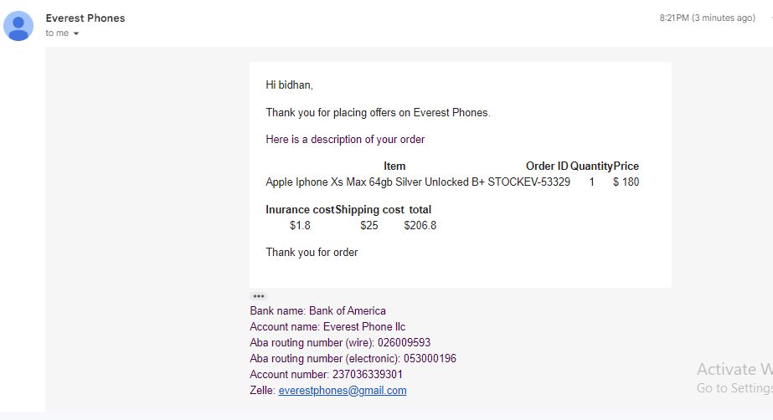
Step 8 - Order Confirmation and Tracking
• After completing the payment, you will receive an order confirmation via email
• You can track your shipment online

Slide 10
Contact Support
For assistance with your orders or account:
• Email: support@everestphones.com
• Phone: +1-800-EVEREST

