Slide 1

Welcome to Everest Phones
Your Go-To Platform for Mobile Phones

Slide 2
Device Grading Scale: Understanding Product Quality
A+ Grade:
Like-new devices with very minor or no cosmetic blemishes.
Battery health will be equal to or greater than 90%.
A Grade:
Devices with a battery health equal to or greater than 80%.
Minimal signs of wear, fully functional.
B+ Grade:
Devices have passed all functional tests but may show some noticeable cosmetic blemishes.
Battery health will be equal to or greater than 80%.

Slide 3
B Grade:
Devices have passed all functional tests and will exhibit more noticeable cosmetic blemishes.
C+ Grade:
Devices are functional but may have several noticeable cosmetic blemishes.

Slide 4
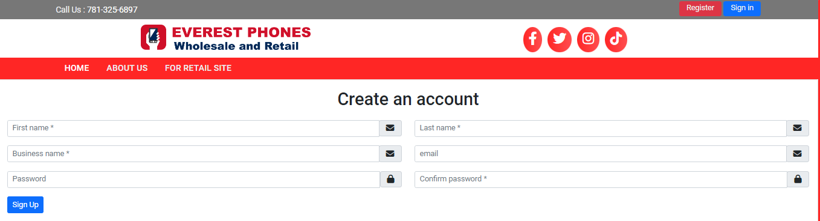
Step 1 - Account Creation
• Visit Everest Phones and register
• Provide personal/business details (first name, last name, email, password)
• System sends an email for verification
• Submit the form

Slide 5
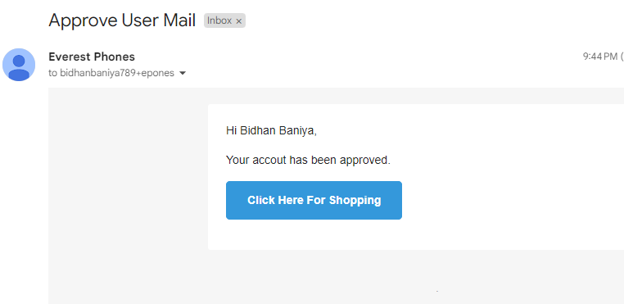
Step 2 - SysAdmin Approval
• Admin reviews your registration request
• Upon approval, you receive an email notification
• You can now log in with your credentials

Slide 6
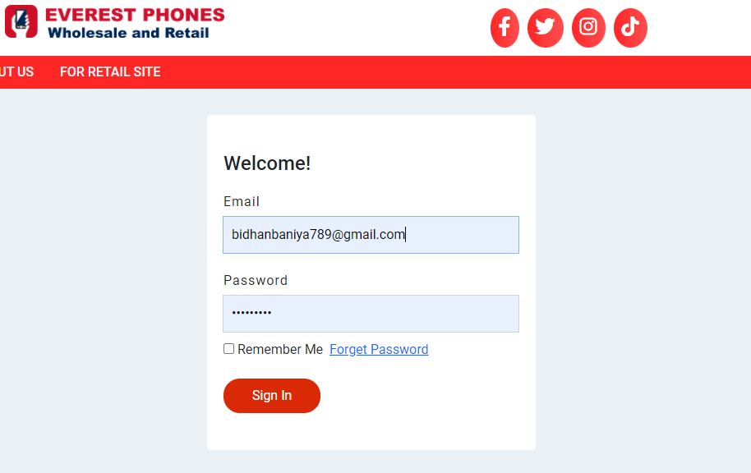
Step 3 - First-Time Login
• Log in for the first time after approval
• Provide additional business details (phone, address)

Slide 7
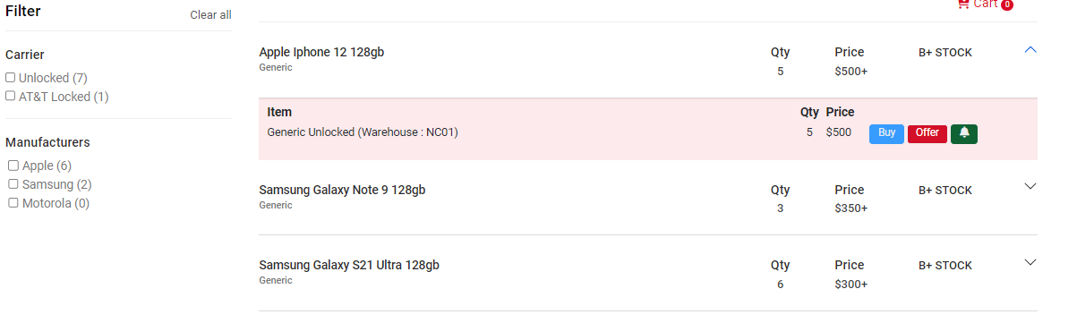
Step 4 - Browsing the Stock List
• Access a curated list of available phones with real-time updates
• See pricing and quality grades

Slide 8
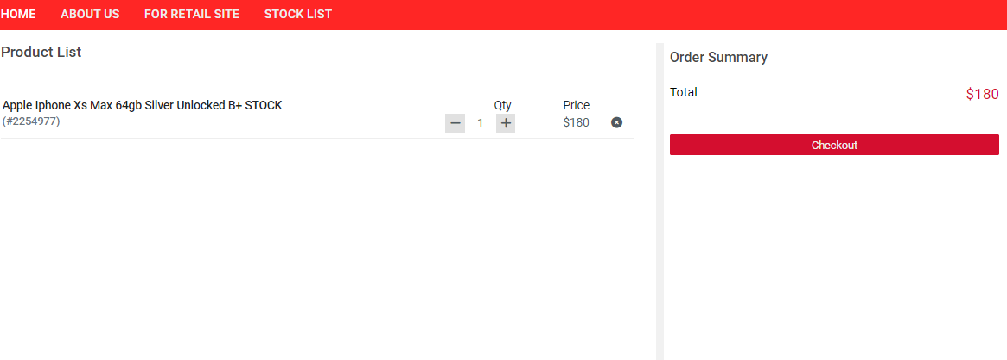
Step 5 - Adding Items to Cart
• Click 'Buy Now' to add phones to your cart
• Adjust quantities, review product details, and proceed to checkout

Slide 9
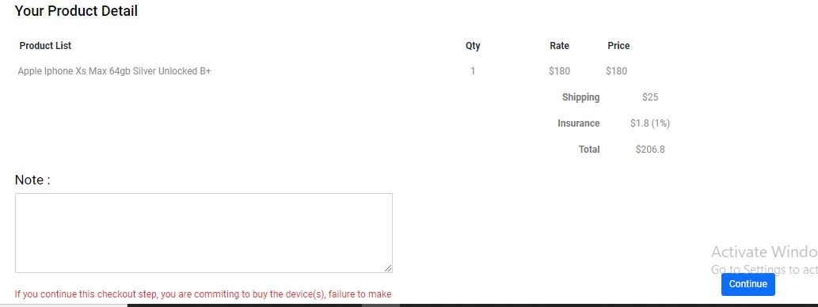
Step 6 - Finalizing Order and Checkout
• Fill in shipping details, select a shipping method, and review your order
• Complete the payment process

Slide 10
Step 7 - Payment Details (Bank Transfer & Zelle)
To complete your purchase, use the following payment methods:
**Bank Wire Transfer**:
• Bank Name: Bank of America
• Account Name: Everest Phone LLC
• ABA Routing Number (Wire): 026009593
• ABA Routing Number (Electronic): 053000196
• Account Number: 237036339301
**Zelle**: everestphones@gmail.com

Slide 11
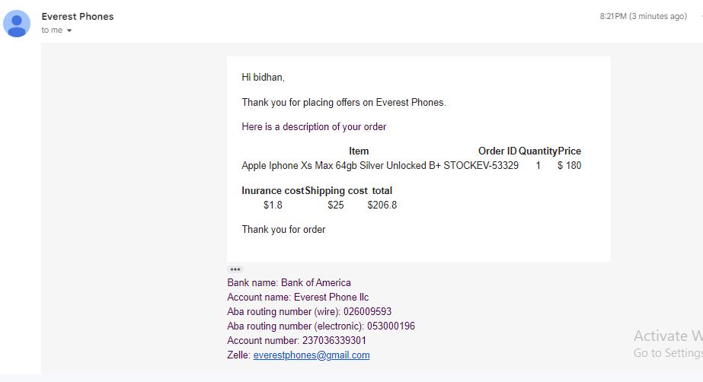
Step 8 - Order Confirmation and Tracking
• After completing the payment, you will receive an order confirmation via email
• You can track your shipment online

Slide 12
Order History and Tracking
Pending:
When you place an order, it is initially in the "Pending" state.
Paid and Shipped:
After payment, the sys admin updates the order status.
The shipping method, tracking number, and ESN for the phone are assigned.
Notifications:
You will be notified via email once your order is shipped.
You can track the shipment using the provided tracking number.
Invoice:
View and download your invoice from the order details page.
Delivered:
Once your order has arrived, the status will be updated to "Delivered".
A final email notification will confirm successful delivery.

Slide 13
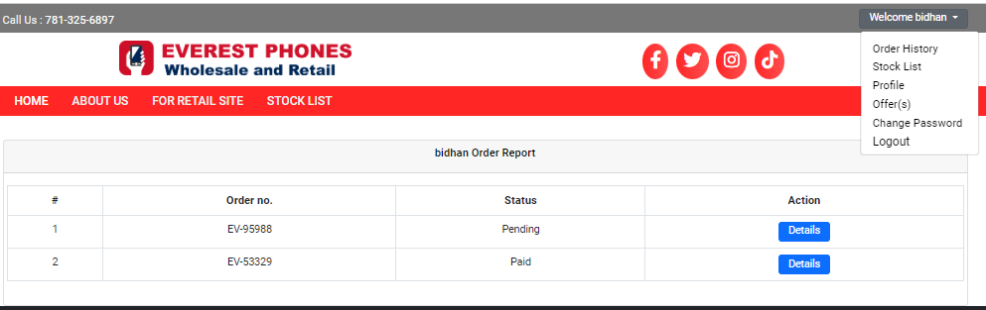
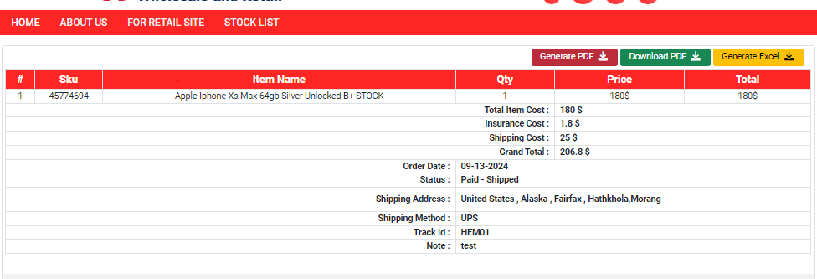
Some Screenshot of user order dashboard

Slide 14
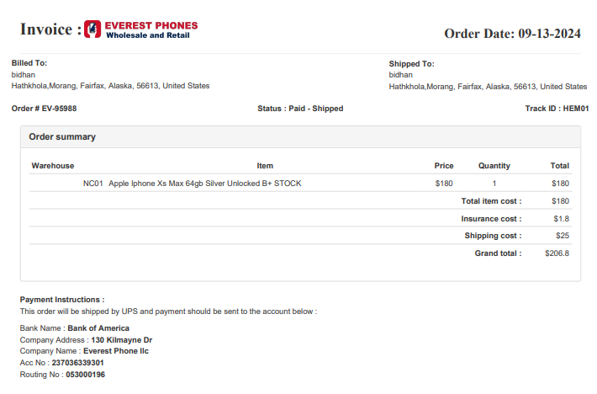
Screenshot of invoice

Slide 15
Negotiating Offers: Flexible Pricing for Phones
Making an Offer:
If the listed price of a phone is $500, the user can make an offer for a lower price (e.g., $485).
The offer can be submitted via the Offer(s) section.
Offer Review by Admin:
The system admin will review the user's offer.
Admin can either accept, reject, or counter the offer with a new price (e.g., $490).
User Response:
The user will be notified via email or can visit the Offer(s) section to check the updated offer.
The user can accept, reject, or make one final counter-offer.
Offer Limit:
The offer negotiation can only happen twice. After that, the final offer must be accepted or rejected.
Checkout Process:
Once the offer is accepted, the user can proceed to checkout by adding the phone to the cart and completing the order just like any regular purchase.

Slide 16
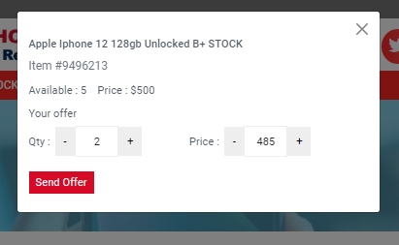
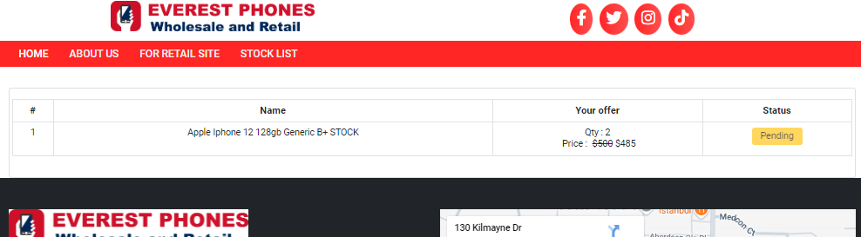
Screenshot of offer section

Slide 17
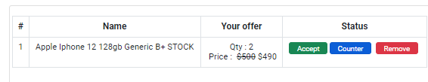
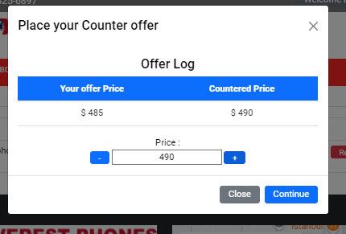

Slide 18
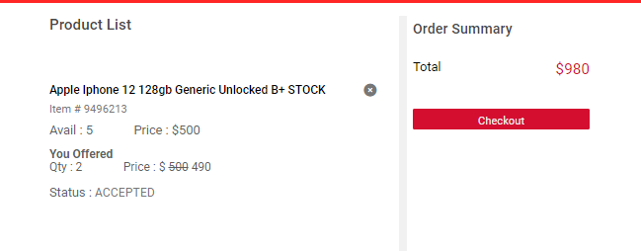

Slide 19
Our Services: Tailored Solutions for Your Needs
Facebook Marketplace Posting:
We provide professional assistance in listing your products on Facebook Marketplace.
Our team ensures your items are posted with optimized descriptions, high-quality images, and targeted to the right audience for maximum visibility.
Service Fee: [Insert Fee Details]
CCTV Monitoring Service:
We offer comprehensive CCTV monitoring services to ensure the safety of your premises.
Our team monitors real-time footage and alerts you to any suspicious activity, 24/7.
Service Fee: [Insert Fee Details]

Slide 20
Contact Support
For assistance with your orders or account:
• Email:everestphones@gmail.com
• Phone: +1 781-325-6897

