Slide 1

Welcome to Everest Phones
Your Go-To Platform for Mobile Phones

Slide 2
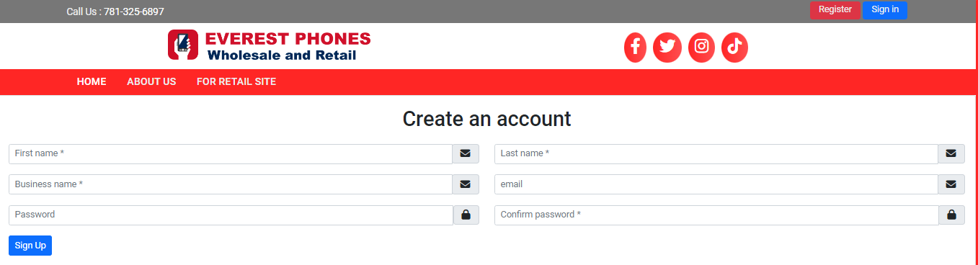
Step 1 - Account Creation
• Visit Everest Phones and register
• Provide personal/business details (first name, last name, email, password)
• System sends an email for verification
• Submit the form

Slide 3
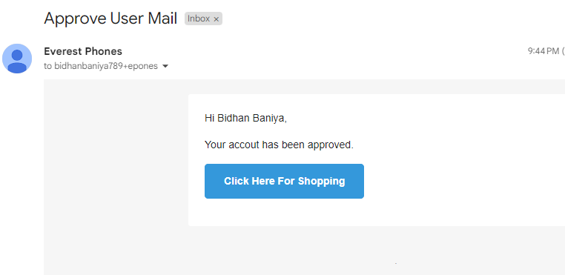
Step 2 - SysAdmin Approval
• Admin reviews your registration request
• Upon approval, you receive an email notification
• You can now log in with your credentials

Slide 4
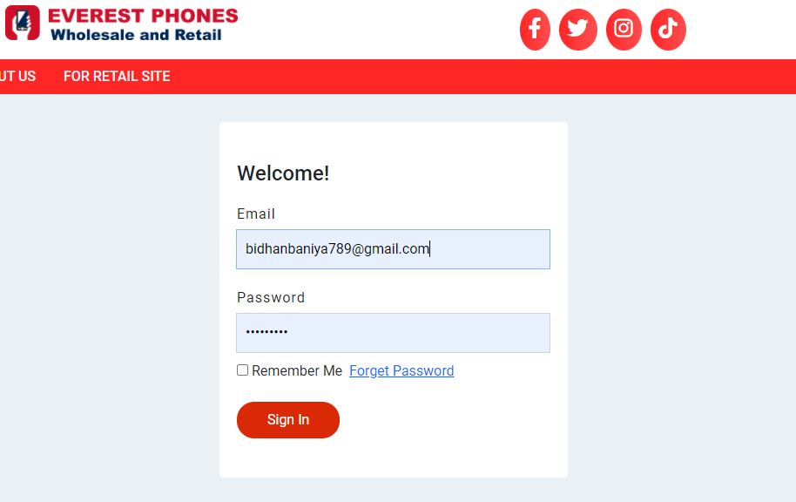
Step 3 - First-Time Login
• Log in for the first time after approval
• Provide additional business details (phone, address)

Slide 5
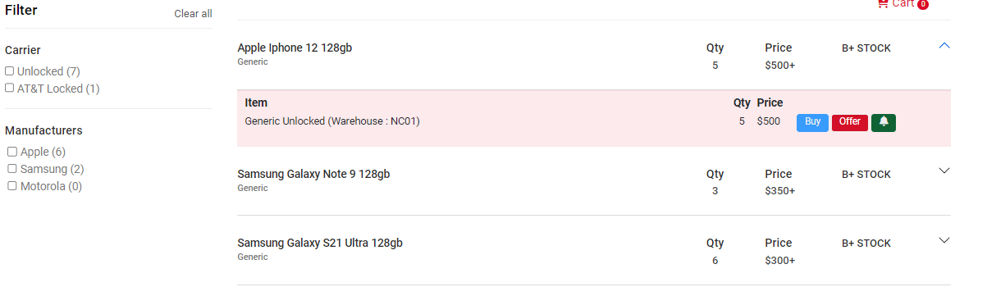
Step 4 - Browsing the Stock List
• Access a curated list of available phones with real-time updates
• See pricing and quality grades

Slide 6
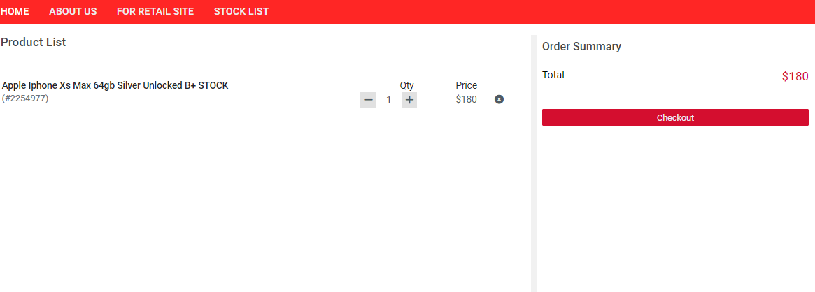
Step 5 - Adding Items to Cart
• Click 'Buy Now' to add phones to your cart
• Adjust quantities, review product details, and proceed to checkout

Slide 7
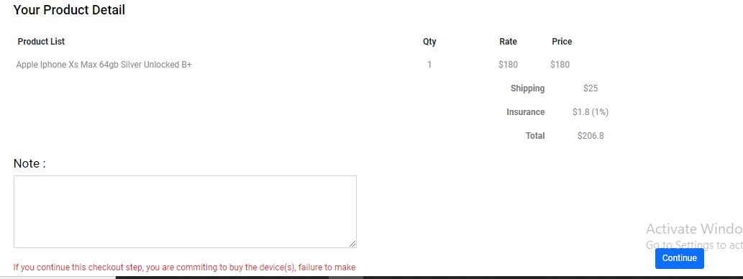
Step 6 - Finalizing Order and Checkout
• Fill in shipping details, select a shipping method, and review your order
• Complete the payment process

Slide 8
Step 7 - Payment Details (Bank Transfer & Zelle)
To complete your purchase, use the following payment methods:
**Bank Wire Transfer**:
• Bank Name: Bank of America
• Account Name: Everest Phone LLC
• ABA Routing Number (Wire): 026009593
• ABA Routing Number (Electronic): 053000196
• Account Number: 237036339301
**Zelle**: everestphones@gmail.com

Slide 9
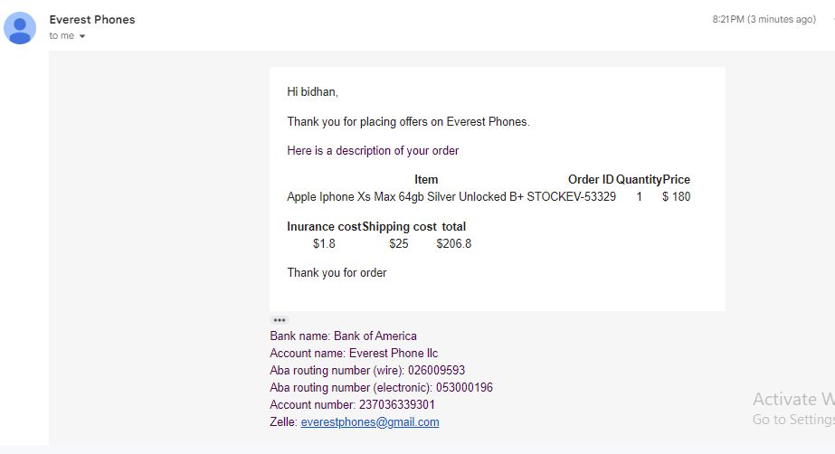
Step 8 - Order Confirmation and Tracking
• After completing the payment, you will receive an order confirmation via email
• You can track your shipment online

Slide 10
Order History and Tracking
Pending:
When you place an order, it is initially in the "Pending" state.
Paid and Shipped:
After payment, the sys admin updates the order status.
The shipping method, tracking number, and ESN for the phone are assigned.
Notifications:
You will be notified via email once your order is shipped.
You can track the shipment using the provided tracking number.
Invoice:
View and download your invoice from the order details page.
Delivered:
Once your order has arrived, the status will be updated to "Delivered".
A final email notification will confirm successful delivery.

Slide 11
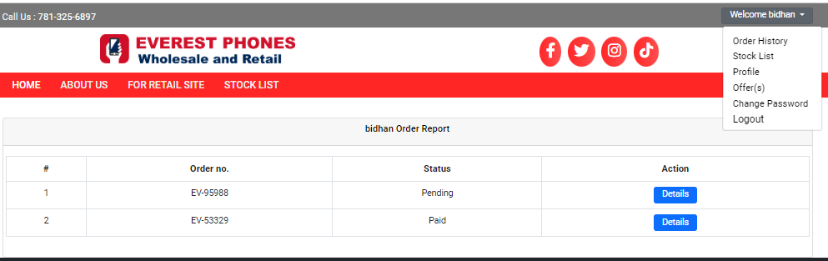
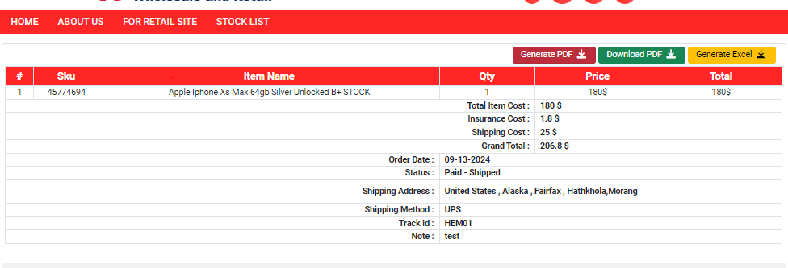
Some Screenshot of user order dashboard

Slide 12
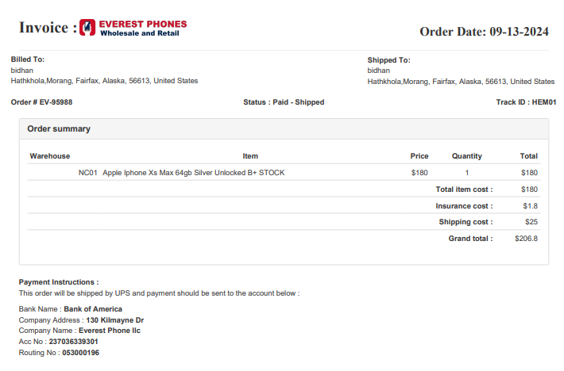
Screenshot of invoice

Slide 13
Negotiating Offers: Flexible Pricing for Phones
Making an Offer:
If the listed price of a phone is $500, the user can make an offer for a lower price (e.g., $485).
The offer can be submitted via the Offer(s) section.
Offer Review by Admin:
The system admin will review the user's offer.
Admin can either accept, reject, or counter the offer with a new price (e.g., $490).
User Response:
The user will be notified via email or can visit the Offer(s) section to check the updated offer.
The user can accept, reject, or make one final counter-offer.
Offer Limit:
The offer negotiation can only happen twice. After that, the final offer must be accepted or rejected.
Checkout Process:
Once the offer is accepted, the user can proceed to checkout by adding the phone to the cart and completing the order just like any regular purchase.

Slide 14
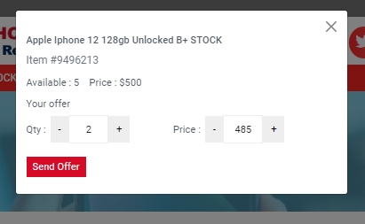
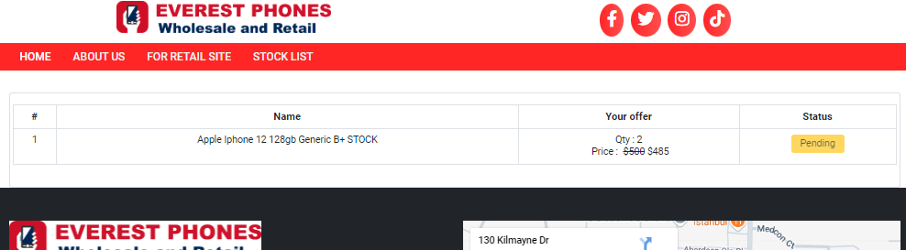
Screenshot of offer section

Slide 15
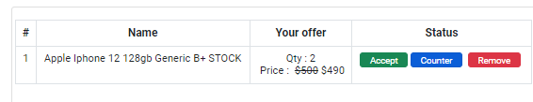
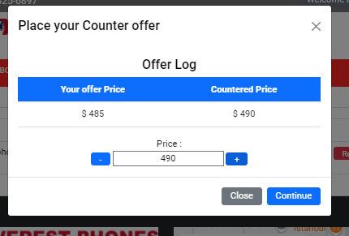

Slide 16
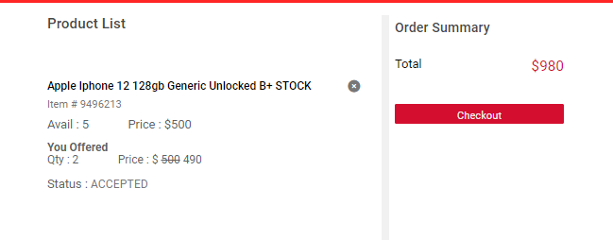

Slide 17
Contact Support
For assistance with your orders or account:
• Email:everestphones@gmail.com
• Phone: +1 781-325-6897

