Slide 1

Predicting Student Performance
Forecasting final Math grades (G3) with Linear Regression and Random Forest
Aleida Ramirez · Bidhan Khadka
UCI Student Performance Dataset — student-mat.csv
Notes:
Introduce the team and the goal: predict the final Math grade from student data.

Slide 2




Problem Statement
Can we predict a student's final Math grade (G3) from their background, habits and earlier grades?
Why it matters
The task
How we judge it
Spotting struggling students early lets teachers step in before the final exam.
Supervised regression: predict a grade from 0 to 20 for each student.
MSE and R² on students the model has never seen.
Two scenarios: with earlier grades G1/G2 (late in the year) and without them (early warning).
Notes:
Regression task on a 0–20 scale. Two scenarios: with prior grades (late in the year) and without them (early warning).

Slide 3




Dataset Description
395
33
0
0–20
students
attributes
missing values
grade scale (target G3)
Demographic
Family
School
Social
School, sex, age, home address, family size
Parents' education and jobs, guardian, family support
Study time, past failures, extra classes, absences
Going out, free time, relationships, alcohol use, health
Grades: G1 = 1st period, G2 = 2nd period, G3 = final (what we predict). 16 numeric + 17 categorical columns.
Notes:
Source: Cortez & Silva (2008). Data from school reports and questionnaires at two Portuguese secondary schools.

Slide 4
EDA: Descriptive Statistics
Feature | Mean | Median | Std Dev
Age | 16.70 | 17 | 1.28
Absences | 5.71 | 4 | 8.00
Study time (1–4) | 2.04 | 2 | 0.84
Past failures | 0.33 | 0 | 0.74
G1 | 10.91 | 11 | 3.32
G2 | 10.71 | 11 | 3.76
G3 (target) | 10.42 | 11 | 4.58
Average grade ≈ 10.5 / 20
G3 has the widest spread (std 4.58).
Mean below median for G3
10.42 vs 11: a group of zero grades pulls the average down.
Absences are skewed
Median 4 but mean 5.71; a few students miss many classes.
Notes:
Mean, median, standard deviation from df[key].agg(...).

Slide 5
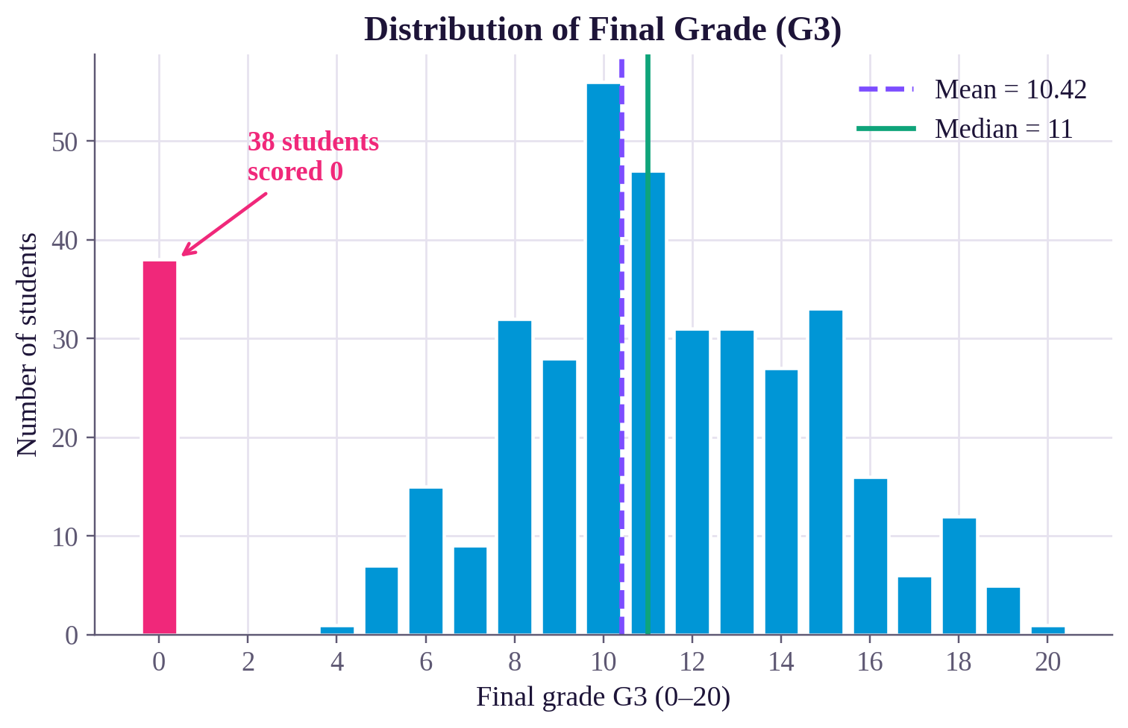
EDA: Final Grade Distribution
38 students
scored exactly 0 (9.6%)
Bell-shaped otherwise
Most grades fall between 8 and 15.
Likely dropouts
All 38 have 0 absences, so they probably skipped the final exam.
Notes:
All 38 zero-grade students have 0 absences recorded; consistent with dropping the course or missing the final exam.

Slide 6
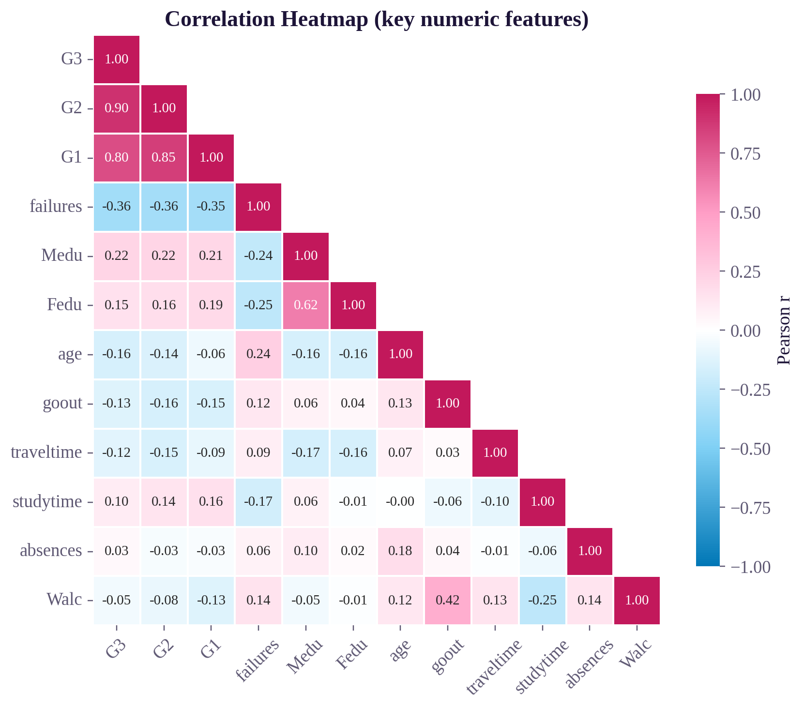
EDA: Correlation Analysis
How to read the heatmap
Each square shows the correlation (r) between two features, from −1 to +1. Pink means they rise together, blue means one goes up as the other goes down, and white means no clear link. Darker color = stronger relationship. The first column compares every feature with G3.
What it shows
Earlier grades dominate: G2 (0.90) and G1 (0.80). Past failures is the strongest non-grade signal (−0.36). Parents' education helps a little (0.22, 0.15), while age, going out and travel time lower grades slightly.
Notes:
Heatmap of the 12 most relevant numeric features. Full heatmap is in the Part A notebook.

Slide 7
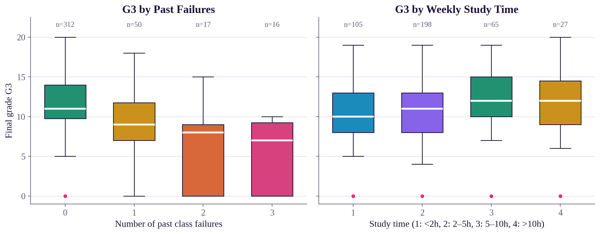
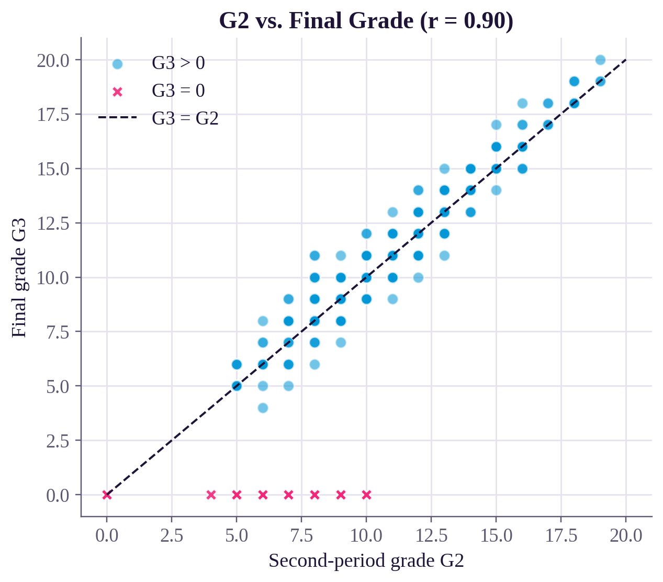
EDA: Failures, Study Time & Earlier Grades
What the box plots show
What the scatter shows
Each box holds the middle 50% of students in a group; the white line is the median and dots are outliers. Students with more past failures score clearly lower (median 11 → 7). More study time only nudges grades up (10 → 12), and the boxes overlap a lot.
Each dot is a student. Most sit on the dashed line, so G3 ≈ G2. Pink X's scored 0 on the final.
Notes:
Box plots: white line = median. Scatter: pink X = students with G3 = 0.

Slide 8
Data Preprocessing
1
2
3
4
5
Check quality
One-hot encode
Keep ordinal
Split 80/20
Standardize
395 × 33, no missing values or duplicates
17 text columns → 0/1 dummies with drop_first=True
Parents' education & 1–5 ratings stay as numbers
316 train / 79 test, random_state = 42
StandardScaler for Linear Regression only
Why one-hot?
Why scale after splitting?
Models need numbers. Numbering jobs 0–4 would imply a fake order; drop_first avoids redundant columns.
Features range from 0–1 to 0–75. Fitting the scaler on training data only avoids leaking test information.
Notes:
Scaling is done after the split and fit on training data only to prevent data leakage.

Slide 9
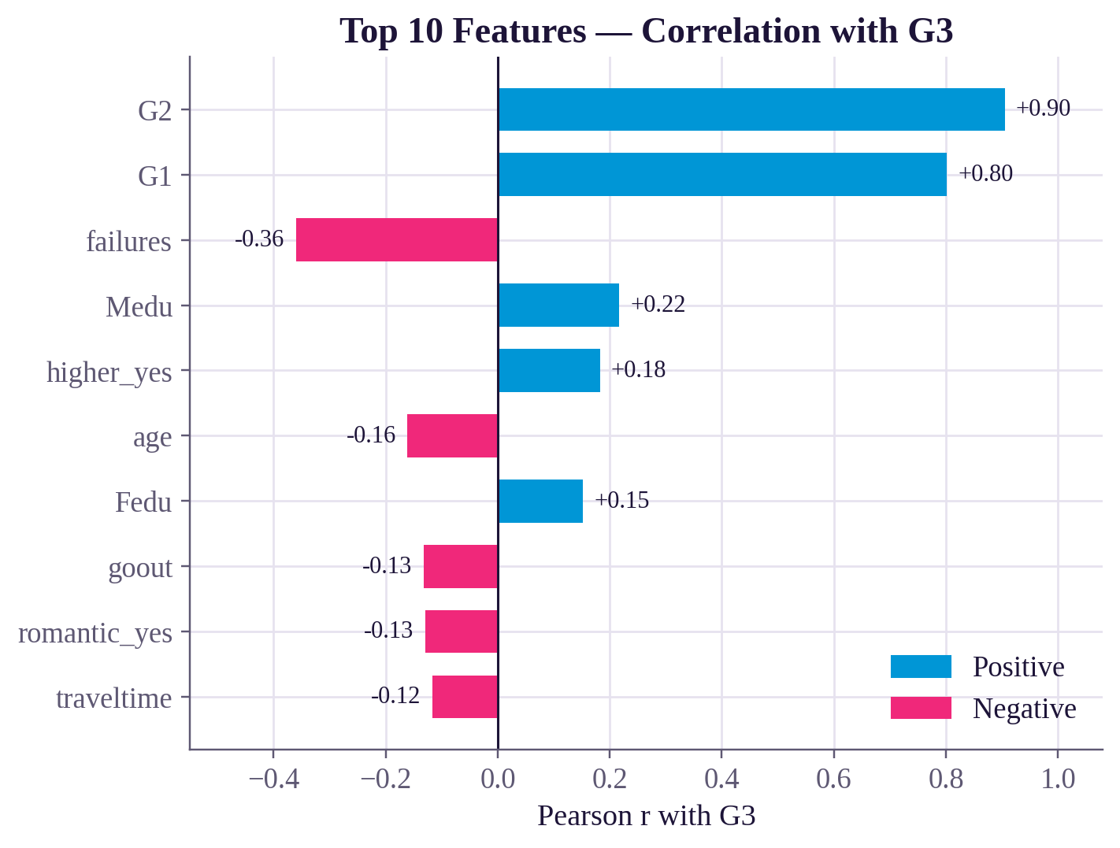
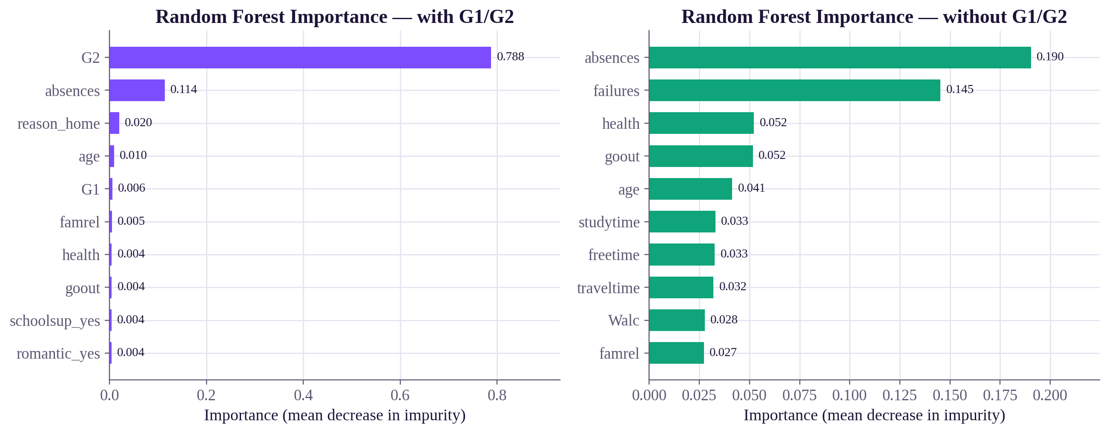
Feature Importance
Correlation (left)
Random Forest, with G1/G2
Random Forest, without G1/G2
How strongly each feature moves with G3 in a straight line. Blue rises with G3, pink falls. G2 (0.90) and G1 (0.80) lead; past failures is the top negative (−0.36).
How much each feature helped the model predict (scores add to 1). G2 alone is 0.79. Absences is 2nd (0.11) even though its correlation is ≈ 0: it helps flag the zero-grade students.
With earlier grades removed, the model leans on absences (0.19) and past failures (0.14), then health, going out and age. No single feature is strong.
Notes:
SCRIPT: We measured which features matter in two ways. The left chart is correlation: how strongly each feature moves with the final grade in a straight line. Blue bars go up with G3, pink bars go down. G2 and G1 are far ahead, and past failures is the biggest negative. The two green and purple charts come from the Random Forest. Importance shows how much each feature helped the model make accurate predictions, and the scores add up to 1. With earlier grades, G2 alone accounts for about 79%. Interesting point: absences has almost zero correlation, but it is the forest's second most useful feature. That is because all 38 students who scored 0 had zero absences, so the forest uses it to spot them. When we remove G1 and G2, the model has to rely on absences and past failures, and no single feature is strong, which is why accuracy drops.

Slide 10
Models & Training Methodology
Linear Regression: the simple baseline
Random Forest: 200 decision trees
Fits a weighted sum of the features: each feature gets one weight. Easy to interpret. Needs standardized features, and can predict impossible grades (below 0 or above 20).
Each tree learns from a random sample of students; the forest averages their answers. Captures non-linear patterns (e.g. a sudden drop to 0). No scaling needed.
1. Split 80 / 20
2. Two feature sets
3. Train
4. Test
5. Cross-validate
316 students to learn from, 79 held back. random_state = 42 makes it repeatable.
With G1/G2 (41 features) and without them (39) as an early-warning model.
Each model learns only from the 316 training students.
Predict the 79 unseen students; score with MSE and R².
5-fold CV: each fifth takes a turn as the test set; the 5 scores are averaged.
Why both models? Compare a simple, explainable baseline with a more powerful model and see if the extra complexity pays off.
Notes:
SCRIPT: This slide shows how we built and tested our models. Linear Regression is our simple baseline: it fits a weighted sum of the features, so each feature gets one weight. It needs scaled features, and because it is a straight line it can even predict impossible grades below 0 or above 20. Random Forest builds 200 decision trees, each trained on a random sample of students, and averages their predictions. It captures non-linear patterns like a sudden drop to 0, needs no scaling, and its predictions stay in the 0 to 20 range. We used both to see whether the extra complexity pays off. For training, we split the data 80/20: 316 students to learn from and 79 held back, with random_state 42 so the split is reproducible. We trained each model with and without G1 and G2. We scored the 79 test students with MSE and R², and because one test set of 79 students is small, we also ran 5-fold cross-validation: each fifth of the data takes a turn as the test set and the five scores are averaged.

Slide 11
Performance Metrics
MSE (Mean Squared Error)
R² (coefficient of determination)
Average of (actual − predicted)². Lower is better.
Share of grade variation explained. 1 = perfect, 0 = guessing the average.
Model | Features | MSE | R² (test) | R² (5-fold CV)
Linear Regression | with G1/G2 | 5.66 | 0.724 | 0.792
Linear Regression | without G1/G2 | 17.60 | 0.141 | 0.026
Random Forest | with G1/G2 | 3.87 | 0.811 | 0.872
Random Forest | without G1/G2 | 14.97 | 0.270 | 0.286
Best: Random Forest with G1/G2. Lowest error; explains about 81% (test) to 87% (CV) of grade variation. Random Forest beats Linear Regression in both settings, and removing G1/G2 makes R² drop sharply.
Mean-only baseline: MSE 20.7
Notes:
SCRIPT: We measured performance with two metrics. MSE is the average squared difference between the actual and predicted grade, so lower is better. R² is the share of grade variation the model explains: 1 is perfect, 0 is no better than guessing the average. The R² test column uses the 79 test students; the CV column averages 5 cross-validation rounds, which is more reliable. Random Forest with G1 and G2 is the best on every measure: MSE 3.87, R² 0.811 on the test set and 0.872 with cross-validation. Random Forest beats Linear Regression in both settings, and removing G1 and G2 makes R² drop sharply. For reference, always predicting the average grade gives MSE 20.7.

Slide 12
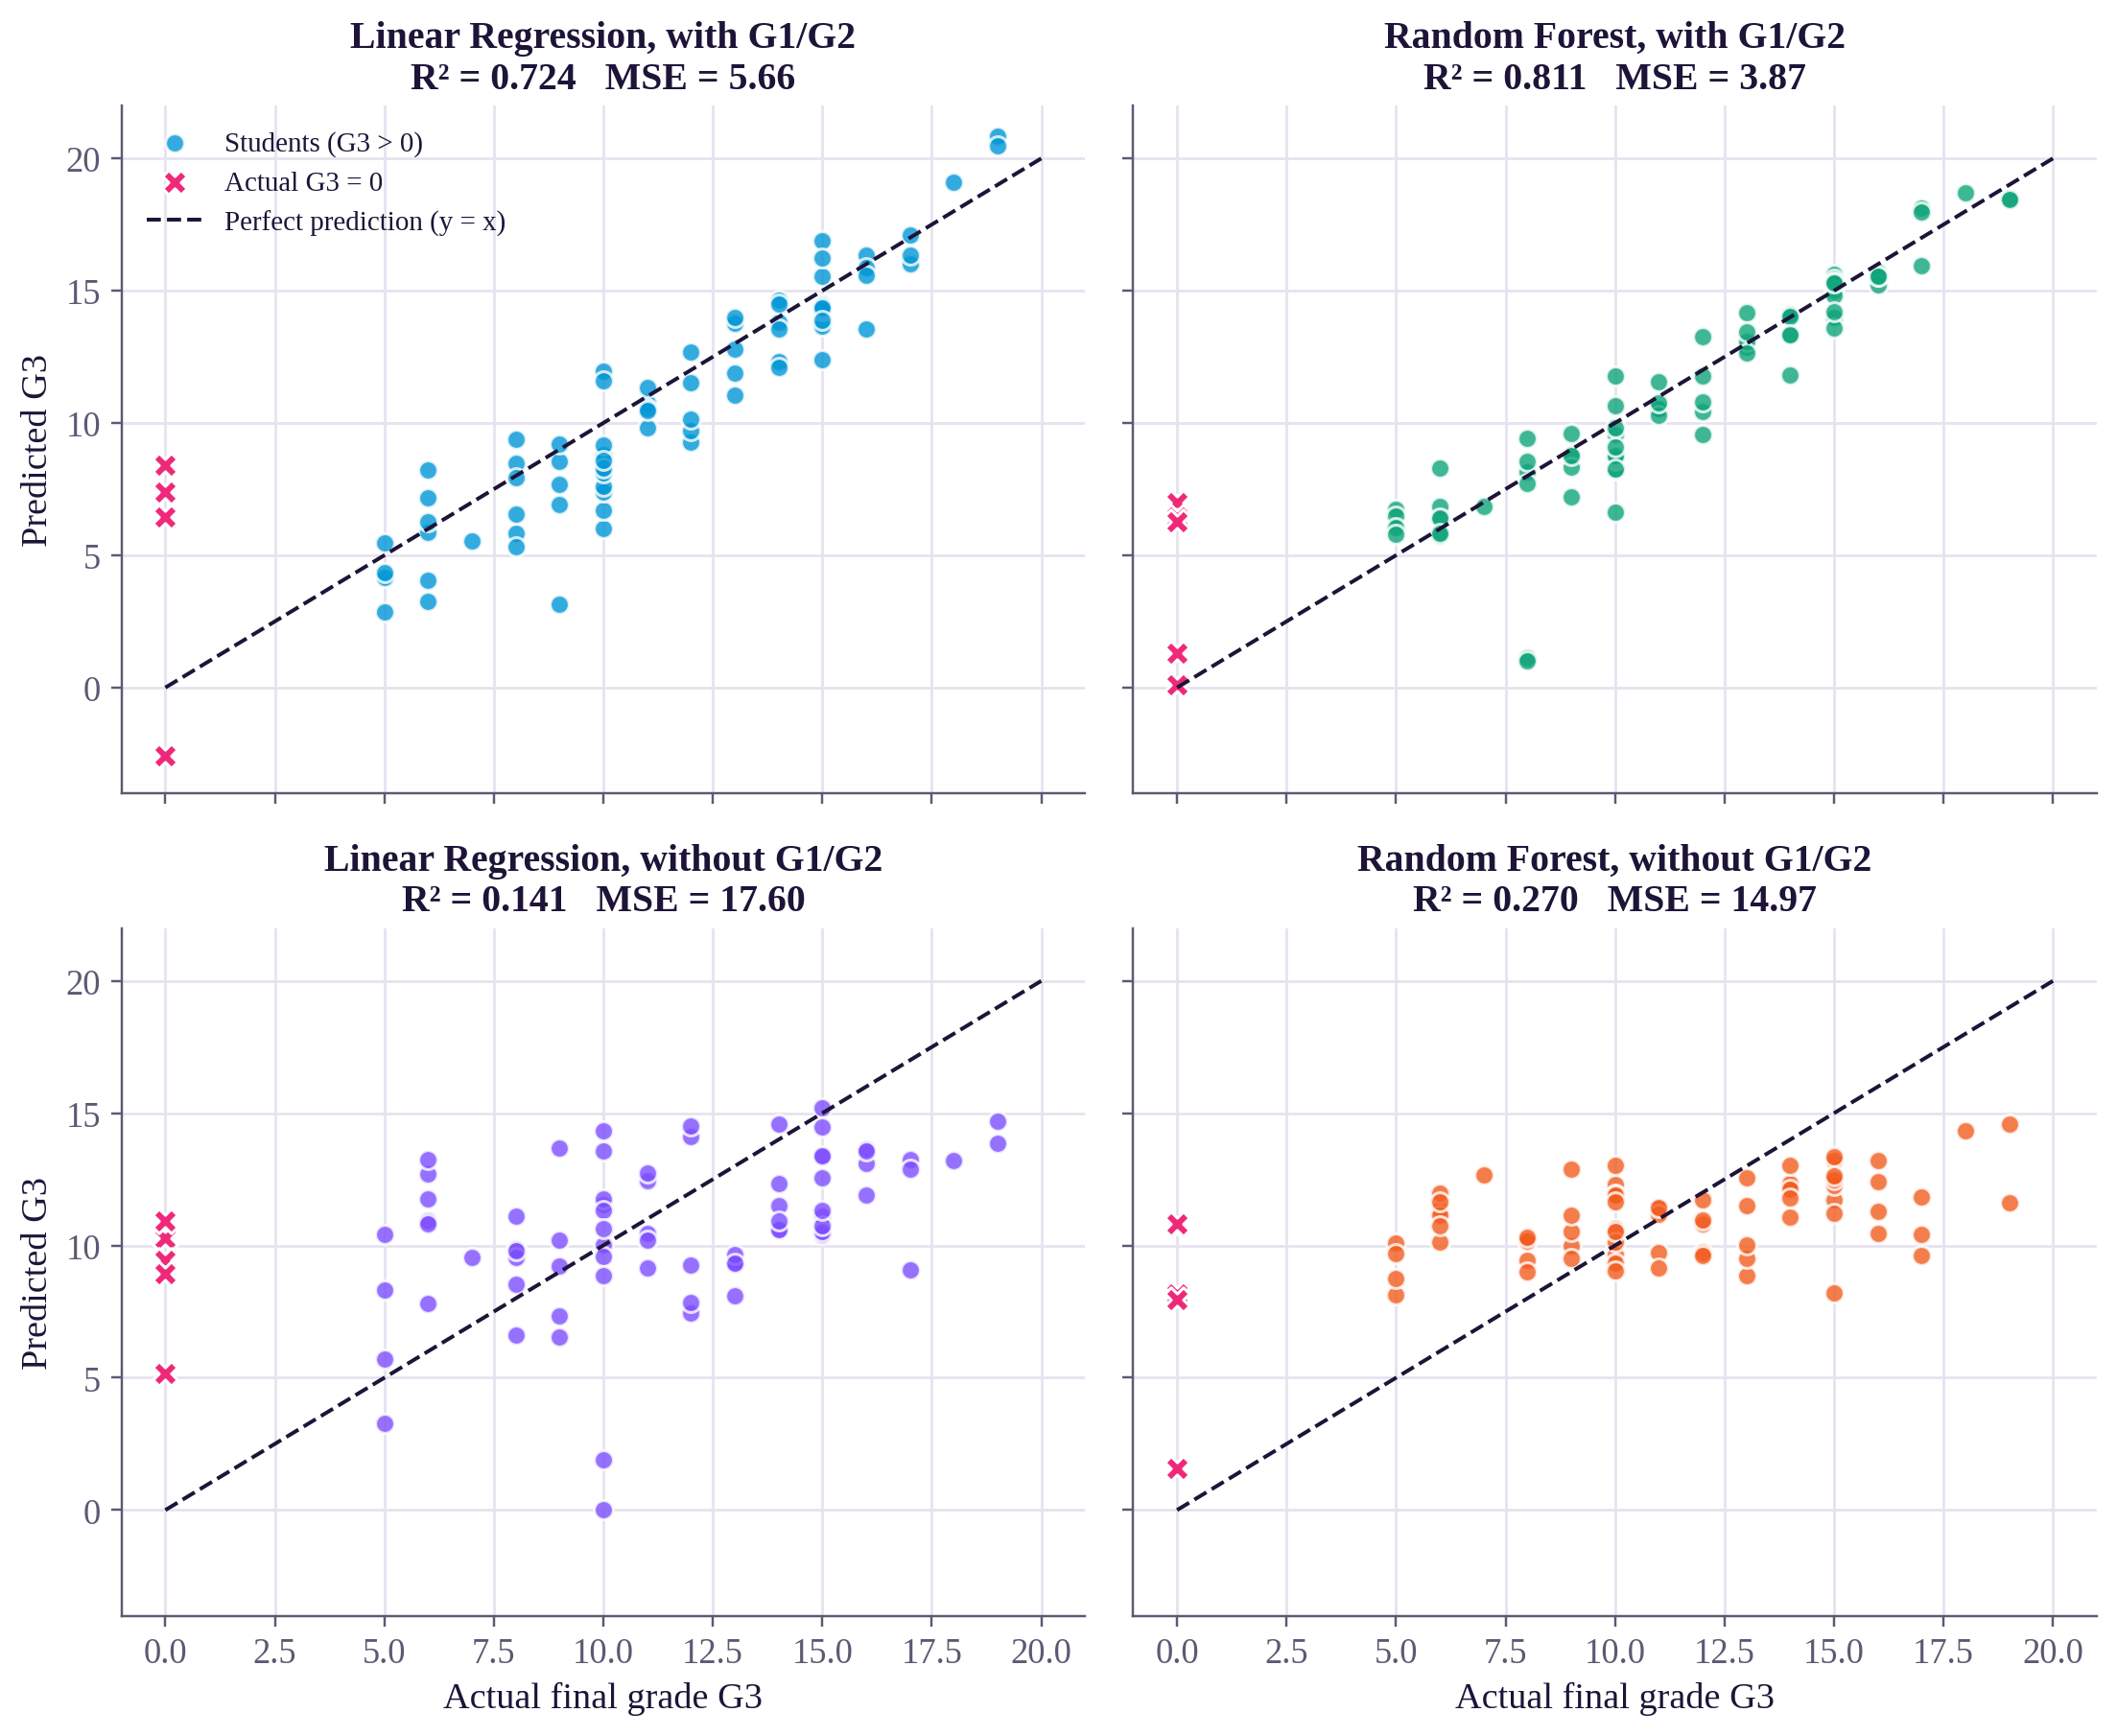
Actual vs. Predicted Grades
How to read it
Each dot is one test student. Dots on the dashed y = x line are perfect predictions; the farther away, the bigger the error.
With G1/G2 (top): dots hug the line, tightest for Random Forest (R² = 0.811).
Without G1/G2 (bottom): predictions bunch around 9–13; the model mostly guesses an average student.
Pink X (actual G3 = 0) are the largest errors in every panel. Most had normal earlier grades.
Linear Regression even predicts impossible grades (about -2.6 and above 20).
Notes:
SCRIPT: These four plots compare each model's prediction with the real final grade for the 79 test students. Each dot is one student: left to right is the actual grade, up and down is the prediction. Dots on the dashed line are perfect predictions; the farther away, the bigger the error. The top row uses G1 and G2. The dots hug the line, and Random Forest is the tightest, with R² 0.811. The bottom row removes G1 and G2: the Random Forest's predictions bunch around 9 to 13, so the model mostly guesses an average student. The pink X's are students whose actual grade was 0. They are the largest errors in every panel because most of them had normal earlier grades; in the best model these 5 students cause 43% of the error. Finally, Linear Regression even predicts impossible grades, about -2.6 and 20.8, because a straight line has no 0 to 20 limit.

Slide 13
Results & Observations
R² 0.81
R² 0.72
R² 0.27
Random Forest, with G1/G2 (CV 0.87)
Linear Regression, with G1/G2 (CV 0.79)
Random Forest, without G1/G2 (CV 0.29)
Random Forest is best: it explains 81% (test) to 87% (CV) of the variation in final grades, around the 0.6–0.85 reference range.
Random Forest beats Linear Regression because it handles non-linear patterns such as the zero-grade students.
Removing G1/G2 drops R² from 0.81 to 0.27: past grades drive the prediction.
Without G1/G2 the model still beats guessing the average (MSE 14.97 vs 20.7).
Excluding the zero-grade students, Random Forest reaches R² = 0.83.
Notes:
SCRIPT: Summarize the three headline R² values, then walk through the bullets.

Slide 14
Challenges Encountered
Should G1/G2 be used?
Zero-grade outliers
Small dataset
They make prediction easy but aren't available at the start of the year.
38 students (about 10%) have G3 = 0, likely dropouts no model can foresee.
Only 395 students; one 79-student test set gives noisy scores.
What we did: Trained and compared both feature sets.
What we did: Highlighted them in plots and measured their effect.
What we did: Added 5-fold cross-validation for a stable estimate.
Technical issue
Overfitting
Data leakage risk
NumPy 2.0 on macOS printed false math warnings in Linear Regression.
Random Forest scores R² 0.98 on training data vs 0.81 on test data.
Scaling before splitting would leak test information.
What we did: Pinned NumPy 1.26 in requirements.txt (results unchanged).
What we did: Judged models only on unseen test data and CV.
What we did: Fit the scaler on the training set only.
Notes:
SCRIPT: For each challenge, say the problem first, then what we did about it.

Slide 15
Conclusion
0.81
0.27
38
best R² — Random Forest with G1/G2 (0.87 with CV)
R² without earlier grades
zero-grade students: the hardest cases
Earlier grades are the strongest predictor. With G1 and G2, Random Forest explains 81% of grade variation (87% with cross-validation), within the 0.6–0.85 range for reasonable performance.
Random Forest beat Linear Regression (R² 0.81 vs 0.72) because it captures non-linear patterns, like grades dropping to 0.
Background factors alone explain only about 27% of grade variation, so early-warning prediction would need more or better data.
Practical meaning: useful as a mid-year prediction tool. The 38 students who scored 0 (likely dropouts) are the biggest source of error.
Future work: predict dropouts separately (classification), tune the Random Forest, and try gradient boosting.
Thank you! Questions?
Notes:
SCRIPT: To wrap up: earlier grades are by far the best predictor. Random Forest with G1 and G2 explains about 81% of grade variation, 87% with cross-validation, and beat Linear Regression because it handles non-linear patterns. Background factors alone explain only about 27%, so this works as a mid-year tool, but early warning would need more data. The students who scored 0 were the hardest to predict. Next we'd model dropouts separately, tune the forest and try gradient boosting. Thank you, we're happy to take questions.

