Slide 2

SMART
AGRICULTURE
PRESENTED BY: BIDHAN NATH
ID: 0222220005101027

Slide 3
01
Introduction
Smart Agriculture
02
Principles of smart Agriculture
03
Advantages
04
Disadvantages
05
Future Prospects
06
Conclusion

Slide 4
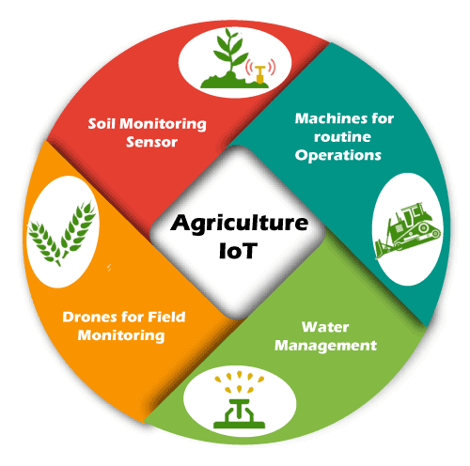
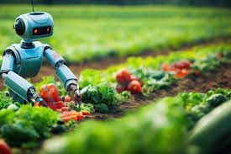
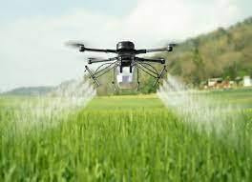
AI
IOT
Drone
Introduction

Slide 5
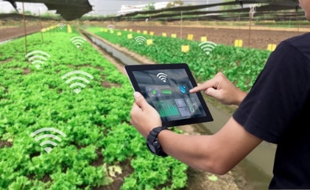
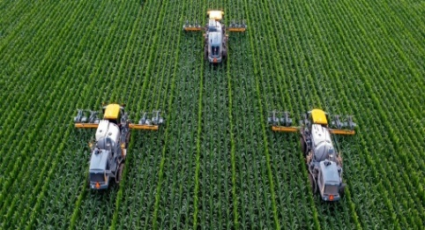
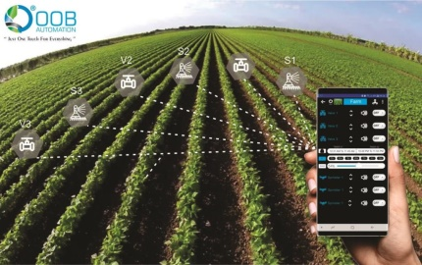
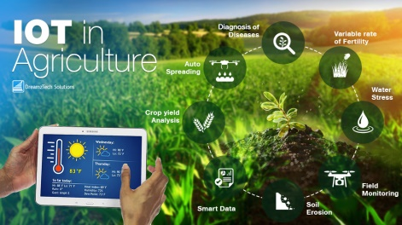
Principles of Smart Agriculture
01
Data-driven Decision Making
Collecting data from soil moisture, temperature,
nutrient levels, and crop health.
02
Precision Farming Techniques
Applying input like water, fertilizers, and pesticides.
03
Automated Monitoring Systems
Monitoring crop growth by using drones and satellite
Imagery.
04
Integration of IOT and AI
Providing actionable insights, predicting crop yields.

Slide 6
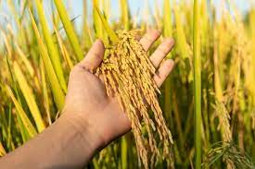
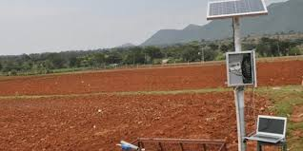

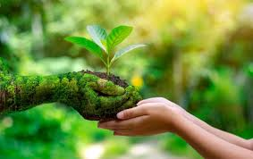
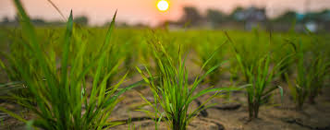
Advantages of Smart Agriculture
01
Increased Crop Yields
02
Resource Efficiency
03
Cost Savings
04
Improved Crop Quality
05
Climate Resilience

Slide 7
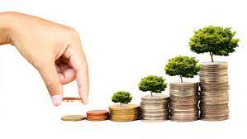



Disadvantages of Smart Agriculture
01
High Initial Investment
02
Data Privacy and Security Concerns
03
Digital Divide
04
Skills Gap

Slide 8
Future prospects of Smart Agriculture
01
Continued Innovation
02
Sustainable Practices
03
Digital Transformation
04
Collaborative Partnerships
05
Inclusive Growth

Slide 9
Conclusion

Slide 10
Thank you

