Slide 1
TRex
by CISCO

Slide 2
TRex
Traffic Generation Tool based on DPDK upto 200GB/sec (Intel) 40GB/sec (CISCO UCS)
Generates and analyzes L4-7 traffic
Create server- and client- side traffic.
Traffic Generation modes : Stateless & Stateful
Replay of real traffic templates using different traffic profiles.
Create packet using Field Engine.
Virtual interface support enables TRex to be run on VM’s without physical NIC’s
Can stitch multiple traffic profile together as one

Slide 3
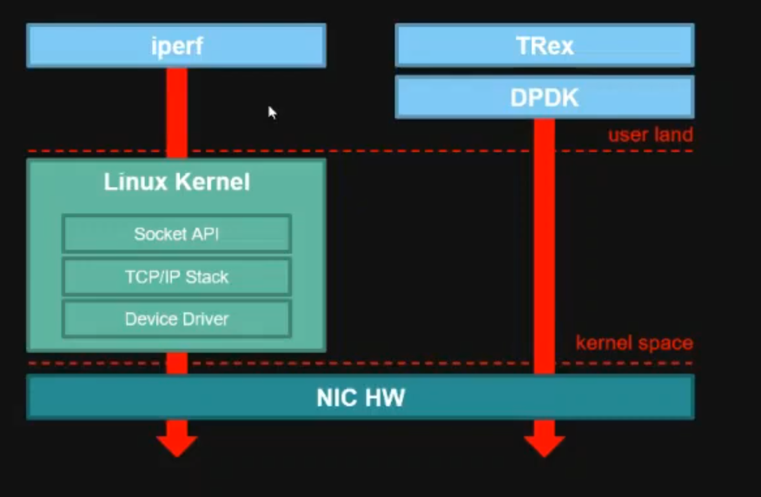
TRex Architecture

Slide 4
Use Cases:
High scale Benchmark Testing.
for stateful networking gear with TCP stack
for high scale, flexible switch testing
Scale tests for number of clients/servers
Routing protocols like OSPF/BGP/RIP
High scale DDoS attack.

Slide 5
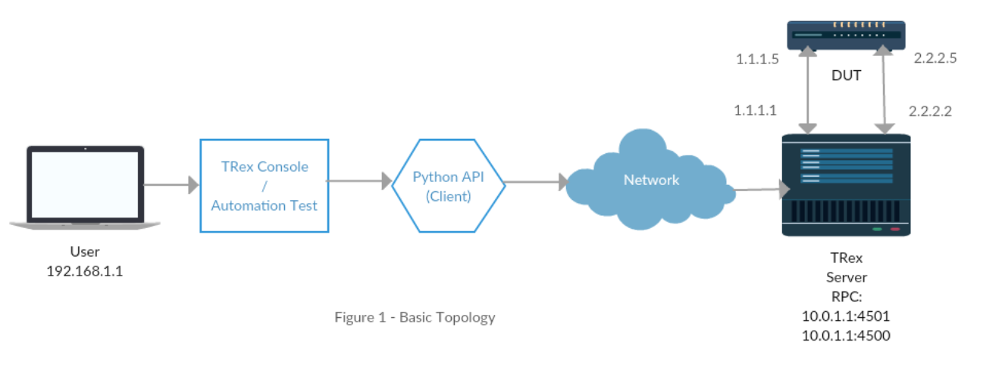
TRex Topology

Slide 6
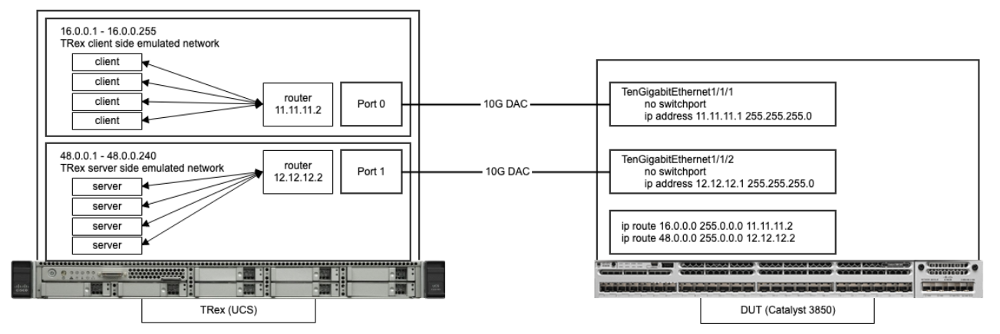
Example: Router Testing

Slide 7
Traffic profile PCAP With TRex
UDP
SMTP
RTSP
mail_pop
ipv6
https
http :- get, post, browsing
DNS variations
voice calls
video calls
oracle

Slide 8
Traffic Configurations:
Burst, Continuous
IMIX :- Internet Mix
UDP variations
TCP variations
HTTP variations
HTTPS variations

Slide 9
Questions
How do TRex generate traffic?
Traffic profiles
pcap files
Field engine that generate packet from scratch
Can Packet Replay use a distribution?
Traffic Rate: Yes (Can’t be done in Realtime needs pre-processing)
Interarrival Time : No
LifeTime : Yes (Can’t be done in Realtime needs pre-processing)
Can we generate east-west traffic?
Yes, by using TRex in stateful mode.

Slide 10
Questions
Can Server and receiver be generated by TRex?
Yes, install TRex on 2 hosts and setup the configuration file accordingly.
Generate mice flows and elephant flows
There is a volume and time multiplier that helps to increase the packet traffic from mice to elephant.
How CISCO do their internal workload generation and testing?
CISCO, Intel, Microsoft use TRex for testing their devices.

Slide 11
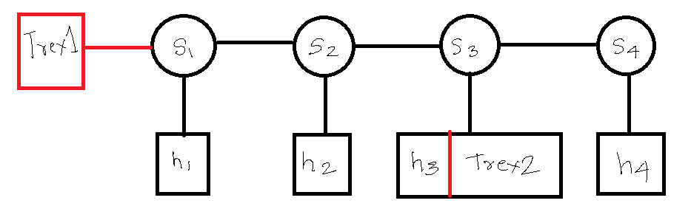
Topologies Tested

Slide 12
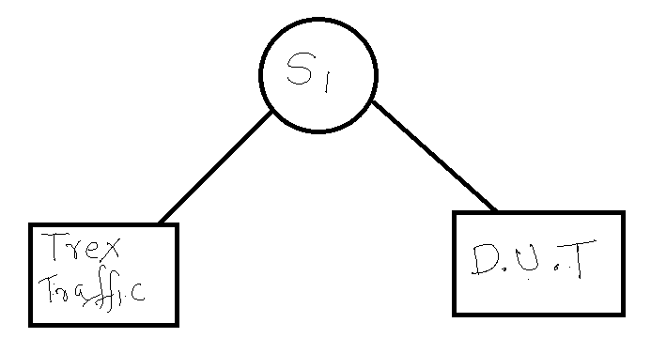
Topologies Tested

Slide 13
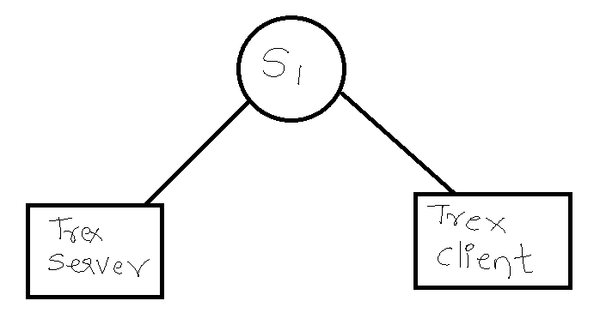

Topologies Tested

Slide 14
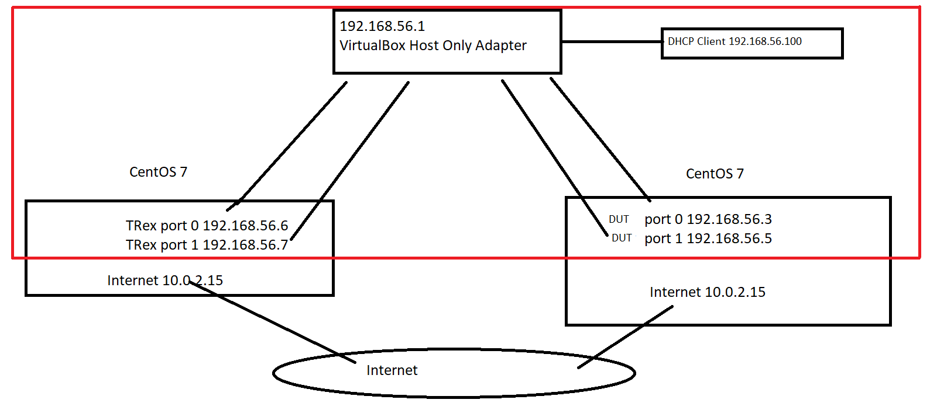
Topologies Tested

Slide 15
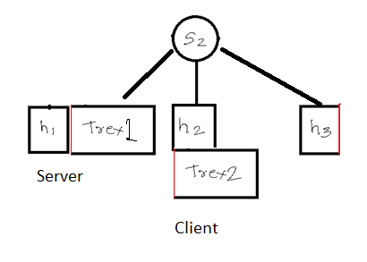
Topologies Tested

