Slide 1
Prediction in Market Volatility
A case study in predicting market volatility and building short-term trading strategies using data from Reddit’s WallStreetBets.
Bidhya Pokharel
September 2021

Slide 2
CONTENT
Project Approach
What does the DATA tell us?
Our PREDICTION models
PERFORMANCE evaluate
CONCLUSION & NEXT STEP

Slide 3
Helps to make a prediction on stock prices and market volatility.
The aim of this project is to use data from posts made made on the sub-reddit “Wallstreet-Bets” to make a prediction of given scenario.
SCENARIO

Slide 4
Covers two datasets:
JSON file:
Contains comment of
Reddit’s post.
Performed Sentiment
Analysis.
Excel file:
Trimmed this huge org.
provided data as per the
other similar file hosted on Kaggle.
Help to predict if specific stocks rose or fell in the given time frame.
SCENARIO

Slide 5
Predict Market Volatility, why? How can predicting market volatility add values to business world. Current scenarios’ relation between stock market and social media.

Slide 6
Sudden market volatility increment affects the investment so predicting
Market volatility in advance can increase /lead us to proﬁts in
Stock market.

Slide 7
80% of investors today use it as their regular Workflow &
Approx. 30% obtain information
about the investment market through different
Social Media (it).
Economic Times
Research

Slide 8
Target Variable
- Created comparing today’s close price and yesterday’s closing price.
- Check how the sentiment analysis of comment made in the day affects the closing price.

Slide 9
Why
Data
Science?
If we can
Predict the future closing
price, we can AVOID
the market volatility and get maximum profit from current stocks.

Slide 10
APPROACH How data science helps to predict the market volatility, and how we are going to do with it.

Slide 11
Exploratory Data Analysis
Feature Selection
Performance evaluate
APPROACH
Model selection
Model Training

Slide 12
DATA ANAYLSIS
What the data told us? Let go for an EDA on the data set.

Slide 13
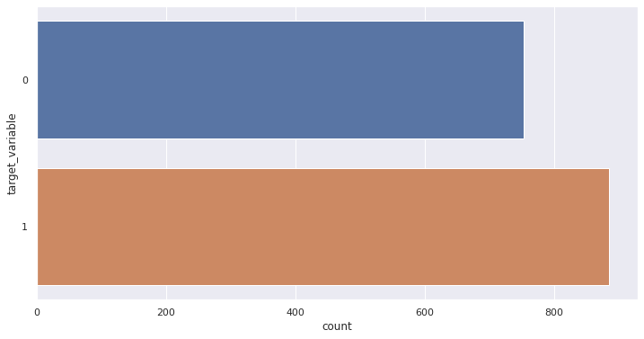
Our Target Variable (P/L)
More positive response/profit in datasets.

Slide 14
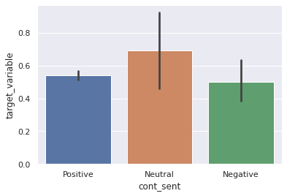
Bi-variate Plot (Polarity- Sentiment Analysis)
Neutral > Positive> Negative Responses seems to affect target variable.
SUMMARY

Slide 15
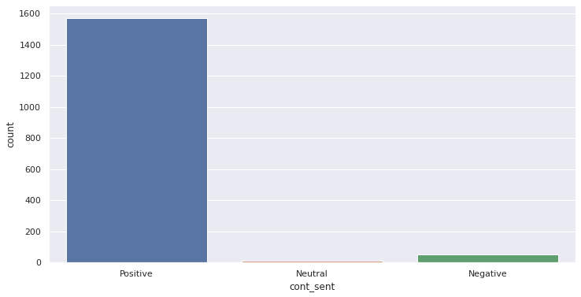
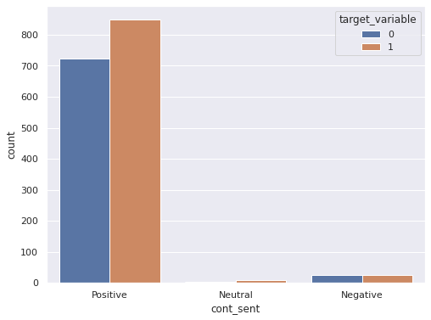
Count Plot (Univariate and Bivariate)
- Univariate Plot (Number of positive responses > Negative > Neutral) - Positive response influences profit(1) in target variable/Closing Price.

Slide 16
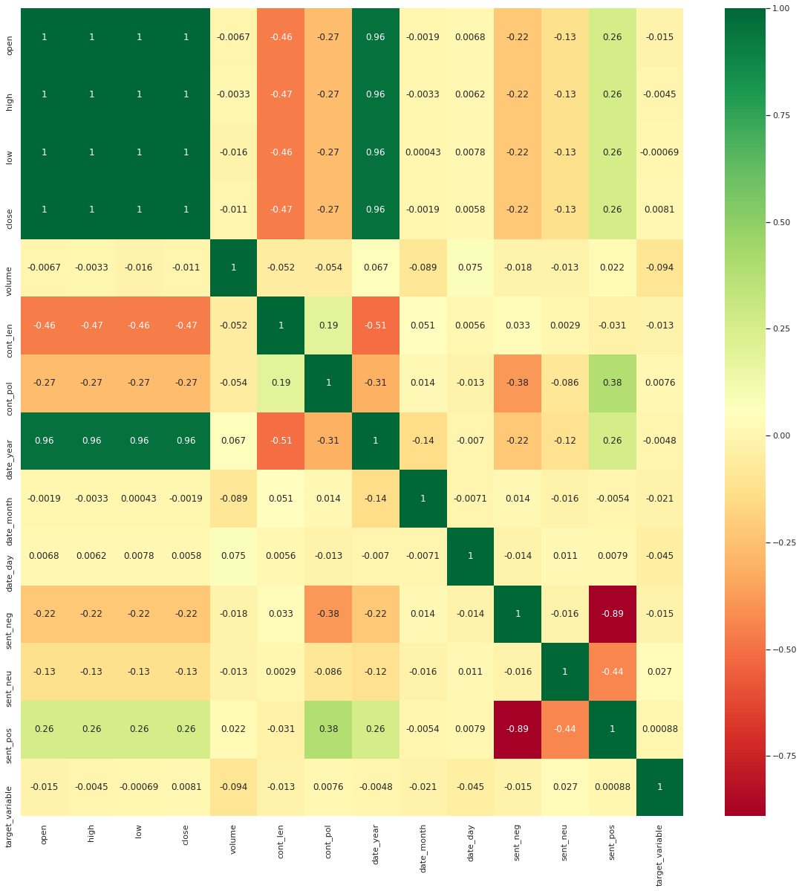
Relation
Among all the
Dependent
And Independent
Variables
Heatmap

Slide 17
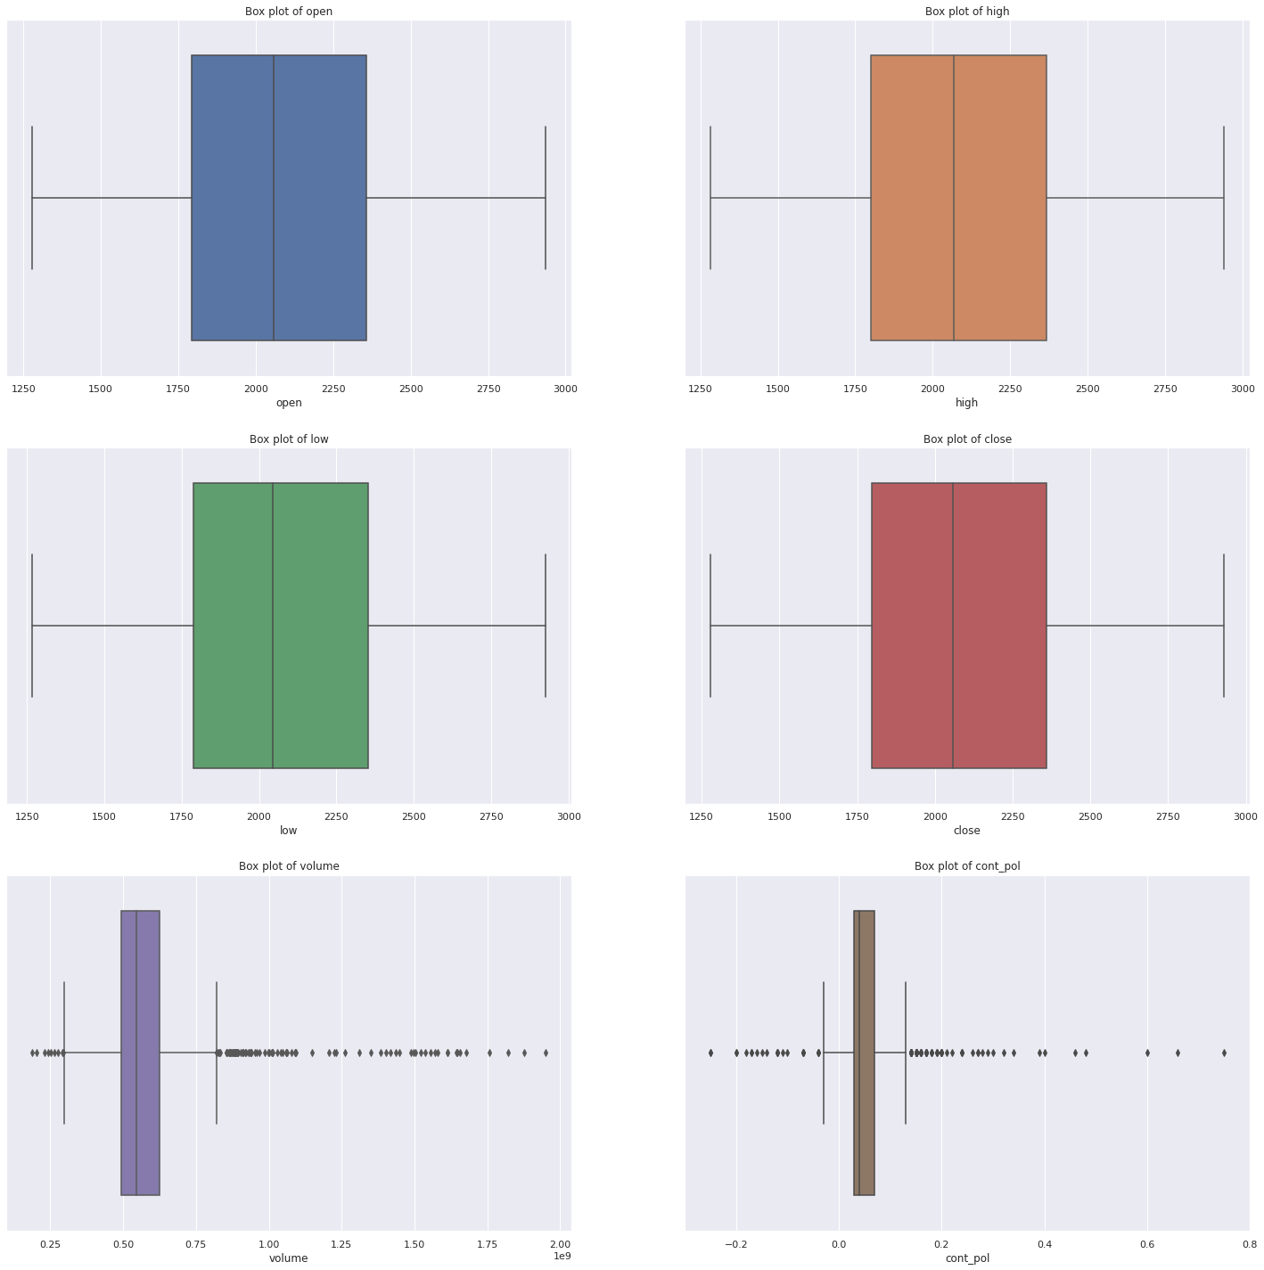
Check the Outliers:
All the variables
are outliers free
other than:
- Volume
- Content Polarity
BoxPlot

Slide 18
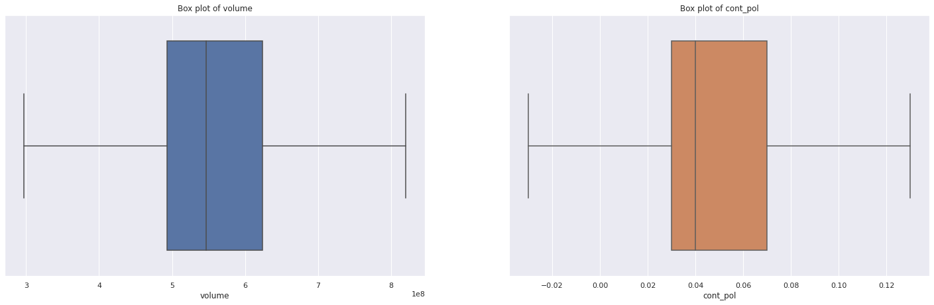
Box Plot (After):
- IQR was performed where the outliers were treated via flooring and capping. - Volume and Content Polarity columns are now outliers free.

Slide 19
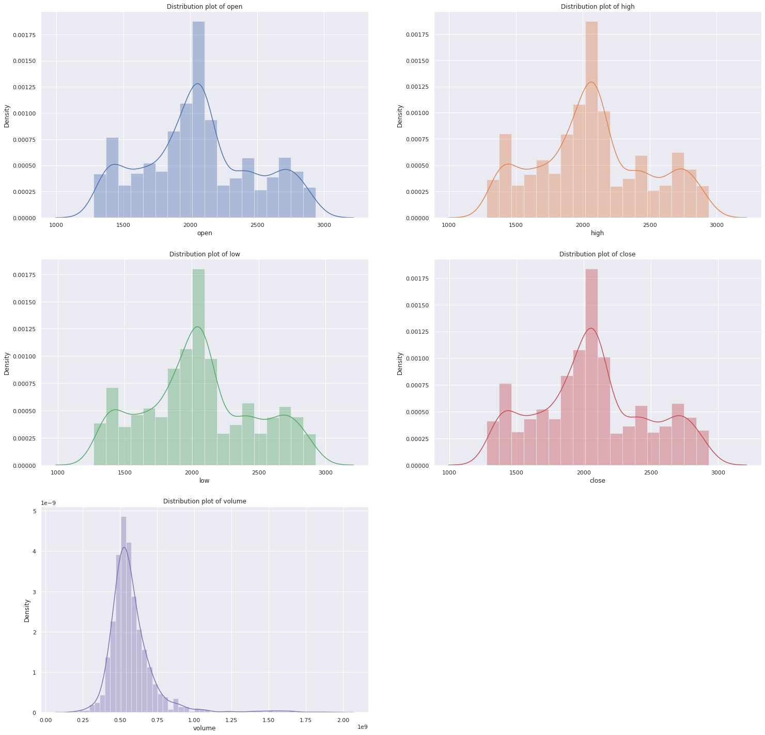
Data of all the variables
are
Normally
Distributed.
Disribution Plot

Slide 20
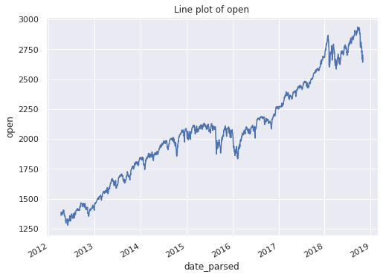
- It seems that all the other variables like : Close, High, Low has similar line plot other than Volume.
- All the variables value seems to increase as per the time.
Line Plot

Slide 21
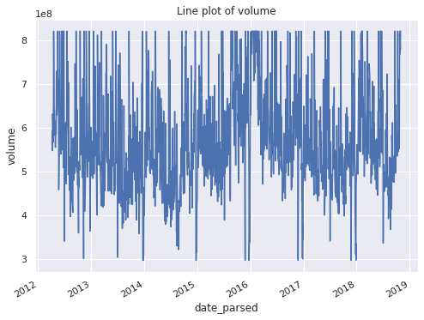
Volume seems to increase and decrease along with time.
Line Plot

Slide 22
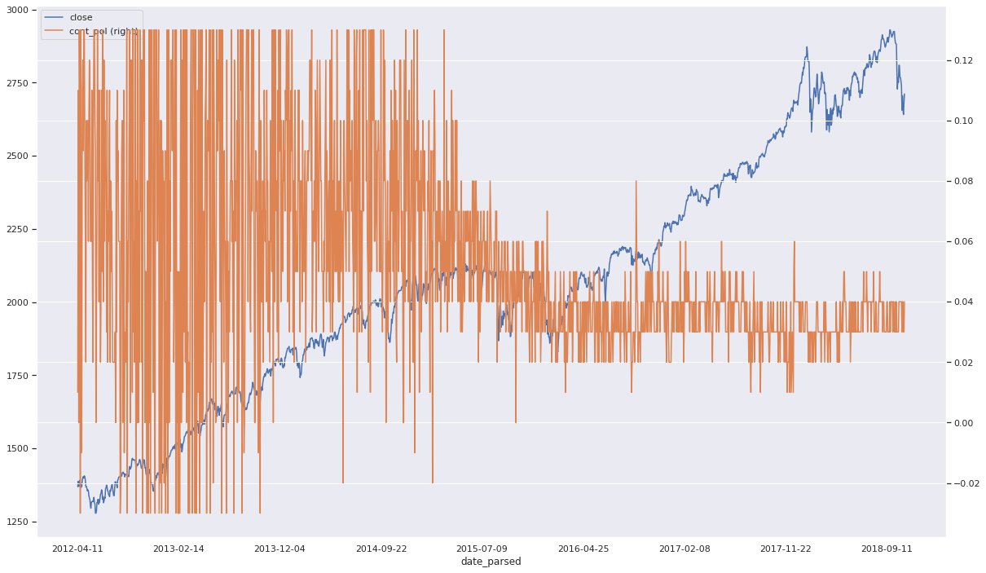
Box Plot (After):
- Seems like closing price and Content Polarity are correlated with one another.
- Closing price increases with year but content polarity seems not to.

Slide 23
PREDICTION MODEL
Build a classification model to predict the market volatility.

Slide 24
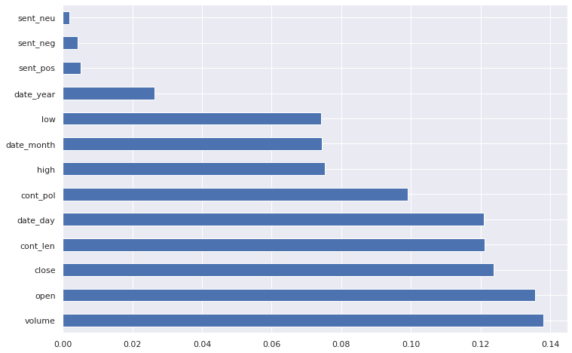
Most Imp. Features :
1. Volume
2. Open
3. Close
4. Cont_len
5. Date

Slide 25
TARGET VARIABLE
- Though positive target variable is quite more in comparison to negative target variable we cannot say dataset is imbalanced because data the difference is not so huge.

Slide 26
FEATURES SELECTION

Slide 27
MODEL SELECTION
Logistic Regression was selexted for a model.
!pip install logisticregression
From sklearn.import lazyp
from lazypredict.Supervised import LazyClassifier
clf = LazyClassifier(verbose=0,ignore_warnings=True, custom_metric=None)
models,predictions = clf.fit(X_train_resampled, X_test, y_train_resampled, y_test)
print(models)

Slide 28
Telecom-churn Model Building.ipynb
base_rf = RandomForestClassifier(n_estimators=200, random_state = 100) base_rf.fit(X_train_resampled, y_train_resampled)
y_pred = base_rf.predict(X_test)
print(f"Model base score: {base_rf.score(X_test, y_test):.4}\n") print(f"Model base ROC_AUC score: {roc_auc_score(y_test,y_pred):.4}\n") print(classification_report(y_test, y_pred, labels=[0,1]))

Slide 29
MODEL BUILDING - RANDOM FOREST
 | Accuracy | F1 score | **Recall** | Precision
base model | 0.74 | 0.62 | 0.77 | 0.52
5 features | 0.71 | 0.53 | 0.62 | 0.47
10 features | 0.74 | 0.58 | 0.68 | 0.51
Final Tuned | 0.74 | 0.57 | 0.82 | 0.44

Slide 30
@coletangsy
PERFORMANCE EVALUATE
Going to build a machine learning model to predict it.

Slide 31
CONFUSION MATRIX
Predicted Class
STAY (0) CHURN (1)
Actual Class
STAY (0)
TN FP
CHURN (1)
FN
TP

Slide 32
CONFUSION MATRIX
Predicted Class
FP: I predicted he will leave, but he stayed
vs
FN: I predicted he will stay, but he leaved
STAY (0) CHURN (1)
Actual Class
STAY (0)
TN FP
CHURN (1)
FN
TP

Slide 33
CONFUSION MATRIX
Lucky...
FP: I predicted he will leave, but he stayed
vs
FN: I predicted he will stay, but he leaved
Predicted Class
STAY (0) CHURN (1)
Actual Class
STAY (0)
TN FP
CHURN (1)
FN
TP
!

Slide 34
CONFUSION MATRIX
Predicted Class
Accuracy
the testing data is imbalanced that can mislead the accuracy score.
STAY |  | (0) CHURN
STAY (0) | TN |  | FP
CHURN (1) | FN |  | TP
(1)
Actual Class
vs
Recall
How many churn case is correctly predicted

Slide 35
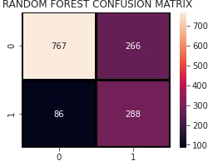
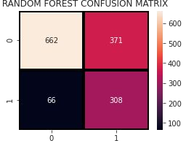
MODELS PERFORMANCES
Actual Class
Actual Class
.Predicted Class.
Predicted Class
-- Parameter Tuning -->

Slide 36
MODELS PERFORMANCES
Accuracy | F1 score | **Recall** | Precision
base model 0.74 | 0.62 | 0.77 | 0.52
5 features 0.71 | 0.53 | 0.62 | 0.47
10 features 0.74 | 0.58 | 0.68 | 0.51
10 features (ﬁne-tuned) 0.74 | 0.57 | 0.82 | 0.44

Slide 37
@coletangsy
CONCLUSION

Slide 38
CUSTOMER CHARACTERISTICS
Customers
who have the following characteristics,
Having month-to-month contract;
Tenure within 1- 12 months;
Using electronic check to pay;
Do not use Online Security, Technical Support, Online Backup, Device Protection;
Using Fiber optic;
are likely to churn.

Slide 39
BUSINESS VALUES
“The cost of acquiring a new customer can be higher than that of retaining a customer by as much as
700%”
By increasing customer retention rates 5% , we could increase proﬁts by 25% to 95%
How to turn these into numbers, proﬁt for boss?
if we can have 80% rate to predict the one who are gonna churn, we can target them
we can target them and oﬀer more to retent them and which increasing our customer retention rates,
and lower the cost of acquiring a new customer.

Slide 40
WHAT CAN WE DO
General
Target customer who are likely to churn
enhance Fiber optic services’ quality;
Transfer Month-to-month customer into a longer contract term;
Review the current internet support services and develop new strategies
Develop speciﬁc offers for them to keep them with us;
Identify which kind of churn and the reason behind

Slide 41
@coletangsy
LIMITATION & NEXT STEP

Slide 42
HOW TO IMPROVE
Only apply Random Forest classiﬁer
Apply more models and compare the tuned performance.
Cross check hyperparameter tuning process
Hyperparameter tuning with mircosoft auto-ml library FLAML, to check is there any better way to ﬁne-tuned the models

Slide 43
@coletangsy
Q & A

Slide 44
@coletangsy
END.
thank you for your time.

