Slide 1
Historical Sales and Active Inventory
Building a binary classifier which gives a list of product ID what need to be retained in the inventory or list of products that need to be removed using Exploratory Data Analysis
Bidisha Banerjee
Exploratory Data Analysis-DSC530

Slide 2
The Problem statement and the Objective of the EDA
Problem
A retail firm has many products in their inventory, and very few of them tend to sell (only about 10% sell each year) and many of the products only have a single sale in the course of a year
Objective
The sales and growth team of the retail firm wants to determine which products from their inventory should they retain to sell and the ones to discard
https://www.kaggle.com/flenderson/sales-analysis

Slide 3
Variables Defined for the Exploratory Data Analysis
Name | Description
File_Type | The value “Active” means that the particular product needs investigation. “Historical” represents the training set which will be used in modeling
SoldFlag | The value 1 = sale, 0 = no sale in past six months
ItemCount | The number of items in inventory for each item
StrengthFactor | Some numerical measure of the items
MarketingType | Two categories of how we market the product
ReleaseYear | Any product that has had a Release in the past
SoldCount | The number of items sold for each item
PriceReg | Regular price of the items

Slide 4
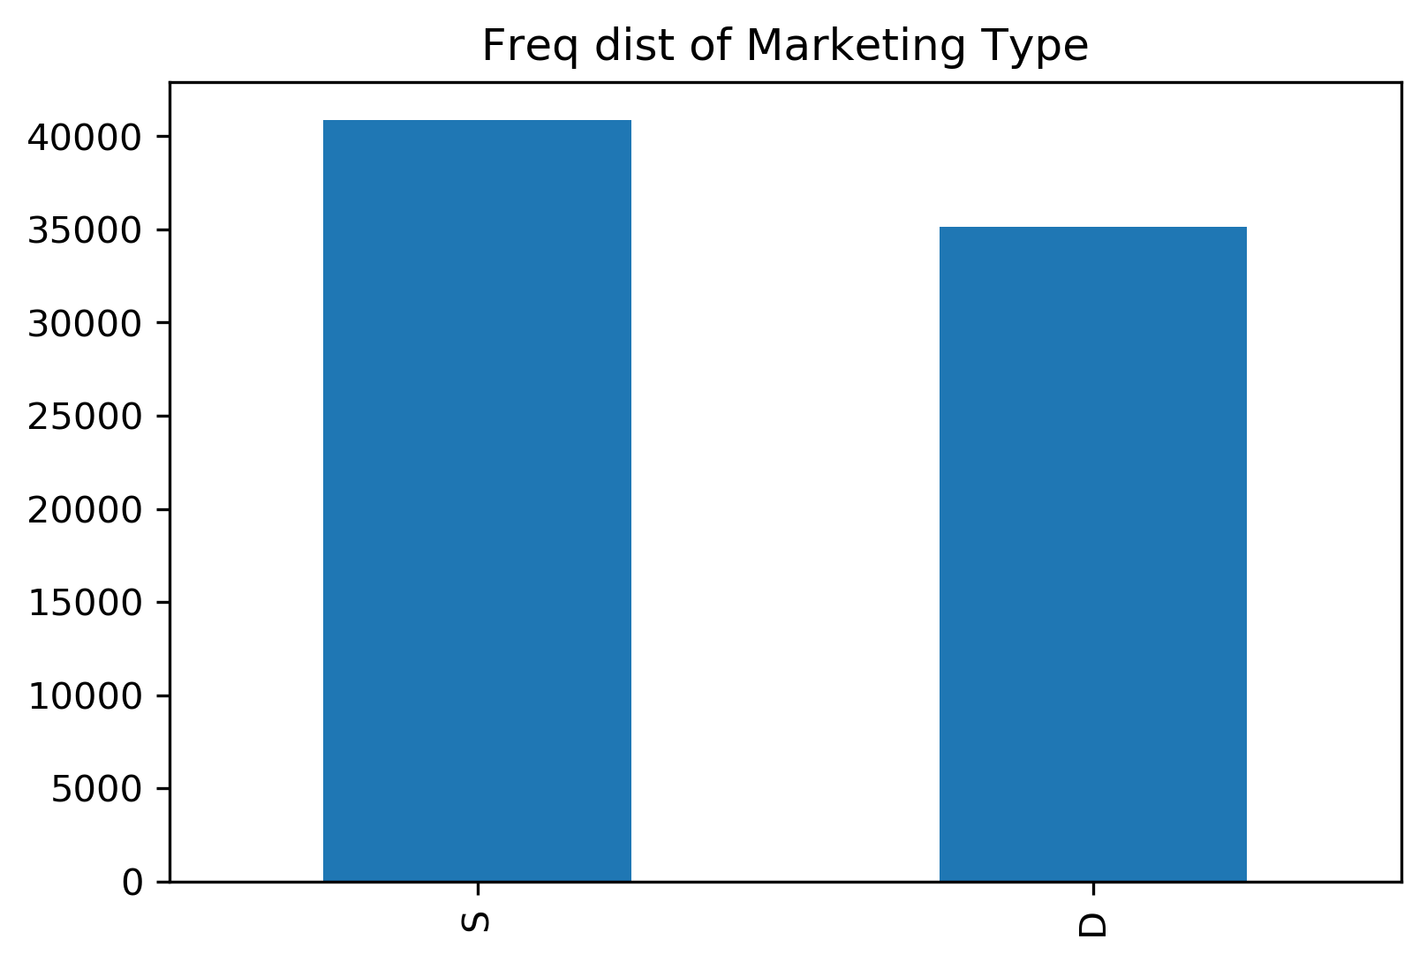
Frequency Distribution on Marketing Type
This shows us the total number of records in the history file by marketing type.

Slide 5
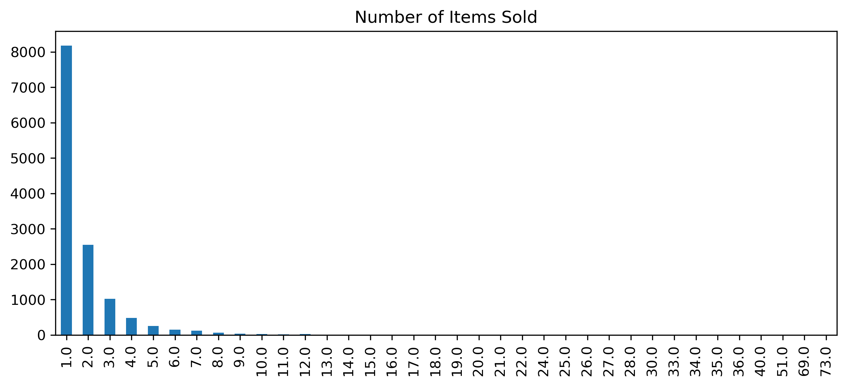
Frequency Distribution Items Sold
This shows the histogram of the # of items sold and its distribution.
From the distribution it shows that most of the items were sold once

Slide 6
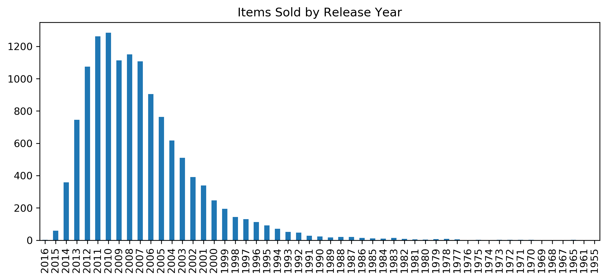
Frequency Distribution of Items Sold by Release Year
This shows the number of items sold by release year has increased only recently.

Slide 7
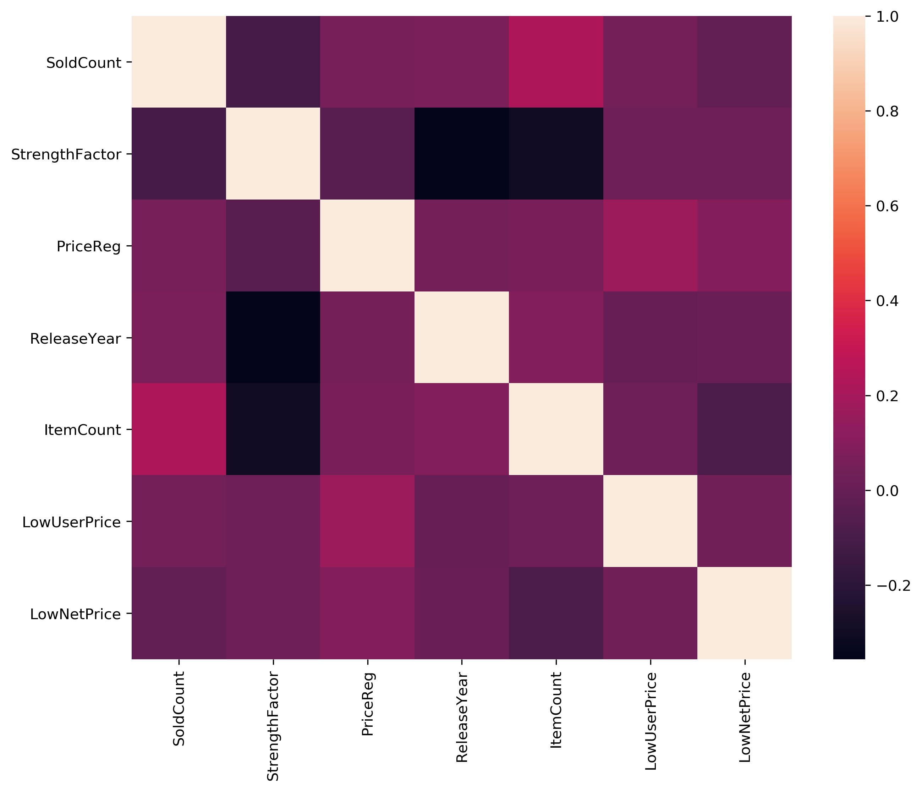
Frequency Distribution on Marketing Type
This shows

Slide 8
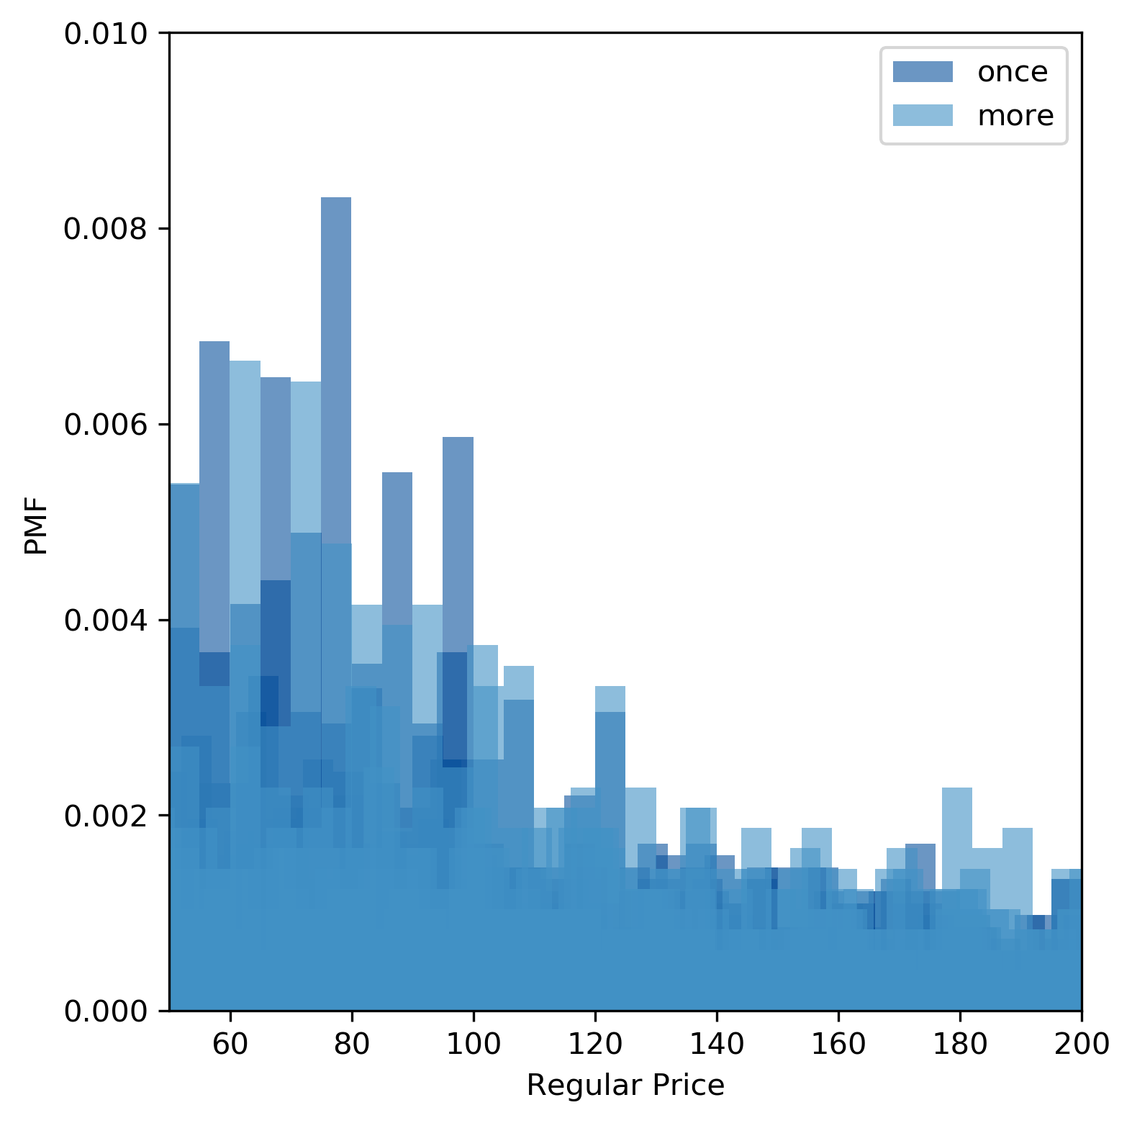
PMF of Items Sold once and more than once
Comparing the PMF of items sold once and more using bar graphs.

Slide 9
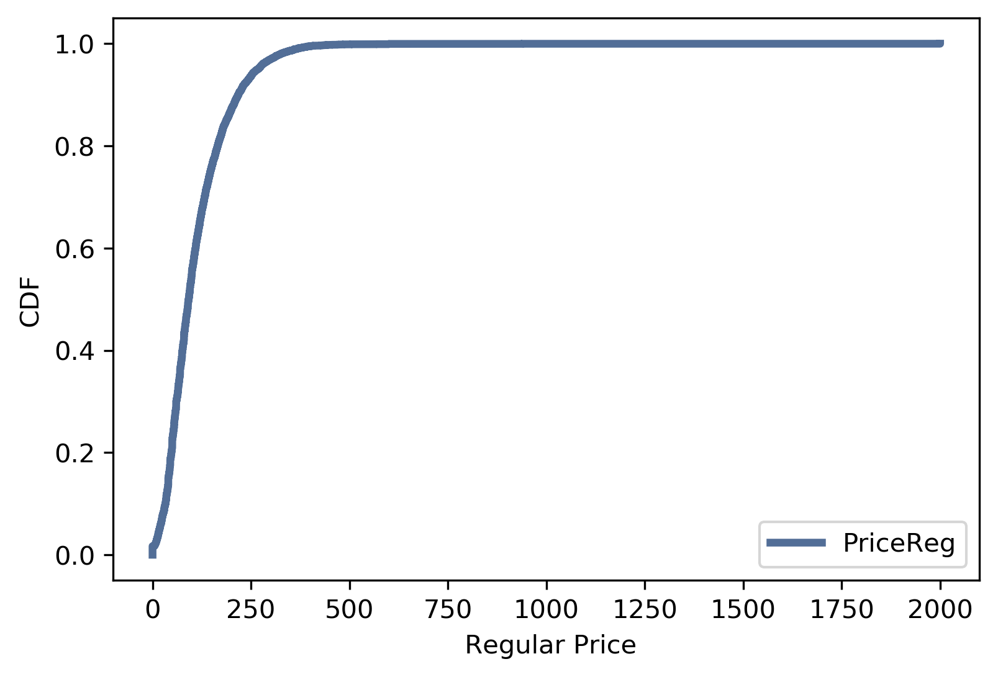
CDF of Regular Price
This CDF shows that the median price is $78 and only 10% of items are priced less than $33.

Slide 10
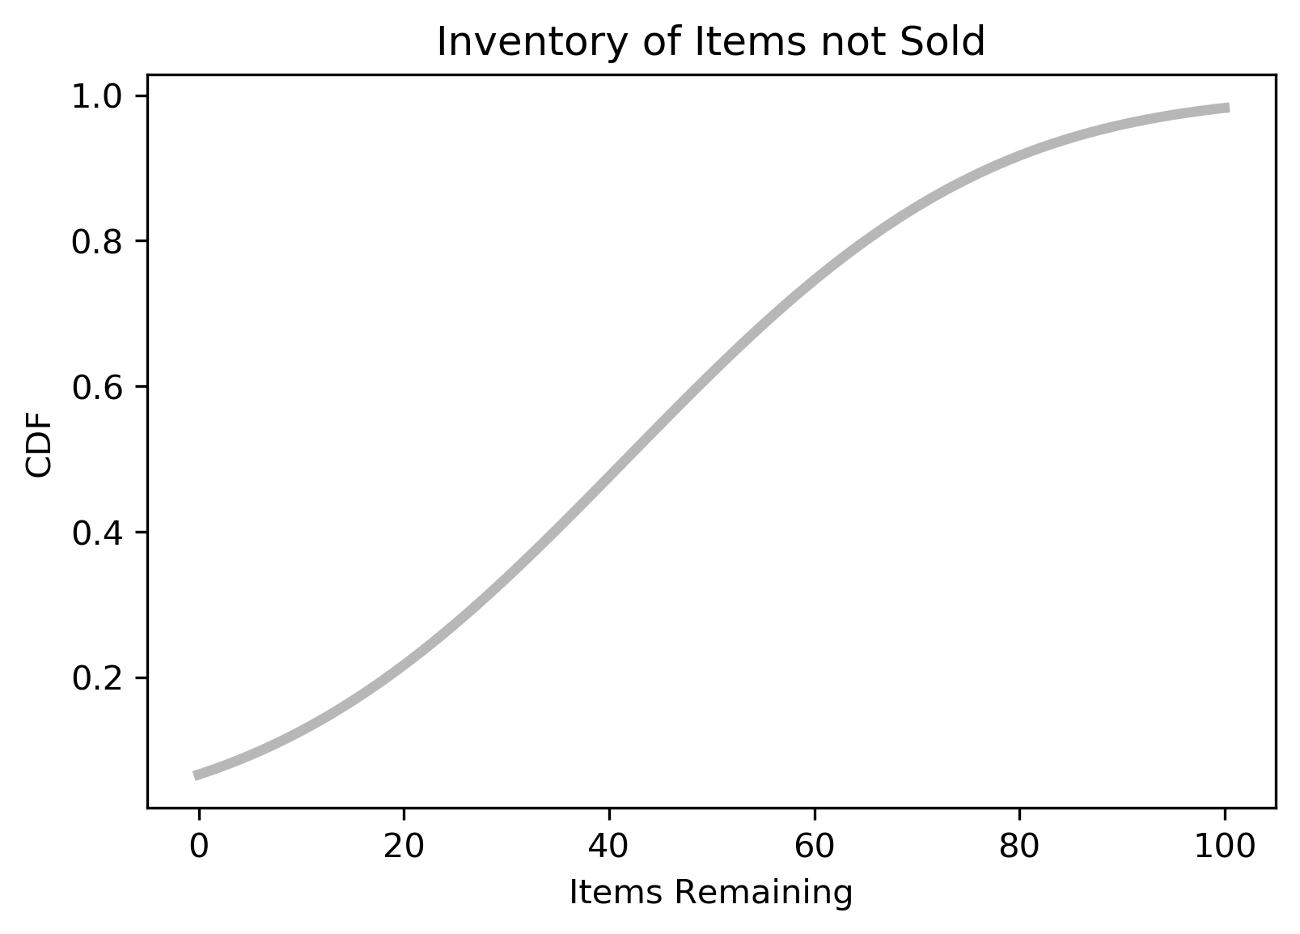
Analytical distribution of the items remaining
Showing the analytical distribution of the items remaining in the inventory after deducting the sold counts from the historical data.

Slide 11
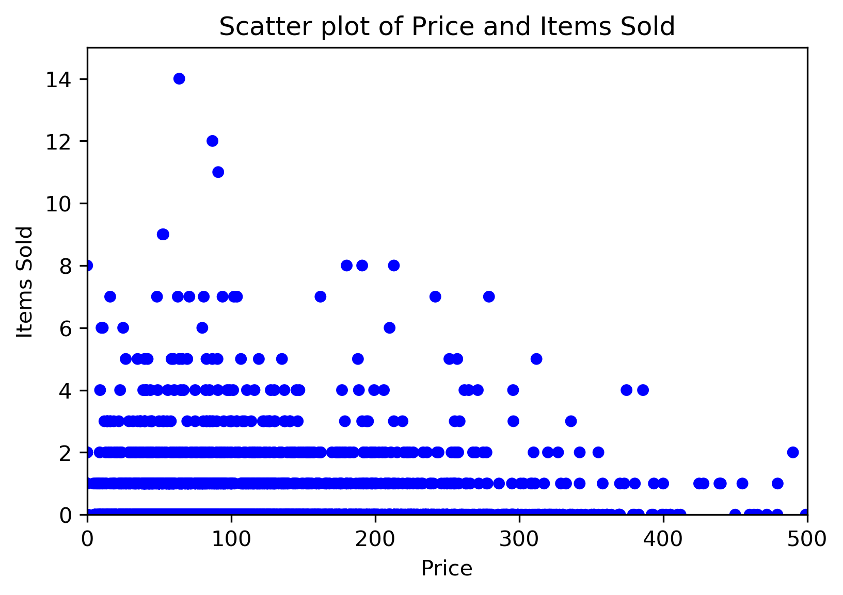
Scatter Plot 1: Regular Price vs Sold Count
Showing the scatter plot for # of items sold against price which is very flat from the historical data.The data falls in rows as they were sold in blocks.
Spearman Corr: 0.072

Slide 12
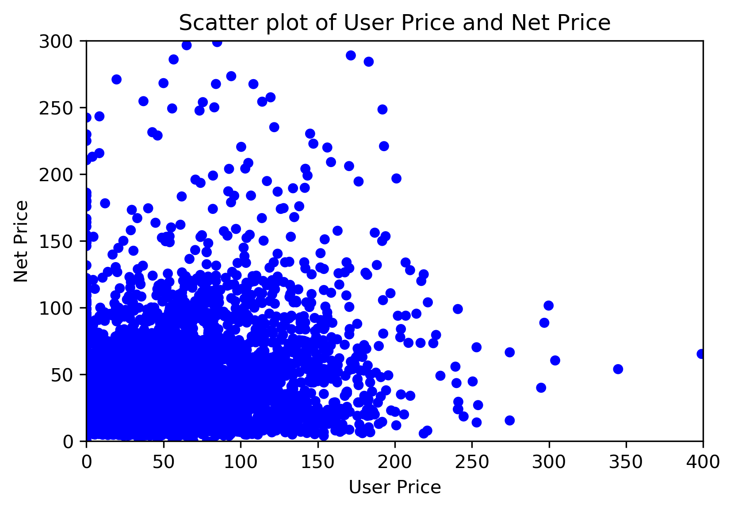
Scatter Plot 2: Net price vs User price
This scatter plot shows a weak positive relation between the Net price and the User price.
Spearman Corr: 0.205

Slide 13
Testing the hypothesis
Testing the difference in the mean price for the items sold is less than the mean price of the items not sold. We will test if the effect is statistically significant.
The Null hypothesis is that the distributions for the two groups are the same. One way to model the hypothesis is by permutation; that is we can take values for the mean price of items sold and others and shuffle them.
The hypothesis under test is that price of item sold is less than the price of item not sold, so using test statistic of raw difference between the prices, and the absolute value of the difference. In both the cases, the p-value is significantly small, so the null hypothesis is ignored.

Slide 14
Logistic Regression
Logistic Regression
We are trying to predict the endogenous variable (dependant) variable sold flag using a logistic model. So that the retail firm can decide which products to keep in the inventory and which ones to discard.
We would be modeling this variable using the history dataset df.
1) Initially we are trying to predict the SoldFlag using the PriceReg explanatory variable. As per the below output, the PriceReg is positive which suggests that higher priced items should be mainatined in the inventory.
But the p-value of 0.000 suggest it is purely due to chance.
2) Now let us build the model with more explanatory variables like, PriceReg, StrengthFactor, ReleaseYear, ItemCount, LowUserPrice, LowNetPrice

