Slide 1
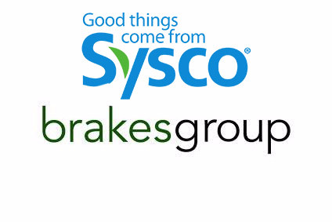
Marketing Analytics and Recommendations For Brakes
Presented by Bidisha Ghosh

Slide 2
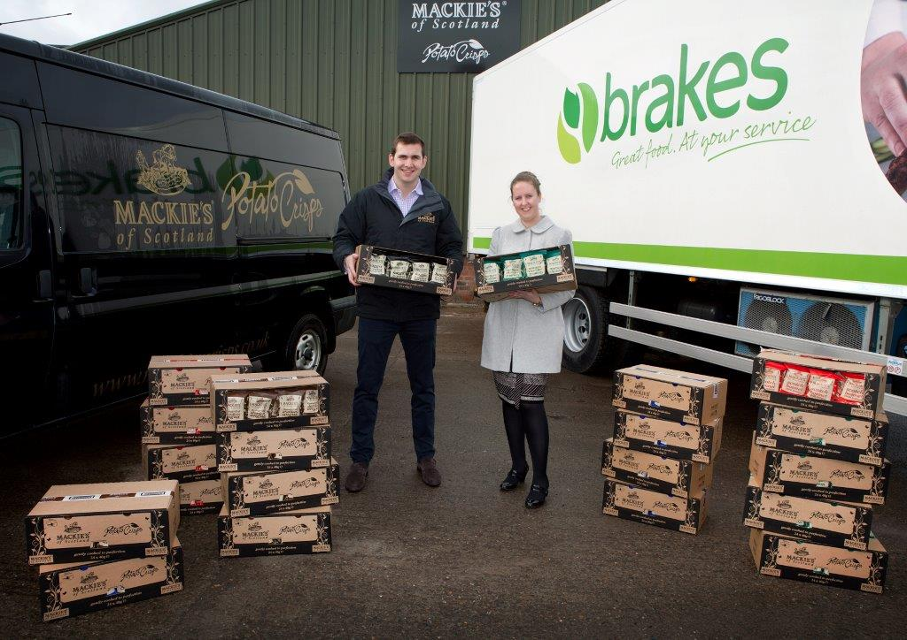
Agenda
1. Introduction
2. Data Overview
3. Market Size Analysis
4. Current Market Share for Brakes
5. Customer Segmentation Analysis
6. Strategic Recommendations
7. Competitive Analysis
8. Customer Feedback and Food Trends
9. Conclusion and Ideas & Challenges
10. Q&A

Slide 3
Introduction
Project Background
Brakes is a food and distribution company supplying food, drink and other products to thousands of customers across different industries like restaurants, hotels and catering services. There is an immense opportunity in London to increase its market share across independent food sectors and drive potential growth, therefore this project is initiated to make business strategies.
Objectives
To identify the market share across postcodes and industries.
To represent strengths and weakness in the London market and how to capture key potential areas.
To further research food trends in restaurants and hospitality venues in London.

Slide 4
Data Overview
Description of the Dataset
The dataset used for this analysis was sourced from Brakes' internal customer database and supplemented with external prospect data.
The internal data includes detailed records of current spending by existing customers, while the prospect data provides estimates of potential spending by new customers in the London area.
Data Summary
The dataset consists of six variables customer group, industry, postcode, current spend, potential spend and URN.
To simplify the location of London postcodes, one extra column was created to identify potential growth areas.

Slide 5
Key Metrics Visualized
Current Spend – Amount spent by existing Brakes customers.
Potential Spend – The estimated potential amount that can be spent by existing customers.
Postcode – Layering into different segments to analyze the market geographically.
Customer Industry – To segment the market by different industries.
Total Market Size – Sum of spending by existing customers of Brakes and Potential Spending by Prospects.
Total Potential Spend by Prospects – Potential Spend by Prospects.
Total Current Spending by Existing Customers.
Percentage of Brakes Market Share – Market Share of Brakes from the total market size.

Slide 6
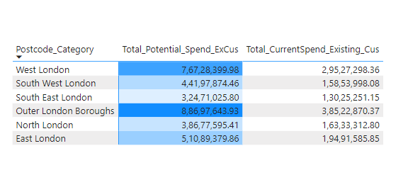
Market Size Analysis
Total Market Size Calculation
1.48bn is the Total Market Size.
(Total_Market_Size = [Total Spend Existing Customer]+[Total Potential Spend Prospect])
1.35bn is the Total Market Size of Prospects.
(Total Potential Spend Prospect = CALCULATE(SUM(London[Potential Spend]),London[Customer Group]= "Prospect"))
133.21M is the Total Market Size of Existing Customers.
(Total Spend Existing Customer = CALCULATE(SUM('London'[Current Spend]),'London'[Customer Group] <> "Prospect“))
Breakdown By Post Code
The Outer London Boroughs and West London have the highest potential spend.

Slide 7
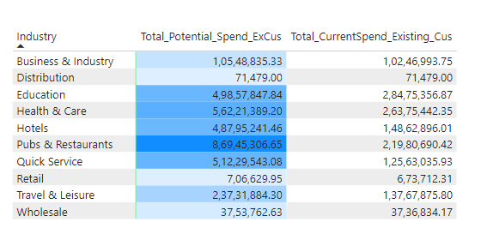
Market Size Analysis
Breakdown by Industry
Pubs & Restaurants, Health & Care, Quick Service and Hotels have the highest potential. There is an immense gap between the potential & the current spending.

Slide 8
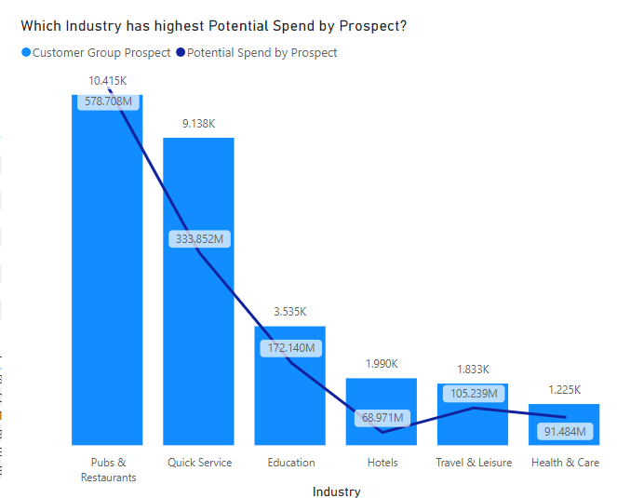
Market Size Analysis
Pubs & Restaurants and Quick Service have the highest potential spending.

Slide 9
Current Market Share for Brakes
Total Current Market Share by Brakes
8.98% is the current market share by Brakes from the total market Size. (DIVIDE[Total Current Spend Existing Customer],[Total_Market_Size]) *100)
At present, Brakes is holding the Total Market Size at 465.96M
Total Potential Current Spending of Existing Customers is 332.76M
Total Current Spending of Existing Customers is 133.21M

Slide 10
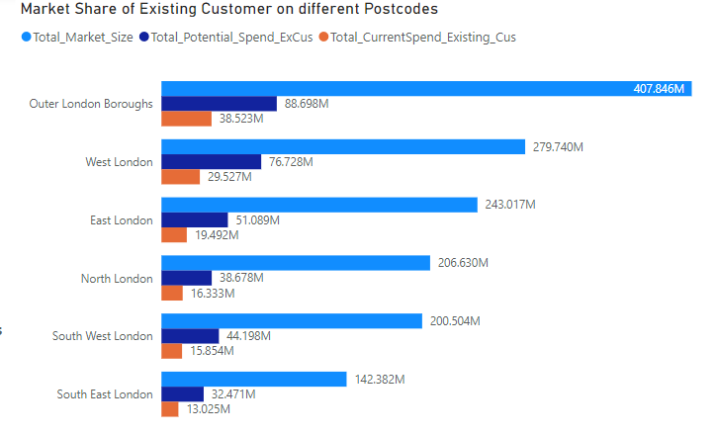
Current Market Share for Brakes
Comparative Analysis of Market Share on Postcodes
There is a huge gap between the potential spending and current spending of existing customers of Brakes. With West London and the Outer Boroughs of London holding most of the market.

Slide 11
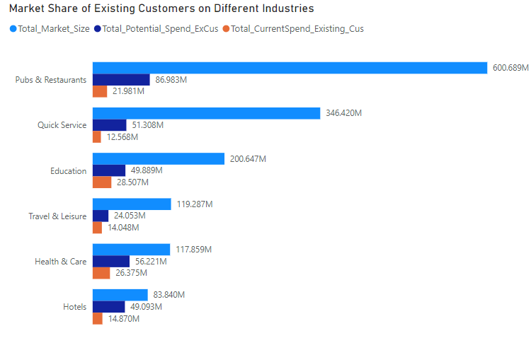
Current Market Share for Brakes
Comparative Analysis Of Market Share on the Industries
Pubs & Restaurants, Quick Service, and Education are the main industry markets that Brakes could focus on driving growth.

Slide 12
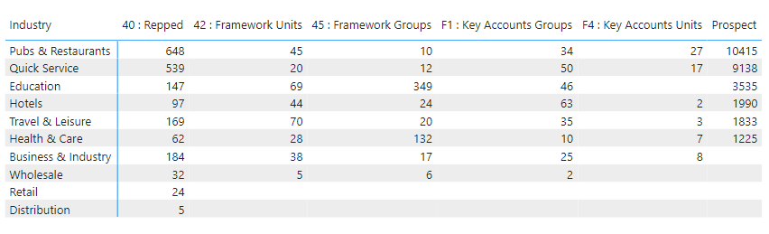
Customer Segmentation Analysis
Key Segments Identified
By differentiating with the Prospects group, we can analyze which other customer groups we need to grow further to capture the market.

Slide 13
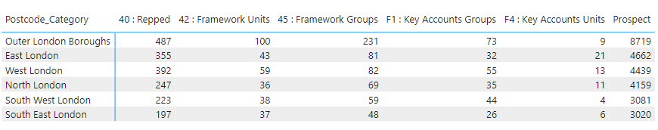
Customer Segmentation Analysis
The interesting fact that we can figure out is that our Key Groups of customers are much fewer than Repped Category.

Slide 14
Strategic Recommendations
Key Focus Areas to Target
According to the postcodes, East & West London has the most market for independent sectors like Pubs and restaurants.
West London is one of the touristy areas so demand for Quick Service will be high.
East London has a very diverse magnitude of customers so regional vegetables and fruits will be more popular.
There is also another part of East London where most of the large office spaces are present, for example, Canary Wharf. In these areas, the food trend can be found like this “ Breakfast is purchased on the way to work, lunch is at or close to the place of work, dinner is carried home or ordered in.
It can be identified from every chart and table that increasing market share in London Pubs & Restaurants are the main focus areas.

Slide 15
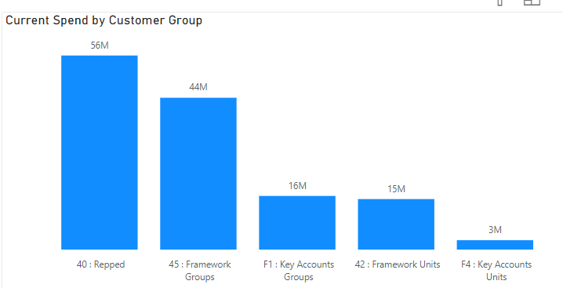
Strategic Recommendations
Key Strength Of Brakes Market
Most of the current spending is from the Repped customer group.

Slide 16
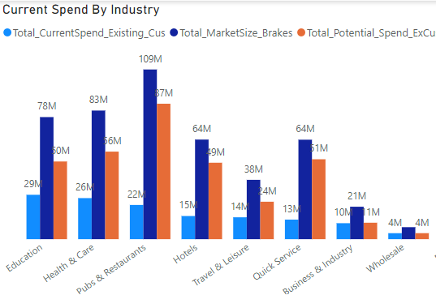
Strategic Recommendations
Key Weakness of the Brakes Market
The most crucial industries to look for are Pubs & Restaurants, Quick Service but also Education and Health Care so the current spending is much lower than the potential spending.

Slide 17
Competitive Analysis
Comparison of Brakes' Proposition Against Competitors
The Tesco-Booker merger was one of the biggest shake-ups in the wholesale and convenience sectors.
The vast variety of products they sell in the market is quite the same as Brakes.
The biggest strength of Bookers is that most of the market is into retailing.
Brakes lack this market and it can create a hurdle in capturing the Independent sector of the London market.
Price is not a major factor here but Bookers reaching directly to customers is a major reason why wholesale suppliers are in a tight phase. This is achieved by selling to Cash & Carry shops.
After merging with Tesco, Booker is playing a key role in maintaining Meal Deal options in Tesco stores. Due to the rise in homelessness in London, the cheap Meal Deal is a go-to food for many people.

Slide 18
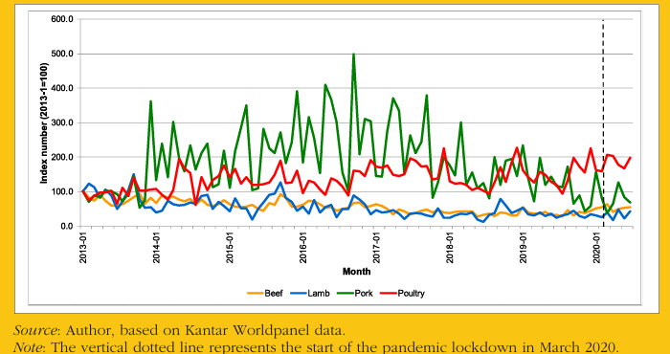
Competitive Analysis
Insights on Competitor Offerings
Organic meat is high in demand in the UK food market.
Even Organic eggs are also high in demand, people prefer free-range eggs.
Investing in local organic farms is a great way to supply organic meats.

Slide 19
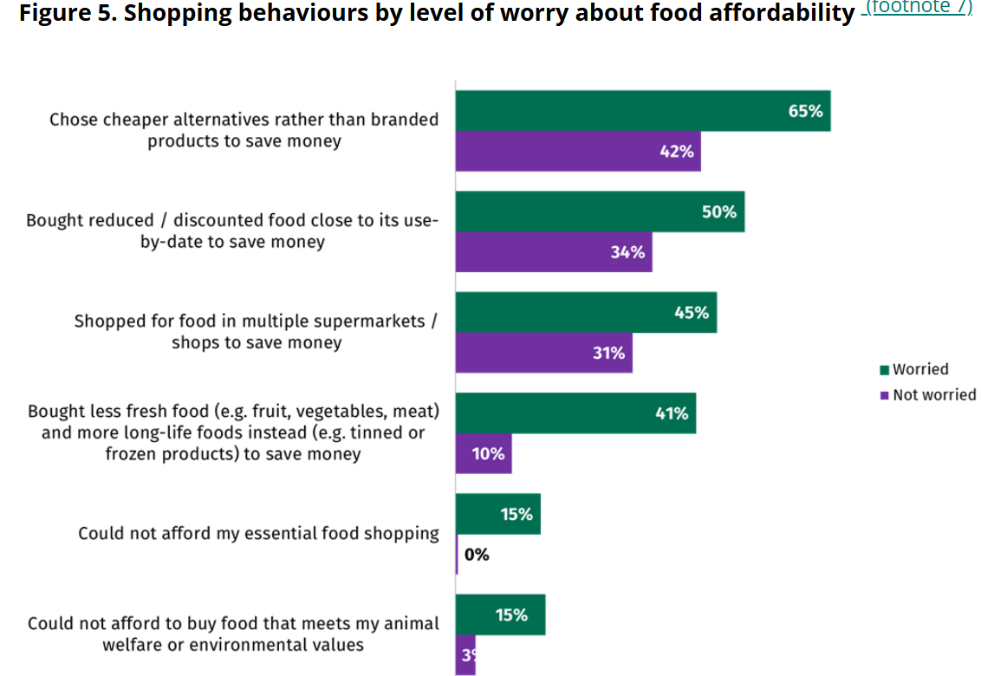
Customer Feedback
Methods to Gather Customer Feedback
Lookout for Government Reports and Customer Insights Reports by market research companies. Roll out consumer surveys through suppliers to gather information regarding what they want and to further analyse what we can offer.
This figure is taken from Food.Gov.uk. It can represent how the cost of living crisis has negatively affected the food industry. To save money, customers are buying from multiple sources and more discounted last-date products.

Slide 20
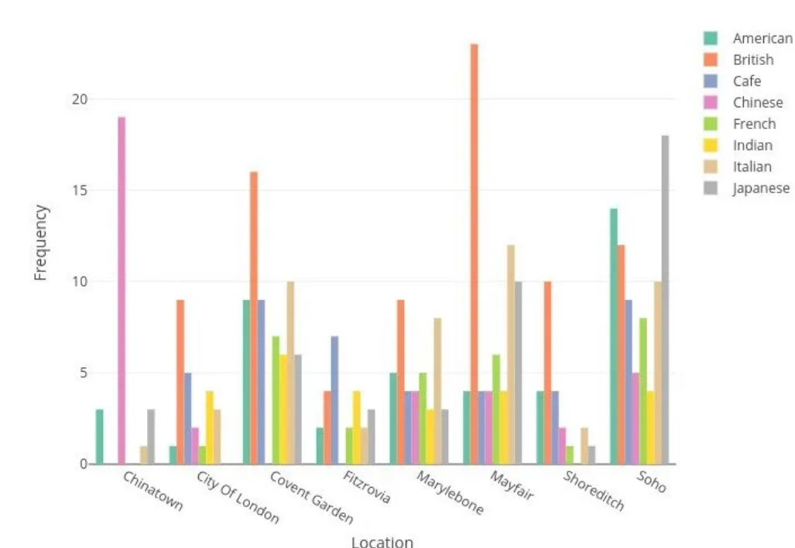
Food Trends
Trends in the Food Industry In London
Salads in every meal are a go-to dish in Lunch and Dinner.
Gluten-free options in the Bakery and Pasta items.
Customers are interested to know whether the restaurant they are dining in, do they follows sustainability and prefer dishes which have a low Carbon footprint.
Locally sourced fruits & vegetables are good marketing tactics used by restaurants to clarify the customer’s doubts about selling expensive dishes in fine dining restaurants.

Slide 21
Conclusion
Summary of Key Findings
Restaurants & Pubs, Quick Service, Health Care and Education are the main Industries.
West London and East London are high-potential areas.
One of the Interesting facts is that the Outer Boroughs of London have a high demand for quick service.
Key Customer Groups are very small in number.
Repped Customers represented the highest potential in Current spending of Brakes Market Share.
Retailing and Online Grocery shopping can affect the wholesale market.
Supplying at a cheap price is the biggest challenge.

Slide 22
Ideas & Challenges
Challenges
Energy Bills are the biggest challenge for the food manufacturing industry.
The price of Canned products is increasing due to the cost of packaging and fertilizer.
Sugar Prices are increasing due to the rise in the increasing use of sugar as ethanol used in fuel.
Ideas
Alternative items using bell peppers for colour and zucchini & squash for texture and taste.
During the extraction of fruit juices, natural sugars can be extracted. For example: Grapes have high sugar content.
To increase the market size of Brakes, bulk-size food can be supplied to local independent shops from the Brakes Depo locations. This is a great way to capture the Retail market and make direct relationships with customers.

Slide 23
Q&A
Questions and Answers

