Slide 1
Lucrative options for a new restaurant in bengaluru

Slide 2
Why a new Restaurant and why bengaluru?
Bengaluru is the one of the fastest growing and developing cities in India with hundreds of people migrating in everyday
It is known as the Silicon Valley of India with major youth population with no time in hand for household chores let alone cooking
The youth has the taste for delicious affordable regular takeaways or occasional/ weekend dine-outs at exclusive food joints.
The number of restaurant are increasing day by day. Currently which stands at approximately 12,000 restaurants. With such a high number of restaurants. This industry hasn't been saturated yet.
This project aims at analysing demography, its food culture of the location. Most importantly it will help new restaurants in deciding their theme, menus, cuisine, cost etc for a particular location. It also aims at finding similarity between neighbourhoods of Bengaluru on the basis of food. With the analysis the project also will help people in choosing the restaurant based on several other factors. The project will mainly try to answer the question based on restaurants and foodies interest. And what factors should be kept in mind if someone wants to open new restaurant.

Slide 3
Data scraping and refining from zomato site.
The main data used were from two sources:
The restaurants in each neighbourhood scraped from the Zomato website.
Explore trending restaurants in a neighbourhood particularly from FourSquare API.
In total, 51,717 rows and 17 columns in the dataset.
Cleaned data contains 13000(approx) rows after dropping the duplicates.

Slide 4
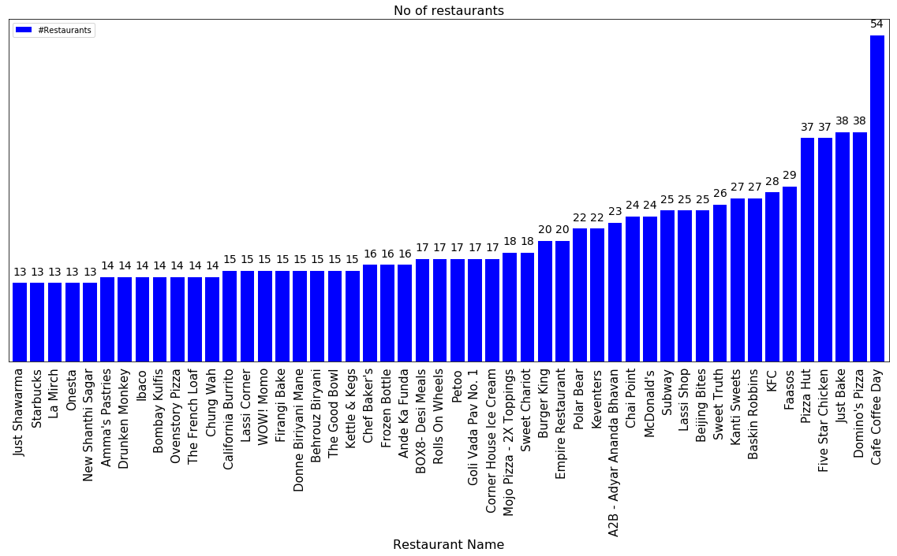
THIS IS A VISUALISATION OF THE NUMBER
OF RESTAURANTS IN BANGALORE
**Clearly Cafe Coffee Day holds the first Spot with highest number of chains.

Slide 5
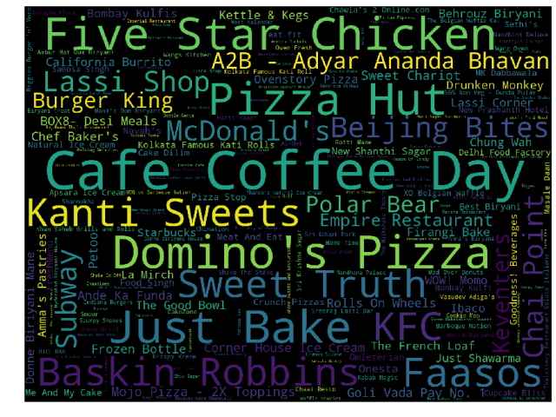
here is a word cloud of the various restaurants in bengaluru.
in

Slide 6
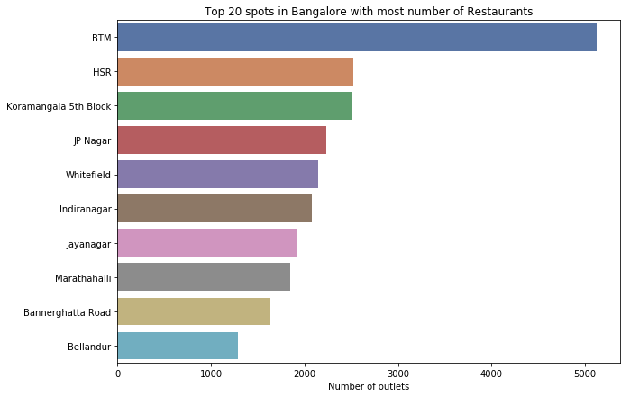
RESTAURANT COUNT WITH RESPECT TO VARIOUS NEIGHBOURHOODS
**Clearly BTM and HSR top the list

Slide 7
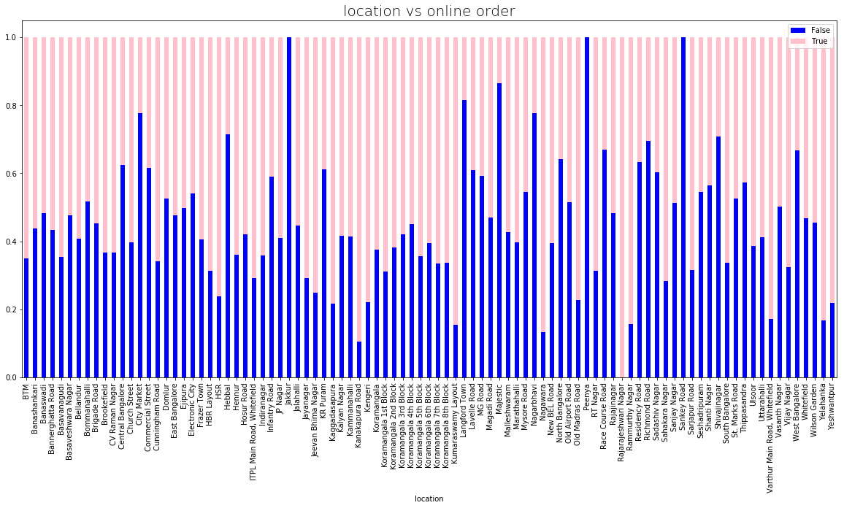
Neighbourhood vs online order taking food joints

Slide 8
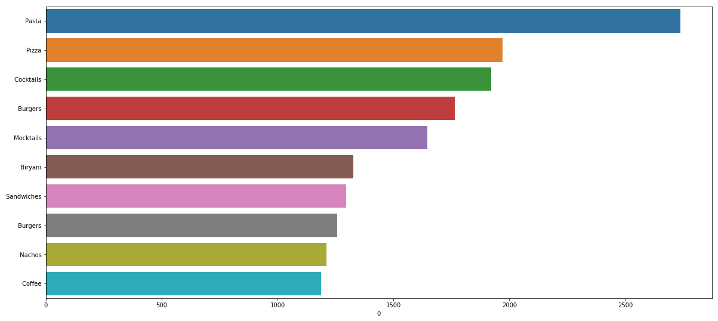
visualisation of food preferred/liked by people of bengaluru

Slide 9
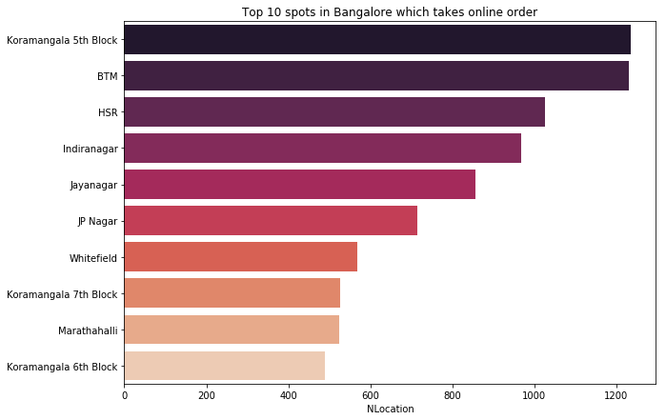
top 10 spots in bengaluru which takes online order

Slide 10
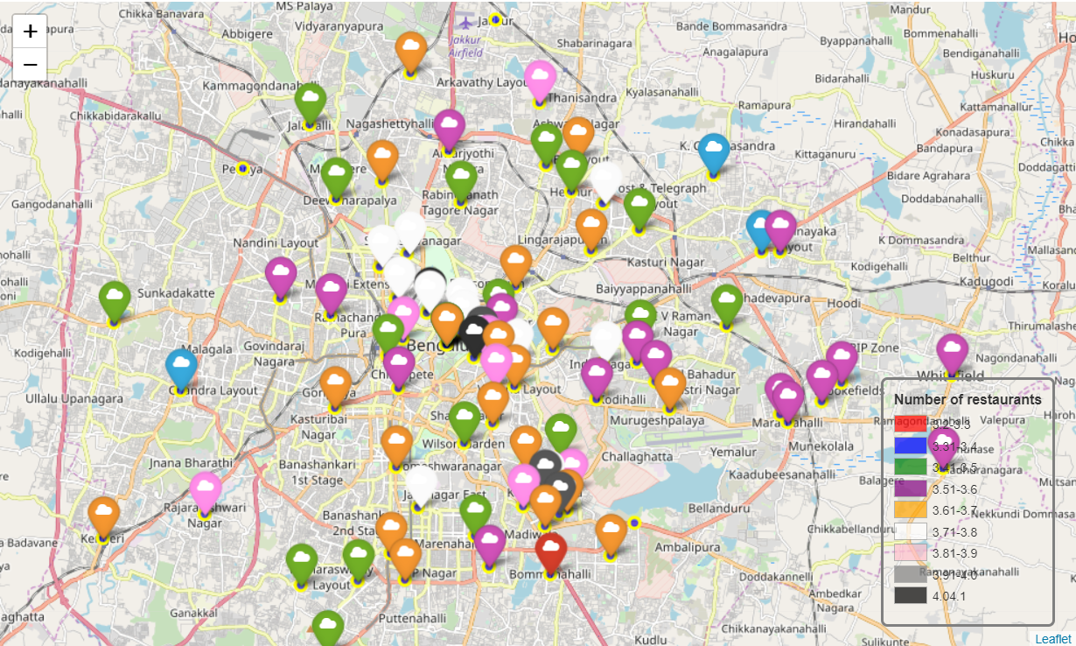
We can also observe that most of the restaurants are situated in center of bengaluru

Slide 11
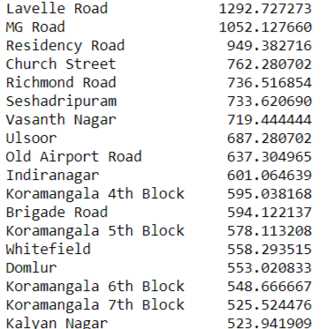
Cost of food (for 2 people) neighbourhood wise

Slide 12
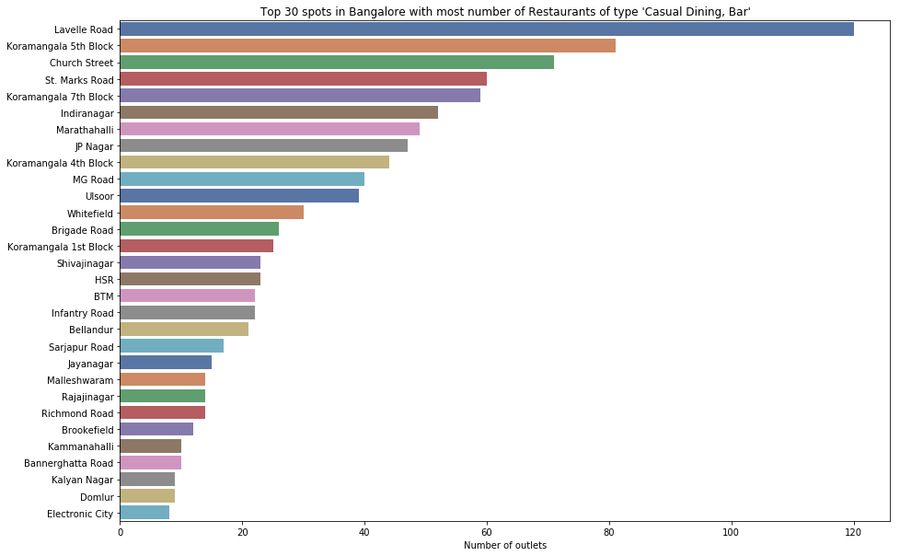
Keeping in mind about all age group, Casual dining cum bar seems like a lucrative option .

Slide 13
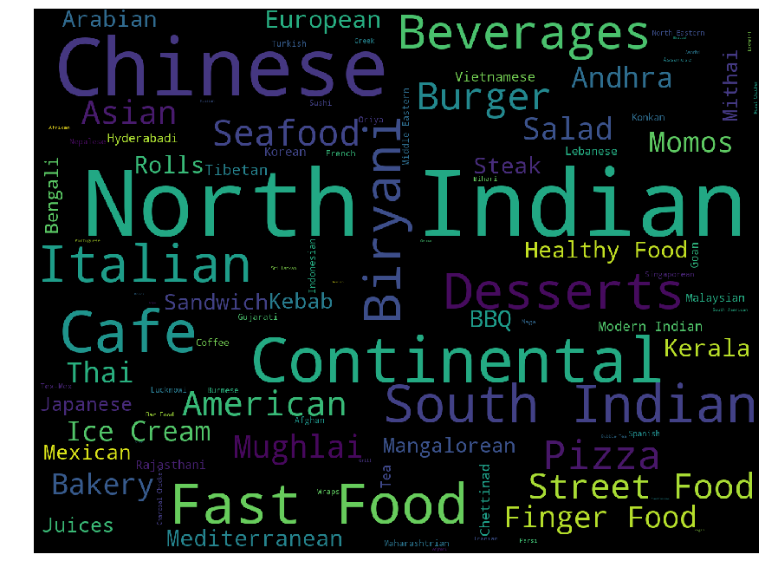
word cloud of most liked cuisine
Bengaluru being
in South India ,
people here like
North Indian food more

Slide 14
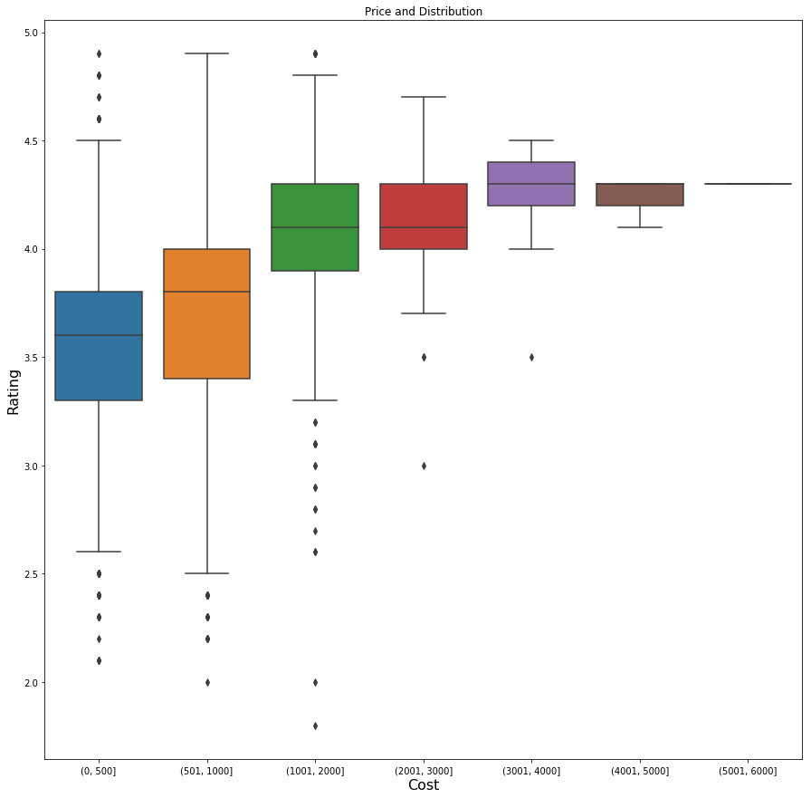
Cost for 2 people vs ratings

Slide 15
We used Pearson’s Correlation to analyse the relationship between Ratings and Cost of Food in a restaurant .
Null Hypothesis : There is no Relationship whatsoever
Alternate Hypothesis : There is some relationship between them
P Value: 6.633647396643138e-28
So we Reject our NULL hypothesis since the P value is so less. There is definitely some relationship between the two .

Slide 16
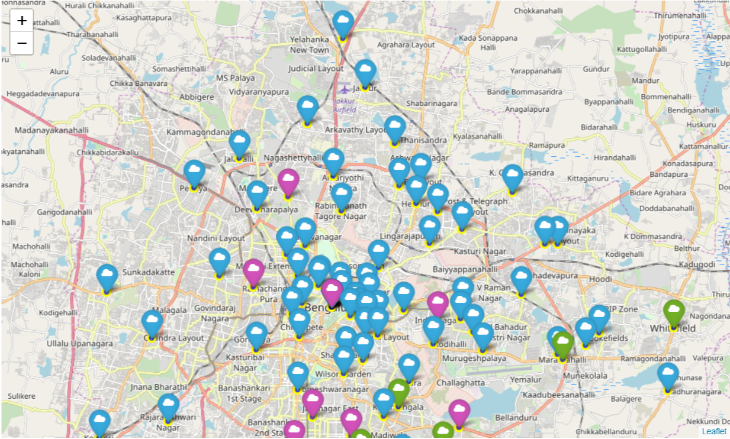
K-means Clustering based on Type of Restaurant
Cluster 1 or those marked in Blue are the places that are more famous for its Biryani, Chinese, Fast food and North Indian food.
Cluster 2 or those marked in Green are those places that are more famous for its South Indian, Indian, North Indian, Chinese as well as fast food.
Cluster 3 or those marked in Purple were those areas where Street Food, Chinese, Fast food were more popular or we can say more number of restaurants were present.

Slide 17
Conclusion and analysis
Basically we can visualise the lucrative options for cuisines , type and location in Bengaluru where new restaurant can be established based upon the preference of the client.
Visualisation of Cuisines and food items preferred and the quantity can be well noticed in the findings provided.
Quick service restaurants , take aways are giants of the Indian food service market, and are growing exponentially. Fine dining is gaining prominence too.Conspicuous consumption I believe. Both multi-cuisine and single-cuisine establishments have shown tremendous growth.
The model and the idea can be used with the help of Real Time data
Ordering Pattern , cuisines can quite accurately predict the type of restaurant .
Cafe Coffee day has its outlet in most of the neighbourhood of Bengaluru.
These pattern can be mined from the data which is seen in the real life too. Thanks to the diversity of India. The data can also be used to find out the popular food, type of people, residency area etc to help new restaurants take better data driven decisions.

