Slide 1
ViTs for SITS: Vision Transformers for Satellite Image Time Series
Team LezitNet
Bidit Sadhukhan
Srijan Rit

Slide 2
About the Paper
Authors: Michail Tarasiou, Erik Chavez, Stefanos Zafeiriou
Institution: Imperial College London
Publication Details: Proceedings of the IEEE/CVF Conference on Computer Vision and Pattern Recognition (CVPR) 2023

Slide 3
Contents (Planned)
Introduction
Objectives
Methodology
ViT Primer
TSViT Architecture
Experiments and Results
Conclusion
1
1
2
4
10
2
1

Slide 4
Introduction
The monitoring of crop development can help design optimum strategies aimed at improving the welfare of farmers and resilience of the food production system.
A Satellite Image Time Series (SITS) is a set of satellite images taken from the same area at regular intervals
Towards more accurate automatic crop type recognition, the paper introduces Temporo-Spatial Vision Transformer (TSViT), the first fully-attentional architecture for SITS processing.

Slide 5
Objectives
Crop type recognition is a subcategory of land use recognition which involves assigning one of K crop categories (classes) at a set of desired locations on a geospatial grid.
For successfully doing so modelling the temporal patterns of growth during a time period of interest has been shown to be critical.
Model inputs are timeseries of T satellite images of spatial dimensions H × W with C channels, X ∈ R^{T×H×W×C}

Slide 6
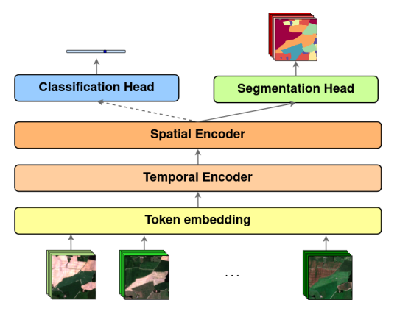

Slide 7
Self-attention in vision
Convolutional and fully-convolutional networks (FCN) have been the de-facto model of choice for vision tasks.
Following the adoption of Transformers as the dominant architecture in natural language processing tasks, several works have attempted to exploit self-attention in vision architectures.

Slide 8
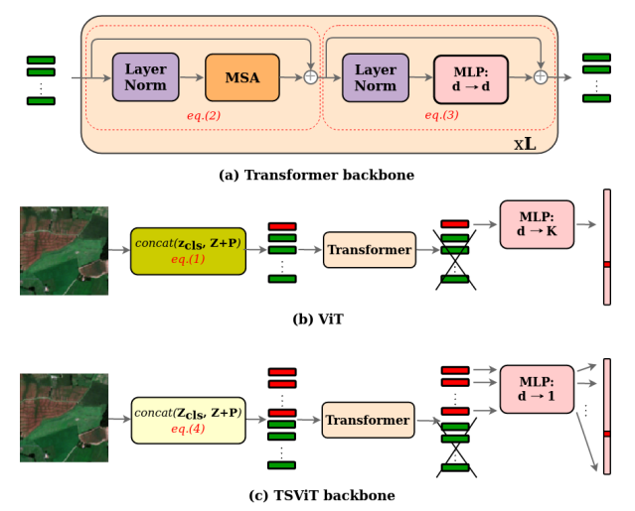

Slide 9
Primer on ViT
The Vision Transformer (ViT) is an application of the Transformer architecture to images with the fewest possible modifications.
Their framework involves the tokenization of a 2D image X ∈ R ^{H×W×C} to a set of patch tokens Z ∈ R ^{N×d} by splitting it into a sequence of N = [H/h]*[W/w] same-size and non-overlapping patches of spatial extent (h × w) which are flattened into 1D tokens x_{i} ∈ R^{hwC} and linearly projected into d dimensions.

Slide 10
Primer on ViT
Overall, the process of token extraction is equivalent to the application of 2D convolution with kernel size (h × w) at strides (h, w) across respective dimensions. The extracted patches are used to construct model inputs as follows:
Z⁰ = concat(z_{cls}, Z + P) ∈ R ^{N+1×d}
A set of learned positional encoding vectors P ∈ R N×d , added to Z, are employed to encode the absolute position information of each token and break the permutation invariance property of the subsequent Transformer layers.

Slide 11
Primer on ViT
A separate learned class (cls) token zcls ∈ R d [12] is prepended to the linearly transformed and positionally augmented patch tokens leading to a length N + 1 sequence of tokens Z⁰ which are used as model inputs.
The Transformer backbone consists of L blocks of alternating layers of Multiheaded Self-Attention (MSA) and residual Multi-Layer Perceptron (MLP)
Y^{l} = MSA(LN(Z^{l})) + Z^{l}
Z^{l+1} = MLP(LN(Y^{l})) + Y^{l}

Slide 12
Primer on ViT
Prior to each layer, inputs are normalized following Layernorm (LN). MLP blocks consist of two layers of linear projection followed by GELU non-linear activations.
In contrast to CNN architectures, in which spatial dimensions are reduced while feature dimensions increase with layer depth, Transformers are isotropic in that all feature maps Z^{l} ∈ R ^{1+N×d} have the same shape throughout the network.
After processing by the final layer L, all tokens apart from the first one (the state of the cls token) are discarded and unnormalized class probabilities are calculated by processing this token via a MLP.

Slide 13
TSViT backbone architecture
K (equal to the number of object classes) additional learnable cls tokens Z_{cls} ∈ R^{K×d} , compared to ViT which uses a single token.
Z⁰ = concat(Z_{cls}, Z + P) ∈ R^{N+K×d}
All cls and positionally augmented patch tokens are concatenated and processed by the L layers of a Transformer encoder.
After the final layer, we discard all patch tokens and project each cls token into a scalar value. By concatenating these values we obtain a length K vector of unormalised class probabilities.

Slide 14
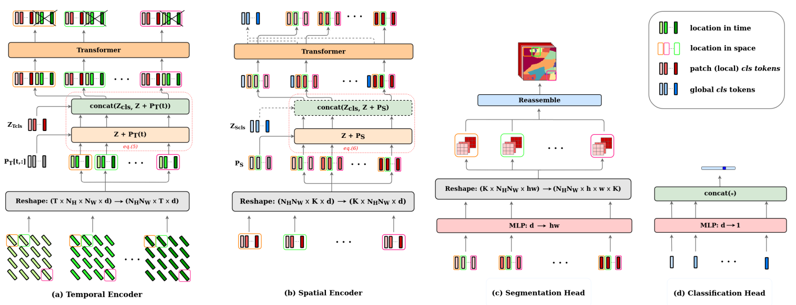

Slide 15
Tokenization of SITS inputs
A SITS record X ∈ R^{T ×H×W×C} consists of a series of T satellite images of spatial dimensions H × W with C channels.
For the tokenization of our 3D inputs, we can extend the tokenization-as-convolution approach to 3D data and apply a 3D kernel with size (t×h×w) at stride (t, h, w) across temporal and spatial dimensions.
In this manner N = [T/t]*[H/h]*[W/w] non-overlapping tokens x_{i} ∈ R^{thwC} are extracted, and subsequently projected to d dimensions

Slide 16
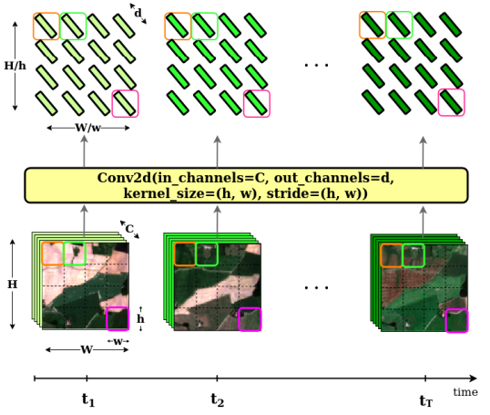

Slide 17
Tokenization of SITS inputs
Using t > 1, all extracted tokens contain spatio-temporal information.
For the special case of t = 1 each token contains spatial-only information for each acquisition time and temporal information is accounted for only through the encoder layers.
Since the computation cost of global self-attention layers is quadratic w.r.t. the length of the token sequence O(N2 ), choosing larger values for t, h, w can lead to significantly reduced number of FLOPS.

Slide 18
Temporal encoder
A SITS record X ∈ R^{T ×H×W×C} is tokenized into a set of tokens of size (N_{T} × N_{H} × N_{W} × d), and subsequently reshape to Z_{T} ∈ R ^{NH×NW×NT ×d} , to get a list of token time- series for all patch locations.
The input to the temporal encoder is: Z⁰_{T} = concat(Z_{T cls}, Z_{T} + P_{T}[t, :]) ∈ R^{NHNW ×K+NT ×d}
where P_{T}[t, :] ∈ R^{NT ×d} and Z_{Tcls} ∈ R^{K×d} are respectively added and prepended to all N_{H}N_{W} timeseries and t ∈ R^{T} is a vector containing all T acquisition times.

Slide 19
Temporal Encoder
Consequently, the final feature map of the temporal encoder becomes Z^{L}_{T} ∈ R ^{NHNW ×K+NT ×d} in which the first K tokens in the temporal dimension correspond to the prepended cls tokens.
We only keep these tokens, discarding the remaining N_{T} vectors.

Slide 20
Spatial Encoder
We now transpose the first and second dimensions in the temporal encoder output, to obtain a list of patch features Z_{S} ∈ R^{K×NHNW ×d} for all output classes. In a similar spirit, the input to the spatial encoder becomes:
Z⁰_{S} = concat(Z_{Scls}, Z_{S} + P_{S}) ∈ R^{K×1+NHNW}
where P_{S} ∈ R^{NHNW ×d} are respectively added to all K spatial representations and each element of Z_{Scls} ∈ R ^{K×1×d} is prepended to each class-specific feature map.

Slide 21
Spatial Encoder
We note, that while in the temporal encoder cls tokens were prepended to all patch locations, now there is a single cls token per spatial feature map such that Z_{Scls} are used to gather global SITS-level information.
Processing with the spatial encoder leads to a similar size output feature map
Z_{LS} ∈ R^{K×1+NHNW ×d}

Slide 22
Decoder Architecture
To accommodate both global and dense prediction tasks we design two decoder heads which feed on different components of the encoder output.
We view the output of the encoder as Z^{L}_{S} = [Z^{L}_{Sglobal}|Z^{L}_{Slocal}] respectively corresponding to the states of the global and local cls tokens.
For image classification, we only make use of Z^{L}_{Sglobal} ∈ R^{K×d}
Projecting each feature into a scalar value and concatenate these values to obtain global unormalised class probabilities as shown in Fig.4(d). Complementarily, for semantic segmentation we only use Z^{L}_{Slocal} ∈ R ^{K×NHNW ×d} .

Slide 23
Decoder Architecture
These features encode information for the presence of each class over the spatial extent of each image patch.
By projecting each feature into hw dimensions and further reshaping the feature dimension to (h × w) we obtain a set of class specific probabilities for each pixel in a patch.
It is possible now to merge these patches together into an output map (H × W × K) which represents class probabilities for each pixel in the original image.

Slide 24
Position Encodings
First, temporal position encodings are added to all patch tokens before processing by the temporal encoder.
This operation aims at breaking the permutation invariance property of MSA by introducing time-specific position biases to all extracted patch tokens.
For crop recognition encoding the absolute temporal position of features is important as it helps identifying a plant’s growth stage within the crop cycle.
To introduce acquisition-time-specific biases into the model, our temporal position encodings P_{T}[t, :] depend directly on acquisition times t.

Slide 25
Position Encodings
More specifically, we make note of all acquisition times t’ = [t1, t2, ..., tT’ ] found in the training data and construct a lookup table P^{T} ∈ R ^{T````````’×d} containing all learnt position encodings indexed by date.
Finding the date-specific encodings that need to be added to patch tokens (eq.5) reduces to looking up appropriate indices from P_{T}.

Slide 26
Positional Encoding
In this way temporal position encodings introduce a dynamic prior of where to look at in the models’ global temporal receptive field, rather than simply encoding the order of SITS acquisitions which would discard valuable information.
Following token processing by the temporal encoder, spatial position embeddings PS are added to the extracted cls tokens.
These are not dynamic in nature and are similar to the position encodings used in the original ViT architecture, with the difference that these biases are now added to K feature maps instead of a single one.

Slide 27
Experiments
We apply TSViT to two tasks using SITS records X ∈ R^{T ×H×W×C} as inputs: classification and semantic segmentation.
At the object level, classification models learn a mapping f(X) ∈ R^{K} for the object occupying the center of the H × W region.
Semantic segmentation models learn a mapping f(X) ∈ R^{H×W×K}, predicting class probabilities for each pixel over the spatial extent of the SITS record.

Slide 28
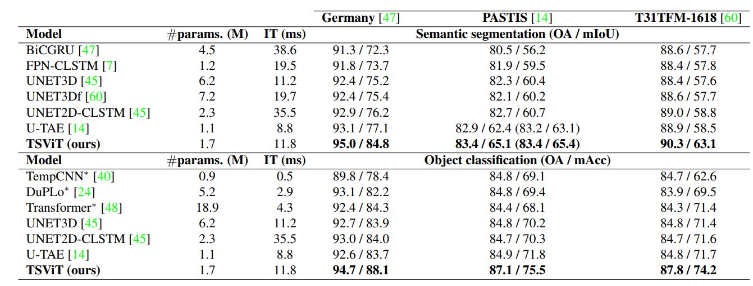
Results

Slide 29
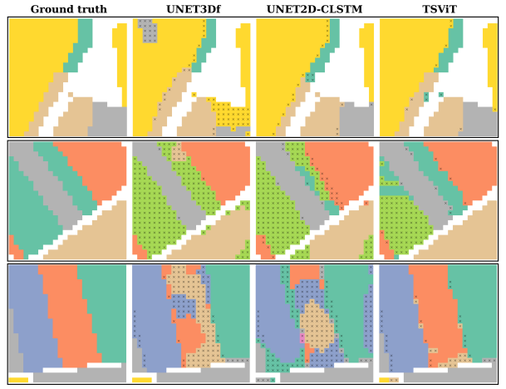

Slide 30
Conclusion
Overall, TSViT has been shown to significantly outperform state-of-the-art models in three publicly available land cover recognition datasets.
The method is limited by its quadratic complexity with respect to the input size.
While this may not pose a significant issue for semantic segmentation or SITS classification, it can present challenges for detection tasks that require isolating large objects, thus limiting its application.

Slide 31
Thank
You

