Slide 1

Identification And Prediction Of Drought Prone Areas In Uttar Pradesh Using
Machine Learning
Ramakrishna Mission Vivekananda Educational and Research Institute
Group Name – LezitAnBi
Anirban Dey (anirbandey.rkmrcnpur@gmail.com)
Bidit Sadhukhan (sadhukhanbidit@gmail.com)

Slide 2
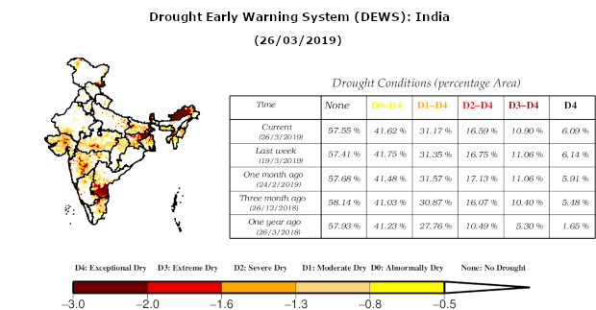
Problem Definition:
Drought is a recurrent and persistent problem in several parts of the world, particularly in India. In Uttar Pradesh, a state in northern India, drought has affected crop production, livestock, and water resources. Although droughts cannot be prevented entirely, predicting drought-prone areas can help
mitigate the adverse effects of drought. Therefore, the problem this project aims to address is to develop a model that can predict and classify drought-prone areas in Uttar Pradesh
Picture: 1

Slide 3
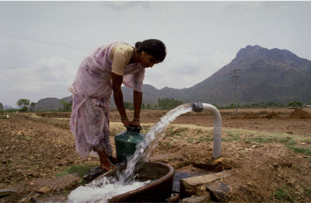
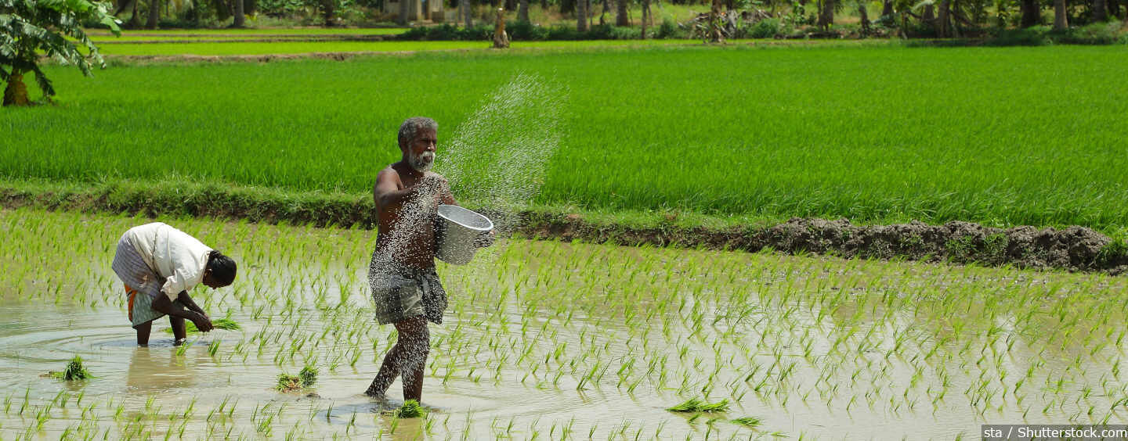
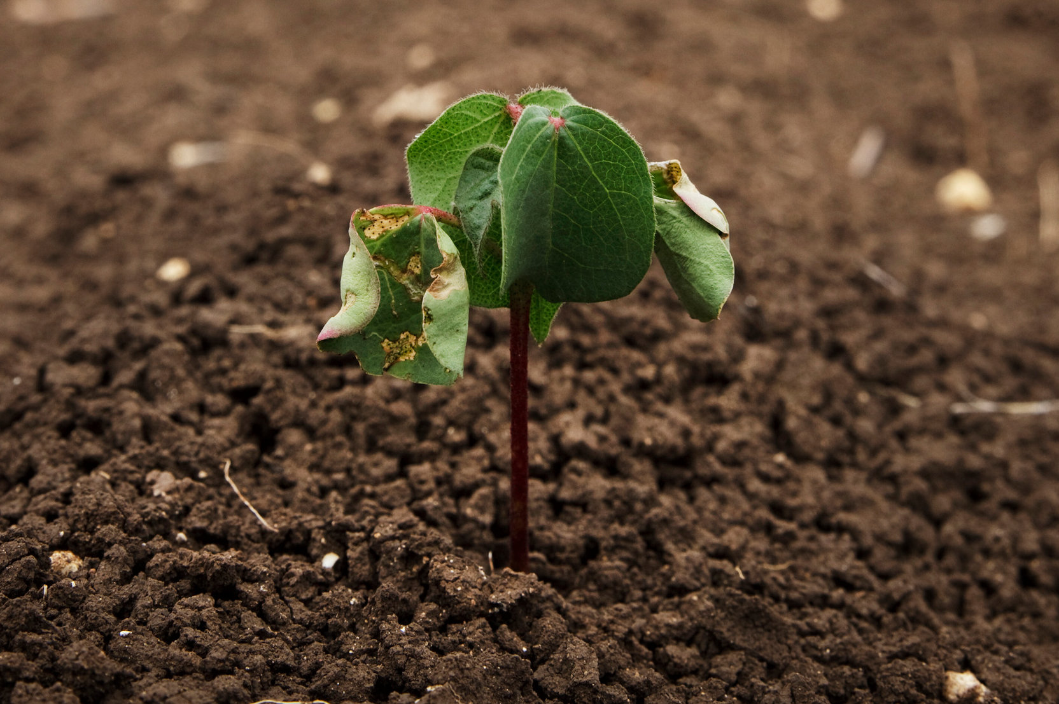
Motivation
The prediction of drought-prone areas can help policymakers and farmers in the state to prepare for and mitigate the adverse effects of drought. Accurate prediction of drought-prone areas can enable farmers to adopt appropriate agricultural practices, such as crop diversification and soil moisture conservation, to mitigate the impact of drought on crop yields. Additionally, policymakers can use this information to allocate resources such as water and subsidies for agricultural inputs, in a targeted and efficient manner, to the areas that need them the most. Hence, the motivation behind this project is to develop a model that can accurately predict drought-prone areas in Uttar Pradesh, with the potential to benefit farmers, policymakers, and the state's economy as a whole

Slide 4
Literature Review_1:
Drought is a natural hazard that affects various sectors such as agriculture, water resources, ecosystems, and human health. It is characterized by a prolonged period of low precipitation that causes water scarcity and reduces soil moisture. Drought monitoring and forecasting are essential for mitigating its impacts and enhancing adaptive capacity. Machine learning (ML) is a branch of artificial intelligence that can learn from data and provide accurate predictions for complex problems. ML techniques have been widely applied for drought analysis and prediction using various drought indices such as the Standardized Precipitation Index (SPI), which measures the deviation of precipitation from its long-term mean . ML methods can be classified into supervised, unsupervised, and hybrid approaches. Supervised methods require labeled data to train the model, while unsupervised methods do not need labels and can discover hidden patterns in the data. Hybrid methods combine different ML techniques or other methods such as wavelet analysis (WA), which can decompose time series data into different frequency components . Some of the common ML techniques used for drought forecasting are artificial neural networks (ANNs), support vector regression (SVR), random forest (RF), k-means clustering, fuzzy logic, etc. These methods can handle nonlinear relationships, high-dimensional data, noise, uncertainty, and missing values . However, they also have some limitations such as overfitting, parameter tuning, interpretability, computational cost, etc.

Slide 5
Literature Review_2:
The project aims to identify and predict drought prone areas in Uttar Pradesh using ML techniques. Uttar Pradesh is a state in northern India that has a population of about 200 million people and covers an area of about 240 thousand square kilometers. It has a diverse climate ranging from humid subtropical to semi-arid conditions. The state faces frequent droughts due to erratic rainfall patterns, high evapotranspiration rates, low groundwater recharge rates, increasing water demand, poor water management practices, etc . The project will use remote sensing and GIS data to obtain spatial information on rainfall, temperature,
soil moisture content , land use/land cover , slope , drainage density , groundwater yield , etc . These parameters will be used as input variables for ML models to calculate SPI values at different time scales (e.g., 3-months , 6-months , 12-months ) for each pixel or grid cell in the study area . The SPI values will be classified into different drought categories (e.g., mild , moderate , severe , extreme ) based on predefined thresholds . The output will be a drought map that shows the spatial distribution of drought severity for each time scale . The project will also use historical data to train and test different ML models such as ANNs , SVR , RF , etc . The performance of these models will be evaluated using statistical criteria such as root mean square error (RMSE) , mean absolute error (MAE) , Nash-Sutcliffe efficiency coefficient (NSE) , etc . The best performing model will be selected for forecasting future SPI values based on projected climate scenarios . The forecasted SPI values will be used to generate future drought maps that can help decision makers and stakeholders to plan appropriate mitigation measures and adaptation strategies .

Slide 6
Proposed Methods & Output:
One proposed methodology for predicting and classifying drought-prone areas in Uttar Pradesh using Rainfall, soil moisture, irrigation, temperature, tree cover, geology, water body data etc:
1.Data Collection: Collecting data on Hydrological Factors(Ground Water,irrigation water,Presence of Water sources) aslo rainfall, soil moisture, , temperature, tree cover, geological datum in Uttar Pradesh. This data can be obtained from government agencies, satellite data, and ground-based sensors.
2.Data Preprocessing: Cleaning the data and remove any missing values or outliers. Normalize the data to ensure that all variables are on the same scale.
3.Feature Selection: Using statistical methods and domain knowledge to select the most relevant features for predicting and classifying drought-prone areas. This can include variables such as average rainfall, soil moisture content, irrigation intensity, temperature variability, tree cover density, geology type, and distance to water bodies.
4.Model Training: Train a machine learning algorithm on the selected features and historical drought data to predict drought-prone areas or a regression model on the selected features and historical drought data to predict drought-prone areas. This can include methods such as linear regression, multiple regression, or polynomial regression, decision trees, random forests, or neural networks etc.
5.Model Evaluation: Evaluating the model's performance using metrics such as accuracy, precision, recall, and F1 score, metrics such as mean squared error, mean absolute error, and R-squared value.We may Use cross-validation to ensure that the model is robust and can generalize to new data.
6.Classification: Using the trained model to classify different regions of Uttar Pradesh as either drought-prone or not. This can help policymakers and farmers to take proactive measures to mitigate the impact of drought.
7.Visualization: We can visualize the predicted drought-prone areas on a map to aid in decision-making and resource allocation. This can include tools such as GIS or interactive dashboards.
Overall, this methodology can help to identify areas in Uttar Pradesh that are vulnerable to drought and provide actionable insights for mitigating the impact of drought on agriculture, water resources, and livelihoods.

Slide 7
Work-Plan (Timetable):
TASKS | ASSIGNEE | DEADLINE | STATUS
DataCollection | Both | 21-03-2023 | Completed
LiteratureReview | BiditSadhukhan | 21-03-2023 | Completed
CreatingaPlanning | BiditSadhukhan | 20-03-2023 | Completed
SubmitProjectProposal | AnirbanDey | 21-03-2023 | Completed
Reviewingliteratureformethodology | BiditSadhukhan | 31-03-2023 | NotStarted
DataFilteringandcleaning | AnirbanDey | 07-04-2023 | NotStarted
FeatureEngineering | BiditSadhukhan | 01-04-2023 | NotStarted
WritingCodetotrainData | BiditSadhukhan | 15-04-2023 | NotStarted
TestingTheModelParameterwithValidation | AnirbanDey | 12-04-2023 | NotStarted
FindingaSuitableModel | BiditSadhukhan | 21-04-2023 | NotStarted
PredictionofAreasandIdentification | AnirbanDey | 06-05-2023 | NotStarted
WritingtheFinalReport | Both | 11-05-2023 | NotStarted

Slide 8
THANK YOU ALL…!!!!

