Slide 1
CAPTCHA Classification

Slide 2
Problem description:
Introduction
The problem at hand for this mini-project was to design and build a pipeline for an
image analysis task, namely, to identify 3-digit numbers on captcha images. These
images are usually highly distorted, to make them unrecognizable for computers.
Our goal was to identify at least 50% of them correctly.

Slide 3
Methods:

Slide 4
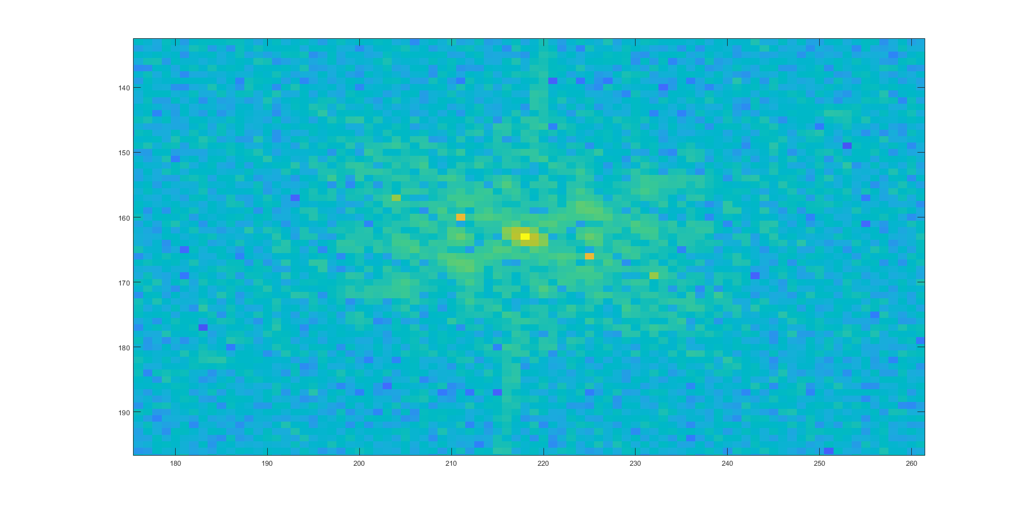
Noise removal in the Fourier domain
Periodic additive noise
Distinct, constant frequency

Slide 5
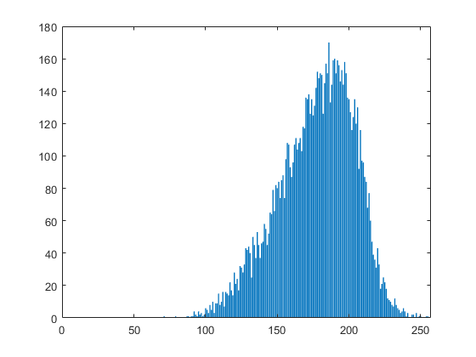
Gaussian noise removal
Homogeneous patch analysation
Gaussian distributed background noise

Slide 6
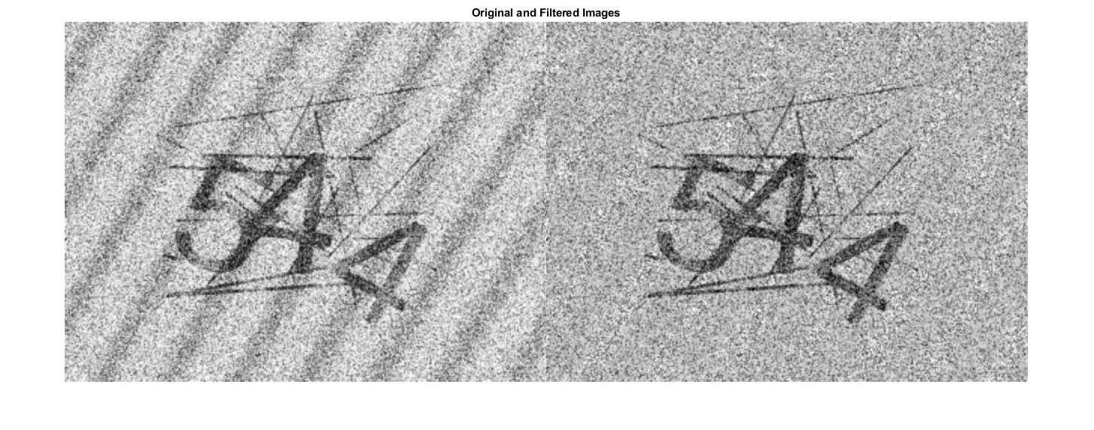
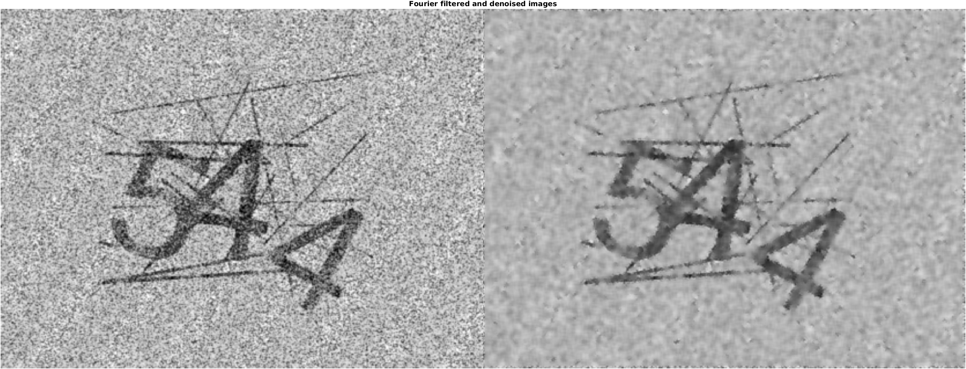
Where we are right now

Slide 7
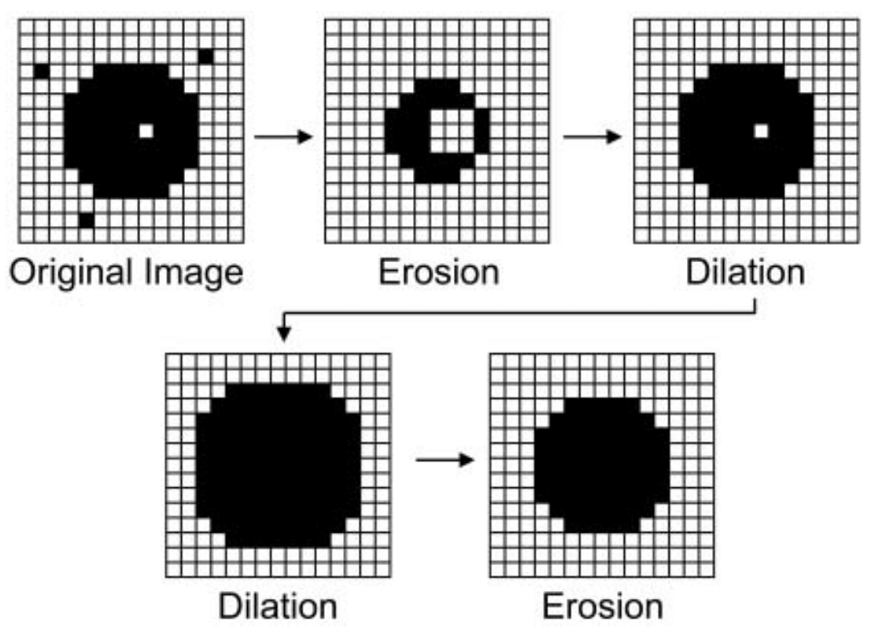
Morphological transformation
Black and White threshoilding
Erosion and dilation

Slide 8
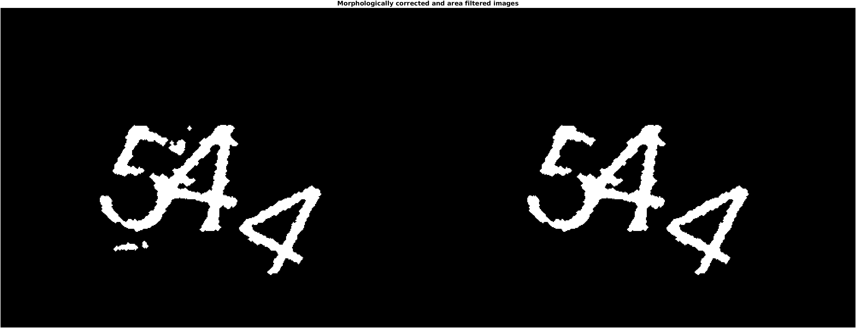
Area filtering
Artifacts still on the pictures, that could not be removed with morphological transformation
Generally little, separate artifacts

Slide 9
Area segmentation

Slide 10
Template matching using cross correlation

Slide 11
Implementation

Slide 12
Results

Slide 13
Discussion

