Slide 1

Breast Cancer Diagnosis Using Support Vector Machine

Slide 2
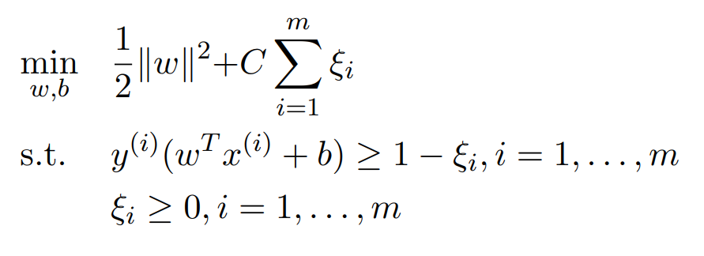
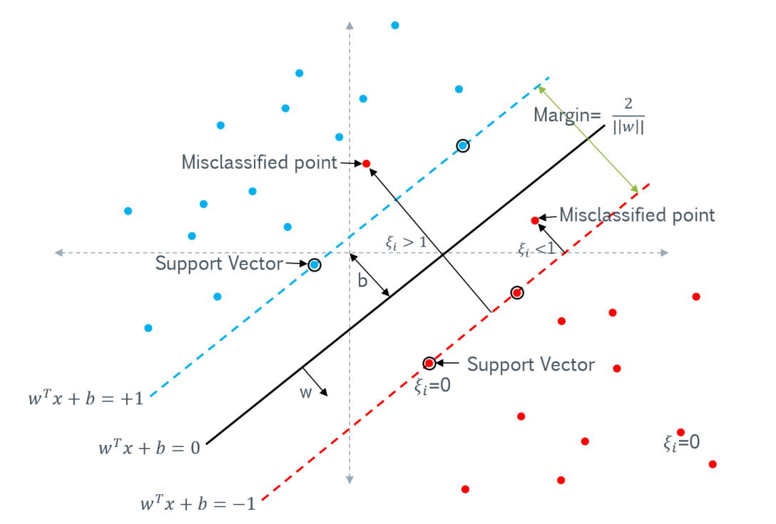
Support Vector Machine (SVM)
Support Vector Machines (SVM) are supervised learning models used for classification and regression tasks
Find the optimal hyperplane that separates data points into different classes, maximizing the margin between them (minimizing the inverse of it)
"Hard margin" when data is linearly separable, "soft margin" allows for some misclassifications by introducing a penalty parameter (C)

Slide 3
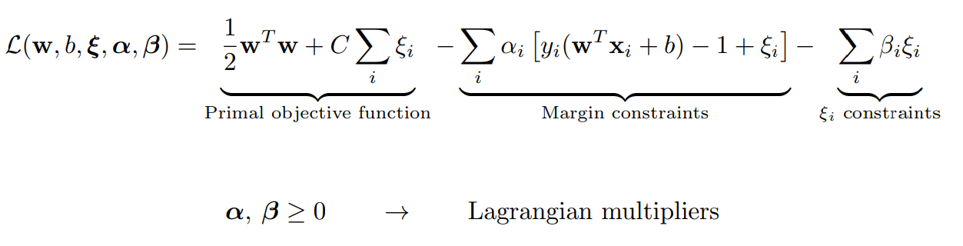
How do we minimize the function?
We don’t know b!
We construct the Lagrangian

Slide 4
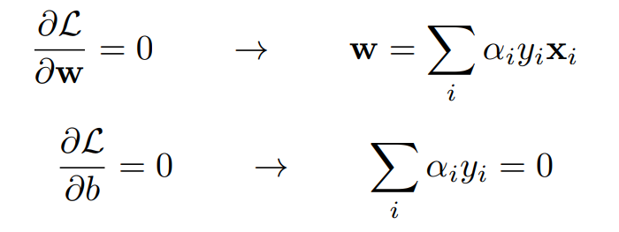
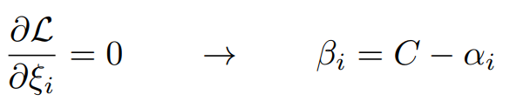

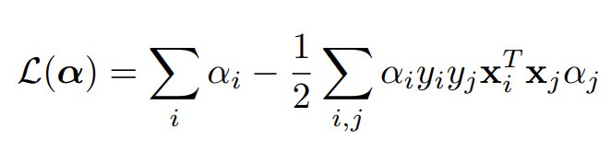
Dual problem
Inserting these in the Lagrangian, after some algebra:
Only depends on alpha!

Slide 5
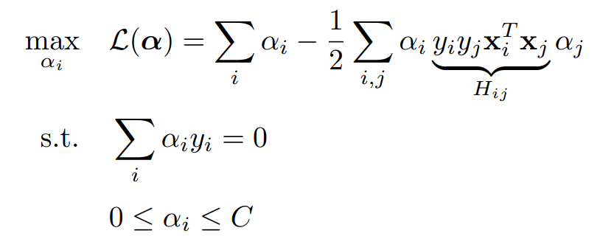
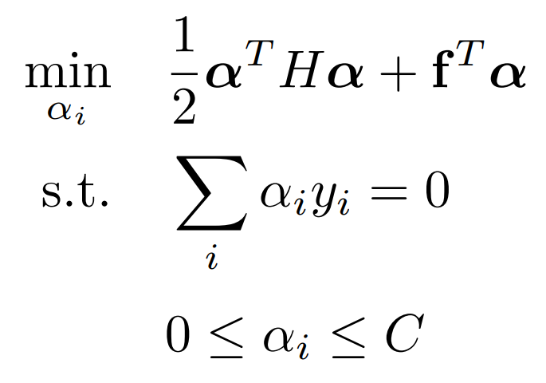
Dual problem: Quadratic programming
Equivalent to primal problem
Easy to implement

Slide 6
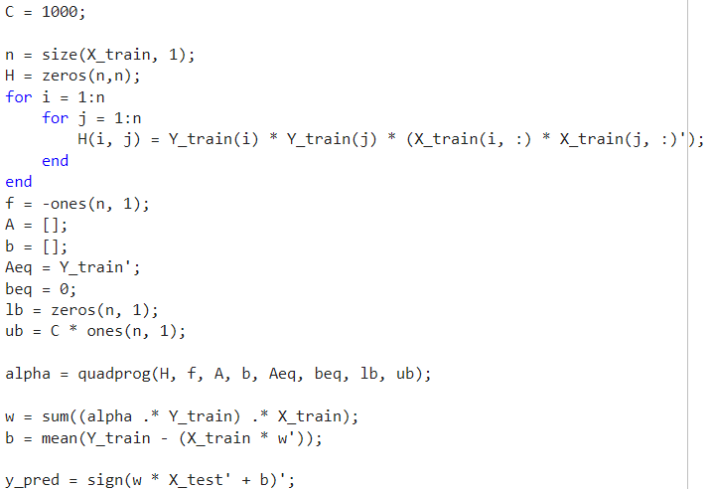
Matlab Code
Dividing the dataset to training and testing sets
Creating the necessary variables for quadprog solver function
Evaluating the results such as: Accuracy, specificity, sensitivity

Slide 7
Results
With C = 1000:
Accuracy: 0.956522
Sensitivity: 0.882353
Specificity: 0.980769
Best result with C = 10:
Accuracy: 0.971014
Sensitivity: 0.941176
Specificity: 0.980769
Accuracy: Correctness rate Sensitivity: True positive ratio Specificity: True negative rate

