Slide 1

Breast Cancer Diagnosis Using Support Vector Machine

Slide 2
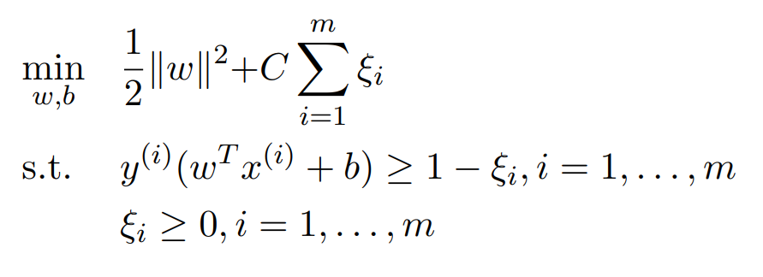
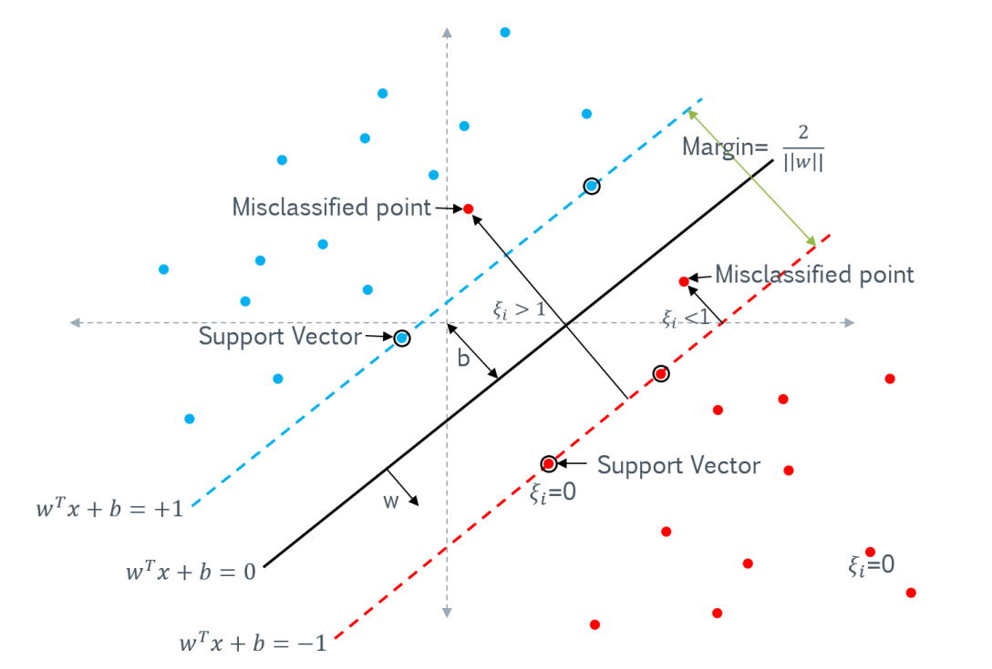
Support Vector Machine (SVM)
Support Vector Machines (SVM) are supervised learning models used for classification and regression tasks
Find the optimal hyperplane that separates data points into different classes, maximizing the margin between them (minimizing the inverse of it)
"Hard margin" when data is linearly separable, "soft margin" allows for some misclassifications by introducing a penalty parameter (C)

Slide 3
Problem Forming Langrangian Dual
Mathematical Explanation of the Langrangian Dual Formulation

Slide 4
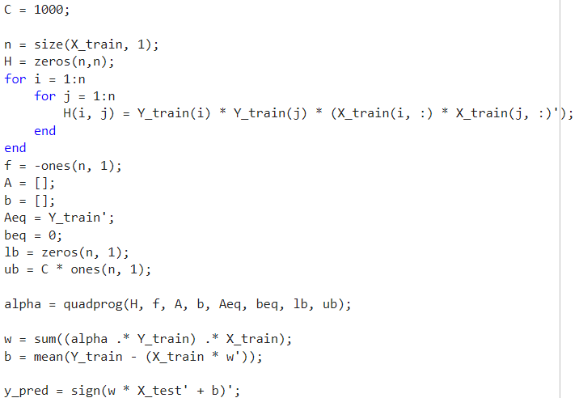
Matlab Code
Dividing the dataset to training and testing sets
Creating the necessary variables for quadprog solver function
Evaluating the results such as: Accuracy, specificity, sensitivity

Slide 5
Results
With C = 1000:
Accuracy: 0.956522
Sensitivity: 0.882353
Specificity: 0.980769
Best result with C = 10:
Accuracy: 0.971014
Sensitivity: 0.941176
Specificity: 0.980769

