Slide 1
Category review: Chips
June 2020
Retail Analytics
Brand note: If client logo is not required, use alternate title page layout right click slide thumbnail > Layout > Title

Slide 2
Notes:
To view Privacy video explaining how important data privacy is to Quantium, please click here: https://www.youtube.com/watch?v=Zq1QDAkoRzU
or here Q:\Company Reference\Brand & Design\Brand videos\Q Privacy.mp4
At Quantium, we believe that data is the behavioural footprint of humanity and that it has to be treated with the utmost care and responsibility.
Histories, attitudes, indeed lives are stored within it in ways that aren’t always apparent – and that’s what makes its potential so powerful.
To work with it responsibly, sensitively, we set ourselves the highest data privacy protection and governance standards.
We have spent 17 years perfecting privacy-by-design and secure-by-design principles. Central to this is not holding any personally identifiable information about people –
we neither receive it, and put the necessary protections in place to be unable to decipher it.
Every aspect of handling data is safeguarded: from its de-identification, to its encryption – data security is paramount and of the highest grade.
We pride ourselves on gaining the trust of iconic organisations around the world through years of securely working with their data,
and in turn the trust that builds with their stakeholders.

Slide 3
Executive summary
01
Chips Category Review
The Mainstream category of Young and Mid-age Singles/Couples have the highest spending of chips per purchase.
The Older Families(Budget) have the highest frequency of purchase followed by Young Singles/Couples (Mainstream) and at last Retirees (Mainstream) contributing to a total 25% sales revenue.
Chips Brand Kettle is the most purchased brand in all stores.
Young and Mid-age Singles/Couples is the only segment having Doritos as the highest purchase brand while Smiths is for other segments.
Most frequent chip size purchased is 175 gr followed by 150 gr size for all segments.
Chips transactions increase a lot before Christmas which can be an advantage with the help of promotional offers.
02
Store Analysis
Trial stores 77 and 86 have significant increase in total sales and number of customers during trial as compared to control store.
Trial store 88 had increase as well but not as good as stores 77 and 86.

Slide 4
01
Category

Slide 5
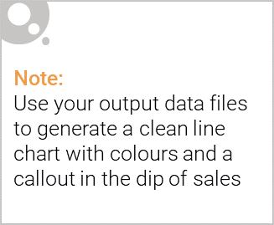
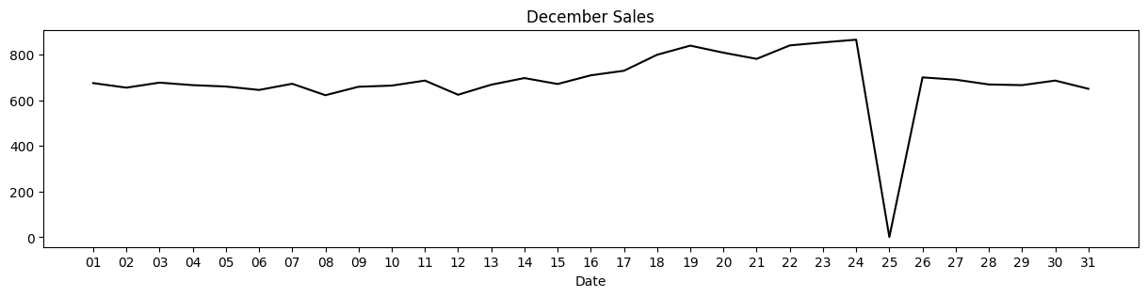
The day with no transaction is a Christmas day that is when the store is closed hence there is a dip in sales on 25th December as shops were non-operational.
Sales increase steadily as the Christmas day approaches and return again to early December sales level during New Year Eve.

Slide 6
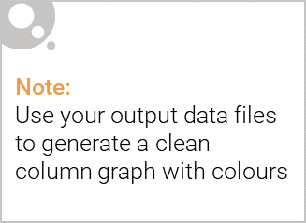
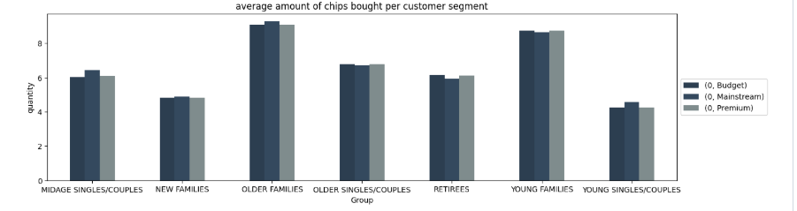
Sales mainly came from Budget - older families, Mainstream - young singles/couples, and Mainstream - retirees. In total contributing 25% of sales revenue.
Older and Young Family segment have the highest average purchase units per unique customer

Slide 7
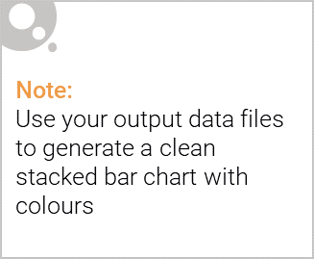
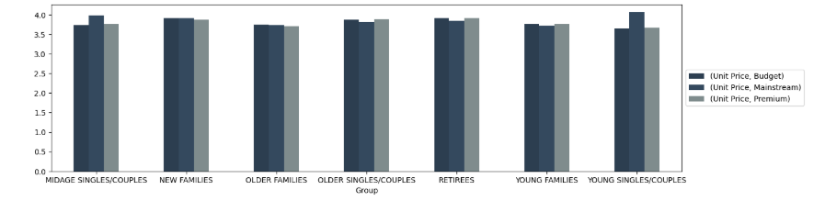
Editable (delete this)
Consistent Pricing Across Groups
The unit prices for Budget, Mainstream, and Premium categories remain relatively stable across different consumer groups.
There is no significant deviation in pricing between family types, indicating uniform pricing strategies.
e key observations from the graph:
Higher Pricing for Young Singles/Couples and Mid age Singles/Couples
The Young Singles/Couples and Mid age Singles/Couples segments show slightly higher unit prices, particularly in the Budget and Mainstream categories.
This suggests that these demographics might have a higher spending tendency on these products.
Minimal Price Variation Between Categories
The differences between Budget, Mainstream, and Premium pricing within each group are marginal.
This indicates a close competition between the three pricing segments.
Lower Unit Price for Older Families and Young Families
Older Families and Young Families have slightly lower unit prices, suggesting possible pricing strategies targeting family-based affordability.

Slide 8
02
Trial store performance

Slide 9
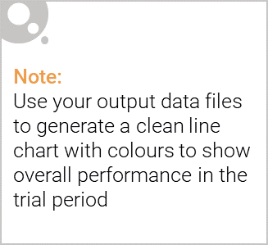
Trial Store Sales Analysis
Store 77
Total Sales: $3,040.00
Identified control store based on sales similarity and correlation.
Sales pattern shows fluctuations, requiring validation against control store performance.
Store 86
Total Sales: $10,635.35
Shows a higher total sales volume compared to Store 77.
Control store selection ensured alignment in sales trends before and after the trial period.
Store 88
Total Sales: $16,333.25
Highest sales among trial stores.
Further analysis needed to assess the impact of external factors.
Control Store Selection & Analysis
Matching Control Stores
Used total sales comparison and Pearson correlation test to find the best match.
Ensured minimal variance in pre-trial sales patterns.
Sales Trend Comparison
Trial stores’ performance will be assessed against control stores post-trial.
Helps determine if sales changes are due to external factors or the applied strategies.

Slide 10
