Slide 2


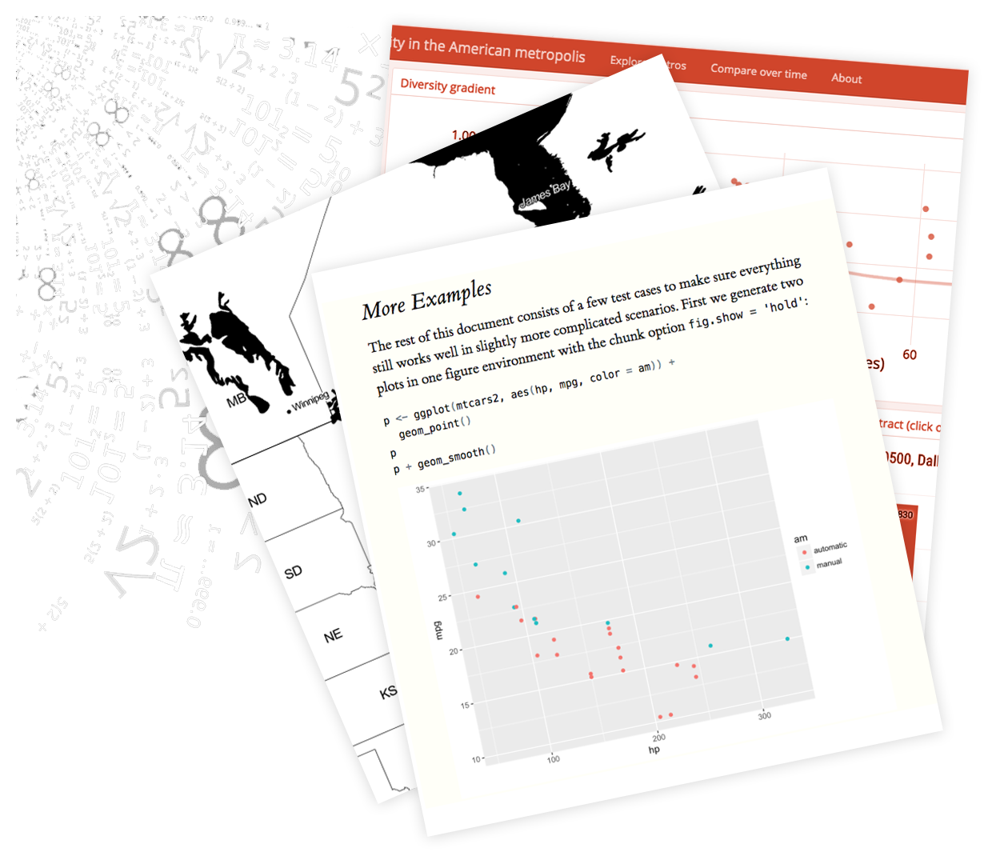





LOAD
TRANSFORM
VISUALIZE
PRESENT
ANALYZE

