Slide 1
MC²: High Performance GC for Memory-Constrained Environments
Narendran Sachindran
J. Eliot B. Moss
Emery D. Berger
University of Massachusetts Amherst

Slide 2
Motivation
Java widely used
  Safety
  Portability
Garbage collector requirements
  High throughput
  Short pauses
  Good memory utilization

Slide 3
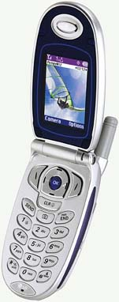
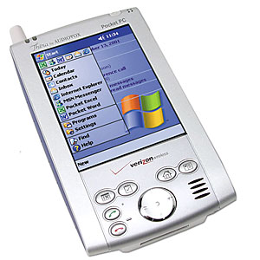
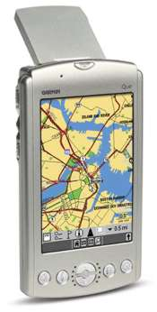
Motivation
Handheld Devices
  Cellular phones, PDAs widely used
  Constrained memory
Diverse applications
  Media players
  Video games
  Digital cameras
  GPS
  Scaled down desktop apps (e-mail, browser etc.)
Require high throughput, short response time

Slide 4
Talk Outline
Generational collection
MC² overview
Algorithmic Details
Experimental Results
Conclusions

Slide 5
Generational Collection
Divide heap into regions called generations
Generations segregate objects by age
Focus GC effort on younger objects
Nursery
Old Generation

Slide 6
Generational Copying Collection
Root
Root
Nursery
Old Generation
D
A
C
E
E
B
D
Remset
Root

Slide 7
Generational Copying Collection
Root
Nursery
Old Generation
Root
A
C
A
B
E
B
D
D
E
Root
Root

Slide 8
MC² Overview
Extends gen. copying, overcomes 2X overhead
Divides space into equal size windows
Reserves one or more windows for copying
Collects in two phases: mark and copy
Nursery
Old Generation
Generational
copying
Nursery
Old Generation
MC²

Slide 9
MC² – Mark Phase
Logically order old gen. windows
Three mark phase tasks:
  Mark reachable objects
  Calculate live data volume in each window
  Build per-window remembered sets
Start when old gen. getting full: 80%, say
Interleave marking with nursery allocation
  Do some marking after every n bytes allocated
  Reduces mark phase pauses

Slide 10
MC² Example – Mark Phase
Root
Root
Old Generation
Root
Nursery
L1
L2
L3
L4
Lmax
Lmax
Root
Root
Nursery
Reachable
Copied
Unreachable
Marked
MC² marks two objects during nursery allocation

Slide 11
MC² Example – Classify Windows
Root
Old Generation
Root
Nursery
L1
L2
L3
L4
Lmax
Lmax
Root
Nursery
Reachable
Copied
Unreachable
Marked
Locate high-occupancy windows and discard remsets

Slide 12
MC² Example – Classify Windows
Root
Old Generation
Root
Nursery
L2
L3
L4
Lmax
Lmax
L1
Root
Nursery
Reachable
Copied
Unreachable
Marked
Locate high-occupancy windows and discard remsets

Slide 13
MC² Example – Classify Windows
Root
Old Generation
Root
Nursery
L2
L3
L4
Lmax
Lmax
Lmax
Root
Nursery
Reachable
Copied
Unreachable
Marked
Locate high-occupancy windows and discard remsets

Slide 14
MC² – Copy Phase
Copy and compact reachable data
Performed in small increments
  One windowful of live data copied per increment
One increment per nursery collection
High-occupancy windows copied logically

Slide 15
MC² Example – Copy Phase
Root
Old Generation
Root
Root
Nursery
L2
L3
L4
Lmax
Lmax
Lmax
Root
Root
Root
Nursery
Reachable
Copied
Unreachable
Marked
Copy a window worth of data during nursery collection

Slide 16
MC² Example – Copy Phase
Old Generation
Root
Root
Nursery
L2
L3
L4
Lmax
Lmax
Lmax
Root
Root
Nursery
Reachable
Copied
Unreachable
Marked
Copy a window worth of data during nursery collection

Slide 17
MC² Example – Copy Phase
Root
Root
Old Generation
Nursery
L4
Lmax
Lmax
Lmax
L2
L3
Root
Root
Nursery
Reachable
Copied
Unreachable
Marked
Copy a window worth of data during nursery collection

Slide 18
MC² Example – Copy Phase
Root
Root
Old Generation
Nursery
Lmax
Lmax
Lmax
L2
L3
L4
Root
Root
Nursery
Reachable
Copied
Unreachable
Marked
Copy a window worth of data during nursery collection

Slide 19
MC² Example – Copy Phase
Root
Root
Old Generation
Nursery
Lmax
Lmax
Lmax
Lmax
Lmax
Lmax
Root
Root
Nursery
Reachable
Copied
Unreachable
Marked
Copy a window worth of data during nursery collection

Slide 20
Algorithmic Details
Large remembered sets
  Bounding space overhead
Popular objects
  Preventing long pauses

Slide 21
Handling large remembered sets
W1
W2
Normal remembered set for W1 stores 5 pointers (20 bytes on a 32 bit machine)

Slide 22
Handling large remembered sets
W1
W2
Card 1
Card 2
Card table requires only 2 bytes (one per card)

Slide 23
Handling large remembered sets
Set a limit on the total remembered set size (e.g., 5% of total heap space).
Replace large remsets with card table when total size approaches limit
Good tradeoff between speed and space utilization

Slide 24
Handling popular objects
Divide heap into small physical windows
Normally copy a group of physical windows
Popular physical windows not grouped
Normal Windows
Popular
Window
Normal Windows

Slide 25
Handling popular objects
Divide heap into small physical windows
Normally copy a group of physical windows
Popular physical windows not grouped
Normal Window
Group
Popular
Window
Normal Window
Group

Slide 26
Handling popular objects
Identify popular object while converting remset to card table
Isolate popular object at high end of heap
  Do not need to maintain references to the objects
Copying a popular object can cause a long pause, but does not recur

Slide 27
Experimental Results
Implemented in Jikes RVM (2.2.3)/MMTk
Pentium 4 1.7 GHz, 512MB memory, RedHat Linux 2.4.7-10
Benchmarks: SPECjvm98, pseudojbb
Collectors evaluated
  Generational Mark-Sweep (MS)
  Generational Mark-(Sweep)-Compact (MSC)
  MC²
MSC, MC² use separate code and data spaces
Results: Execution time, pause time in a heap 1.8x program live size

Slide 28
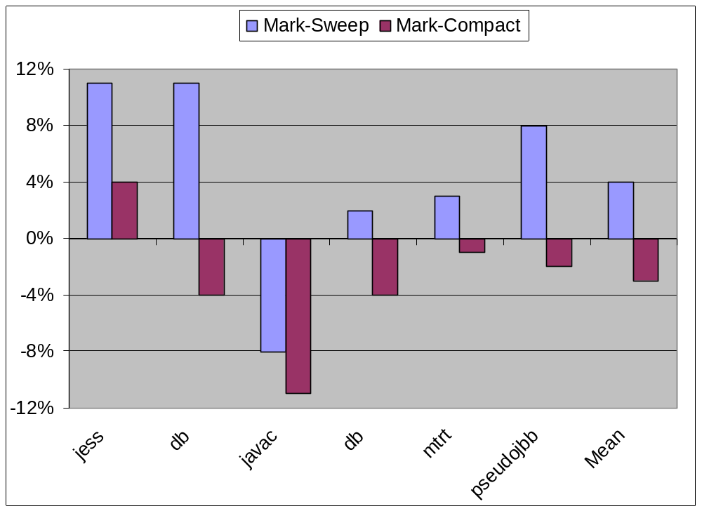
Execution Time relative to MC²
(Heap Size = 1.8x max. live size)

Slide 29
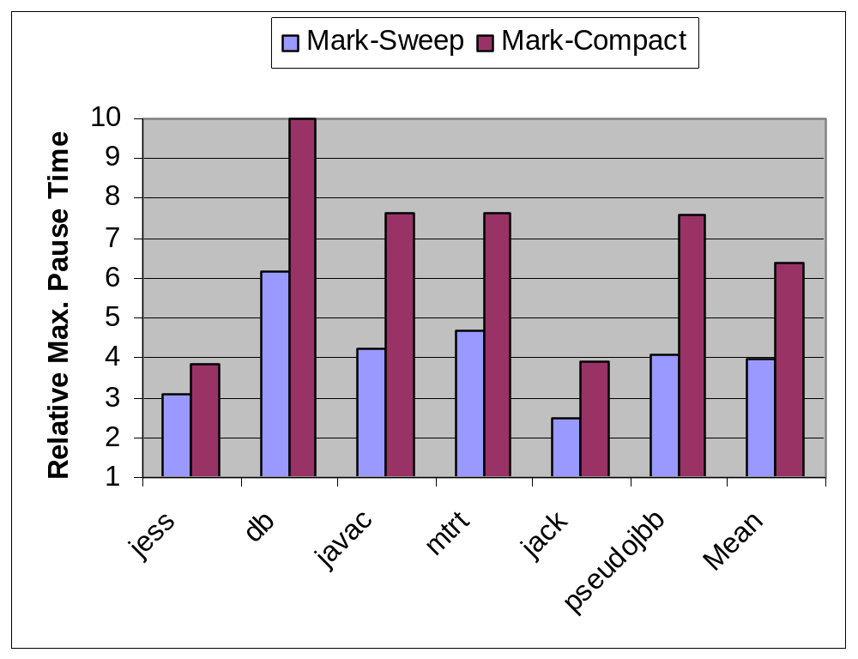
Max. Pause Time relative to MC²
(Heap Size = 1.8x max. live size)
MC² max. pause range: 17-41ms

Slide 30
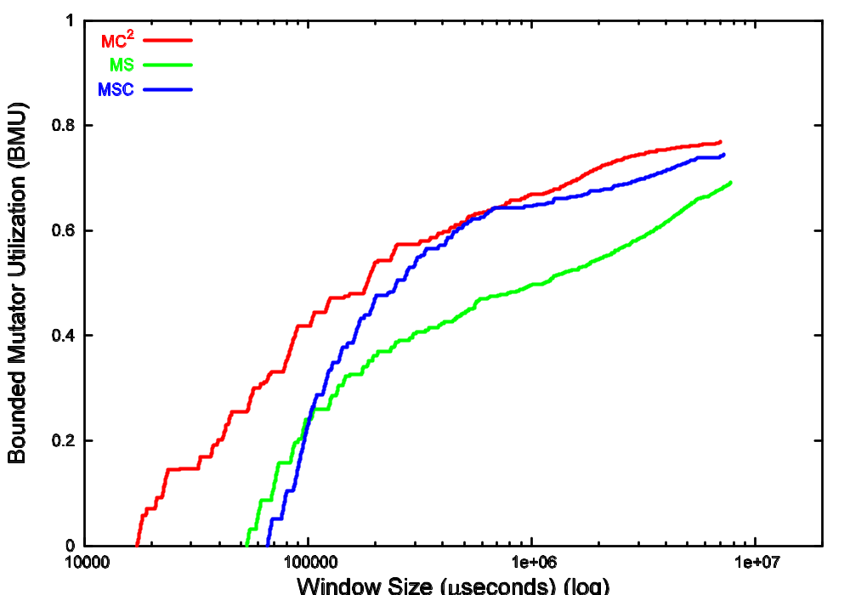
Bounded Mutator Utilization (jess)

Slide 31
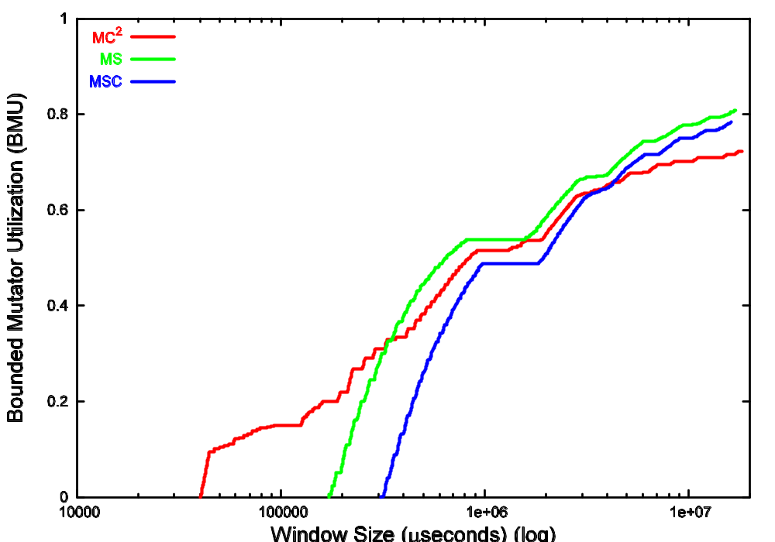
Bounded Mutator Utilization (javac)

Slide 32
Conclusions
MC²: suitable for handheld devices with soft real time requirements
  Low space overhead (50-80%)
  Good throughput (3-4% slower than non-incremental compacting collector)
  Short pause times (17-41ms, factor of 6 lower than non-incremental compacting collector)
  Well distributed pauses
Also suitable for desktop environments

Slide 33
Backup Slides

Slide 34
Traditional Tracing Collectors
Mark-Sweep
  Fragmentation
  Locality effects
Mark-Compact
  Long pauses
Copying
  2X space overhead

Slide 35
Modern incremental collectors
Train collector – Hudson and Moss
  Performs well in moderate size heaps
  High copying overhead
Lang and Dupont, Ben Yitzhak et al
  Good throughput, pause times
  Do not address metadata overheads
Bacon, Cheng, Rajan
  Address memory-constrained device requirements
  Require advanced compiler optimizations

Slide 36
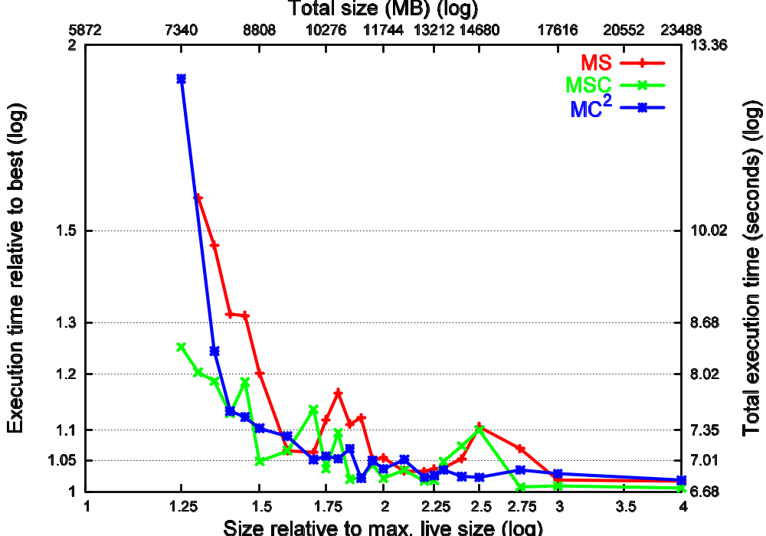
jess Execution Time

Slide 37
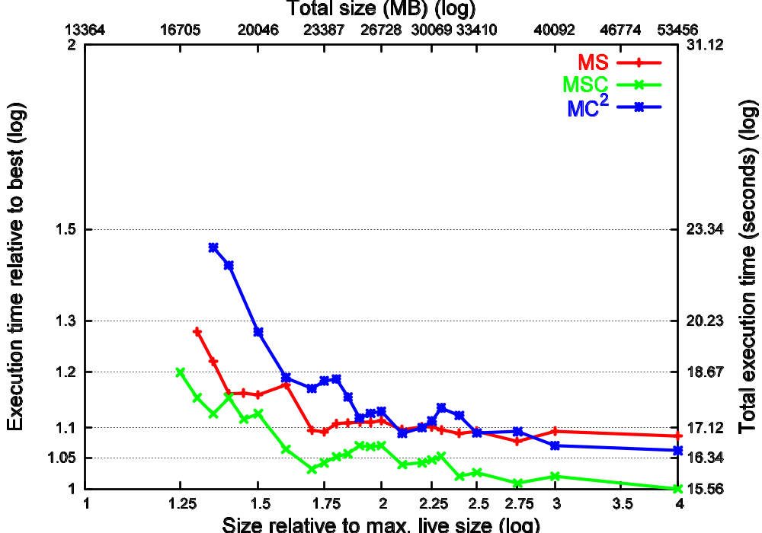
javac Execution Time

Slide 38
Pause Time, Execution Time Comparison
(80% space overhead)
Benchmark | MC² MPT (ms) | MS MPT (ms) | MS/MC² ET | MSC MPT (ms) | MSC/MC²ET
_202_jess | 17.2 | 53.2 | 1.11 | 65.7 | 1.04
_209_db | 19.9 | 123.0 | 1.11 | 198.5 | 0.96
_213_javac | 40.4 | 171.9 | 0.92 | 308.9 | 0.89
_227_mtrt | 29.6 | 138.1 | 1.02 | 225.2 | 0.96
_228_jack | 23.9 | 59.7 | 1.03 | 92.9 | 0.99
pseudojbb | 41.5 | 168.2 | 1.08 | 314.5 | 0.98
Geo. Mean | 27.2 | 107.7 | 1.04 | 172.7 | 0.97

Slide 39
Bounded Mutator Utilization (jess)

Slide 40
Bounded Mutator Utilization (javac)

Slide 41
Max. Pause Time relative to MC²
(Heap Size = 1.8x max. live size)
199
309
225
315
123
138
66
172
93
168
53
60
MC² max. pause range: 17-41ms

Slide 42
Incremental Marking Error
A
B
C
C
D

Slide 43
Handling marking error
Track mutations using write barrier
Record modified old generation objects
Scan these modified objects at GC time
Record interesting slots in remembered sets

Slide 44
JMTk Heap Layout
Boot
Image
Imm.
Object
Space
Large
Object
Space
Old Generation
Nursery

Slide 45
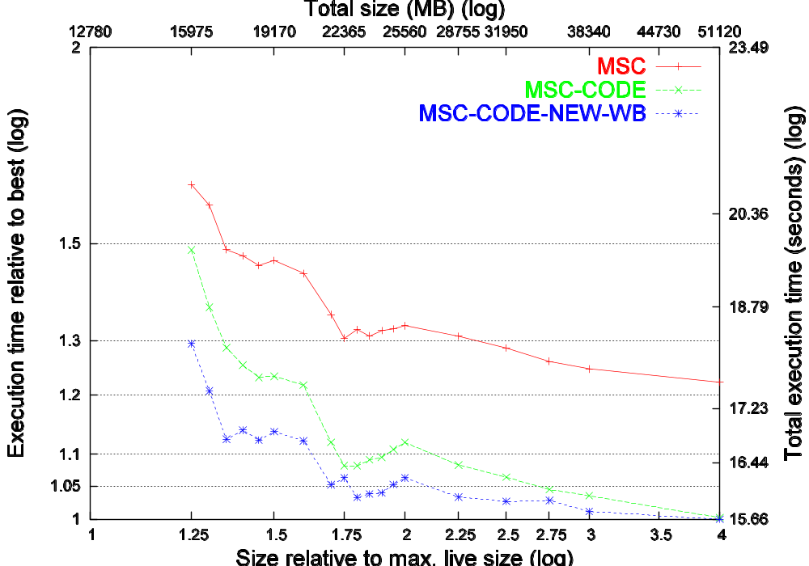
_213_javac (MSC execution time)

Slide 46
MC² Overview
Old Generation
Free Window
Free Window
Free Window
Reachable data
Unreachable data
Copied data

Slide 47
MC² Overview
Old Generation
Free Window
Free Window
Free Window
Free Window
Free Window
Free Window
Reachable data
Unreachable data
Copied data

Slide 48
MC² Overview
Old Generation
Free Window
Free Window
Free Window
Free Window
Free Window
Reachable data
Unreachable data
Copied data

