Slide 1


Quantifying the Performance of Garbage Collection vs.
Explicit Memory Management
Matthew Hertz
Canisius College
Emery Berger
University of Massachusetts Amherst

Slide 2
Explicit Memory Management
malloc / new
  allocates space for an object
free / delete
  returns memory to system
Simple, but tricky to get right
  Forget to free ⇨ memory leak
  free too soon ⇨ “dangling pointer”

Slide 3
Dangling Pointers
Node x = new Node (“happy”);
Node ptr = x;
delete x; // But I’m not dead yet!
Node y = new Node (“sad”);
cout << ptr->data << endl; // sad ☹
Insidious, hard-to-track down bugs

Slide 4
Solution: Garbage Collection
No need to call free
Garbage collector periodically scans objects on heap
Reclaims unreachable objects
  Won’t reclaim objects until it can prove object will not be used again

Slide 5
No More Dangling Pointers
Node x = new Node (“happy”);
Node ptr = x;
// x still live (reachable through ptr) Node y = new Node (“sad”);
cout << ptr->data << endl; // happy! ☺
So why not use GC
all the time?

Slide 6
Conventional Wisdom
“GC worse than malloc, because…”
  Extra processing (collection)
  Poor cache performance (ibid)
  Bad page locality (ibid)
  Increased footprint (delayed reclamation)

Slide 7
Conventional Wisdom
“GC improves performance, by…”
  Quicker allocation
  (fast path inlining & bump pointer alloc.)
  Better cache performance
  (object reordering)
  Improved page locality
  (heap compaction)

Slide 8
Outline
Motivation
Quantifying GC performance
  A hard problem
Oracular memory management
  Selecting & generating the Oracles
Experimental methodology
Results

Slide 9
Quantifying GC Performance
Apples-to-apples comparison
  Examine unaltered applications
  Runs differ only in memory manager
Examine impact on time & space

Slide 10
Quantifying GC Performance
Evaluate state-of-art algorithms
  Garbage collectors
    Generational collectors
    Copying collectors
      Standard for Java, not compatible with C/C++
  Explicit memory managers
    Fast, single-threaded allocators

Slide 11
Comparing Memory Managers
Node v = malloc(sizeof(Node));
v->data= malloc(sizeof(NodeData));
memcpy(v->data, old->data,
sizeof(NodeData));
free(old->data);
v->next = old->next;
v->next->prev = v;
v->prev = old->prev;
v->prev->next = v;
free(old);
BDW
Collector
Using GC in C/C++ is easy:

Slide 12
Comparing Memory Managers
Node v = malloc(sizeof(Node));
v->data= malloc(sizeof(NodeData));
memcpy(v->data, old->data,
sizeof(NodeData));
free(old->data);
v->next = old->next;
v->next->prev = v;
v->prev = old->prev;
v->prev->next = v;
free(old);
BDW
Collector
…ignore calls to free.

Slide 13
Comparing Memory Managers
Node node = new Node();
node.data = new NodeData();
useNode(node);
node = null;
...
node = new Node();
...
node.data = new NodeData();
...
Lea
Allocator
Adding malloc/free to Java: not easy…

Slide 14
Comparing Memory Managers
Node node = new Node();
node.data = new NodeData();
useNode(node);
node = null;
...
node = new Node();
...
node.data = new NodeData();
...
Lea
Allocator
free(node)?
free(node.data)?
... where should free be inserted?

Slide 15
Inserting Free Calls
Do not know where programmer would call free
  Hints provided from null-ing pointers
  Restructure code to avoid memory leaks?
    Tests programming skills, not memory manager
Want unaltered applications

Slide 16
Oracular Memory Manager
Java
C malloc/free
execute program here
Simulator
perform actions at
no cost below here
allocation
Oracle
Consult oracle to place free calls
  Oracle does not disrupt hardware state
  Simulator inserts free…

Slide 17
Object Lifetime & Oracle Placement
freed by
lifetime-based oracle
can be freed
obj =
new Object;
live
dead
reachable
unreachable
freed by
reachability-based oracle
free(obj)
free(obj)
free(??)
can be collected
Oracles bracket placement of frees
  Lifetime-based: most aggressive
  Reachability-based: most conservative

Slide 18
Reachability Oracle Generation
Java
C malloc/free
execute program here
PowerPC
Simulator
perform actions at
no cost below here
allocations,
ptr updates,
prog roots
Merlin analysis
Oracle
trace
file
Illegal instructions mark heap events
  Simulated identically to legal instructions

Slide 19
Liveness Oracle Generation
Java
C malloc/free
execute program here
PowerPC
Simulator
perform actions at
no cost below here
allocations, mem access, prog roots
Post-
process
Oracle
trace
file
Record allocations, memory accesses
  Preserve code, type objects, etc.
  May use objects without accessing them

Slide 20
Liveness Oracle Generation
Java
C malloc/free
execute program here
if (f.x == y) { … }
uses address of f.x,
but may not touch f.x or f
PowerPC
Simulator
perform actions at
no cost below here
allocation, mem access, prog. roots
Post-
process
Oracle
trace
file
Record allocations, memory accesses
  Preserve code, type objects, etc.
  May use objects without accessing them

Slide 21
Oracular Memory Manager
Java
C malloc/free
execute program here
PowerPC
Simulator
perform actions at
no cost below here
allocation
oracle
Consult oracle before each allocation
  When needed, modify instructions to call free
  Extra costs hidden by simulator

Slide 22
Experimental Methodology
Java platform:
  MMTk/Jikes RVM(2.3.2)
Simulator:
  Dynamic SimpleScalar (DSS)
  Simulates 2GHz PowerPC processor
    G5 cache configuration

Slide 23
Experimental Methodology
Garbage collectors:
  GenMS, GenCopy, GenRC, SemiSpace, CopyMS, MarkSweep
Explicit memory managers:
  Lea, MSExplicit (MS + explicit deallocation)

Slide 24
Experimental Methodology
Perfectly repeatable runs
  Pseudoadaptive compiler
    Same sequence of optimizations
    Advice generated from mean of 5 runs
  Deterministic thread switching
  Deterministic system clock
  Use “illegal” instructions in all runs

Slide 25
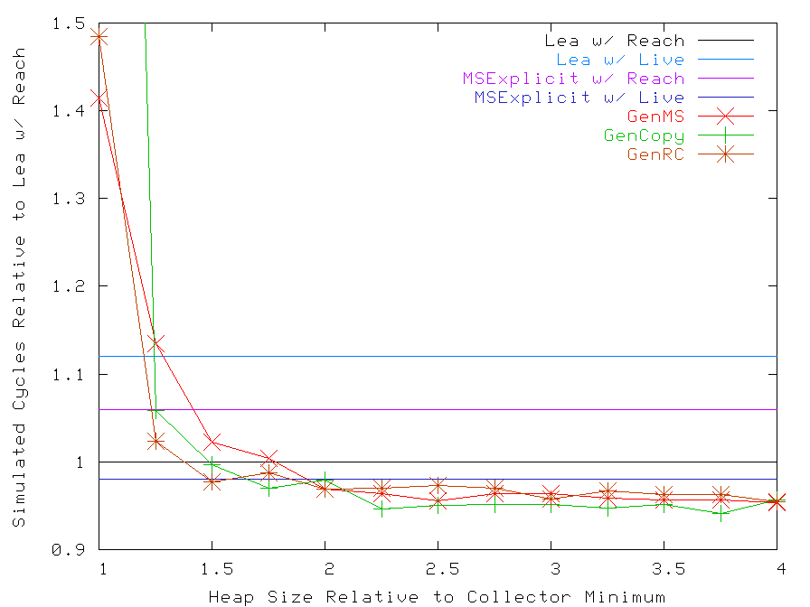
Execution Time for pseudoJBB
GC performance can be competitive

Slide 26
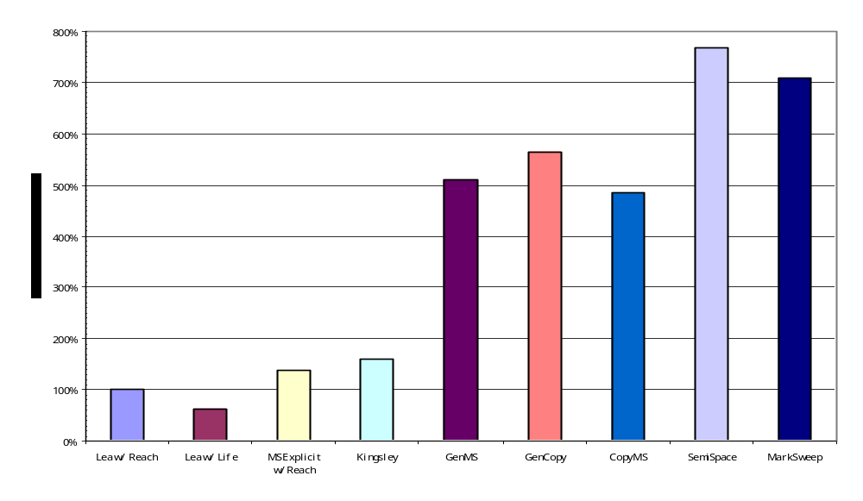
Footprint at Quickest Run
GC uses much more memory

Slide 27
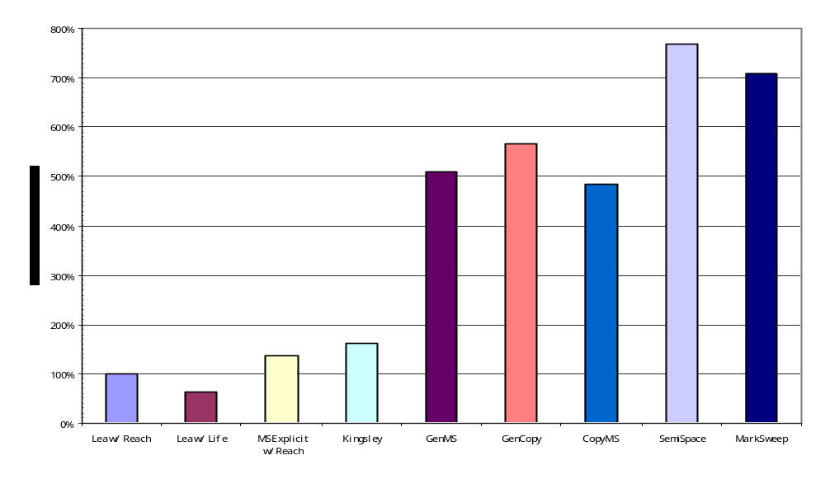
Footprint at Quickest Run
7.69
7.09
5.66
5.10
4.84
1.38
1.61
1.00
0.63
GC uses much more memory

Slide 28
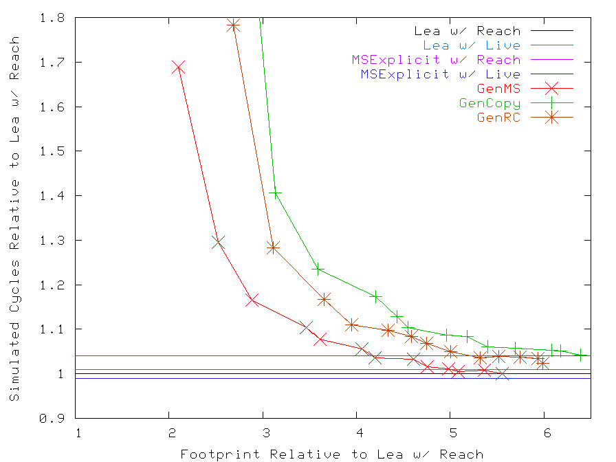
Avg. Relative Cycles and Footprint
GC trades space for time

Slide 29
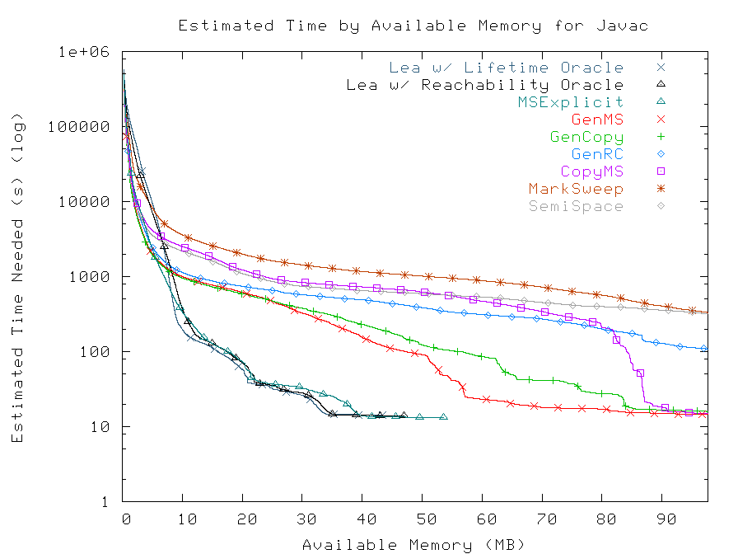
Javac Paging Performance
Much slower in limited physical RAM

Slide 30
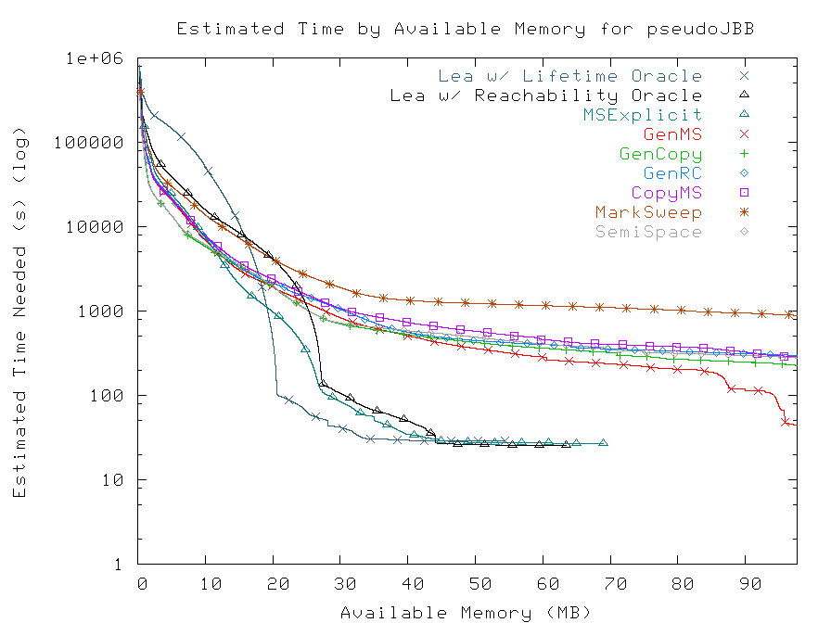
pseudoJBB Paging Performance
Lifetime analysis adds little

Slide 31
Summary of Results
Best collector equals Lea's performance…
  Up to 10% faster on some benchmarks
... but uses more memory
  Quickest runs use 5x or more memory
  At least twice mean footprint

Slide 32
Take-home: Practitioners
GC ok if:
  system has more than 3x needed RAM,
  and no competition with other processes
GC not so good if:
  Limited RAM
  Competition for physical memory
  Relies upon RAM for performance
    In-memory database
    Search engines, etc.

Slide 33
Take-home: Researchers
GC performance already good enough with enough RAM
Problems:
  Paging is a killer
  Performance suffers when RAM limited

Slide 34
Future Work
Obvious dimensions
  Other collectors:
    Bookmarking collector [PLDI 05]
    Parallel collectors
  Other allocators:
    New version of DLmalloc (2.8.2)
    VAM [ISMM 05]
  Other architectures:
    Examine impact of cache size

Slide 35
Future Work
Other memory management methods
  Regions, reaps

Slide 36
Conclusion
Code available at:
http://www-cs.canisius.edu/~hertzm

