Slide 1
Deadlocks
3.1. Resource
3.2. Introduction to deadlocks
3.3. The ostrich algorithm
3.4. Deadlock detection and recovery
3.5. Deadlock avoidance
3.6. Deadlock prevention
3.7. Other issues

Slide 2
Resources
Examples of computer resources
  printers
  tape drives
  tables
Processes need access to resources in reasonable order
Suppose a process holds resource A and requests resource B
  at same time another process holds B and requests A
  both are blocked and remain so

Slide 3
Resources (1)
Deadlocks occur when …
  proses diberikan akses eksklusif ke perangkat
  perangkat ini secara umum disebut sebagai sumber daya
Preemptable resources
  dapat diambil dari suatu proses tanpa efek buruk
  sumber daya komputasi yang dapat dihentikan (oleh SO atau penyedia layanan sewa cloud) untuk memberikan prioritas kepada beban kerja yang lebih tinggi
  Contoh :
    CPU (SO)
    Google Cloud Platform (GCP) dengan fitur "Preemptible VM Instances"
    Amazon Web Services (AWS) dengan "Spot Instances".
Nonpreemptable resources
  akan menyebabkan proses gagal jika dihilangkan
  sumber daya komputasi yang tidak dapat dihentikan atau diambil alih (oleh SO atau penyedia layanan sewa cloud) tanpa pemberitahuan sebelumnya
  Contoh :
    Printer (SO)
    Amazon Web Services (AWS) EC2 Instances
    Google Cloud Platform (GCP) Compute Engine Instances.

Slide 4

Resources (2)
Sequence of events required to use a resource
  request the resource
  use the resource
  release the resource
Must wait if request is denied
  requesting process may be blocked
  may fail with error code

Slide 5

Introduction to Deadlocks
Formal definition :
A set of processes is deadlocked if each process in the set is waiting for an event that only another process in the set can cause
Usually the event is release of a currently held resource
None of the processes can …
  run
  release resources
  be awakened

Slide 6
Four Conditions for Deadlock
Mutual exclusion condition
  each resource assigned to 1 process or is available
Hold and wait condition
  process holding resources can request additional
No preemption condition
  previously granted resources cannot forcibly taken away
Circular wait condition
  must be a circular chain of 2 or more processes
  each is waiting for resource held by next member of the chain

Slide 7
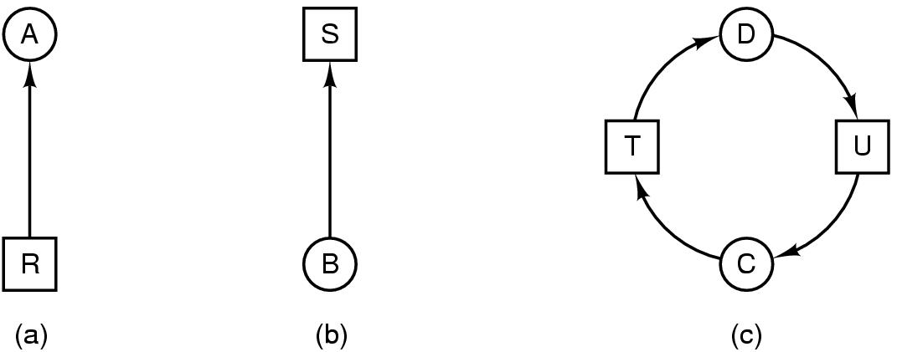
Deadlock Modeling (2)
Modeled with directed graphs
  resource R assigned to process A
  process B is requesting/waiting for resource S
  process C and D are in deadlock over resources T and U

Slide 8
Deadlock Modeling (3)
Strategies for dealing with Deadlocks
  just ignore the problem altogether
  detection and recovery
  dynamic avoidance
    careful resource allocation
  prevention
    negating one of the four necessary conditions

Slide 9
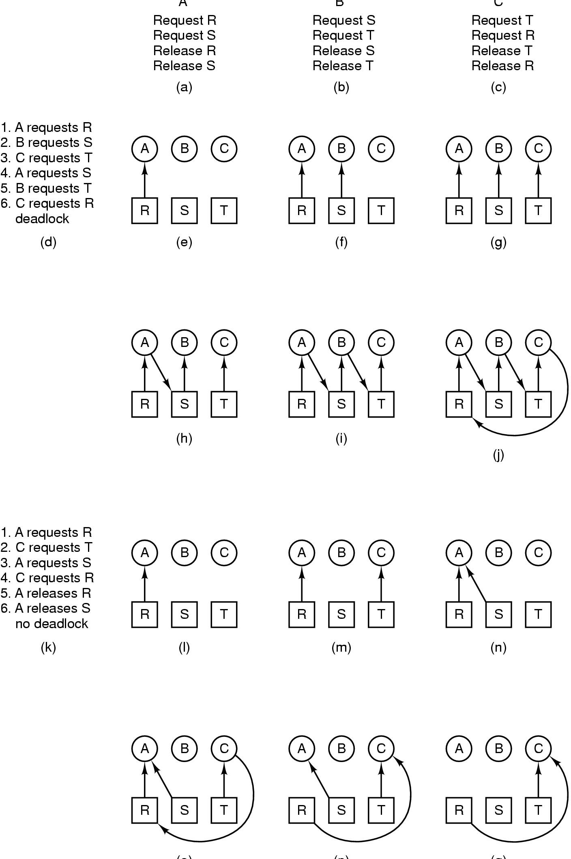
Deadlock Modeling (4)
A B C
How deadlock occurs

Slide 10
Deadlock Modeling (5)
(o) (p) (q)
How deadlock can be avoided

Slide 11
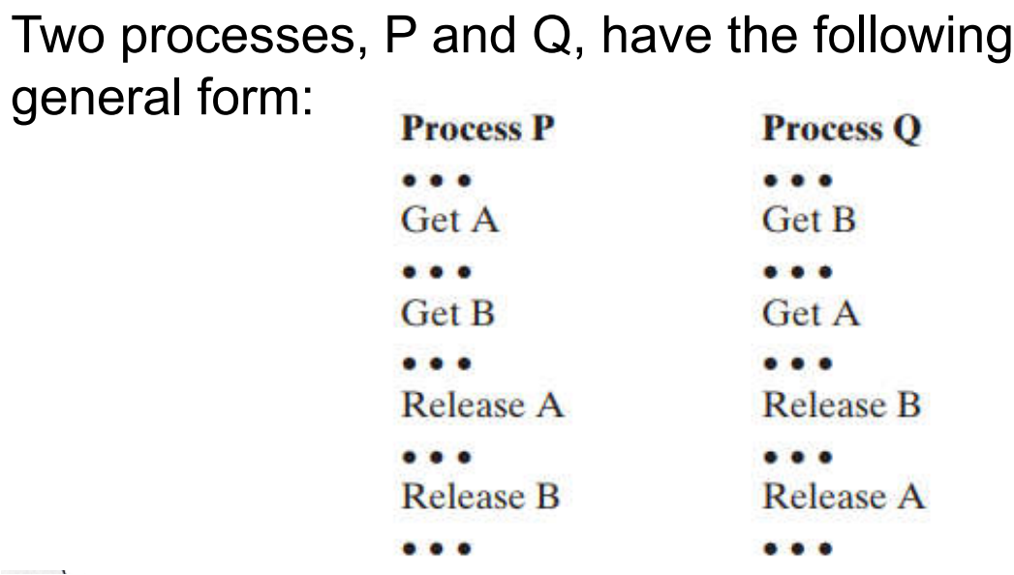

Slide 12
The Ostrich Algorithm
Pretend there is no problem (seolah tidak masalah)
Reasonable if
  deadlocks occur very rarely (jarang terjadi deadlock)
  cost of prevention is high (biaya pencegahannya mahal)
UNIX and Windows takes this approach
It is a trade off between
  Convenience (kemudahan)
  Correctness (kebenaran)
Melibatkan keseimbangan antara kemudahan dan kebenaran. Jika deadlocks terjadi sangat jarang dan biaya pencegahan tinggi, maka mungkin masuk akal untuk mengutamakan kemudahan daripada kebenaran yang ketat.

Slide 13

Detection with One Resource of Each Type (1)
Note the resource ownership and requests
A cycle can be found within the graph, denoting deadlock

Slide 14

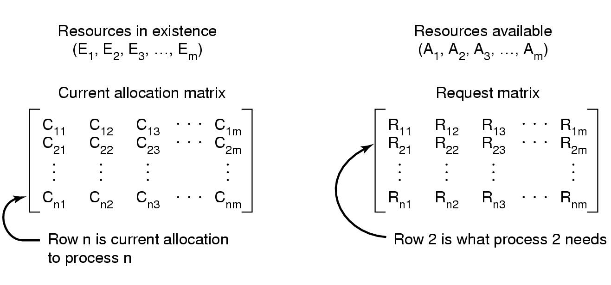
Detection with One Resource of Each Type (2)
Data structures needed by deadlock detection algorithm

Slide 15
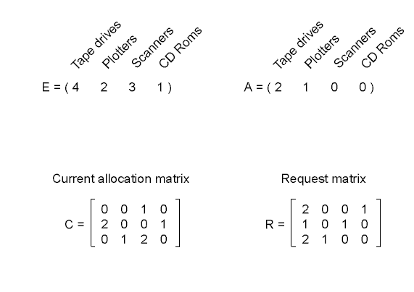
Detection with One Resource of Each Type (3)
An example for the deadlock detection algorithm

Slide 16
Recovery from Deadlock (1)
Recovery through preemption
  take a resource from some other process
  depends on nature of the resource
Recovery through rollback
  checkpoint a process periodically
  use this saved state
  restart the process if it is found deadlocked

Slide 17
Recovery from Deadlock (2)
Recovery through killing processes
  crudest but simplest way to break a deadlock
  kill one of the processes in the deadlock cycle
  the other processes get its resources
  choose process that can be rerun from the beginning

Slide 18

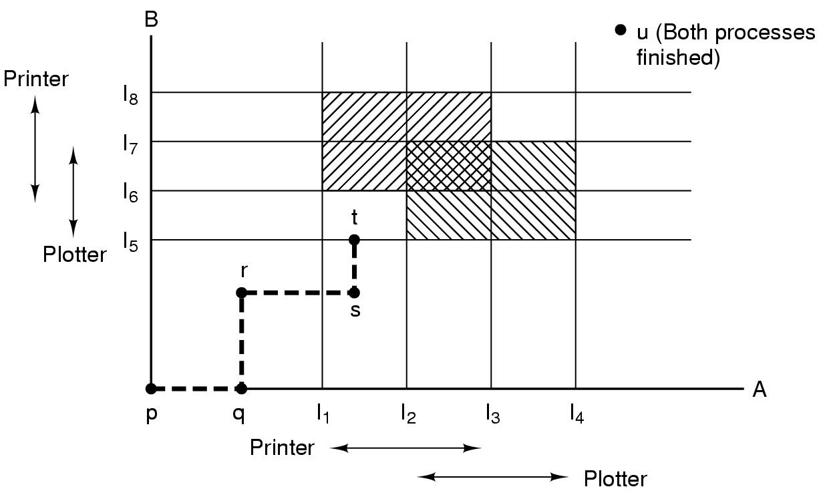
Deadlock Avoidance
Resource Trajectories
Mulai dari titik p, jalankan A ke titik q, jalankan B ke titik r, jalankan A ke titik s, memberikan printer, jalankan B ke titik t, minta plotter, hanya bisa menjalankan A hingga selesai.
Two process resource trajectories

Slide 19
Two process resource trajectories
Proses A dan B
Sumber daya: printer dan plotter
A membutuhkan printer dari I1 ke I3
A membutuhkan plotter dari I2 ke I4
B membutuhkan plotter dari I5 ke I7
B membutuhkan printer dari I6 ke I8
Setiap titik dalam diagram adalah status bersama A & B
Hanya bisa bergerak secara vertikal atau horizontal (satu CPU)

Slide 20
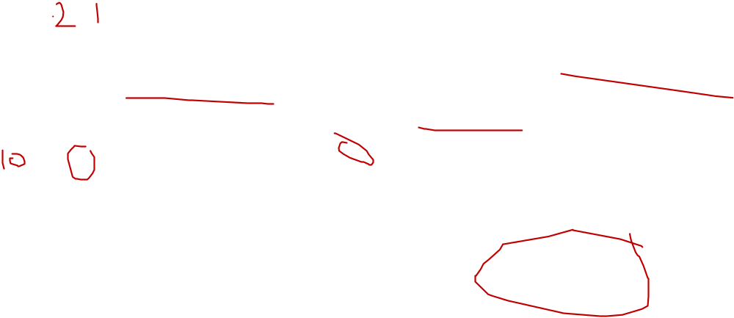
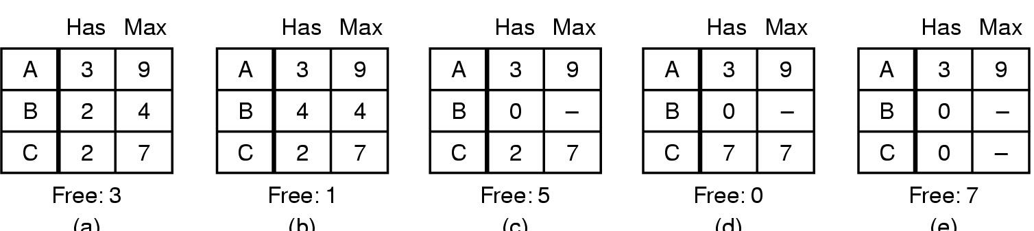
Safe and Unsafe States (1)
(a) (b) (c) (d) (e)
Demonstration that the state in (a) is safe

Slide 21

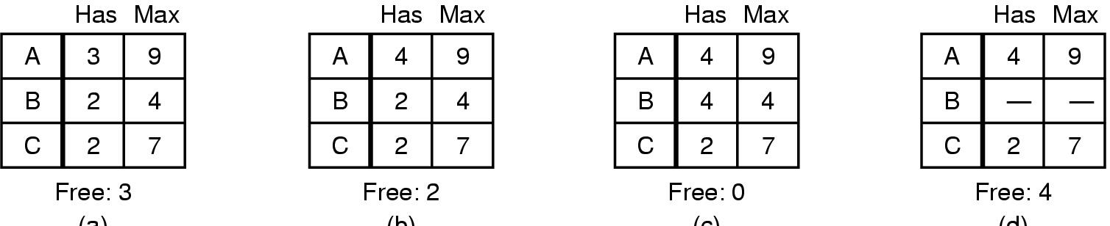
Safe and Unsafe States (2)
(a) (b) (c) (d)
Demonstration that the sate in b is not safe

Slide 22
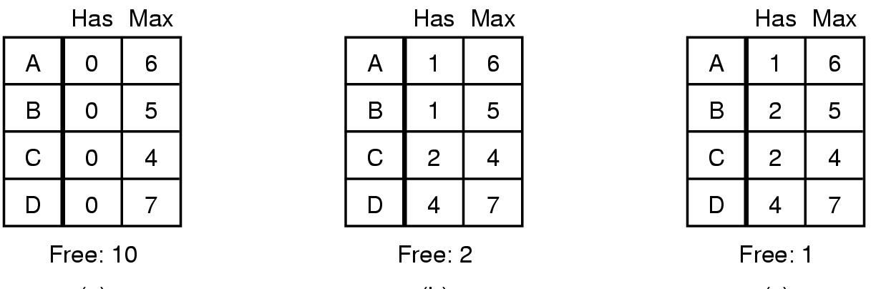
The Banker's Algorithm for a Single Resource
(a) (b) (c)
Three resource allocation states
  safe
  safe
  unsafe

Slide 23
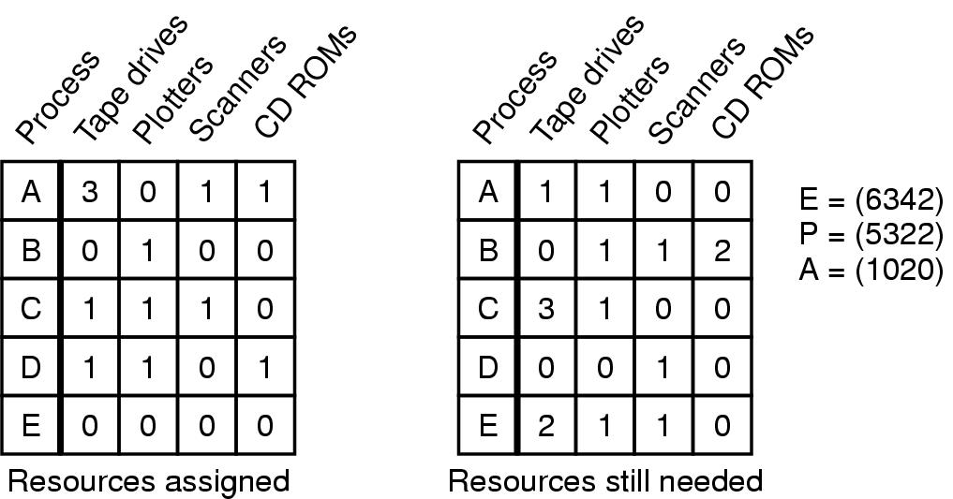
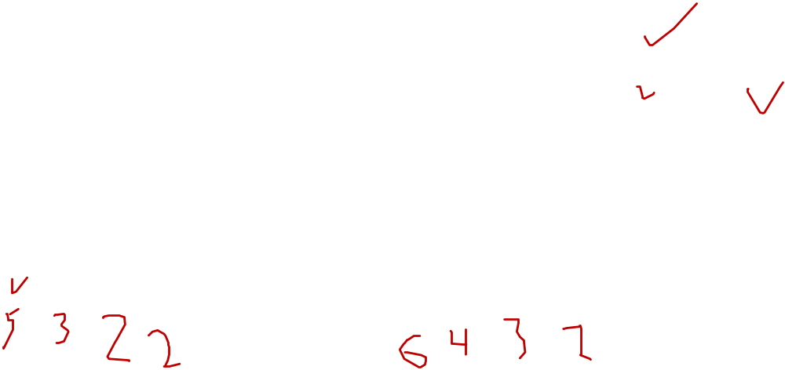
Banker's Algorithm for Multiple Resources
Example of banker's algorithm with multiple resources

Slide 24
Deadlock Prevention
Attacking the Mutual Exclusion Condition
Some devices (such as printer) can be spooled
  only the printer daemon uses printer resource
  thus deadlock for printer eliminated
Not all devices can be spooled
Principle:
  avoid assigning resource when not absolutely necessary
  as few processes as possible actually claim the resource

Slide 25
Attacking the Hold and Wait Condition
Require processes to request resources before starting
  a process never has to wait for what it needs
Problems
  may not know required resources at start of run
  also ties up resources other processes could be using
Variation:
  process must give up all resources
  then request all immediately needed

Slide 26
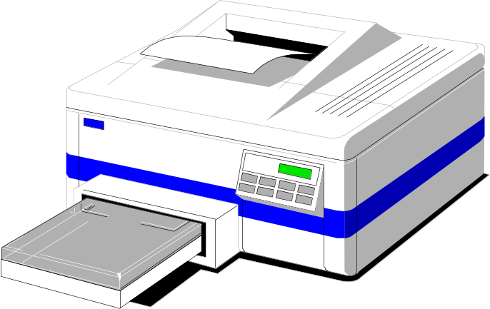
Attacking the No Preemption Condition
This is not a viable option
Consider a process given the printer
  halfway through its job
  now forcibly take away printer
  !!??

Slide 27
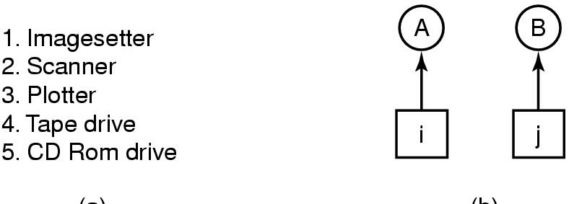
Attacking the Circular Wait Condition (1)
(a) (b)
Normally ordered resources
A resource graph

Slide 28
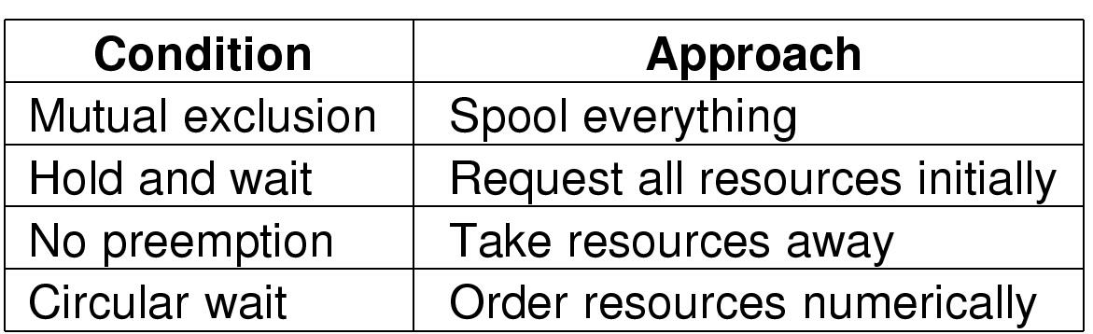
Attacking the Circular Wait Condition (1)
Summary of approaches to deadlock prevention

Slide 29
Other Issues
Two-Phase Locking
Phase One
  process tries to lock all records it needs, one at a time
  if needed record found locked, start over
  (no real work done in phase one)
If phase one succeeds, it starts second phase,
  performing updates
  releasing locks
Note similarity to requesting all resources at once
Algorithm works where programmer can arrange
  program can be stopped, restarted

Slide 30
Nonresource Deadlocks
Possible for two processes to deadlock
  each is waiting for the other to do some task
Can happen with semaphores
  each process required to do a down() on two semaphores (mutex and another)
  if done in wrong order, deadlock results

Slide 31
Starvation
Starvation adalah kondisi yang biasanya terjadi setelah deadlock. Proses yang kekurangan resource karena terjadinya deadlock tidak akan pernah mendapat resource yang dibutuhkan sehingga mengalami starvation (kekurangan sumber daya). Namun starvation juga bisa terjadi tanpa deadlock.

Slide 32
Starvation
Algoritme untuk mengalokasikan sumber daya
  may be to give to shortest job first ( memberi giliran pada job terpendek dulu)
Berfungsi bagus untuk beberapa pekerjaan singkat dalam suatu sistem
Dapat menyebabkan long job ditunda tanpa batas waktu
  meski tidak diblokir
Solusi:
  First come first serve

