Slide 1
SISTEM OPERASI
(4 sks : kuliah dan praktikum)
REFERENSI
  AS Tanenbaum : Modern Operating Systems, edisi tahun 2016
  William Stalings : Operating Systems, Internal and Design Principles. 9th Edition 2018
  Dosen : M. Husni
  Contact : mhusni43@gmail.com

Slide 2
Evaluasi
Tugas
Quis
ETS
EAS
Praktikum

Slide 3
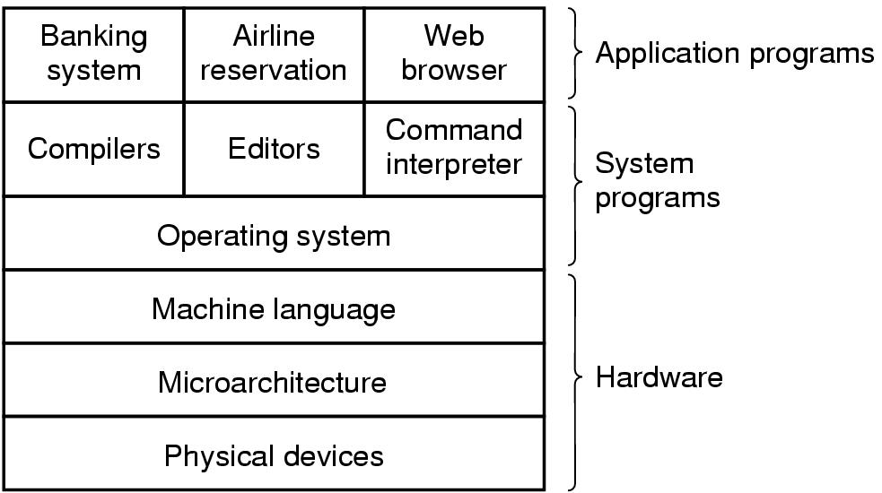
Introduction
A computer system consists of
  hardware
  system programs
  application programs

Slide 4
Hardware
Monitor
Keyboard
Mouse
Speaker
Microphone
CPU/Processor
Memory (Chip)

Slide 5
System Programs
Windows (95….11)
Linux, dll
DOS
MacOS
MS Word
MS Excel
C Compiler

Slide 6
Application Programs
Traveloka
KAI Access
Toped
dll

Slide 7
Basic Elements
Processor
  Two internal registers
    Memory address resister (MAR)
      Specifies the address for the next read or write
    Memory buffer register (MBR)
      Contains data written into memory or receives data read from memory

Slide 8
Basic Elements
Processor
  I/O address register
  I/O buffer register

Slide 9
Basic Elements
Main Memory
  Volatile (mudah hilang/mudah berubah)
  Referred to as real memory or primary memory

Slide 10
Basic Elements
I/O Modules
  Secondary Memory Devices
  Communications equipment
  Terminals
System bus
  Communication among processors, main memory, and I/O modules

Slide 11
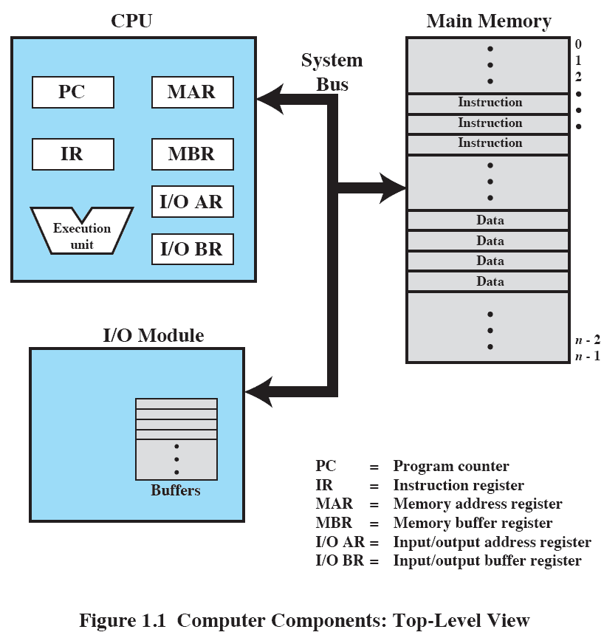
Computer Components: Top-Level View

Slide 12
Processor Registers
User-visible registers
  Enable programmer to minimize main memory references by optimizing register use
Control and status registers
  Used by processor to control operating of the processor
  Used by privileged OS routines to control the execution of programs

Slide 13
User-Visible Registers
May be referenced by machine language
Available to all programs – application programs and system programs

Slide 14
User-Visible Registers
Data
Address
  Index register: Adding an index to a base value to get the effective address
  Segment pointer: When memory is divided into segments, memory is referenced by a segment and an offset
  Stack pointer: Points to top of stack

Slide 15
Control and Status Registers
Program counter (PC)
  Contains the address of an instruction to be fetched
Instruction register (IR)
  Contains the instruction most recently fetched
Program status word (PSW)
  Contains status information

Slide 16
Control and Status Registers
Condition codes or flags
  Bits set by processor hardware as a result of operations
  Example
    Positive, negative, zero, or overflow result

Slide 17
Instruction Execution
Two steps
  Processor reads (fetches) instructions from memory
  Processor executes each instruction

Slide 18
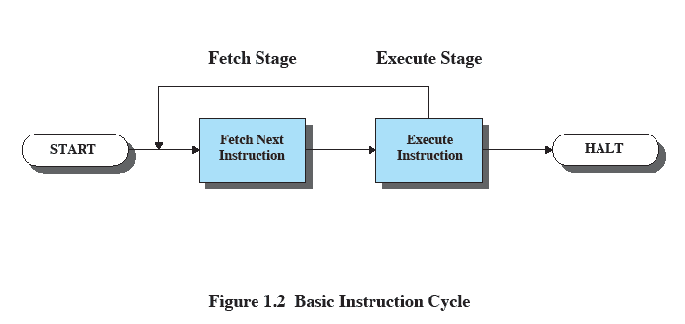
Basic Instruction Cycle

Slide 19
Instruction Fetch and Execute
The processor fetches the instruction from memory
Program counter (PC) holds address of the instruction to be fetched next
PC is incremented after each fetch

Slide 20
Instruction Register
Fetched instruction loaded into instruction register
Categories
  Processor-memory, processor-I/O, data processing, control

Slide 21
What is an Operating System
extended machine
  Menyembunyikan komponen rinci yang dibentuk
  Memudahkan penggunaan virtual machine
resource manager : pengatur sumber daya komputer
  Setiap program yang menggunakan sumber daya mendapatkan jatah waktu
  Setiap program yang menggunakan sumber daya mendapatkan jatah space (memory)

Slide 22
History of Operating Systems (0)
Tahun 1940-an dan 1950-an: Pada awal komputasi, komputer dioperasikan oleh pemrogram melalui panel kontrol fisik.
Tahun 1950-an: Muncul batch processing, di mana sekumpulan pekerjaan diproses dalam satu waktu.
Tahun 1960-an: IBM memperkenalkan System/360 pada tahun 1964, yang memungkinkan kompatibilitas antara berbagai model komputer.
Tahun 1970-an: Sistem operasi UNIX dikembangkan di Bell Labs pada tahun 1969-1970 oleh Ken Thompson dan Dennis Ritchie.
Pada tahun 1981, IBM mengeluarkan IBM PC dengan MS-DOS, yang kemudian berkembang menjadi Microsoft Windows pada tahun 1985.
Tahun 1990-an: Pengembangan berkelanjutan dari Windows: Windows 95, Windows 98, dan Windows NT.
Pada tahun 1991, Linus Torvalds mengumumkan kernel Linux, yang menjadi dasar untuk sistem operasi Linux.

Slide 23
Tahun 2000-an: Perkembangan sistem operasi terus berlanjut dengan penekanan pada keamanan, stabilitas, dan konektivitas jaringan. Windows XP diluncurkan pada tahun 2001 dan menjadi salah satu sistem operasi paling populer.
Tahun 2010-an: Mobilitas menjadi pusat perhatian dengan munculnya iOS (Apple) dan Android (Google) sebagai sistem operasi dominan untuk perangkat mobile.
Tahun 2020-an: Perkembangan teknologi seperti komputasi awan, kecerdasan buatan, dan Internet of Things (IoT) memengaruhi evolusi sistem operasi. Linux terus berkembang dalam berbagai varian, dan perusahaan besar seperti Microsoft terus meningkatkan fitur dan keamanan dalam sistem operasi mereka.

Slide 24

History of Operating Systems (1)
Early batch system
  bring cards to 1401
  read cards to tape
  put tape on 7094 which does computing
  put tape on 1401 which prints output

Slide 25
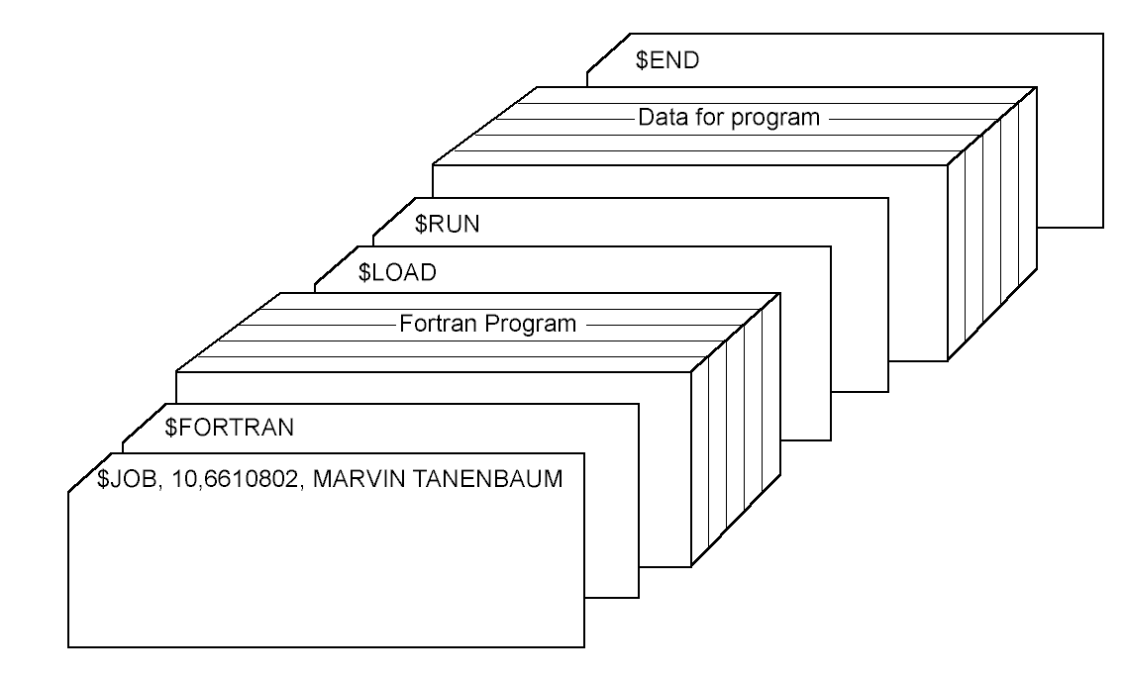
History of Operating Systems (3)
Structure of a typical FMS job – 2nd generation

Slide 26

History of Operating Systems (4)
Multiprogramming system
  three jobs in memory – 3rd generation

Slide 27
Multiprogramming
Prosesor memiliki lebih dari satu program untuk dieksekusi
Urutan pelaksanaan program tergantung pada prioritas relatif dan apakah mereka menunggu I / O
Setelah penangan interupsi selesai, kontrol mungkin tidak kembali ke program yang dieksekusi pada saat interupsi

Slide 28
Memory Hierarchy
Faster access time, greater cost per bit
Greater capacity, smaller cost per bit
Greater capacity, slower access speed

Slide 29
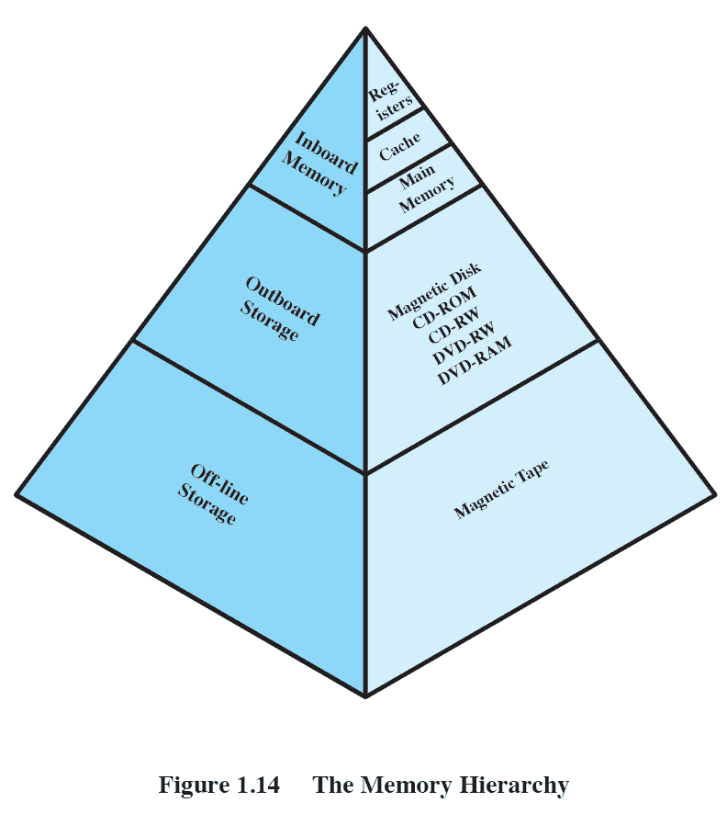
The Memory Hierarchy

Slide 30
Going Down the Hierarchy
Decreasing cost per bit
Increasing capacity
Increasing access time
Decreasing frequency of access to the memory by the processor

Slide 31
Secondary Memory
Auxiliary memory
External
Nonvolatile
Used to store program and data files

Slide 32
Cache Memory
Processor speed faster than memory access speed
Exploit the principle of locality with a small fast memory

Slide 33
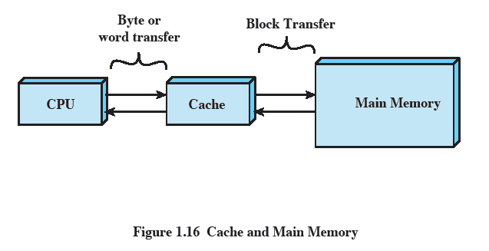
Cache and Main Memory

Slide 34
Cache Principles
Contains copy of a portion of main memory
Processor first checks cache
If desired data item not found, relevant block of memory read into cache
Because of locality of reference, it is likely that future memory references are in that block

Slide 35
The Operating System Zoo
Mainframe operating systems
Server operating systems
Multiprocessor operating systems
Personal computer operating systems
Real-time operating systems
Embedded operating systems
Smart card operating systems

Slide 36
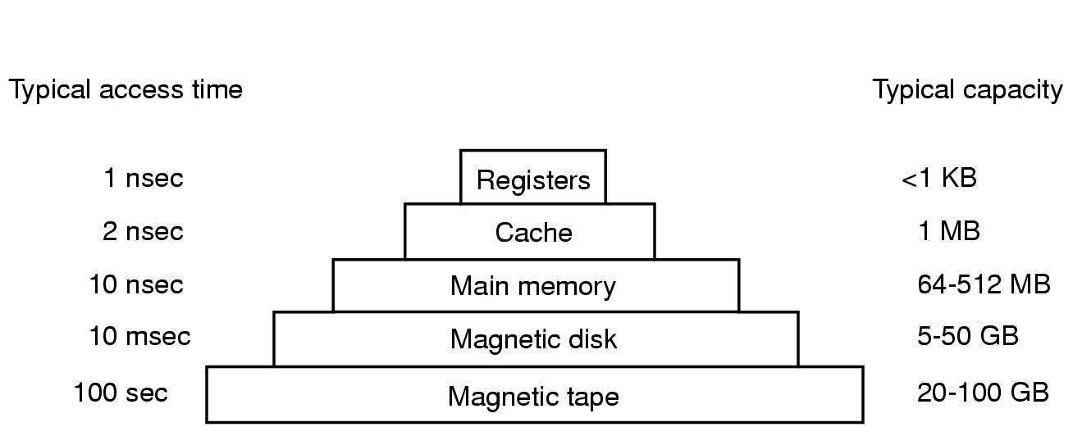
Computer Hardware Review (3)
Typical memory hierarchy
  numbers shown are rough approximations

Slide 37

Operating System Concepts (1)
A process tree
  A created two child processes, B and C
  B created three child processes, D, E, and F

Slide 38
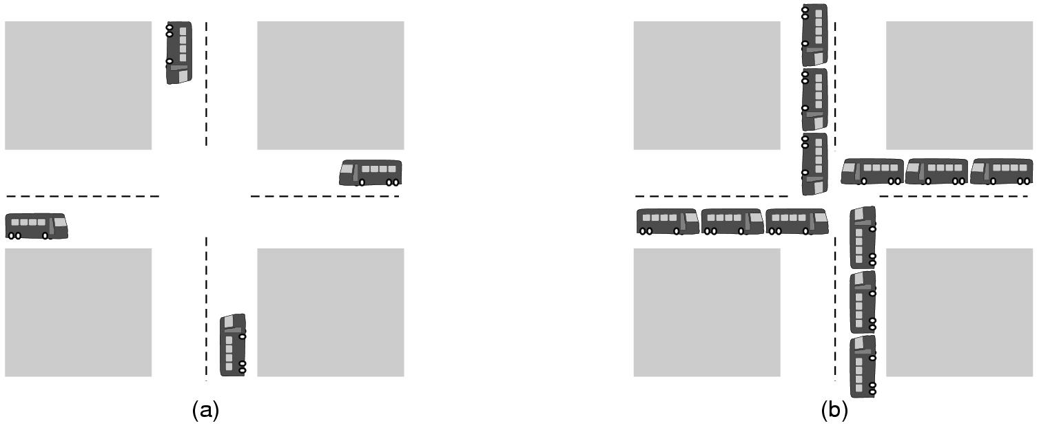
Operating System Concepts (2)
(a) A potential deadlock. (b) an actual deadlock.

Slide 39
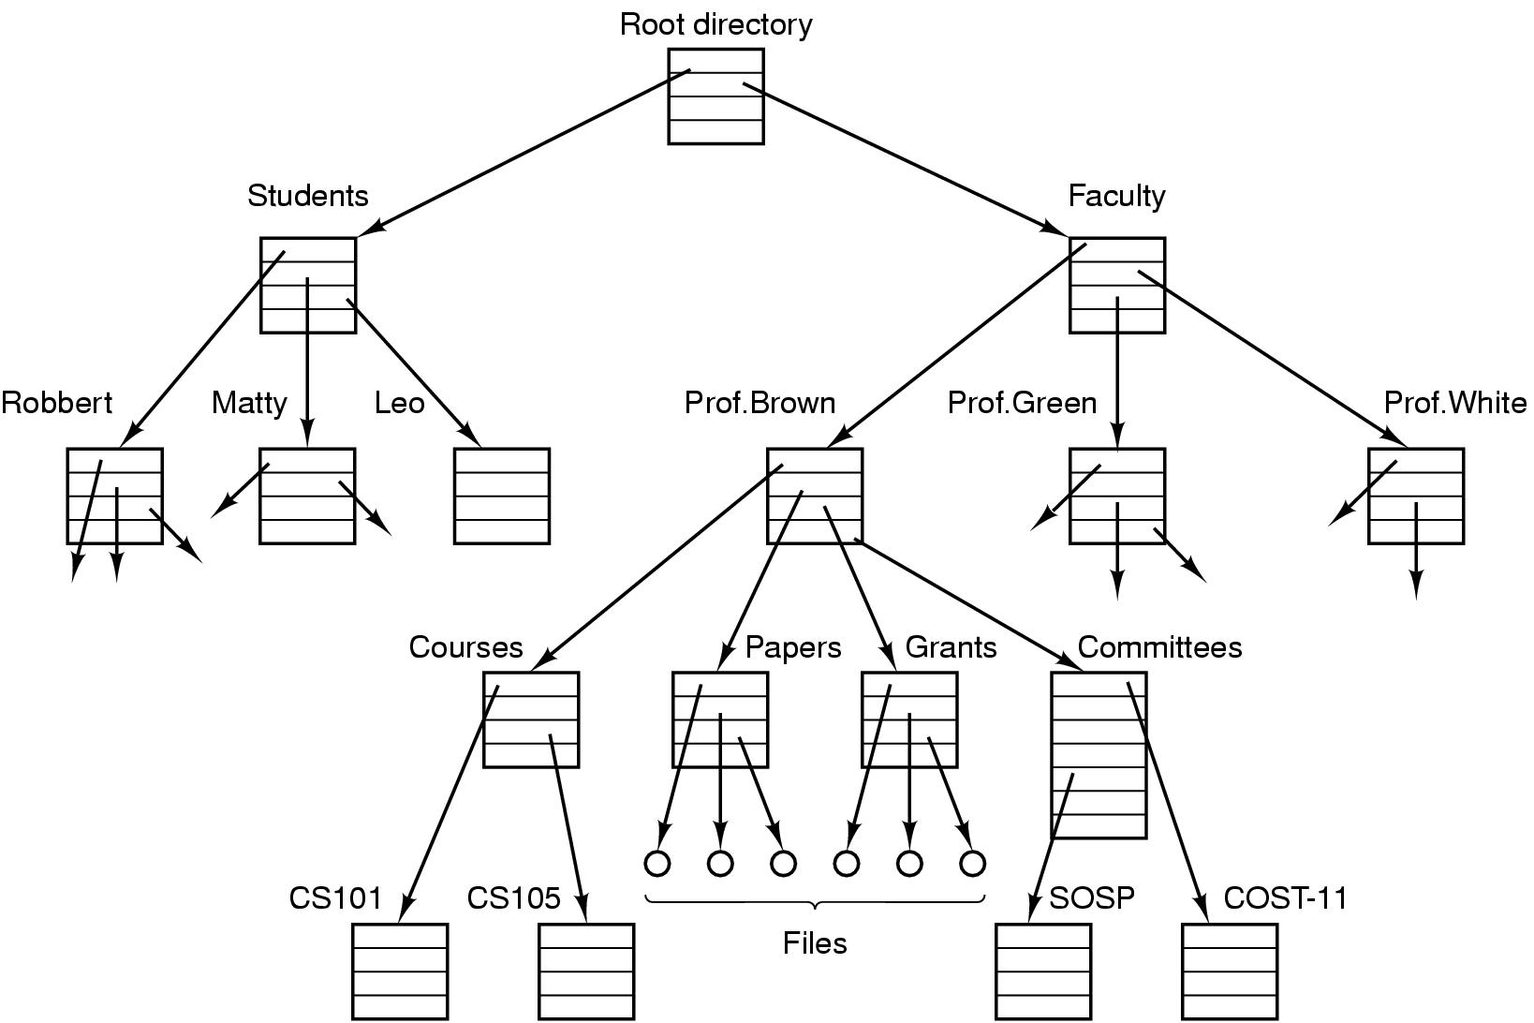
Operating System Concepts (3)
File system for a university department

Slide 40
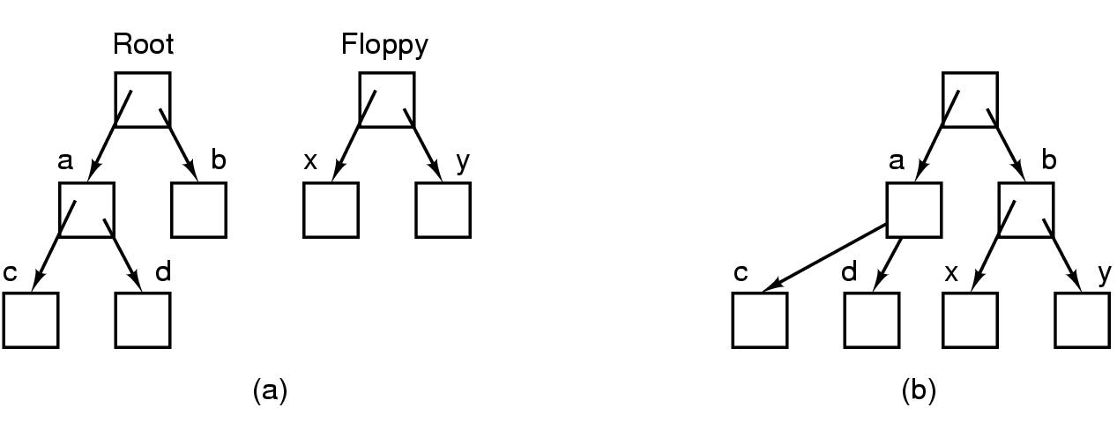
Operating System Concepts (4)
Before mounting,
  files on floppy are inaccessible
After mounting floppy on b,
  files on floppy are part of file hierarchy

Slide 41
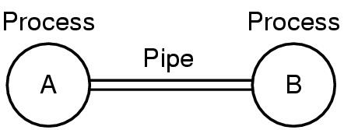
Operating System Concepts (5)
Two processes connected by a pipe

Slide 42
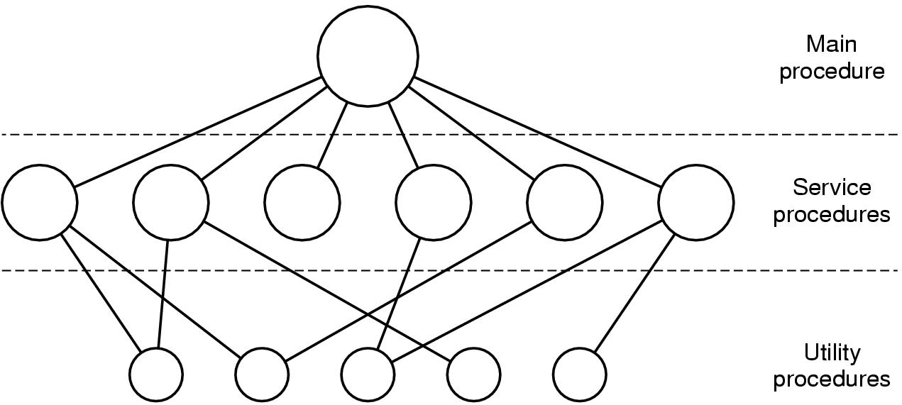
Operating System Structure (1)
Simple structuring model for a monolithic system

Slide 43
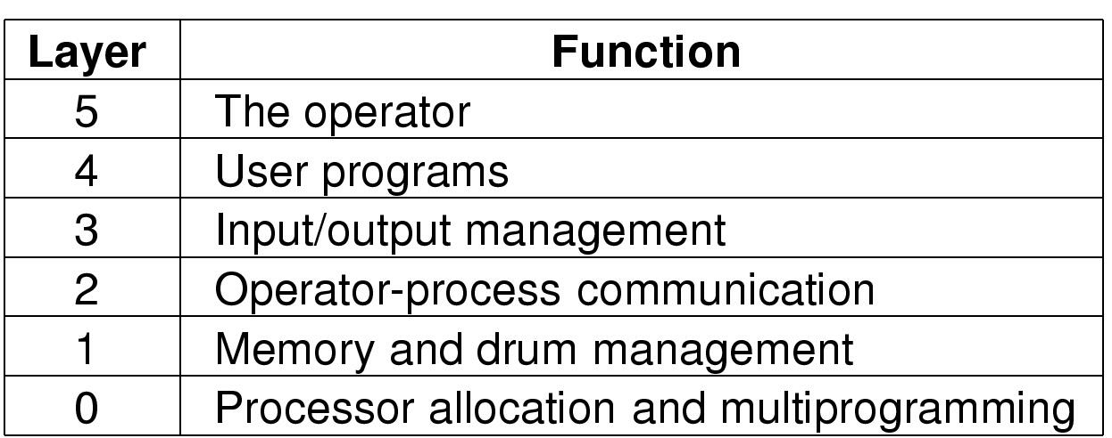
Operating System Structure (2)
Structure of the THE operating system

Slide 44
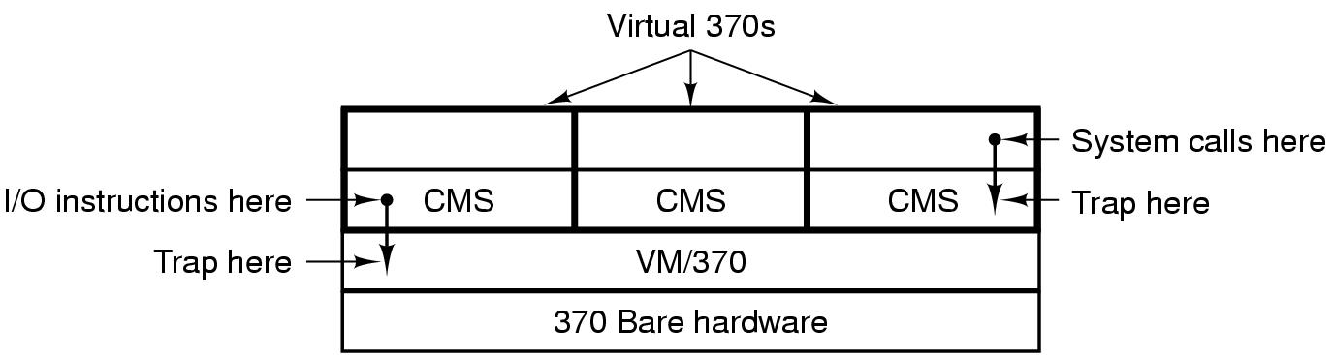
Operating System Structure (3)
Structure of VM/370 with CMS

Slide 45
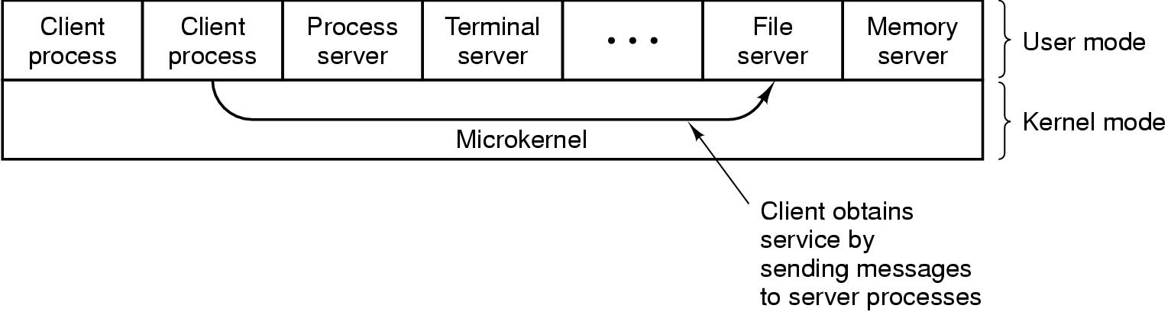
Operating System Structure (4)
The client-server model

Slide 46
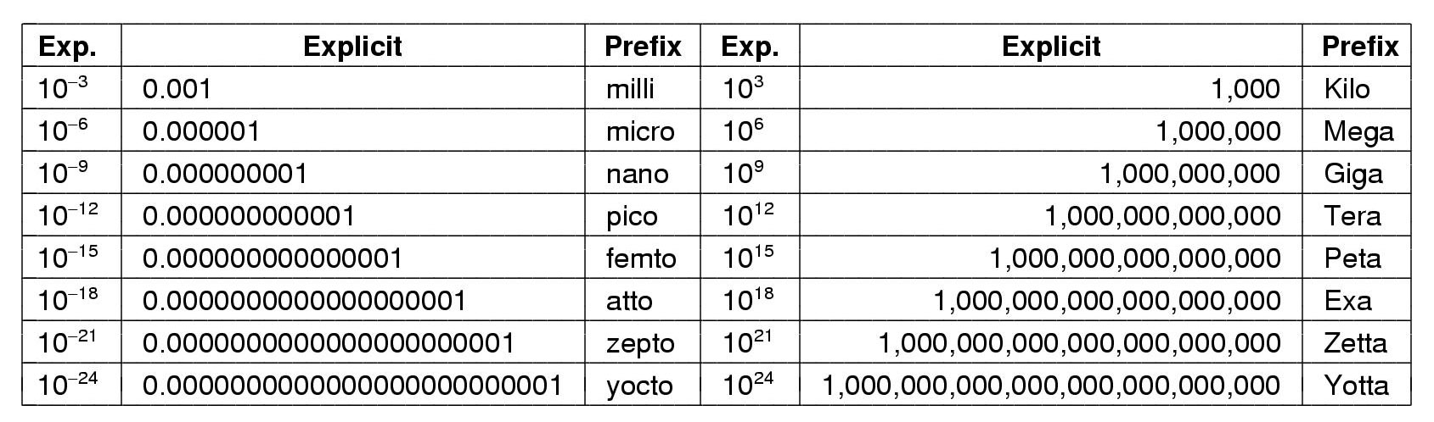
Metric Units
The metric prefixes

Slide 47
Tugas
Tentang OS as Zoo
THE
Carilah 50 nama system operasi beserta jenis komputernya
Apa perbedaan antara system multi user dan client server?

