Slide 1
Scheduling
The art and science of allocating the CPU and other resources to processes
(Slides include materials from Operating System Concepts, by Silbershatz, Galvin, & Gagne and from Modern Operating Systems,., by Tanenbaum)
Scheduling
Notes:
Assumptions:
Graduate level
Operating Systems
Making Choices about operation systems
Why a micro-century? …just about enough time for one concept

Slide 2
Why Scheduling?
We know how to switch the CPU among processes or threads, but …
How do we make the decision which to choose next?
This topic follows §§5.1–5.3 & §5.5 of Silbershatz text
Scheduling

Slide 3

Example
Bursts of CPU usage alternate with periods of I/O wait
  a CPU-bound process (a)
  an I/O bound process (b)
Which process should have preferred access to CPU?
Which process should have preferred access to I/O or disk?
Why?
Scheduling

Slide 4

Alternating Sequence of CPU And I/O Bursts
Scheduling

Slide 5

Histogram of CPU-burst Times
Scheduling

Slide 6
CPU Scheduler
Selects from among the processes in memory that are ready to execute, and allocates the CPU to one of them
CPU scheduling decisions may take place when a process:
    1. Switches from running to waiting state
    2. Switches from running to ready state
    3. Switches from waiting to ready
    4. Terminates
Scheduling under 1 and 4 is non-preemptive
All other scheduling is preemptive
Scheduling

Slide 7
Dispatcher
Dispatcher module gives control of CPU to the process selected by the scheduler:–
    switching context (registers, etc.)
    Loading the PSW to switch to user mode and restart the selected program
Dispatch latency – time it takes for the dispatcher to stop one process and start another one running
    Non-trivial in some systems
Scheduling

Slide 8
Potential Scheduling Criteria
CPU utilization – keep the CPU as busy as possible
Throughput – # of processes that complete their execution per time unit
Turnaround time – amount of time to execute a particular process
Waiting time – amount of time process has been waiting in the ready queue
Response time – amount of time from request submission until first response is produced
Scheduling

Slide 9
Scheduling – Policies
Issues
  Fairness – don’t starve process
  Priorities – most important first
  Deadlines – task X must be done by time t
  Optimization – e.g. throughput, response time
Reality — No universal scheduling policy
  Many models
  Determine what to optimize - metrics
  Select an appropriate one and adjust based on experience
Scheduling

Slide 10
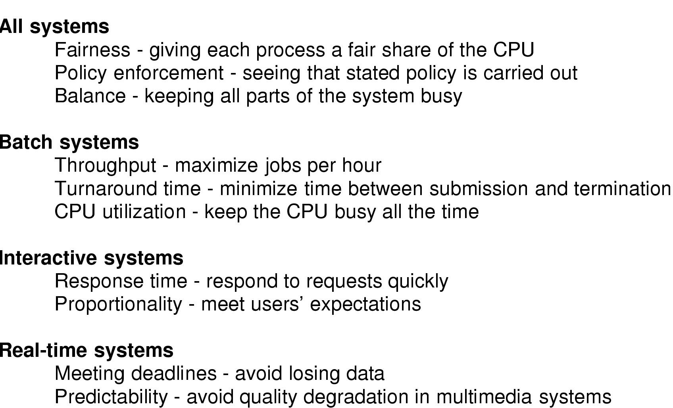
Process Scheduling – System Needs
CS-502 Fall 2006
Scheduling

Slide 11
Scheduling – Metrics
Simplicity – easy to implement
Job latency – time from start to completion
Interactive latency – time from action start to expected system response
Throughput – number of jobs completed
Utilization – keep processor and/or subset of I/O devices busy
Determinism – insure that jobs get done before some time or event
Fairness – every job makes progress
Scheduling

Slide 12
Some Process Scheduling Strategies
First-Come, First-Served (FCFS)
Round Robin (RR)
Shortest Job First (SJF)
  Variation: Shortest Completion Time First (SCTF)
Priority
Real-Time
Scheduling

Slide 13
Scheduling Policies
First Come, First Served (FCFS)
Easy to implement
Non-preemptive
  I.e., no task is moved from running to ready state in favor of another one
Minimizes context switch overhead
Scheduling

Slide 14
Example: FCFS Scheduling
Process Burst Time
P₁ 24
P₂ 3
P₃ 3
Suppose that processes arrive in the order: P₁ , P₂ , P₃
The time line for the schedule is:–
Waiting time for P₁ = 0; P₂ = 24; P₃ = 27
Average waiting time: (0 + 24 + 27)/3 = 17
P₁
P₂
P₃
0
24
27
30
Scheduling

Slide 15
Example: FCFS Scheduling (continued)
Suppose instead that the processes arrive in the order
P₂ , P₃ , P₁
The time line for the schedule becomes:
Waiting time for P₁ = 6; P₂ = 0; P₃ = 3
Average waiting time: (6 + 0 + 3)/3 = 3
Much better than previous case
Previous case exhibits the convoy effect:
  short processes stuck behind long processes
P₂
P₃
P₁
0
3
6
30
Scheduling

Slide 16
FCFS Scheduling (summary)
Favors compute bound jobs or tasks
Short tasks penalized
  I.e., once a longer task gets the CPU, it stays in the way of a bunch of shorter task
Appearance of random or erratic behavior to users
Does not help in real situations
Scheduling

Slide 17
Scheduling Policies – Round Robin
Round Robin (RR)
  FCFS with preemption based on time limits
  Ready processes given a quantum of time when scheduled
  Process runs until quantum expires or until it blocks (whichever comes first)
  Suitable for interactive (timesharing) systems
  Setting quantum is critical for efficiency
Scheduling

Slide 18
Round Robin (continued)
Each process gets small unit of CPU time (quantum), usually 10-100 milliseconds.
  After quantum has elapsed, process is preempted and added to end of ready queue.
If n processes in ready queue and quantum = q, then each process gets 1/n of CPU time in chunks of ≤ q time units.
  No process waits more than (n-1)q time units.
Performance
  q large ⇒ equivalent to FCFS
  q small ⇒ may be overwhelmed by context switches
Scheduling

Slide 19
Example of RR with Time Quantum = 20
Process Burst Time
P₁ 53
P₂ 17
P₃ 68
P₄ 24
The time line is:
Typically, higher average turnaround than SJF, but better response
P₁
P₂
P₃
P₄
P₁
P₃
P₄
P₁
P₃
P₃
0
20
37
57
77
97
117
121
134
154
162
Scheduling

Slide 20
Comparison of RR and FCFS
Assume: 10 jobs each take 100 seconds – look at when jobs complete
FCFS – job 1: 100s, job 2: 200s, … job 10:1000s
RR
  1 sec quantum
  Job 1: 991s, job 2 : 992s …
RR good for short jobs – worse for long jobs
Scheduling

Slide 21
Application of Round Robin
Time-sharing systems
Fair sharing of limited resource
  Each user gets 1/n of CPU
Useful where each user has one process to schedule
  Very popular in 1970s, 1980s, and 1990s
Not appropriate for desktop systems!
  One user, many processes with very different characteristics
Scheduling

Slide 22
Shortest-Job-First (SJF) Scheduling
For each process, identify duration (i.e., length) of its next CPU burst.
Use these lengths to schedule process with shortest burst
Two schemes:–
  Non-preemptive – once CPU given to the process, it is not preempted until it completes its CPU burst
  Preemptive – if a new process arrives with CPU burst length less than remaining time of current executing process, preempt.
    This scheme is known as the Shortest-Remaining-Time-First (SRTF)
SJF is provably optimal – gives minimum average waiting time for a given set of process bursts
  Moving a short burst ahead of a long one reduces wait time of short process more than it lengthens wait time of long one.
Scheduling

Slide 23
Example of Non-Preemptive SJF
Process Arrival Time Burst Time
P₁ 0.0 7
P₂ 2.0 4
P₃ 4.0 1
P₄ 5.0 4
SJF (non-preemptive)
Average waiting time = (0 + 6 + 3 + 7)/4 = 4 → waiting time for P2 = 12-4-2=6
P₁
P₃
P₂
P₄
0
3
7
8
12
16
Scheduling

Slide 24
Example of Preemptive SJF
Process Arrival Time Burst Time
P₁ 0.0 7
P₂ 2.0 4
P₃ 4.0 1
P₄ 5.0 4
SJF (preemptive)
Waiting time = Completion time – Burst Time – Arrival Time
Average waiting time = (9 + 1 + 0 +2)/4 = 3
P₁
P₂
P₃
P₂
P₄
P₁
0
2
4
5
7
11
16
Scheduling

Slide 25
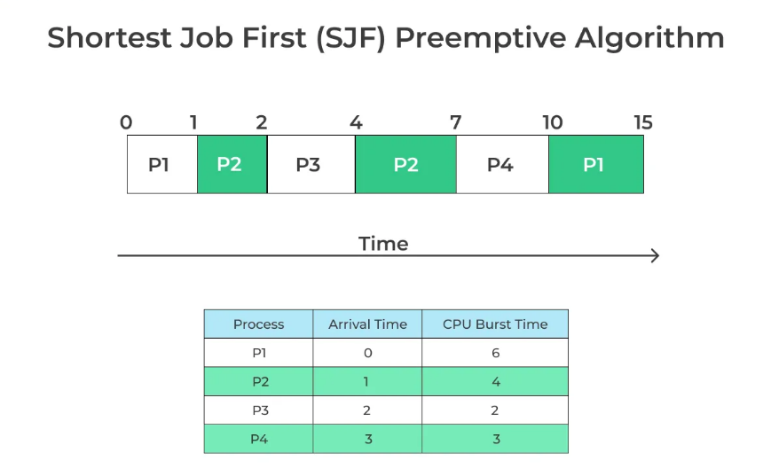
Pada ( t =0ms ), P1 tiba. Ini satu-satunya proses sehingga CPU mulai menjalankannya.
Pada (t = 1ms), P2 telah tiba. Pada saat ini, P1 (waktu tersisa) = 5 ms. P2 memiliki 4ms , sehingga P2 lebih pendek, P1 didahului dan proses P2 mulai dijalankan.
Pada (t = 2ms), proses P3 telah tiba. Pada saat ini, P1(sisa waktu) = 5ms, P2(sisa waktu ) = 3ms, P3 = 2ms. Karena P3 mempunyai waktu burst paling sedikit, P3 dieksekusi.
Pada (t = 3ms), P4 datang, Pada saat ini, P1 = 5ms, P2 = 3ms, P3 = 1ms, P4 = 3ms. Karena P4 tidak memiliki waktu burst yang singkat, maka P3 terus mengeksekusi.
Pada (t= 4ms),P3 selesai. Sekarang, tugas yang tersisa adalah P1 = 5 ms, P2 = 3 ms, P4 = 3 ms. Karena P2 dan P4 mempunyai waktu yang sama, maka tugas yang datang lebih dulu akan dikerjakan terlebih dahulu. Jadi, P2 dieksekusi terlebih dahulu.
Pada ( t = 7ms ), P4 dieksekusi selama 3ms.
Pada ( t = 10ms ), P1 dieksekusi hingga selesai.
CS-502 Fall 2006
Scheduling

Slide 26
Waiting time = Completion time – Burst Time – Arrival Time
P1 waiting time = (15-6-0) = 9ms
P2 waiting time = (7-4-1) = 2ms
P3 waiting time = (4-2-2 )=0ms
P4 waiting time = (10-3-3)= 4ms
The average waiting time is ( 9 +2 + 0 + 4)/4 = 15/4 = 3.75
CS-502 Fall 2006
Scheduling

Slide 27
Burst Time
Lama burst CPU ini adalah waktu yang dibutuhkan oleh proses untuk mengeksekusi instruksi-instruksi yang diberikan kepadanya sebelum melepaskan CPU untuk proses lain.
Lama burst CPU dapat bervariasi dari satu proses ke proses lainnya dan dari satu waktu ke waktu.
Prediksi atau estimasi lama burst CPU sangat penting karena memungkinkan scheduler untuk me “maintain” alokasi sumber daya CPU.
  Dengan informasi perkiraan lama burst CPU, sistem operasi dapat merencanakan tugas-tugas yang akan dieksekusi secara lebih efisien dan menghindari idling CPU yang tidak perlu.
“Burst" dalam konteks komputasi mengacu pada periode singkat di mana sumber daya komputasi digunakan secara intensif oleh suatu proses atau aplikasi.
CS-502 Fall 2006
Scheduling

Slide 28
Contoh menghitung waktu burst selanjutnya dalam algoritma penjadwalan.
Suatu proses atau tugas dengan waktu burst awal (τ1) sebesar 10 ms. Hitung waktu burst selanjutnya (τ2) berdasarkan rata-rata eksponensial yang diberikan oleh rumus berikut:
τn = α * τ1 + (1 - α) * τ1
- τn adalah waktu burst selanjutnya yang ingin dihitung.
τ1 atau τ (n-1) adalah waktu burst sebelumnya
α adalah konstanta (biasanya antara 0 dan 1) yang menentukan berat waktu burst sebelumnya dan waktu burst baru.
Semakin tinggi α, semakin besar bobot waktu burst baru dalam perhitungan. Misalnya, jika α = 0.5, berarti kedua waktu burst diberi bobot yang sama.
τ2 = 0.5 * 10 + (1 - 0.5) * 10 = 5 + 5 = 10 ms
Dalam praktiknya, α dan data historis lebih kompleks untuk menghasilkan perkiraan yang lebih akurat.
CS-502 Fall 2006
Scheduling

Slide 29
Determining Length of Next CPU Burst
Estimate from previous bursts
    exponential averaging
Let
  t_{n} = actual length of n^{th} CPU burst
  τ_{n} = predicted length of n^{th} CPU burst
  α in range 0 ≤ α ≤ 1
Then define
Scheduling

Slide 30
Note
This is called exponential averaging because
α = 0 ⇒ recent history has no effect
α = 1 ⇒ only most recent burst counts
Typically, α = 0.5 and τ₀ is system average
Tn = α * τ + (1 - α) * Tn-1
Scheduling

Slide 31

Predicted Length of the Next CPU Burst
Notice how predicted burst length lags reality
  α defines how much it lags!
Scheduling

Slide 32
Applications of SJF Scheduling
Multiple desktop windows active at once
    Document editing
    Background computation (e.g., Photoshop)
    Print spooling & background printing
    Sending & fetching e-mail
    Calendar and appointment tracking
Desktop word processing (at thread level)
    Keystroke input
    Display output
    Pagination
    Spell checker
Scheduling

Slide 33
Priority Scheduling
A priority number (integer) is associated with each process
CPU is allocated to the process with the highest priority (smallest integer ≡ highest priority)
  Preemptive
  nonpreemptive
Scheduling

Slide 34
Priority Scheduling
(Usually) preemptive
Process are given priorities and ranked
  Highest priority runs next
  May be done with multiple queues – multilevel
SJF = priority scheduling where priority is next predicted CPU burst time
Recalculate priority – many algorithms
  E.g. increase priority of I/O intensive jobs
  E.g. favor processes in memory
  Must still meet system goals – e.g. response time
Scheduling

Slide 35
Priority Scheduling Issue #1
Problem: Starvation – low priority processes may never execute
Solution: Aging – as time progresses, increase priority of waiting processes
Scheduling

Slide 36
Priority Scheduling Issue #2
Priority inversion
  A has high priority, B has medium priority, C has lowest priority
  C acquires a resource that A needs to progress
  A attempts to get resource, fails and busy waits
    C never runs to release resource!
  or
  A attempts to get resources, fails and blocks
    B (medium priority) enters system & hogs CPU
    C never runs!
Priority scheduling can’t be naive
Scheduling

Slide 37
Solution
Some systems increase the priority of a process/task/job to
    Match level of resource
    or
    Match level of waiting process
Some variation of this is implemented in almost all real-time operating sytems
Scheduling

Slide 38
Priority Scheduling (conclusion)
Very useful if different kinds of tasks can be identified by level of importance
  Real-time computing (later in this course)
Very irritating if used to create different classes of citizens
Scheduling

Slide 39
Multilevel Queue
Ready queue is partitioned into separate queues:
  foreground (interactive)
  background (batch)
Each queue has its own scheduling algorithm
  foreground – RR
  background – FCFS
Scheduling must be done between the queues
  Fixed priority scheduling: (i.e., serve all from foreground then from background). Possibility of starvation.
  Time slice – each queue gets a certain amount of CPU time which it can schedule amongst its processes; i.e., 80% to foreground in RR
  20% to background in FCFS
Scheduling

Slide 40

Multilevel Queue Scheduling
Scheduling

Slide 41
Multilevel Feedback Queue
A process can move between the various queues; aging can be implemented this way
Multilevel-feedback-queue scheduler defined by the following parameters:
  number of queues
  scheduling algorithms for each queue
  method used to determine when to upgrade a process
  method used to determine when to demote a process
  method used to determine which queue a process will enter when that process needs service
Scheduling

Slide 42
Example of Multilevel Feedback Queue
Three queues:
  Q₀ – RR with time quantum 8 milliseconds
  Q₁ – RR time quantum 16 milliseconds
  Q₂ – FCFS
Scheduling
  New job enters queue Q₀ (FCFS). When it gains CPU, job receives 8 milliseconds. If it does not finish in 8 milliseconds, job is moved to queue Q₁.
  At Q₁ job is again served FCFS and receives 16 additional milliseconds. If it still does not complete, it is preempted and moved to queue Q₂.
Scheduling

Slide 43

Multilevel Feedback Queues
Scheduling

Slide 44
Thread Scheduling
Local Scheduling – How the threads library decides which user thread to run next within the process
Global Scheduling – How the kernel decides which kernel thread to run next
Scheduling

Slide 45
Scheduling – Examples
Unix – multilevel - many policies and many policy changes over time
Linux – multilevel with 3 major levels
  Realtime FIFO
  Realtime round robin
  Timesharing
Win/NT – multilevel
  Threads scheduled – fibers not visible to scheduler
  Jobs – groups of processes are given quotas that contribute to priorities
Scheduling

Slide 46
Scheduling
General theme – what is the “best way” to run n processes on k resources? ( k < n)
Conflicting Objectives – no one “best way”
  Latency vs. throughput
  Speed vs. fairness
Incomplete knowledge
  E.g. – does user know how long a job will take
Real world limitations
  E.g. context switching takes CPU time
  Job loads are unpredictable
Scheduling

Slide 47
Scheduling (continued)
Bottom line – scheduling is hard!
  Know the models
  Adjust based upon experience
Scheduling

