Slide 1
Deadlocks

Slide 2
Resources
Examples of computer resources
  CPU
  Memory
  Disk drive
  Tape drives
  Printers
  Plotter
  Loudspeaker

Slide 3
Resources
Processes
  Need access to resources in reasonable order
Typical way to use a resource
  Request
  Use
  Release
Suppose a process holds resource A and requests resource B
  At same time another process holds B and requests A
  Both are blocked and remain so

Slide 4
Resources
Active resource
  Provides a service
  E.g. CPU, network adaptor
Passive resource
  System capabilities that are required by active resources
  E.g. memory, network bandwidth
Exclusive resource
  Only one process at a time can use it
  E.g. loudspeaker, processor
Shared resource
  Can be used by multiple processes
  E.g. memory, bandwidth

Slide 5
Resources
Single resource
  Exists only once in the system
  E.g. loudspeaker
Multiple resource
  Exists several time in the system
  E.g. processor in a multiprocessor system
Preemptable resource
  Resource that can be taken away from a process
  E.g. CPU can be taken away from processes in user space
Non-preemptable resource
  Taking it away will cause processes to fail
  E.g. Disk, files

Slide 6
Resources
Process must wait if request is denied
  Requesting process may be blocked
  May fail with error code
Deadlocks
  Occur only when
  processes are granted exclusive access to resources
acquire
block
use
acquire
use

Slide 7
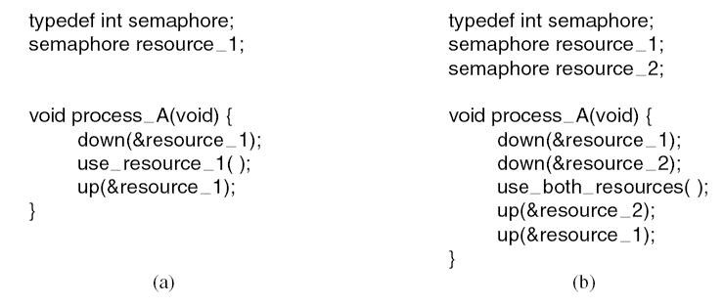
Resource Acquisition (1)
Figure 6-1. Using a semaphore to protect resources. (a) One resource. (b) Two resources.

Slide 8
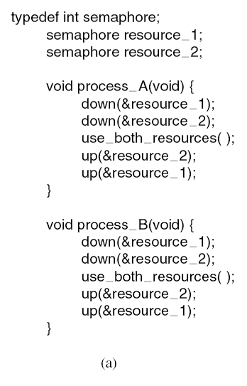
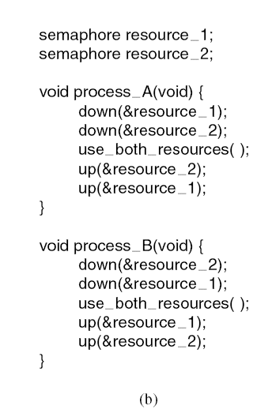
Resource Acquisition (2)

Slide 9
Deadlocks
Formal definition :
A set of processes is deadlocked
if each process in the set is waiting for an event
that only another process in the set can cause
Usually the event is release of a currently held resource
None of the processes can …
  Run
  Release resources
  Be awakened
Notes:
Event - hendelse

Slide 10
Four Conditions for Deadlock
Mutual exclusion condition
  Each resource assigned to 1 process or is available
Hold and wait condition
  Process holding resources can request additional
No preemption condition
  Previously granted resources cannot forcibly taken away
Circular wait condition
  Must be a circular chain of 2 or more processes
  Each is waiting for resource held by next member of the chain
Notes:
Gjensidig utelukkelse
Hold og vent
Ingen

Slide 11
Deadlock Modeling
Modeled with directed graphs
A
S
C
T
R
B
U
D
  Resource R assigned to process A
  Process B is requesting/waiting for resource S
  Process C and D are in deadlock over resources T and U

Slide 12

Deadlock Example
A utility program
  Copies a file from a tape to disk
  Prints the file to a printer
Resources
  Tape
  Disk
  Printer
In what can this result?
A
tape
disk
printer
B

Slide 13
Deadlock Modeling
How deadlock occurs
A
Requests R
Requests S
Releases S
Releases R
A requests R
B requests S
C requests T
A requests S
B requests T
C requests R
Processes
A
B
C
B
Requests S
Requests T
Releases T
Releases S
Resources
R
S
T
C
Requests T
Requests R
Releases R
Releases T

Slide 14
Deadlock Modeling
How deadlock can be avoided
A
Requests R
Requests S
Releases S
Releases R
A requests R
C requests T
A requests S
B requests S
B requests T
C requests R
A releases S
A releases R
C releases R
C releases T
Processes
A
B
C
B
Requests S
Requests T
Releases T
Releases S
Resources
R
S
T
C
Requests T
Requests R
Releases R
Releases T

Slide 15
Deadlocks: Strategies
Ignore the problem
  It is user’s fault
Detection and recovery
  Fix the problem afterwards
Dynamic avoidance
  Careful allocation
Prevention
  Negate one of the four conditions
Notes:
Avoid – unngaa
Prevent - forhindre

Slide 16

The Ostrich Algorithm
Pretend there is no problem
Reasonable if
  Deadlocks occur very rarely
  Cost of prevention is high
UNIX and Windows take this approach
It is a trade-off between
  Convenience
  Correctness

Slide 17
Deadlock Detection and Recovery
One Resource of Each Type (1)
Process A holds R and wants S.
Process B holds nothing but wants T.
Process C holds nothing but wants S.
Process D holds U and wants S and T.
Process E holds T and wants V.
Process F holds W and wants S.
Process G holds V and wants U.
Is the system deadlocked, and if so,
which processes are involved?

Slide 18
Deadlock Detection and Recovery
One Resource of Each Type (2)
R
A
B
C
S
D
T
E
F
U
V
W
G
A cycle can be found within the graph, denoting deadlock
Notes:
Frigjoere
tildele

Slide 19
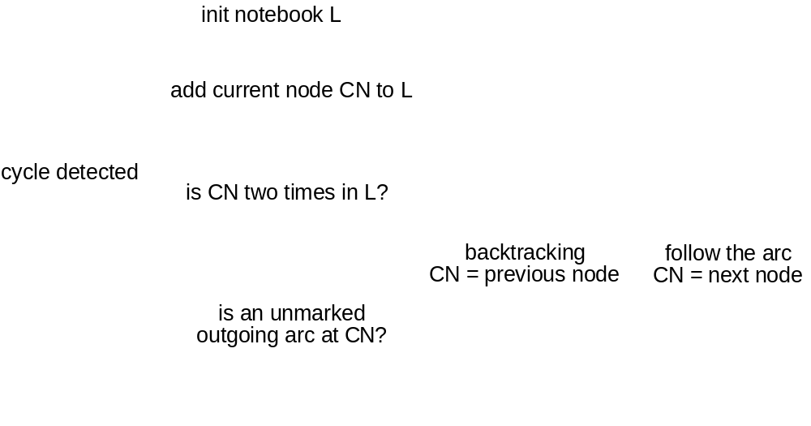
Deadlock Detection and Recovery
One Resource of Each Type

Slide 20


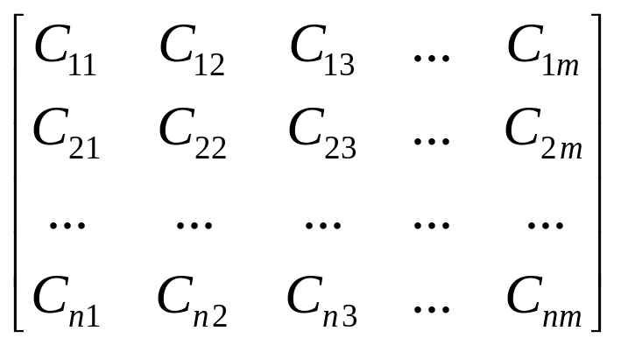
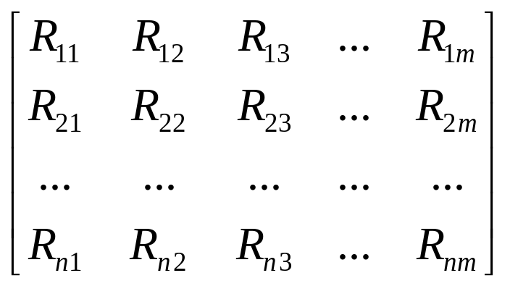
Deadlock Detection and Recovery
Multiple Resources of Each Type
Existing resources
Available resources
Current allocation matrix
Request matrix

Slide 21
Deadlock Detection and Recovery
Multiple Resources of Each Type
Deadlock detection algorithm:
Look for an unmarked process, P_{i} , for which the i-th row of R is less than or equal to A.
If such a process is found, add the i-th row of C to A, mark the process, and go back to step 1.
If no such process exists, the algorithm terminates.
All unmarked processes after termination are deadlocked!
Tanenbaum, Modern Operating Systems 3 e, (c) 2008 Prentice-Hall, Inc. All rights reserved. 0-13-6006639

Slide 22
Deadlock Detection and Recovery
Multiple Resources of Each Type
Tape drivers
CD-Roms
Tape drivers
CD-Roms
Scanners
Scanners
Plotters
Plotters
4
2
3
1
2
1
0
0
E=(
)
A=(
)
Current allocation matrix
Request matrix
0
0
1
0
2
0
0
1
C=
2
0
0
1
1
0
1
0
R=
0
1
2
0
2
1
0
0

Slide 23
Deadlock Detection and Recovery
Recovery
Recovery through preemption
  Take a resource from some other process
  Depends on nature of the resource
Recovery through rollback
  Checkpoint a process periodically
  Use this saved state
  Restart the process if it is found deadlocked
Recovery through killing processes
  Crudest but simplest way to break a deadlock
  Kill one of the processes in the deadlock cycle
  The other processes get its resources
  Choose process that can be rerun from the beginning

Slide 24
Deadlock Avoidance
Resource Trajectories
B
finished
release
Printer
release
request
Plotter
request
start
A
request
request
release
release
Two process
resource trajectories
Printer
Plotter

Slide 25
Deadlock Avoidance
Safe and Unsafe States
has
max
has
max
has
max
has
max
has
max
A
3
9
A
3
9
A
3
9
A
3
9
A
3
9
B
2
4
B
4
4
B
0
B
0
B
0
C
2
7
C
2
7
C
2
7
C
7
7
C
0
Free: 3
Free: 1
Free: 5
Free: 0
Free: 7
state is safe

Slide 26
Deadlock Avoidance
Safe and Unsafe States
has
has
max
max
has
has
max
max
A
3
9
A
4
9
A
4
9
A
3
9
B
2
4
B
2
4
B
4
4
B
0
C
2
7
C
2
7
C
2
7
C
2
7
Free: 3
Free: 2
Free: 0
Free: 4
state is safe

Slide 27
Deadlock Avoidance
Banker’s Algorithm for a Single Resource
Each process has a credit
  System knows how many resources a process requests at most before releasing resources
Total resources may not satisfy all credits
Keep track of resources assigned and needed
Check on each allocation whether it is safe
  Safe: there exists a sequence of other states that all processes can terminate correctly

Slide 28
Deadlock Avoidance
Banker's Algorithm for a Single Resource
Resource allocation state
has
max
has
max
has
max
A
6
0
0
6
6
A
1
3
5
6
1
6
6
A
1
1
6
B
0
5
B
1
5
B
2
5
5
0
5
3
5
1
5
2
C
4
2
4
0
0
4
4
C
4
2
4
C
2
2
4
D
0
7
D
4
7
D
4
7
7
0
7
7
4
7
4
Free: 10
Free: 2
Free: 1
Free: 4
Free: 5
Free: 6
Free: 2

Slide 29
Deadlock Detection and Recovery
Banker’s Algorithm for Multiple Resources
Tape drivers
CD-Roms
Scanners
Plotters
6
3
4
2
E=(
)
5
3
2
2
P=(
)
Assigned resources
Resources still needed
1
0
2
0
A=(
)
A
3
0
1
1
A
1
1
0
0
B
0
1
0
0
B
0
1
1
2
C
1
1
1
0
C
3
1
0
0
D
1
1
0
1
D
0
0
1
0
E
0
0
0
0
E
2
1
1
0
An example for the deadlock
detection algorithm

Slide 30
Deadlock Detection and Recovery
Banker’s Algorithm for Multiple Resources
Tape drivers
CD-Roms
Scanners
Plotters
6
3
4
2
E=(
)
4
2
2
1
P=(
)
Assigned resources
Resources still needed
2
1
2
1
A=(
)
A
3
0
1
1
A
1
1
0
0
B
0
1
0
0
B
0
1
1
2
C
1
1
1
0
C
3
1
0
0
D
0
0
0
0
D
-
-
-
-
E
0
0
0
0
E
2
1
1
0
An example for the deadlock
detection algorithm

Slide 31
Deadlock Detection and Recovery
Banker’s Algorithm for Multiple Resources
Tape drivers
CD-Roms
Scanners
Plotters
6
3
4
2
E=(
)
1
2
1
0
P=(
)
Assigned resources
Resources still needed
5
1
3
2
A=(
)
A
0
0
0
0
A
-
-
-
-
B
0
1
0
0
B
0
1
1
2
C
1
1
1
0
C
3
1
0
0
D
0
0
0
0
D
-
-
-
-
E
0
0
0
0
E
2
1
1
0
An example for the deadlock
detection algorithm

Slide 32
Deadlock Detection and Recovery
Banker’s Algorithm for Multiple Resources
Tape drivers
CD-Roms
Scanners
Plotters
6
3
4
2
E=(
)
1
1
1
0
P=(
)
Assigned resources
Resources still needed
5
2
3
2
A=(
)
A
0
0
0
0
A
-
-
-
-
B
0
0
0
0
B
-
-
-
-
C
1
1
1
0
C
3
1
0
0
D
0
0
0
0
D
-
-
-
-
E
0
0
0
0
E
2
1
1
0
An example for the deadlock
detection algorithm

Slide 33
Deadlock Detection and Recovery
Banker’s Algorithm for Multiple Resources
Tape drivers
CD-Roms
Scanners
Plotters
6
3
4
2
E=(
)
0
0
0
0
P=(
)
Assigned resources
Resources still needed
6
3
4
2
A=(
)
A
0
0
0
0
A
-
-
-
-
B
0
0
0
0
B
-
-
-
-
C
0
0
0
0
C
-
-
-
-
D
0
0
0
0
D
-
-
-
-
E
0
0
0
0
E
2
1
1
0
An example for the deadlock
detection algorithm

Slide 34
Deadlock Detection and Recovery
Banker’s Algorithm for Multiple Resources
Tape drivers
CD-Roms
Scanners
Plotters
SAFE
6
3
4
2
E=(
)
5
3
2
2
P=(
)
Assigned resources
Resources still needed
1
0
2
0
A=(
)
A
3
0
1
1
A
1
1
0
0
B
0
1
0
0
B
0
1
1
2
C
1
1
1
0
C
3
1
0
0
D
1
1
0
1
D
0
0
1
0
E
0
0
0
0
E
2
1
1
0
An example for the deadlock
detection algorithm

Slide 35
Deadlock Avoidance
Practical Avoidance
Two Phase Locking
  Phase I
    Process tries to lock all resources it needs, one at a time
    If needed resources found locked, start over
    (no real work done in phase one)
  Phase II
    Run
    Releasing locks
Note similarity to requesting all resources at once (meminta semua sumber daya sekaligus)
Algorithm works where programmer can arrange (programmer dapat mengaturnya)

Slide 36
Deadlock Prevention
R: Conditions for Deadlock
Mutual exclusion condition (saling mengecualikan)
  Each resource assigned to 1 process or is available
Hold and wait condition
  Process holding resources can request additional (proses dapat meminta tambahan)
No preemption condition
  Previously granted resources cannot forcibly taken away (Sumber daya yang diberikan sebelumnya tidak dapat diambil secara paksa)
Circular wait condition
  Must be a circular chain of 2 or more processes
  Each is waiting for resource held by next member of the chain (masing-masing menunggu sumber daya)

Slide 37
Deadlock Prevention
Mutual Exclusion Condition
Some resources are not sharable
  Printer, tape, etc
Some resources can be made sharable
Some resources can be made virtual
  Spooling - Printer
    Does spooling apply to all non-sharable resources?
  Mixing - Soundcard
Principle:
  Avoid assigning resource when not absolutely necessary
  A few processes as possible actually claim the resource

Slide 38
Deadlock Prevention
Hold and Wait Condition
Require processes to request resources before starting
  A process never has to wait for what it needs
  Telephone companies do this
Problems
  May not know required resources at start of run
  Also ties up resources other processes could be using
Variation:
  Process must give up all resources
  Then request all immediately needed

Slide 39
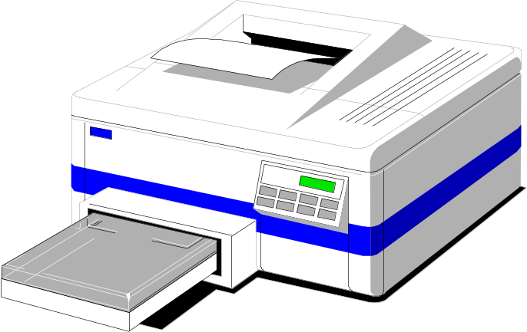
Deadlock Prevention
No Preemption Condition
This is not a viable option
Consider a process given the printer
  Halfway through its job
  No forcibly take away printer
  !!??

Slide 40
Deadlock Prevention
Circular Wait Condition
A
CD Rom drive
Tape drive
Plotter
Scanner
Imagesetter
1
2
3
4
5
Normally ordered resources
A resource graph

Slide 41
Deadlock Prevention
Circular Wait Condition
Impose an order of requests for all resources
Method
  Assign a unique id to each resource
  All resource requests must be in an ascending order of the ids
  Release resources in a descending order
Can you prove this method has no circular wait?
Is this generally feasible?

Slide 42
Deadlock Prevention
Overview
Condition | Approach
Mutual exclusion | Spool everything
Hold and wait | Request all resource initially
No preemption | Take resources away
Circular wait | Order resources numerically

Slide 43
Non-resource Deadlocks
Possible for two processes to deadlock
  Each is waiting for the other to do some task
Can happen with semaphores
  Each process required to do a down() on two semaphores (mutex and another)
  If done in wrong order, deadlock results

Slide 44
Summary
Resource
Introduction to deadlocks
Strategies
  Ostrich algorithm
  Deadlock detection and recovery
  Deadlock avoidance
  Deadlock prevention
Non-resource deadlocks

